Slide 1


http://epoptes.org
Migrating Epoptes
to Python3 & Gtk3
Student: <alkisg>
Alkis Georgopoulos
Mentor: <ftsamis>
Fotis Tsamis

Slide 2
What is Epoptes?
A computer lab management and monitoring tool
Features:
  Screen broadcasting, monitoring, or assisting the users
  Session handling (WOL, logoff, reboot, poweroff)
  Remote command execution, remote terminal access
  Message sending, screen locking, sound muting etc
Initially created for Greece, now used worldwide
  Translated in 40 languages!
In Debian/Ubuntu repositories since 2011

Slide 3
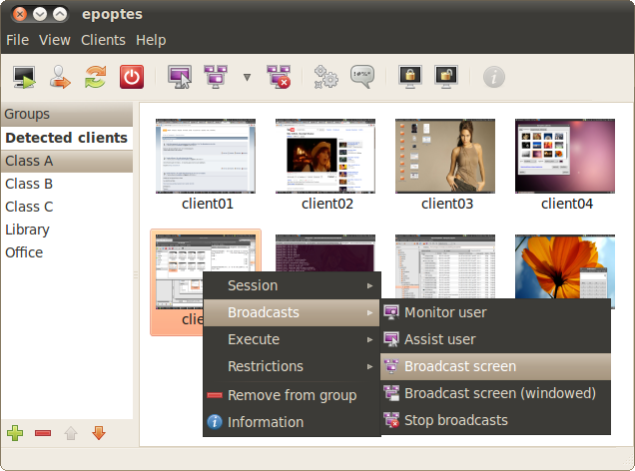
Screenshots: main window

Slide 4
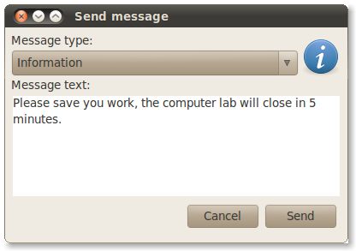
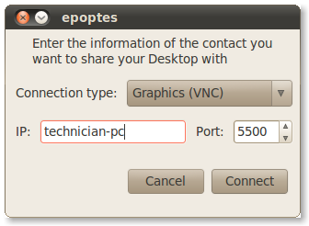
Send message, remote support

Slide 5
GSoC project goals
Migrate epoptes and epoptes-client to Python3
Migrate epoptes and epoptes-client to Gtk3
Improve the code structure
Solve issues for recent distros like Ubuntu 18.04
Update setup.py and the debian packaging
Release a new version

Slide 6
Current project status
Set up development environment, github, wiki etc
Migrated epoptes and epoptes-client to Python3
Migrated epoptes and epoptes-client to Gtk3
Restructured epoptes-client
  Applied PEP8, PEP257, PEP3101, DEP-5, Sphinx and SPDX to epoptes-client
  Solved various pending issues
Next step: restructure epoptes

Slide 7
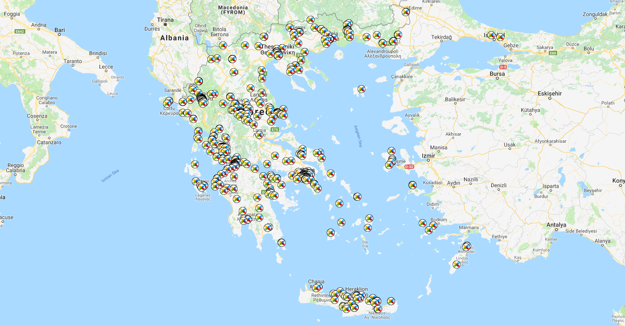
Thank you! Any questions?

