Slide 1
Join Team Ericsson Today!
LightTheNight.ca

Slide 2
Thanks to LTN Top Supporters
Yesterday:
SomeONE donated $20.00 to Hossein Seyedmehdi.
SomeONE said: "Good Job!"
Last 30 days:
Anonymous Donor donated $250.00 to Johanna Nicoletta.

Slide 3
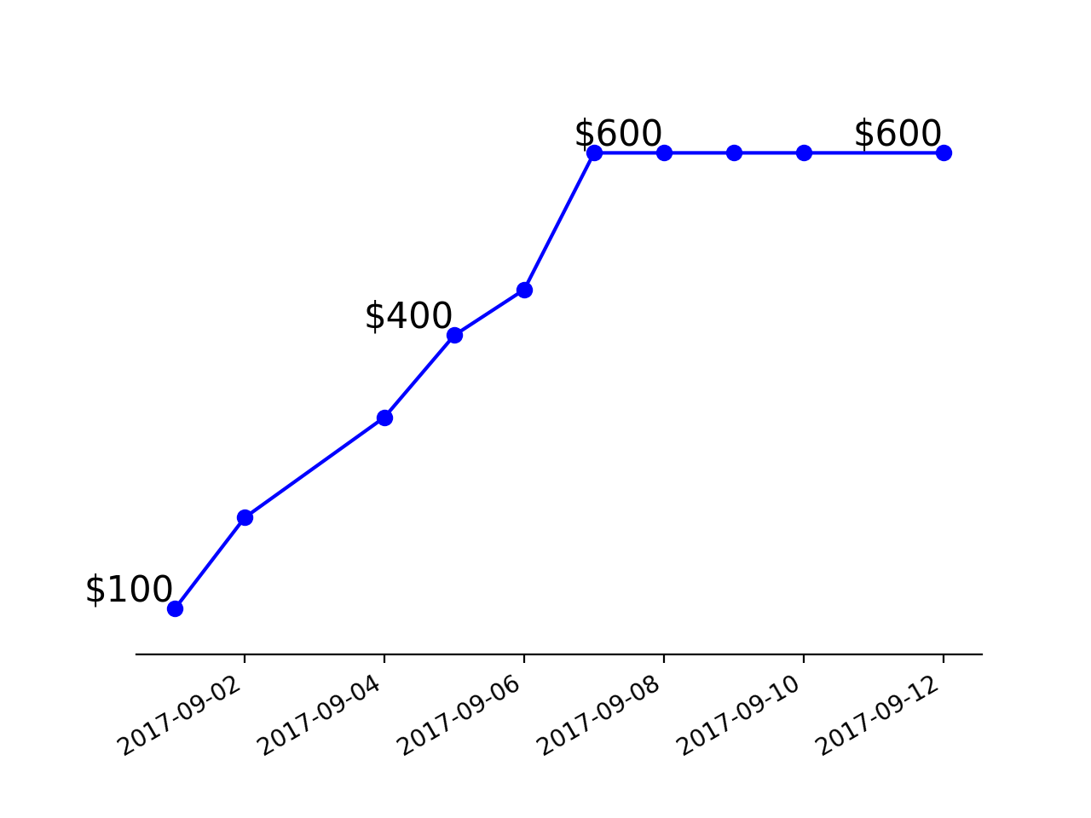
LTN - Total Fund Raised

Slide 4
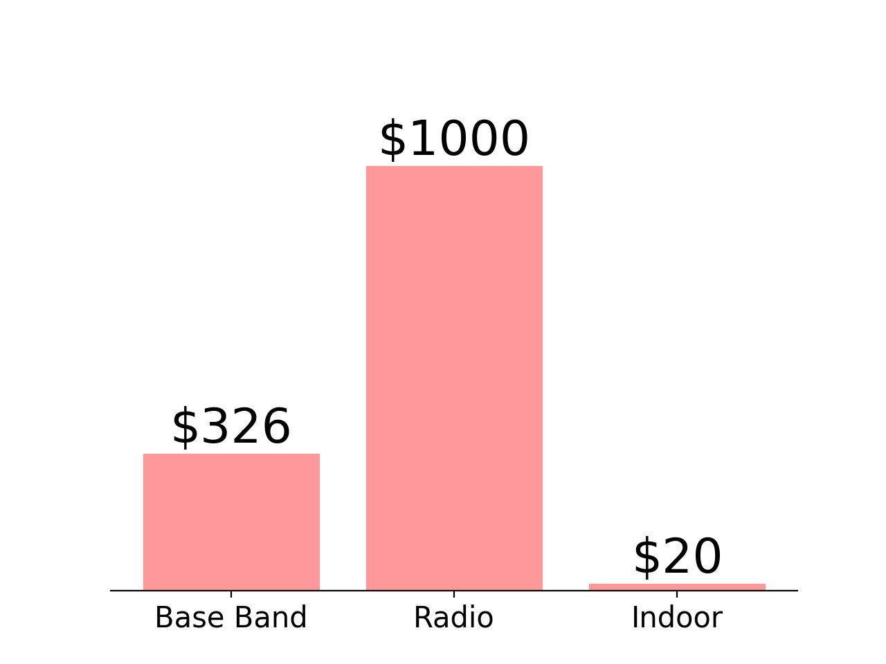
LTN - Section Competition Results

