Slide 1
Join Team Ericsson Today!
LightTheNight.ca

Slide 2
Thanks to LTN Top Supporters
Yesterday:
Ron Casselman donated $100.00 to Ronald Casselman.
Last month:
Anonymous Donor donated $250.00 to Johanna Nicoletta.

Slide 3
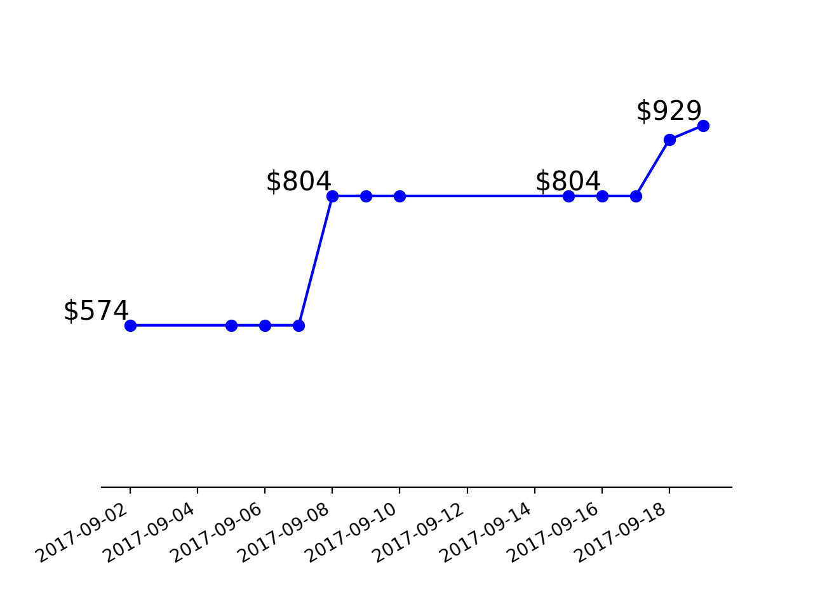
LTN - Total Fund Raised

Slide 4
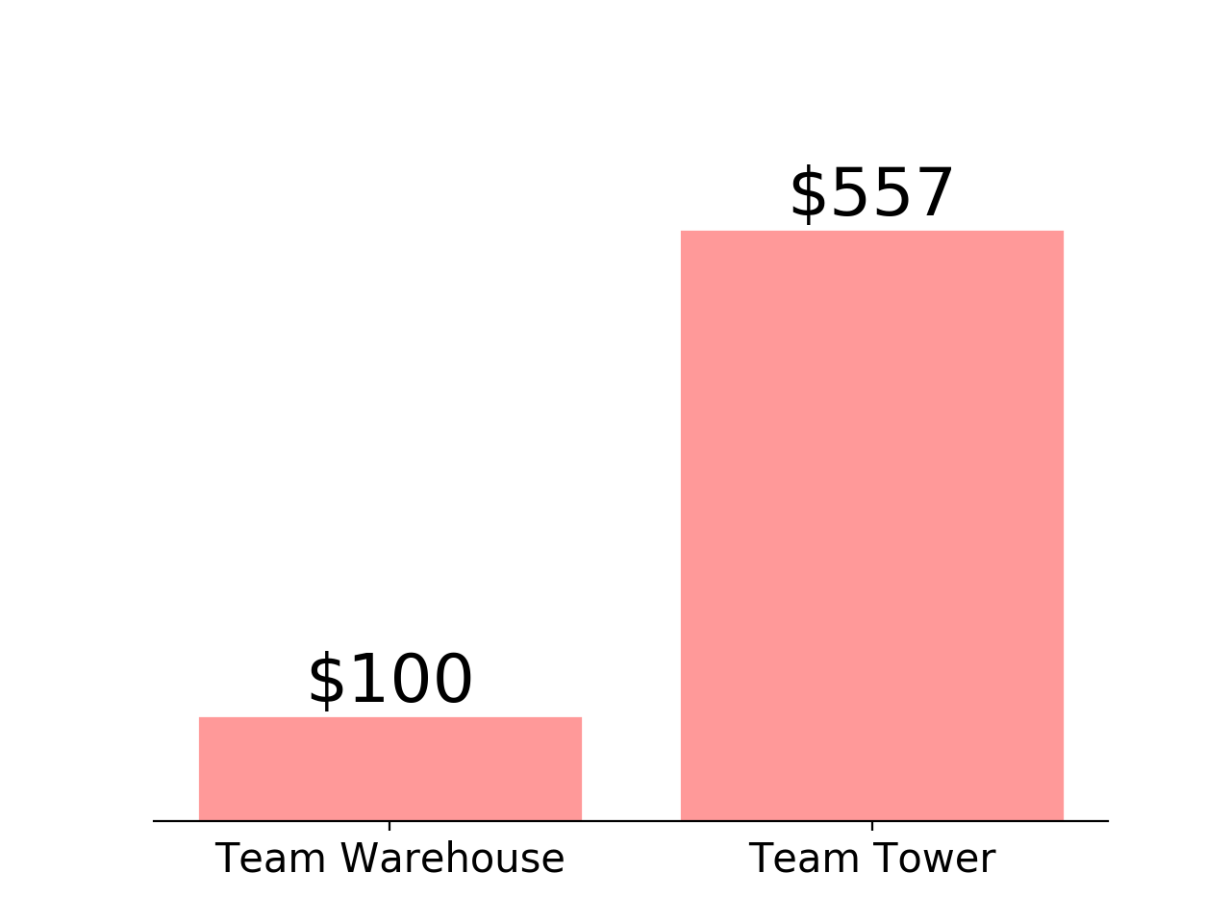
LTN - Competition Results

