Slide 1
Connection Layout
Tiffany Liu 05/17/2023

Slide 2
SMALL GLASS DEWAR
Collector
IDC- IDC+
Emitter
Breakout Box
Breakout Box
DAC
DAC
18 12 B1 A1 7 21 GND
12 8
11
B3
1
B7
8
B2
15
B6 (large capacitance to B7 and B3)
3
SR830
20
SR830
18
13(open,ay)/21
(close,ax)
3
TF
STI
STM
STO
TOP
DOOR
TF
1
SR830
16
SR830
14
15 (open,ay)/23 (close,ax)
1
14
16
A3
24
B4
3
A2
13
TF
STI
STM
STO
TOP
DOOR
TF
2, 23
19,20
5
4
*when connecting do 2 with 20
9
Aux 3,4=Vee, 10=Vee, Aux 1,2=Vdd
17 B5* GND 10 22 6*
STIBiasE = 11 (STI bias tee box)
STOBiasE= 24 ( STO bias tee box)
doorE/C_close = ax
doorE/C_open = ay
STIBiasC = 2 (STI bias tee box)
STOBiasC = 22 ( STO bias tee box)
Filament top plate = 5, note: don’t use DAC port 17 (short to ground)
IDC- IDC+
* Short to ground

Slide 3
Emitter Side | Breakout Box | DAC
Top Metal | 8 | 14
STO | B7 | 24
STI | B3 | 11
STM | 1 | 16
Door | B2 | 15 (open)/23 (close)
Collector Side | Breakout Box | DAC
Top Metal | 3 | 18
STO | B4 | 22
STI | A3 | 2
STM | 24 | 20
Door | A2 | 13 (open)/21 (close)

Slide 4
Grounding
Nice to have a table top rack so instruments (i.e. metal surfaces) aren’t touching each other
Earth ground
USB not great, find usb to ethernet connector (cat)
Insulator
charging
Defects, tunneling,
How this ties into large voltages
Think about using much smaller voltages, see how it looks like in walk on spheres calculation

Slide 5
Collector
IDC- IDC+
Emitter
Breakout Box
Breakout Box
DAC
DAC
B1 2 B2 4 B3 6 18
12 8
B4
7
B5
21
B6
9
23
19
5
A3
3
A2
1
A1
TF
STI
STM
STO
TOP
DOOR
TF
1
SR830
16
SR830
14
15(open,ay)/23(close,ax)
1
3
SR830
20
SR830
18
13(open,ay)/21
(close,ax)
3
TF
STI
STM
STO
TOP
DOOR
TF
BIG GLASS DEWAR
14, 16
15,17
24
13
*when connecting do 14 with 15
22
Aux 3,4=Vee, 10=Vee, Aux 1,2=Vdd
B7 8 20 10 11 12
STIBiasE = 11 (STI bias tee box)
STOBiasE= 24 ( STO bias tee box)
doorE/C_close = ax
doorE/C_open = ay
STIBiasC = 2 (STI bias tee box)
STOBiasC = 22 ( STO bias tee box)
Filament top plate DAC = 5
IDC- IDC+

Slide 6
Collector
IDC- IDC+
Emitter
Breakout Box
Breakout Box
DAC
DAC
B2 2 A2 4 B5 6 18
3
13(open,ay)/21
(close,ax)
18
SR830
20
SR830
3
B1
19
5
B4
3
A1
1
NA
12 8
TF
DOOR
TOP
STO
STM
STI
TF
B3
23
9
B6
21
A3
7
NA
1
15(open,ay)/23(close,ax)
14
SR830
16
SR830
1
TF
DOOR
TOP
STO
STM
STI
TF
BIG GLASS DEWAR (RF)
14, 15
16,17
24
13
*when connecting do 14 with 16
22 (DAC=5)
Aux 3,4=Vee (-5V), 10=E (Gnd), Aux 1,2=Vdd (+5V)
B7 8 20 10 11 12
doorE/C_close = ax
doorE/C_open = ay
STIBiasE = 11 (STI bias tee box)
STOBiasE= 24 ( STO bias tee box)
IDC- IDC+
STIBiasC = 2 (STI bias tee box)
STOBiasC = 22 ( STO bias tee box)

Slide 7
Collector
TFC IDC+ DrainC IDC- DrainE TFE
Emitter
Breakout Box
Breakout Box
DAC
DAC
3
13(open,ay)/21
(close,ax)
18
SR830
20
SR830
3
B1
19
5
B4
3
A1
1
NA
B2 2 A2 4 B5 6 18
12 8
DOOR OUT
TWIDDLE
TOP
STO
STM
STI
DOOR IN
B3
23
9
B6
21
20
7
NA
1
15(open,ay)/23(close,ax)
14
SR830
16
SR830
1
DOOR OUT
TWIDDLE
TOP
STO
STM
STI
DOOR IN
BIG GLASS DEWAR (RF)
14, 15
16,17
24
13
*when connecting do 14 with 16
22 (DAC=5)
Aux 3,4=Vee (-5V), 10=E (Gnd), Aux 1,2=Vdd (+5V)
B7 8 10 11 12 A3
doorE/C_close = ax
doorE/C_open = ay
STIBiasE = 11 (STI bias tee box)
STOBiasE= 24 ( STO bias tee box)
STIBiasC = 2 (STI bias tee box)
STOBiasC = 22 ( STO bias tee box)
Sense TFC IDC+ SourceC IDC- SourceE TFE Sense

Slide 8
Emitter Side | Breakout Box | DAC
Top Metal | 9 | 14
STO | B6 | 24
STI | A3 | 11
STM | 21 | 16
Door | 23 | 15 (open)/23 (close)
TF | B3,7 | 1
Collector Side | Breakout Box | DAC
Top Metal | 5 | 18
STO | B4 | 22
STI | A1 | 2
STM | 3 | 20
Door | 19 | 13 (open)/21 (close)
TF | B1,1 | 3

Slide 9
Wigner

Slide 10
Collector
IDC- IDC+
Emitter
Breakout Box
Breakout Box
DAC
DAC
B2 2 A2 4 B5 6 18
B3
7
A3
21
B6
9
23
19
5
B4
3
A1
1
B1
12(DAC) 8(DAC)
SIM900 (ng,nf) SIM900 (ng,nf)
TF
STI
STM
STO
TOP
DOOR
TF
1
SR830 (sine out)
SR830
SR830
14
15(open,ay)/23(close,ax)
1
3
SR830 (current in)
SR830
SR830
18
13(open,ay)/21
(close,ax)
3
TF
STI
STM
STO
TOP
DOOR
TF
BIG GLASS DEWAR (RF)
14, 15
16,17
24
13
*when connecting do 14 with 16
22
Aux 3,4=Vee, 10=Vee, Aux 1,2=Vdd
B7 8 20 10 11 12
BiasE = 11 (bias tee box)
doorE/C_close = ax
doorE/C_open = ay
BiasC = 2 (bias tee box)
Filament top plate DAC = 5, note: don’t use DAC port 17 (short to ground)
IDC- IDC+

Slide 11
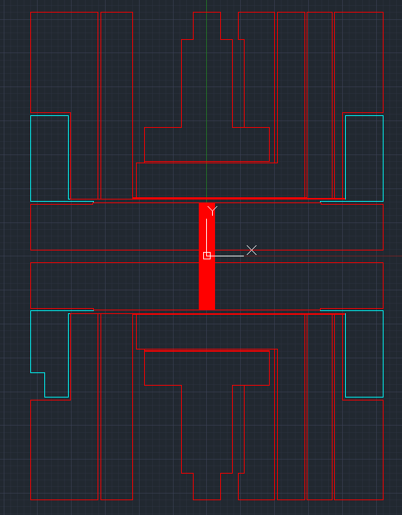
Door out
Door out
sense
sense
TOP
TOP
STO
STO
STM
STM
STI
STI
Door in
Door in
twiddle
twiddle

Slide 12
