Slide 1
Connection Layout
Tiffany Liu 06/26/2023

Slide 2
SMALL GLASS DEWAR
Collector
IDC- IDC+
Emitter
Breakout Box
Breakout Box
DAC
DAC
18 12 B1 A1 7 21 GND
12 8
11
B3
1
B7
8
B2
15
B6 (large capacitance to B7 and B3)
3
SR830
20
SR830
18
13(open,ay)/21
(close,ax)
3
TF
STI
STM
STO
TOP
DOOR
TF
1
SR830
16
SR830
14
15 (open,ay)/23 (close,ax)
1
14
16
A3
24
B4
3
A2
13
TF
STI
STM
STO
TOP
DOOR
TF
2, 23
19,20
5
4
*when connecting do 2 with 20
9
Aux 3,4=Vee, 10=Vee, Aux 1,2=Vdd
17 B5* GND 10 22 6*
STIBiasE = 11 (STI bias tee box)
STOBiasE= 24 ( STO bias tee box)
doorE/C_close = ax
doorE/C_open = ay
STIBiasC = 2 (STI bias tee box)
STOBiasC = 22 ( STO bias tee box)
Filament top plate = 5, note: don’t use DAC port 17 (short to ground)
IDC- IDC+
* Short to ground

Slide 3
Emitter Side | Breakout Box | DAC
Top Metal | 8 | 14
STO | B7 | 24
STI | B3 | 11
STM | 1 | 16
Door | B2 | 15 (open)/23 (close)
Collector Side | Breakout Box | DAC
Top Metal | 3 | 18
STO | B4 | 22
STI | A3 | 2
STM | 24 | 20
Door | A2 | 13 (open)/21 (close)

Slide 4
Grounding
Nice to have a table top rack so instruments (i.e. metal surfaces) aren’t touching each other
Earth ground
USB not great, find usb to ethernet connector (cat)
Insulator
charging
Defects, tunneling,
How this ties into large voltages
Think about using much smaller voltages, see how it looks like in walk on spheres calculation

Slide 5
Collector
IDC- IDC+
Emitter
Breakout Box
Breakout Box
DAC
DAC
B1 2 B2 4 B3 6 18
12 8
B4
7
B5
21
B6
9
23
19
5
A3
3
A2
1
A1
TF
STI
STM
STO
TOP
DOOR
TF
1
SR830
16
SR830
14
15(open,ay)/23(close,ax)
1
3
SR830
20
SR830
18
13(open,ay)/21
(close,ax)
3
TF
STI
STM
STO
TOP
DOOR
TF
BIG GLASS DEWAR
14, 16
15,17
24
13
*when connecting do 14 with 15
22
Aux 3,4=Vee, 10=Vee, Aux 1,2=Vdd
B7 8 20 10 11 12
STIBiasE = 11 (STI bias tee box)
STOBiasE= 24 ( STO bias tee box)
doorE/C_close = ax
doorE/C_open = ay
STIBiasC = 2 (STI bias tee box)
STOBiasC = 22 ( STO bias tee box)
Filament top plate DAC = 5
IDC- IDC+

Slide 6
Collector
IDC+ IDC-
Emitter
Breakout Box
Breakout Box
DAC
DAC
B2 2 A2 4 B5 6 18
3
13(open,ay)/21
(close,ax)
18
SR830
20
SR830
3
B1
19
5
B4
3
A1
1
NA
12 8
TF
DOOR
TOP
STO
STM
STI
TF
B3
23
9
B6
21
A3
7
NA
1
15(open,ay)/23(close,ax)
14
SR830
16
SR830
1
TF
DOOR
TOP
STO
STM
STI
TF
BIG GLASS DEWAR (RF)
14, 15
16,17
24
13
*when connecting do 14 with 16
22 (DAC=5)
Aux 3,4=Vee (-5V), 10=E (Gnd), Aux 1,2=Vdd (+5V)
B7 8 20 10 11 12
doorE/C_close = ax
doorE/C_open = ay
STIBiasE = 11 (STI bias tee box)
STOBiasE= 24 ( STO bias tee box)
STIBiasC = 2 (STI bias tee box)
STOBiasC = 22 ( STO bias tee box)
IDC+ IDC-

Slide 7
TFC IDC+ IDC- TFE
*looking down at device
Collector
B4 2 A2 4 B5 6 18
Emitter
Breakout Box
Breakout Box
DAC
13(open,ay)/21
(close,ax)
7
18
SR830
20
SR830
10
DAC
B1
19
5
B2
3
A1
1
NA
3 12 D1 8 D2 1
DOOR OUT
TWIDDLE
TOP
STO
STM
STI
DOOR IN (MOD)
B3
23
9
B6
21
20
7
NA
15(open,ay)/23(close,ax)
17
14
SR830
19
SR830
9
DOOR OUT
TWIDDLE
TOP
STO
STM
STI
DOOR IN(MOD)
BIG GLASS DEWAR (RF)
14, 15
16,17
24
13
*when connecting do 14 with 16
22 (DAC=5)
Aux 3,4=Vee (-5V), E (Gnd), Aux 1,2=Vdd (+5V)
Aux1=+4.5V,Aux2=-1.5V, Aux3=+1.5V
11 3 S1 S2 1 16
doorE/C_close = ax
doorE/C_open = ay
STI BiasE= 4
STO BiasE= 24
STI BiasC = 2
STO BiasC = 22
B7 8 10 11 12 A3
BiasD1 TFC IDC+ IDC- TFE BiasD2

Slide 8
*looking down at device
Collector
B4 2 A2 4 B5 6 18
Emitter
Breakout Box
Breakout Box
B1
19
5
B2
3
A1
1
NA
B3
23
9
B6
21
20
7
NA
BIG GLASS DEWAR (RF)
14, 15
16,17
24
13
22 (DAC=5)
B7 8 10 11 12 A3

Slide 9
Emitter Side | Breakout Box | DAC
Top Metal | 9 | 14
STO | B6 | 24
STI | 20 | 4
STM | 21 | 19
Door Out | B3 | 15 (open)/23 (close)
TF | 12,18 | 1
Door In | 7 | 9
 | BB | DAC
Sense | A3 | 16
Twiddle | 23 | 17
S2 | 11 | NA
D2 | 6 | NA
Collector Side | Breakout Box | DAC
Top Metal | 5 | 18
STO | B2 | 22
STI | A1 | 2
STM | 3 | 20
Door Out | B1 | 13 (open)/21 (close)
TF | 2,8 | 3
Door In | 1 | 10
 | BB | DAC
Sense | B7 | 11
Twiddle | 19 | 7
S1 | 10 | NA
D1 | 4 | NA

Slide 10
Notes on above
B4 has like a 40Mohm resistance to ground
Idk how to fix that other than feeding new wire
TFs have ~10Mohm resistance to ground because they’re kinda capacitively coupled to nearby source and drain gates which have a resistance to ground
Probably from residual flux in pin connectors??
Strange, definitely not on wire side, but when disconnected from board, get quick OL between a TF and source/drain gate (neither shorted to ground when disconnected)
But when connected, see the resistance to ground…
All resistances and capacitances read correctly, but not when I check shorts to ground
A lot of pins have quick OL…not sure if this is a factor of the weather or the soldering of the pin connectors…
See if it makes things weird when cold/during measurement, otherwise have ignored it

Slide 11
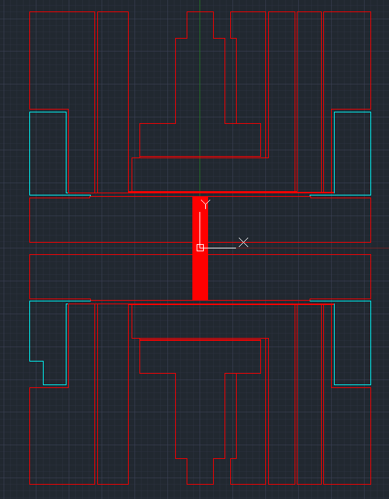
TF C
IDC +
IDC -
TF E
Door out
Door out
Twiddle
Twiddle
TOP
TOP
STO
STO
STM
STM
STI
STI
Door in
Door in
Sense
TF C
IDC +
IDC -
TF E
Sense

Slide 12
Emitter Side | Breakout Box | DAC
Top Metal | 9 | 14
STO | B6 | 24
STI | A3 | 11
STM | 21 | 16
Door | 23 | 15 (open)/23 (close)
TF | B3,7 | 1
Collector Side | Breakout Box | DAC
Top Metal | 5 | 18
STO | B4 | 22
STI | A1 | 2
STM | 3 | 20
Door | 19 | 13 (open)/21 (close)
TF | B1,1 | 3

Slide 13
Wigner

Slide 14
Collector
IDC- IDC+
Emitter
Breakout Box
Breakout Box
DAC
DAC
B2 2 A2 4 B5 6 18
B3
7
A3
21
B6
9
23
19
5
B4
3
A1
1
B1
12(DAC) 8(DAC)
SIM900 (ng,nf) SIM900 (ng,nf)
TF
STI
STM
STO
TOP
DOOR
TF
1
SR830 (sine out)
SR830
SR830
14
15(open,ay)/23(close,ax)
1
3
SR830 (current in)
SR830
SR830
18
13(open,ay)/21
(close,ax)
3
TF
STI
STM
STO
TOP
DOOR
TF
BIG GLASS DEWAR (RF)
14, 15
16,17
24
13
*when connecting do 14 with 16
22
Aux 3,4=Vee, 10=Vee, Aux 1,2=Vdd
B7 8 20 10 11 12
BiasE = 11 (bias tee box)
doorE/C_close = ax
doorE/C_open = ay
BiasC = 2 (bias tee box)
Filament top plate DAC = 5, note: don’t use DAC port 17 (short to ground)
IDC- IDC+

Slide 15
New RF cell
4/23/24

Slide 16
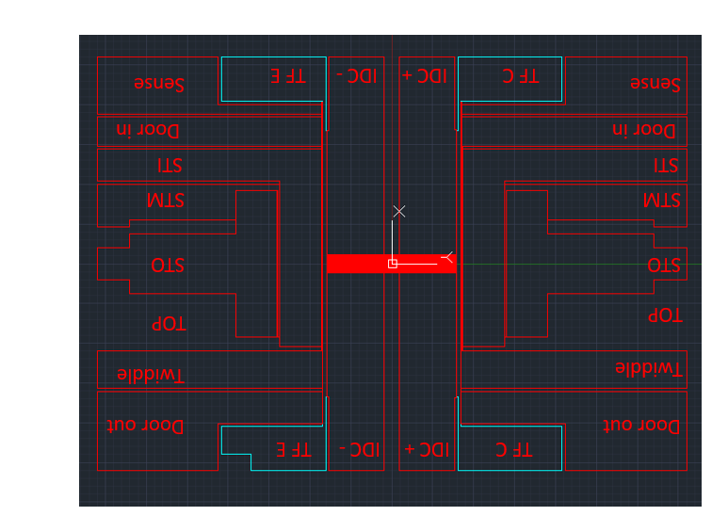
sp7 sp20
*looking down at device
Door in (AC=cx 10, DC=11)
STI (AC=cx 9,DC=24)
STM (10)
STO (AC=cx 7,DC = 22)
TOP (9)
TWIDDLE (AC=cx 8,DC=21)
H1
DC
HBT1
Fast
HBT2
Fast
DC
H2
Emitter
Collector
Door in (AC=cx 4,DC=14)
STI (AC =cx 3, DC = 2)
STM (4)
STO (AC =cx 5, DC= 15)
TOP (17)
TWIDDLE (AC=cx 6, DC = 5)
Fast
SENSE TFC IDC- IDC+ TFE Sense
(cx2) (16) (AC=cx 1,DC=1) (AC=cx 12, DC=13) (23) (cx 11)
20M=3 20M=12
Fast
Fast
Fast
DC
DC
Fast
Fast
DC
DC
DC
DC
DC
DC
DC
DC
Fast
Fast
Door out TFC IDC- IDC+ TFE Door out
(18) (6) (19) (20) (7) (8)

Slide 17
Pinout for amplifiers
Sense 1 (left, collector)
Current in = supply 23
Vcc amplifier = supply 7
Vbb amplifier = supply 24
Vcc follower = supply 13
Vout = coax 1
20Meg = 3
Sense 2 (right, emitter)
Current in = supply 16
Vcc amplifier = supply 20
Vbb amplifier = supply 15
Vcc follower = supply 14
Vout = coax 10
20Meg = 12

