Slide 1
Limit-Cycle Oscillations [LCO(s)]
-Series 2

Slide 2
As mentioned in the previous series, the following discussions are purely based on the linear analysis. There will be no any non-linearity involved.
(Then the superposition principle will be applicable in the discussions below).

Slide 3

A Large Airplane subjected to only unsteady drag forces
Since unsteady lift forces have been investigated extensively in the flutter literatures, we will only concern ourselves with unsteady drag forces here.
D(t)
Where D(t) stands for unsteady aerodynamic drag forces.

Slide 4
Mathematic Model with horizontal deflection
D(t)
δ_{y}
The equation of motion for this simple mathematical model will lead the Mathieu’s equation in the horizontal plane.

Slide 5
Mathematic Model for the unsteady aerodynamic drag forces
Since the major unsteady drag forces come from wing or empennage chord-wise motions, here D(t) will be represent by
D(t) = εΑ∗ cos(θt), with θ as the frequency of the chord-wise motions, and εΑ as small amplitudes of the motions.
D(t)
δ_{y}
Where D(t) = εΑ∗ cos(θt),
As mentioned before, this mathematic model will lead to the Mathieu equation.

Slide 6
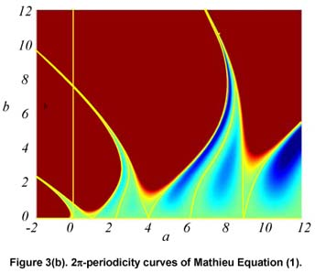
Stability Chart for the Mathieu’s Equation with damping term
Where a = (2 ∗ ω_{α} / θ)², α = 1,2, …N, ω_{α} = Natural Frequencies,
b is proportional to the amplitude of unsteady aerodynamic drag. The boundary of the unstable region (in red color) depends on the magnitude of the (positive) aero-elastic damping.

Slide 7
Unsteady Aerodynamic Fore-&-Aft (Drag) Forces
The resultant unsteady aerodynamic forces D(t) in the fore-&-aft direction (drag) are actually come from the combination of the distributed unsteady drag forces due to the wing or the empennage chord-wise motions, (since the wing and the empennage are the most flexible parts of the airplane).
It is obvious that an airplane with 4 engines is subjected to larger unsteady drag forces D(t) than an airplane with only 2 engines. This may explain why the LCO events are so far only observed on airplanes with 4 engines, but not on airplanes with only 2 engines.
From the stability chart in the previous page, the most likely situation to fall into the unstable regions of the Mathieu equation is when the ratio of the excitation frequency of the unsteady forces D(t) to the first (most critical) aero-elastic frequency of the idealized airplane is 2. Hence, the term – subharmonic resonance is used in the mathematic theory of the Mathieu equation.

Slide 8
Examples of Limit-Cycle Oscillations [LCO(s)] – Example #1
The consequence of falling into the unstable regions is the occurrences of the limit-cycle oscillations [LCO(s)], which is well known in the mathematic theory of the Mathieu’s equation.
First example involves a large airplane with the LCO mode showing anti-symmetric mode shape. This LCO event occurred at an altitude of 22,000 ft, around Mach 0.78.
In this example, the airplane is with full payload and the full wing fuel tanks, but also with full fuel in the tail tank.
The time-history traces and the frequency domain power spectrum are displayed on the next page.

Slide 9
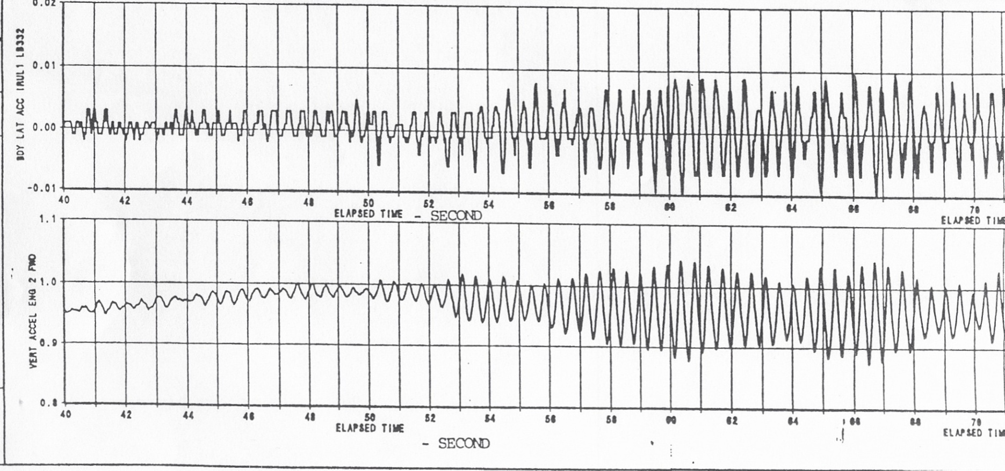
Real LCO Example #1 for a Large Airplane - in The Time Domain

Slide 10
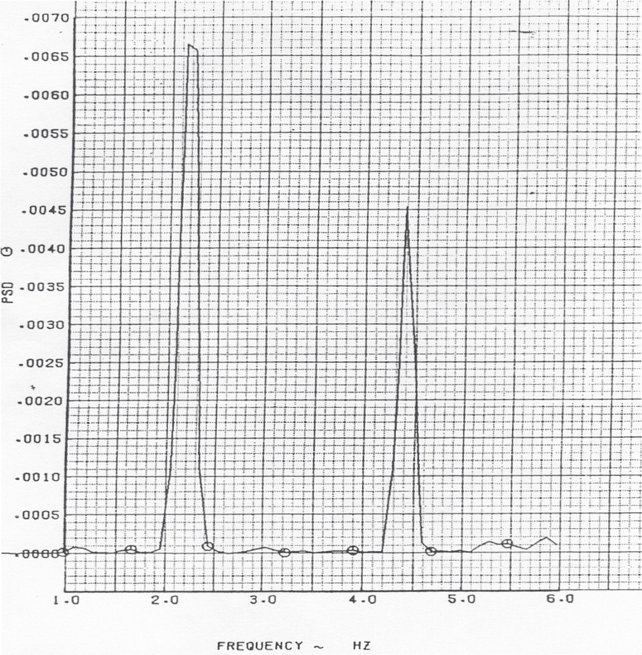
Real LCO Example #1 for a Large Airplane - in The Frequency Domain

Slide 11
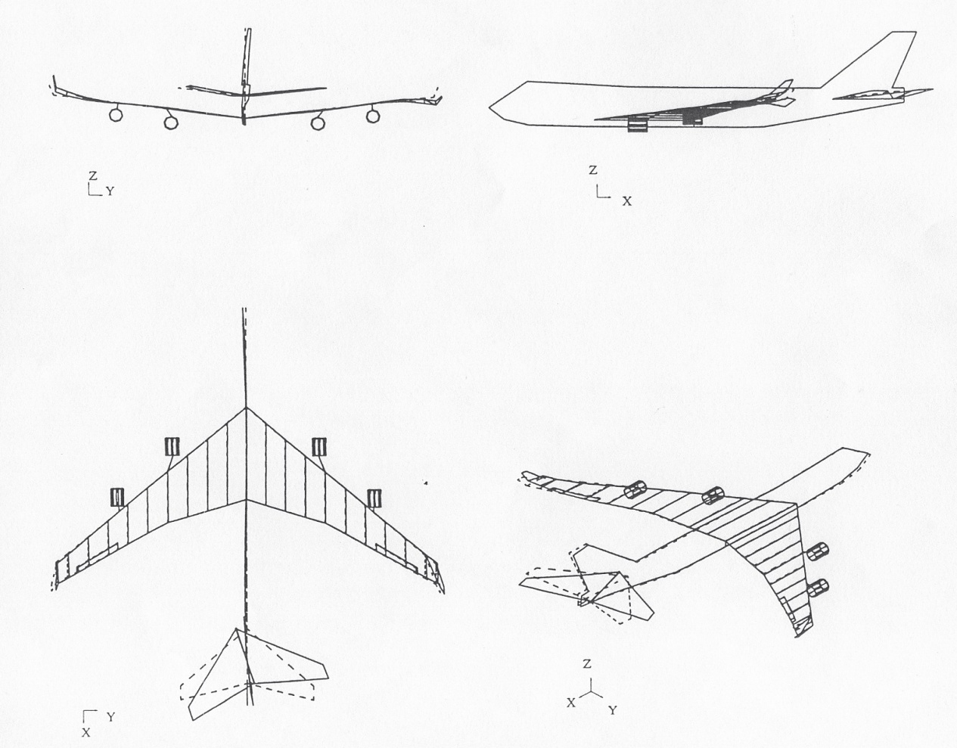
Real LCO Example #1 for a Large Airplane – 2nd Dominant Mode, Frequency = 4.4 Hz

Slide 12
Important Observations for the Example #1
The 2nd dominant mode shows very strong empennage chord-wise motions in the aero-elastic mode shape.
This implies that the empennage should have picked up fairly large unsteady aerodynamic forces in the chord-wise direction.
Hence, this 2nd dominant mode serves as the source of excitations, (as shown on page 4), to induce the LCO event, which is shown in the time domain on page 9 with the LCO frequency (about the half of the excitation frequency) as illustrated by the frequency of the 1st dominant mode.

Slide 13
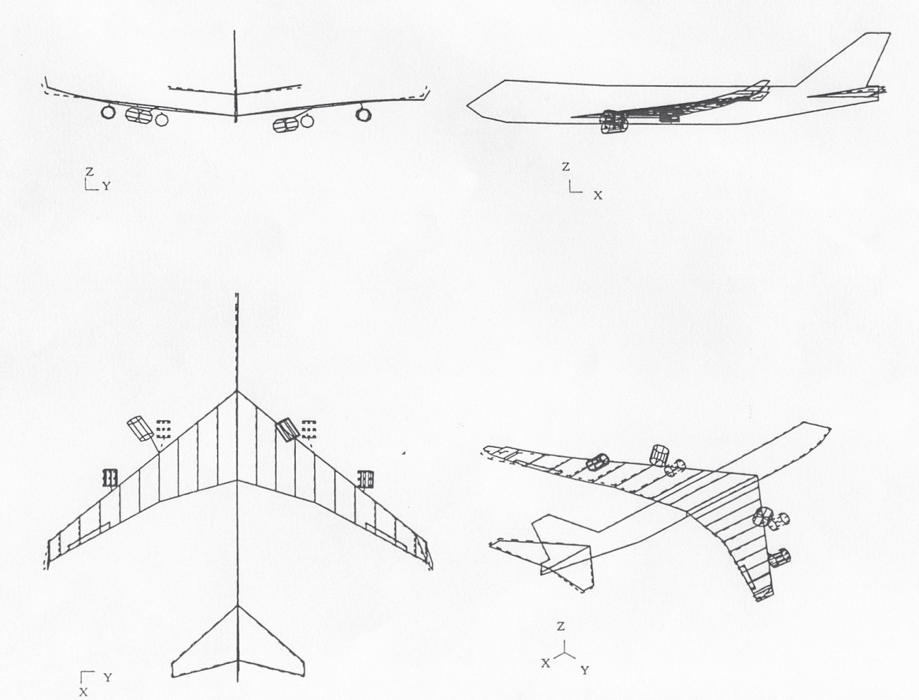
Real LCO Example #1 for a Large Airplane - 1st Dominant Mode, Frequency = 2.15 Hz

Slide 14
Examples of Limit-Cycle Oscillations [LCO(s)] – Example #2
As mentioned before, the consequence of falling into the unstable regions is the occurrences of the limit-cycle oscillations [LCO(s)], which is well known in the mathematic theory of the Mathieu’s equation.
Second example involves a large airplane with the LCO mode showing anti-symmetric mode shape. This LCO event occurred at an altitude of 22,000 ft, around Mach 0.90.
In this example, the airplane is with empty payload and the partial full condition of the wing fuel tanks, but without any fuel in the tail tank.
The time-history traces and the frequency domain power spectrum are displayed on the next page.

Slide 15
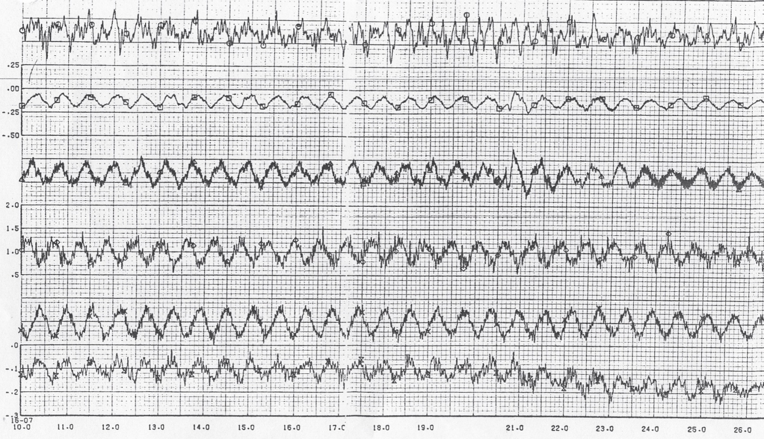
Real LCO Example #2 for a Large Airplane - in The Time Domain

Slide 16
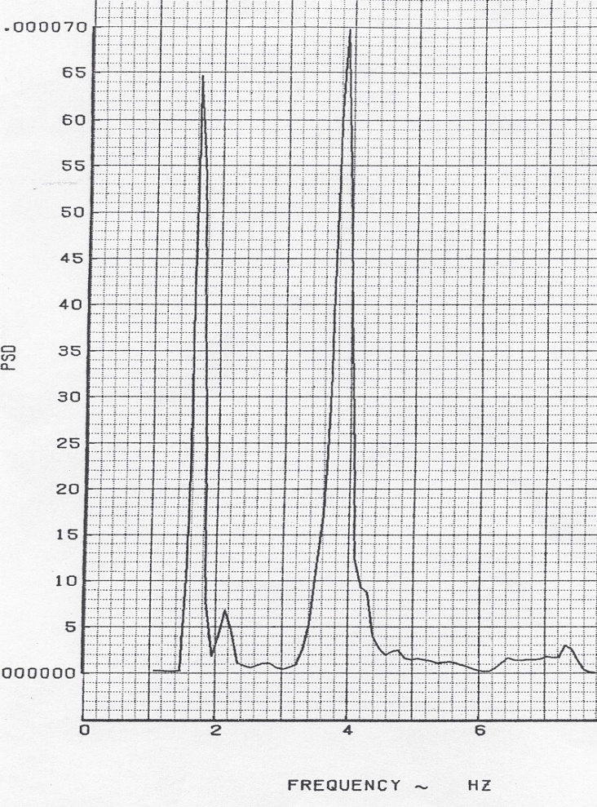
Real LCO Example #2 for a Large Airplane - in The Frequency Domain

Slide 17
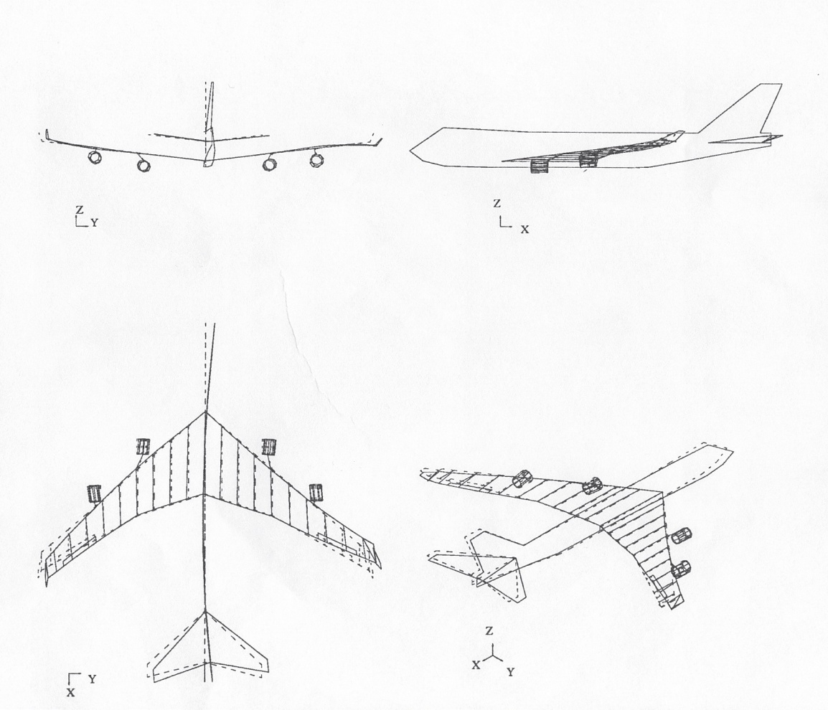
Real LCO Example #2 for a Large Airplane – 2nd Dominant Mode, Frequency = 3.67 Hz

Slide 18
Important Observations for the Example #2
The 2nd dominant mode shows very strong wing chord-wise motions in the aero-elastic mode shape.
This implies that the wings should have picked up fairly large unsteady aerodynamic forces in the chord-wise direction.
Hence, this 2nd dominant mode serves as the source of excitations, (as shown on page 4), to induce the LCO event, which is shown in the time domain on page 15 with the LCO frequency (about the half of the excitation frequency) as illustrated by the frequency of the 1st dominant mode.

Slide 19
Conclusions
These real examples show that the unsteady aerodynamic forces generated by the strong movements in the chord-wise direction (i.e. fore-&-aft direction) of either the empennage or the wings serve as the source of excitations to induce the occurrences of the LCO events.
It is important to include the unsteady forces (or moments) in the fore-&-aft direction in order to predict any LCO events.
Our current flutter analyses at Boeing do not have the unsteady forces (or moments) in the fore-&-aft direction. This is why the current flutter analyses at Boeing can not predict the LCO(s).

Slide 20
Conclusions (Cont’d)
For an airplane with only 2 engines, the magnitudes of the unsteady drag forces may not be big enough to induce the LCO events. But for a large airplane with 4 engines, the unsteady aerodynamic forces in the fore-&-aft direction (drag) can be significant enough to give rise to the LCO(s).
As shown on page 6, even if the aero-elastic damping of a large airplane is positive, it is still possible to induce the LCO events as long as the aero-elastic damping is small enough for its critical mode to fall into the unstable (in red color) region.

