Slide 1
🎮 GAMEHUB
GAMEHUB
Smart PC Game Discovery Platform
AI-Powered Recommendations · PC Compatibility Checker · Gamer Partner Finder
2000+
50K+
15
6
Games
Gamers
Genres
Core Modules
Group Members: M.Hashim · Hassam · Khadija · Noor · Eman

Slide 2
Project Overview
What is GameHub and why we built it
What is GameHub?
Tech Stack
A full-stack web platform (PHP · MySQL · HTML/CSS/JS) — an intelligent PC game discovery engine. Core Features:
Smart personalised recommendations
Real-time PC compatibility checker
Gamer partner matching system
Role-based admin control panel
Wishlist, reviews & game catalogue
Frontend:
HTML · CSS · JS
Backend:
PHP · REST APIs
Database:
MySQL
Server:
XAMPP
Project Scope
50+ PHP/HTML/JS/CSS source files
7 database tables, 20 seed games
Admin + User role separation
Fully responsive design
50+
7
15
20
Source Files
DB Tables
Genres
Seed Games

Slide 3
System Architecture
3-tier architecture
PRESENTATION LAYER
BUSINESS LOGIC LAYER
DATA LAYER
index.html
recommendation.php
MySQL Database
games.html
compatibility.php
users table
game_detail.html
partner_match.php
games table
dashboard.html
⟷
admin.php
⟷
reviews table
login / register.html
review_process.php
wishlist table
wishlist.html
wishlist_process.php
gamer_profiles table
partner_finder.html
session_check.php
categories table
partner_requests table
compatibility_checker.html
login / register.php
partner_requests.php
db.php connector

Slide 4
Database Schema
MySQL — 7 tables with foreign key relationships
USERS
GAMES
REVIEWS
• id (PK)
• id (PK)
• id (PK)
• username
• title
• user_id (FK)
• email
• genre
• game_id (FK)
• password_hash
• description
• rating (1-5)
• role (admin/user)
• rating
• comment
• favorite_genres
• release_date
• is_approved
+ 2 more
+ 5 more
+ 1 more
WISHLIST
GAMER_PROFILES
CATEGORIES
PARTNER_REQUESTS
• id (PK)
• profile_id (PK)
• id (PK)
• id (PK)
• user_id (FK)
• user_id (FK)
• name
• sender_id (FK)
• game_id (FK)
• favorite_game
• icon
• receiver_id (FK)
• added_at
• playing_time
• created_at
• message
• play_style
• status ENUM
• bio
+ created_at, updated_at

Slide 5
All System Modules
Complete feature breakdown across user roles
🏠
Home Page
🎮
Game Catalogue
📄
Game Detail
🔐
Auth System
Trending games, genre browse, featured content
Search, filter by genre, sort by rating/date
Full info, reviews, PC reqs, ⚡ cracked link
Register, Login, Role-based sessions (admin/user)
📊
User Dashboard
♥
Wishlist
🖥️
PC Compatibility
🤝
Partner Finder
Personalised recs, stats, wishlist overview
Save games, manage collection, remove items
Enter specs → instant compatibility score
Match gamers by play style, time, favourite game. Send/accept partner requests
⚙️
Admin Dashboard
🎯
Manage Games
👥
Manage Users
⭐
Manage Reviews
Analytics, user/game/review management
Add/Edit/Delete games, cracked URL, trending flag
View, ban/unban, role management
Approve, reject, moderate community reviews

Slide 6
①
Authentication & User Management Module
Authentication System
Module Responsibilities
📁 Files Handled
• login.html + php/login.php
User Registration
• register.html + php/register.php
username, email, bcrypt password hashing
• php/session_check.php
User Login
• php/logout.php
PHP sessions, role detection (admin/user)
• php/db.php (startSession)
Role-Based Access
🗄️ DB Table: users
admin panel locked to admin role only
• id, username, email, password_hash
Session Management
session_check.php API · logout with redirect
• role ENUM('user','admin')
• is_banned, last_login
• favorite_genres, avatar_url, bio

Slide 7
①
Authentication & User Management Module
Login & Register UI + Flow
📱 Login Screen
🔄 Auth Flow
📧 Email address
1. User submits login form
↓
🔒 Password
2. POST → php/login.php
↓
3. password_verify() bcrypt
LOGIN →
↓
4. $_SESSION set (id, role, username)
↓
Don't have an account? Register here
5. session_check.php validates
↓
Default credentials:
admin@gamehub.com / admin123
neon@gamehub.com / gamer123
6. Admin → admin_dashboard.php
↓
7. User → dashboard.html

Slide 8
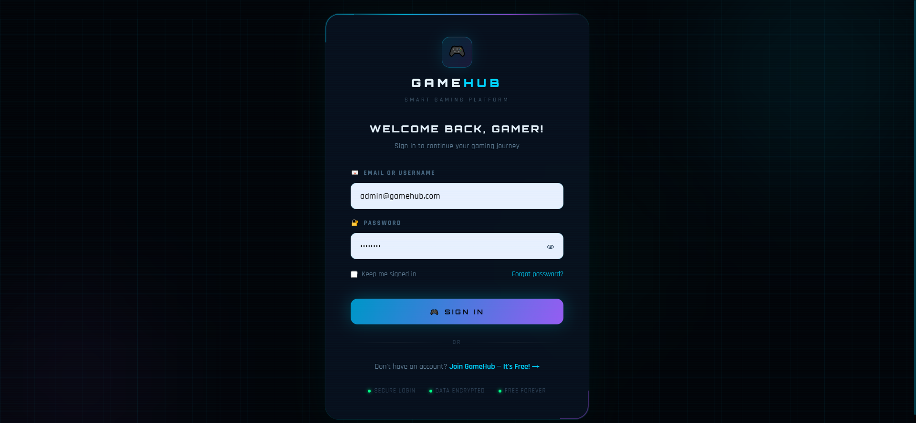

Slide 9
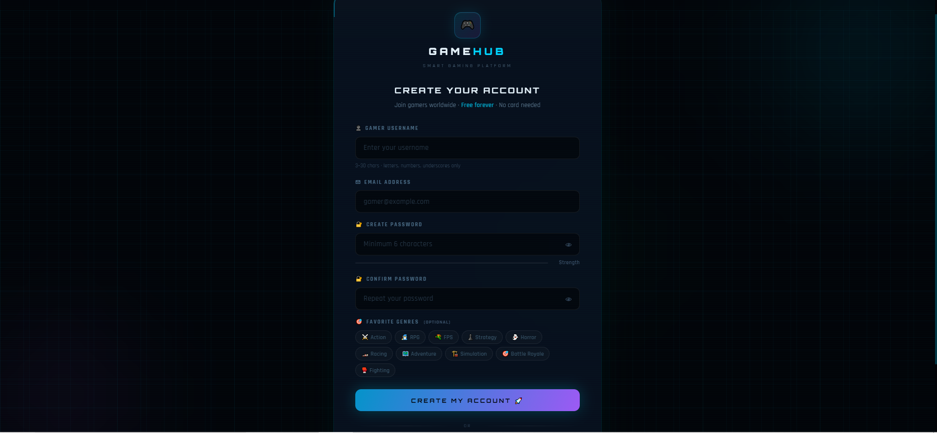

Slide 10
②
Game Catalogue, Detail Page & Reviews Module
Game Catalogue & Detail Page
Game Catalogue (games.html)
📱 Game Card UI
Search & Filter
🎮
Cyber Odyssey 2049
By title, genre, rating — live search
Sort Options
RPG
Newest, top rated, most viewed
★★★★★ 4.8
Game Cards
Cover image, genre badge, rating stars
Game Detail
View Details →
Full description, PC reqs, reviews
API: recommendation.php?action=all_games
Filters applied via JS fetch with query params
⚡ Cracked Link
Download button if admin set a URL

Slide 11
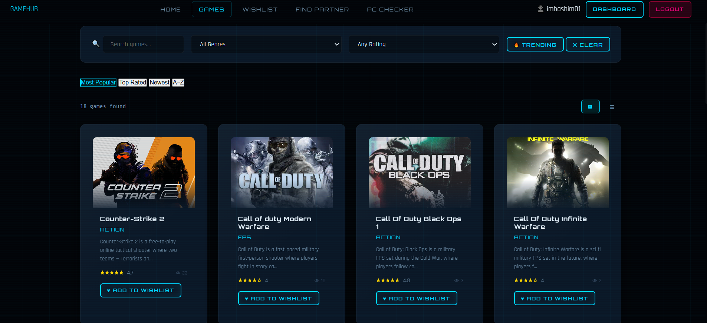

Slide 12
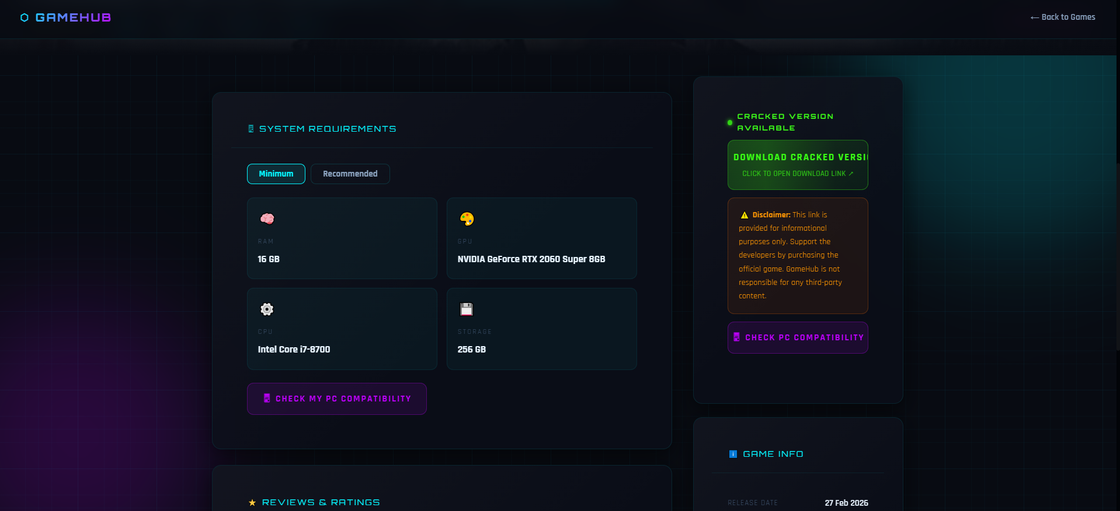

Slide 13
②
Game Catalogue, Detail Page & Reviews Module
Reviews System & Cracked Link Feature
⭐ Reviews System
⚡ Cracked Version Feature
Submit Review
POST → review_process.php, 1 per user/game
Admin sets a download URL per game in the Add/Edit Game page On the game detail page, if cracked_link is set:
A pulsing green ⚡ badge appears
'Cracked Version Available' label shown
Download button links to the URL
Disclaimer shown below button
DB column: cracked_link VARCHAR(500) in games table
Rating
1-5 stars, validated server-side
Approve/Reject
Admin can moderate all reviews
Helpful Votes
Users can upvote/downvote reviews
DB Table
reviews (user_id FK, game_id FK)
⚡ Download Cracked Version ↗

Slide 14
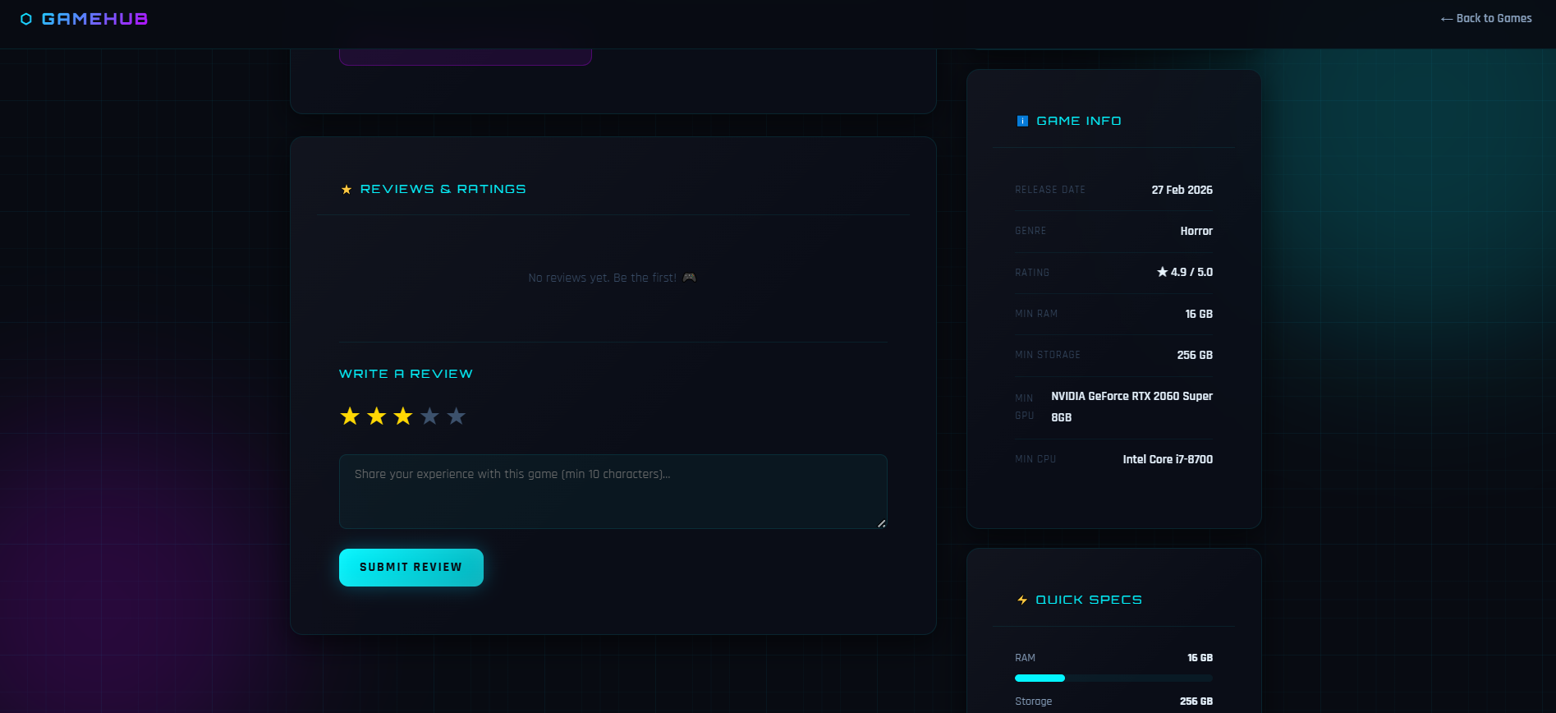

Slide 15
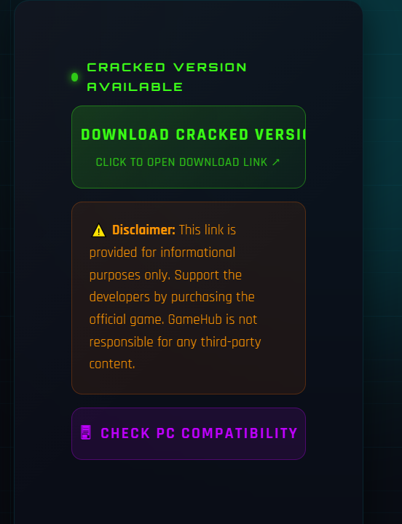

Slide 16
③
AI Recommendations & User Dashboard Module
Smart Recommendations Engine
How the Recommendation Algorithm Works
API Actions
Step 1
User logs in → session reads user.favorite_genres from DB
?action=get_recommendations
Step 2
PHP queries games WHERE genre IN (user genres)
?action=trending
Step 3
Exclude games already in user's wishlist
?action=new_releases
?action=by_genre
Step 4
ORDER BY avg(review rating) DESC, release_date DESC
?action=search
Step 5
Return top 12 personalised games as JSON
?action=game_detail
Fallback
If not logged in → top trending + highest rated games
?action=all_games

Slide 17
③
AI Recommendations & User Dashboard Module
User Dashboard
📊 Stats Panel
🎯 Recommendations
Wishlist count, reviews written, genres explored, member since date
Personalised game grid based on favourite genres, excludes wishlisted
🔥 Trending Now
♥ My Wishlist
Top 6 games by views + trending flag, shown as horizontal card row
Preview of first 4 wishlist items with quick-remove option
🏆 Leaderboard
👤 Profile Setup
Top gamers by activity, reviews, wishlist size
Set favourite genres → drives recommendation engine personalisation

Slide 18
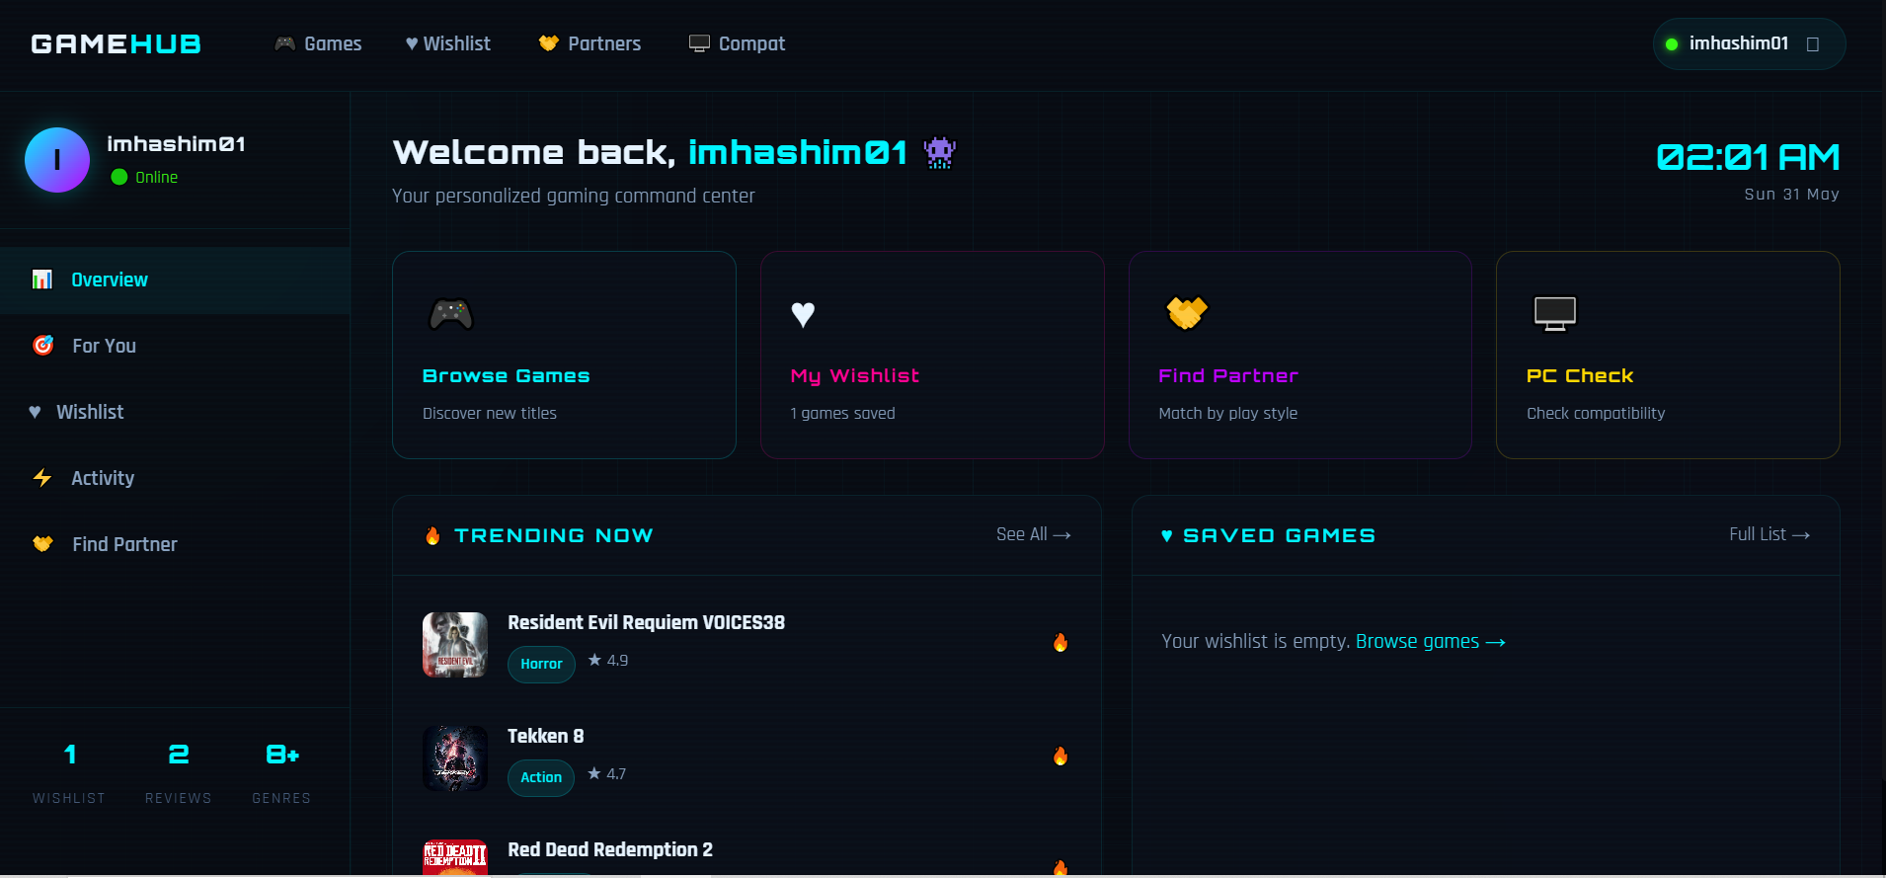

Slide 19
④
PC Compatibility Checker & Partner Finder Module
PC Compatibility Checker
How Compatibility Scoring Works
📊 Score Display
User inputs: RAM (GB), GPU model, CPU model, Storage Scoring Algorithm:
RAM score: user RAM vs game min_ram → 0-30 pts GPU score: text matching + tier lookup → 0-40 pts CPU score: i3/i5/i7/i9 / Ryzen tier → 0-20 pts Storage score: free vs required → 0-10 pts
Result Levels: Runs Great (90-100) · Runs Well (70-89) Runs OK (50-69) · Struggles (30-49) · Won't Run (<30)
Runs Great
90+
Runs Well
70-89
Runs OK
50-69
Struggles
30-49
Won't Run
<30

Slide 20
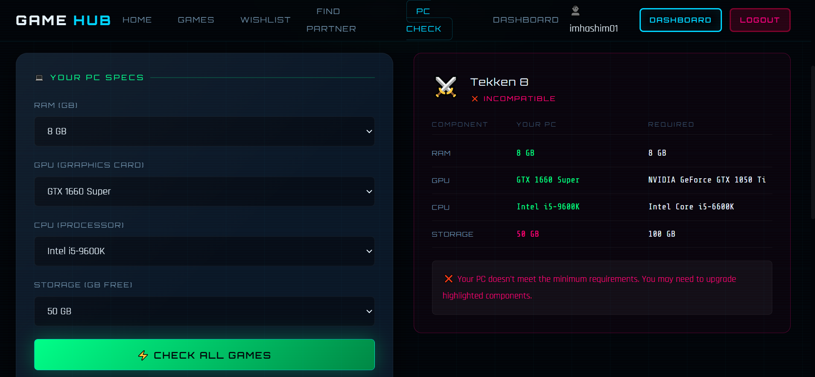

Slide 21
④
PC Compatibility Checker & Partner Finder Module
Gamer Partner Finder
Partner Matching Algorithm
🤝 Partner Card UI
User fills profile: play style, playing time, favourite game Match Score (out of 100):
Same play_style → 40 points Same playing_time → 30 points Same favorite_game → 20 points Random noise (0-9 pts) for tie-breaking Play Styles: casual, competitive, cooperative, speedrun, roleplay Playing Times: mornings, afternoons, evenings, late night, weekends, flexible Request System: Send/Accept/Reject partner requests — stored in partner_requests table with status tracking (pending/accepted/rejected)
👤
NeonSword99
★ 95% Match
competitive
evenings
Phantom Strike
Send Request →

Slide 22
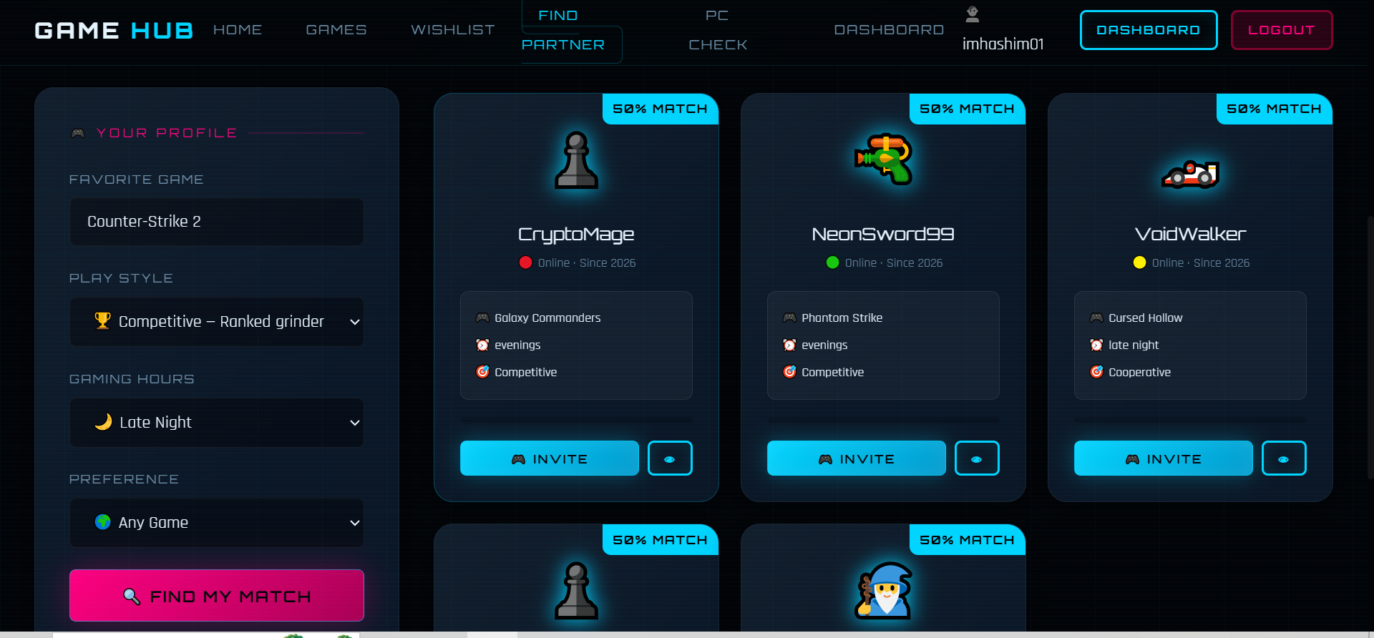

Slide 23
⑤
Admin Control Panel & Analytics Module
Admin Dashboard & Management
📊 Admin Dashboard
🎮 Manage Games
KPI stats: total games, users, reviews, views. Activity charts.
Add/Edit/Delete games. Set cracked URL. Trending toggle. Cover upload.
👥 Manage Users
⭐ Manage Reviews
List all users. Ban/Unban. View role. Filter by status.
View all reviews. Approve/Reject. See helpful vote counts.
🏷️ Categories
📈 Analytics
Add/remove game genres. Icon assignment for each category.
Top games by views, genre distribution pie chart, user growth.

Slide 24
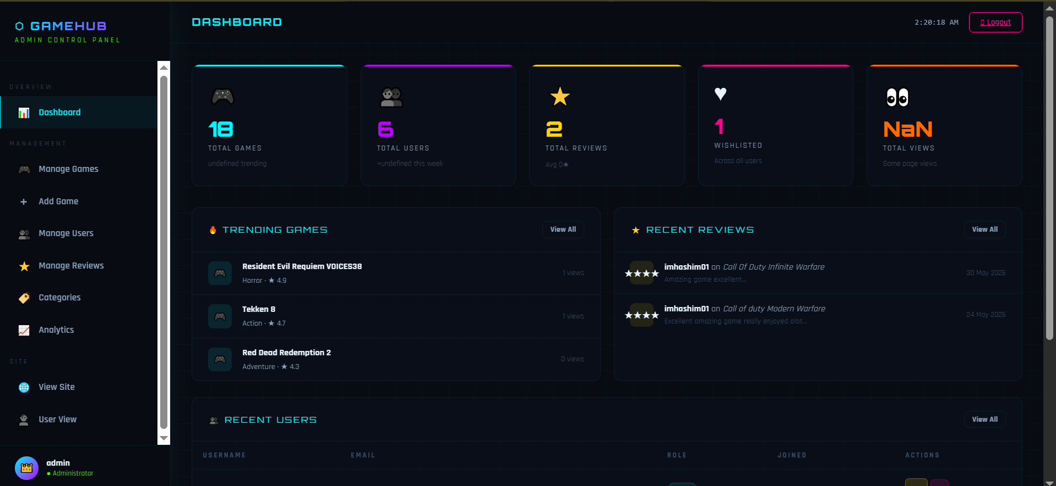

Slide 25
⑤
Admin Control Panel & Analytics Module
Add Game Page & Analytics Charts
➕ Add Game Page (add_game.php)
Title + Genre
Required fields, genre dropdown
Description
Textarea, resizable
⚡ Cracked URL
Highlighted green section — always visible
Cover Image
Upload file or paste URL with preview
PC Requirements
RAM, Storage, GPU, CPU fields
Trending Flag
Checkbox at bottom of form

Slide 26
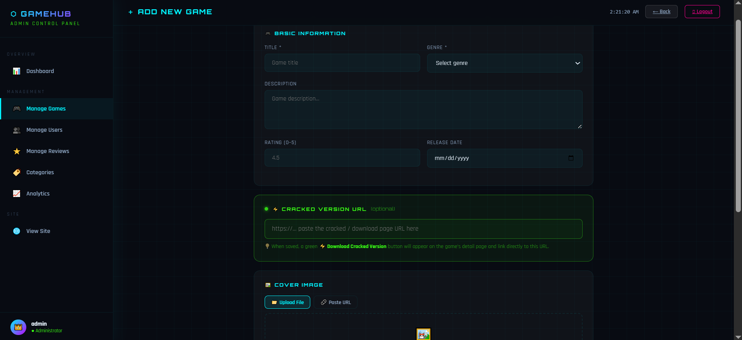

Slide 27
Wishlist Module
User game collection management — wishlist.html + php/wishlist_process.php
♥ Add to Wishlist
🗑️ Remove from Wishlist
One-click from game card or detail page. Prevents duplicates (UNIQUE KEY).
Remove instantly via DELETE request to wishlist_process.php.
📋 Wishlist Page
🔒 Auth Guard
Grid of all saved games with cover, genre, rating, remove button.
Requires login — redirects to login.html if no session found.
DB: wishlist (id, user_id FK, game_id FK, added_at) · UNIQUE KEY on (user_id, game_id) · CASCADE DELETE

Slide 28
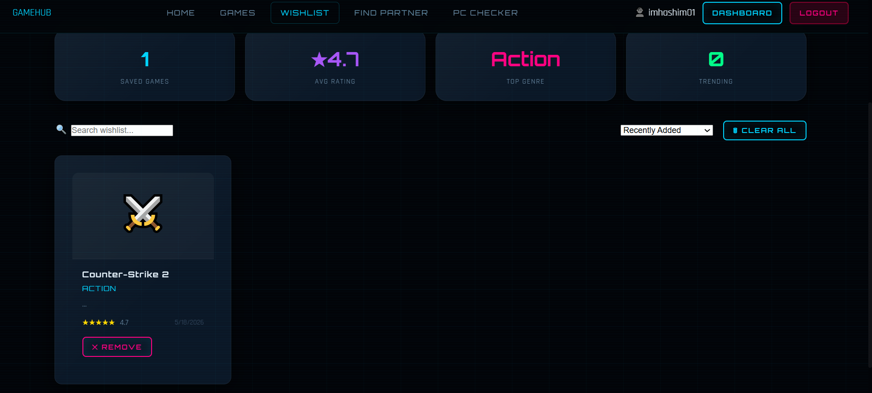

Slide 29
LIVE PREVIEW
Visit the deployed GameHub platform — live and running online
HTTPS
https://gamehub.great-site.net/
->|
GAMEHUB
HOME
GAMES
WISHLIST
PC CHECK
PARTNER
LOGIN
Discover Your
RPG
Cyber Odyssey
FPS
Next Epic Game
★★★★★
Phantom Strike
★★★★★
AI-Powered Recommendations . PC Compatibility . Partner Finder
RACING
Explore Games
Join Free
Neon Racer X
★★★★★
LIVE DEMO
https://gamehub.gamer.free/
OPEN ->
Click to open in browser

Slide 30
FUTURE ENHANCEMENTS
Planned features to scale GameHub into a full-featured gaming platform
AI-Powered Chat Assistant
Mobile App (Android & iOS)
Price Tracker & Deal Alerts
Mobile App (Android & iOS)
An in-platform chatbot that answers game questions, gives personalised recommendations via natural language, and helps users find games matching mood or playtime.
Native mobile application with push notifications for wishlist price drops, new game alerts, and partner match requests. Offline browsing of saved games.
Integrate Steam/Epic/GOG APIs to track real game prices. Email/SMS alerts when a wishlisted game goes on sale. Historical price charts per game.
Achievement & Badge System
Multi-Language Support
Game Trailers & Media Gallery
Gamified user profiles with badges earned for writing reviews, adding games, logging hours, and completing collection goals. Leaderboard ranking.
Internationalisation support for Urdu, Arabic, French, Spanish and more. Auto-detect browser language and allow users to set preferred language.
Embed YouTube trailers and screenshot galleries on each game detail page. Admin can attach media URLs. Users can report broken links.

Slide 31
FUTURE ENHANCEMENTS — Advanced Roadmap
Long-term vision to transform GameHub into a full gaming ecosystem
Live Streaming Integration
Implementation Roadmap
Embed Twitch/YouTube live streams per game on the detail page. Show live viewer count. Let users follow their favourite streamers directly from GameHub.
Phase 1
Game Trading / Lending Board
Mobile App
Price Tracker
AI Chatbot
Game Trailers
Peer-to-peer marketplace where users can list physical games to trade or lend locally. Escrow-style trust system with rating-based verification.
Phase 2
Achievements
Multi-Language
Live Streams
Advanced Analytics
Advanced Analytics Dashboard
Detailed admin charts: user retention curves, genre popularity trends over time, review sentiment analysis using NLP, heatmaps of most visited pages.
Phase 3
Trading Board
Cloud Sync
PWA Support
NLP Reviews
Cloud Save & Cross-Device Sync
Phase 4
Phase 4
Let users sync their wishlist, preferences and profile across devices via cloud account. PWA support for offline access on mobile browsers.
Esports Hub
Game API Partner
Monetisation
Mobile Native

Slide 32
🎮
THANK YOU
GameHub
Smart PC Game Discovery Platform
Authentication
Game Catalogue
Smart Recommendations
PC Compatibility
Partner Finder
Wishlist
Admin Panel
Analytics
Reviews
Cracked Links
Built with PHP · MySQL · HTML · CSS · JavaScript
Questions Welcome · Computer Science Department · BS Software Engineering · 2025

