Slide 1
A Perspective of Property Value and Police Proximity to Crime Rates
At the San Diego Blue Line Trolley
Slides by Emily Chen Lasted updated on July 2024

Slide 2
Introduction
Why are we doing this project?
The San Diego blue line trolley station opened on November of 2021, and it became well known for its speedy and reliable method of transportation. With the University of California San Diego hosting multiple blue line trolley stops on its campus and La Jolla being known as an affluent neighborhood, we were curious and wanted to investigate the crime rates around these stops. The two factors that we were particular interested in understanding crime rates around these stops were property value and police proximity.

Slide 3
Background
Why property value and police proximity?
We believe that using property and police proximity will be an interesting and useful investigation because of the following prior works. One study have found that crime, housing prices, neighborhood satisfaction and desire to move have a relationship³³. Furthermore, there is evidence that when studies attempt to find causal relationship between arrest rates, they generally find that for crimes, higher level of police activity implies lower crime rate⁴. Then, based on these studies, we believe that examining the relationship between crime rates, property values, and police proximities around these stops can advance our understanding of the crime patterns in the area of focus, the San Diego Blue Line trolley station.

Slide 4
Research Question
What are we trying to answer?
Do La Jolla trolley stops on the Blue Line experience higher rates of criminal incidents compared to non-La Jolla trolley stops within San Diego? If so, do property value and proximity to police stations correlate with these these patterns?

Slide 5
Data Collection
1) San Diego crimes report, 2) Zillow home values 3) San Diego police station
All three data sets were publicly available from credible sources
Additionally, we used other publicly available files for plotting charts, and we acknowledge the purpose of our usage in our code.

Slide 6
Pitfalls and Obstacles
What were the limitations and how did we address them?
Zip codes itself did not serve as good proxy for locating crime rates.
Levels of details about crime locations were scattered among the datasets.
Zip codes were replaced by San Diego neighborhoods
Level of details were unified through defining San Diego neighborhoods
Dataset did not include Chula Vista because it is not part of the San Diego County
Make the most out of the publicly available data and resume understanding La Jolla versus non-La Jolla regions within the San Diego County instead

Slide 7
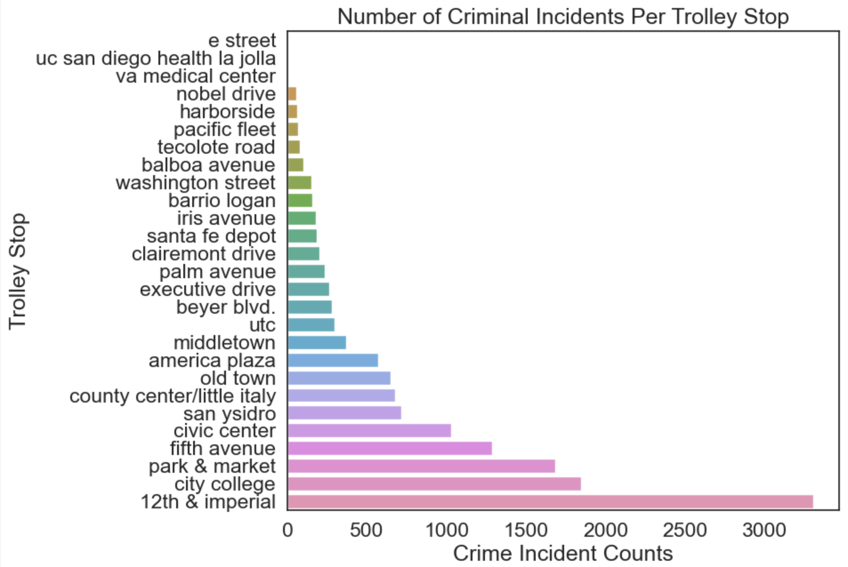
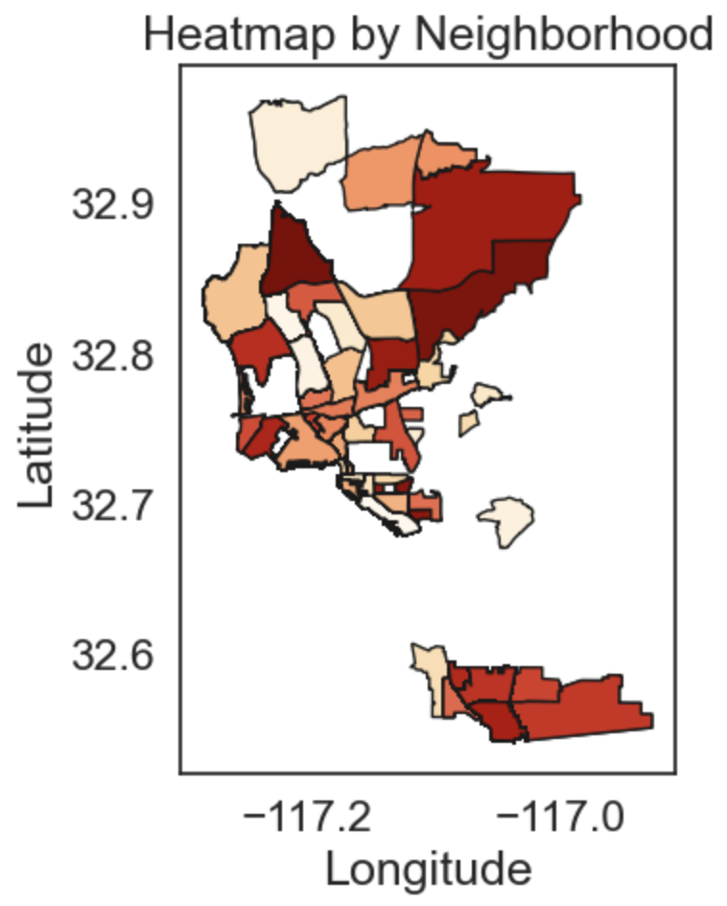
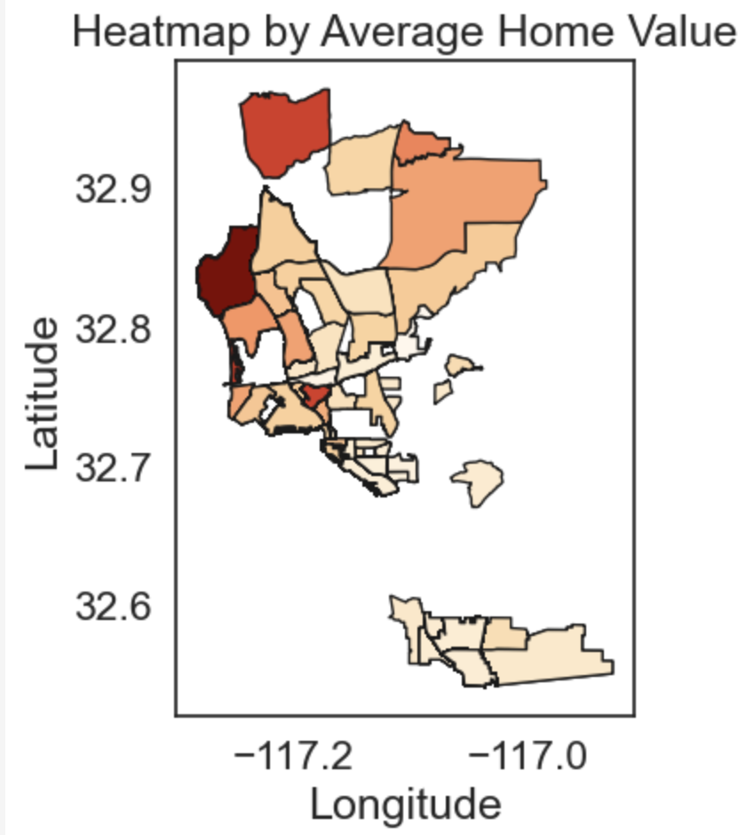
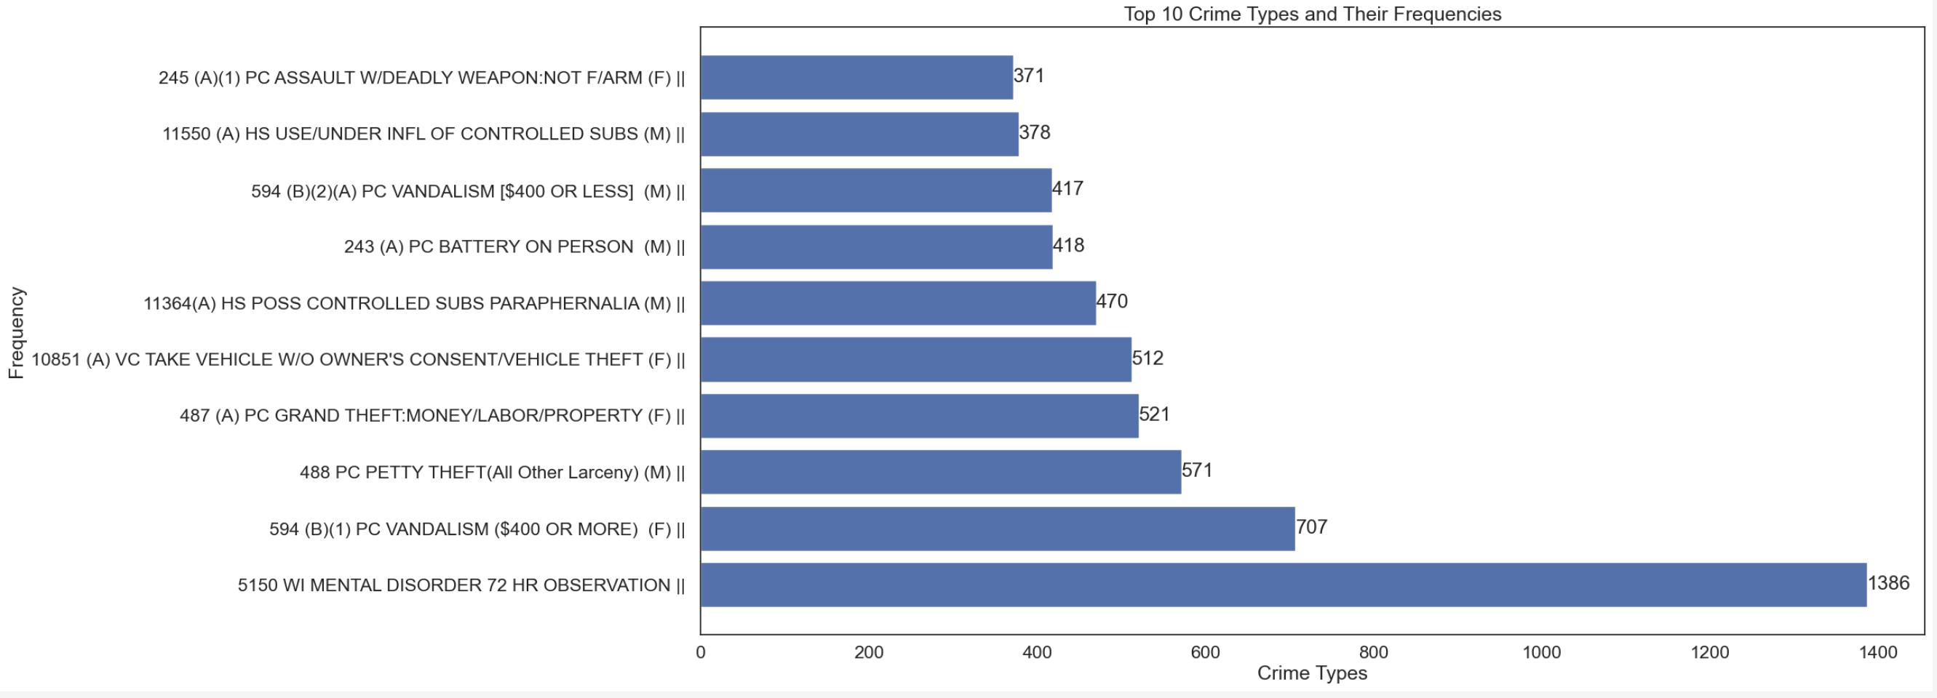
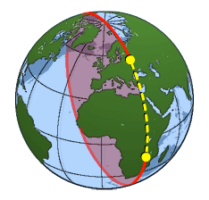
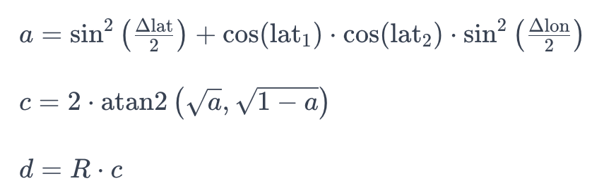
Methodology
Data cleaning, Exploratory Data Analysis, Statistical Inference, Geospatial Analysis
12th & imperial street seem to have over 3000 crime incidents
Haversine Distance Formula

Slide 8
Privacy and Ethics
Data collection: Some potential ethical issues around this could be when we use “neighborhood” to merge crimes and homes value data together, there are potential mis-measurements and inconsistencies around how “near” we’re studying around the trolley stops. For attainability reasons, studying around La Jolla neighborhood which stretches approximately 7 miles (11 km) is a better choice then studying around zip codes 92037 which covers approximately 13 miles (20 km) of land⁵.
Data analysis: A handful of exploratory data analysis were conducted to find graphical relationships between variables and grow the diversity of viewpoints of our investigation. We preserve fairness in our permutation test by refraining to make assumptions about the data. By creating random samples non-La Jolla crime rates and La Jolla crime rates, we could independently calculate each distribution’s statistic, and draw conclusions.
Use and revision: The investigation serves to understand whether or not property value and police proximity were related to crime rates. Thus, we refrained from direct comparison crime rates and neighborhoods because we are aware that this could potentially abet the stigmatization around certain neighborhoods. Moreover, the variable “neighborhood” encompasses many factors that we have not yet understood in this context. Thus, it can give confounding conclusions if misapplied or misinterpreted.

Slide 9
Conclusions
The investigation of the research project attempts to use inferential analysis to determine whether property value and police proximity have a statistical significance to crime rates. From our findings, it seems to be that there is a relationship between property value and crime rates, but there does not seem to be evidence between police proximity and crime rates.

Slide 10
Acknowledgement
This was originally a final course project that I took at UCSD, and it was done alongside with four other group members. Some notable changes I’ve done afterward were the addition of this slide deck that serves to communicate a summary of what was accomplished and clarifying ideas in the Jupyter notebook.

Slide 11
References
BLiggett, R., Loukaitou-Sideris, A., & Iseki, H. (2003). Journeys to Crime: Assessing the Effects of a Light Rail Line on Crime in the Neighborhoods. Journal of Urban Affairs, 25(2), 165-184.
Block, R., & Block, C. (2000). The Bronx and Chicago: Street Robbery in the Environs of Rapid Transit Stations. Journal of Transportation and Statistics, 3(3), 29-36.
Taylor, R. B. (1995). The Impact of Crime on Communities. The Annals of the American Academy of Political and Social Science, 539(1), 28-45.
Weatherburn, D. (2001). What causes crime?
MapsZipCode. (n.d.). ZIP code 92037 population. Zip Code 92037 Population.

