Slide 1
MediDB
A Drug Safety & Recommendation System
Sanjana Garimella · Priyanka Nidadavolu · A.J. Olivares · Emily Chen
Notes:
Hello! We built MediDB, a multi-database clinical decision-support tool.

Slide 2
The Problem
Prescribing a new medication is risky.
Central Question
Patients often take 5–10+ concurrent medications
Drug–drug interactions can cause serious adverse events
Real-world FAERS data contains thousands of warning signals
No single database captures the full picture
Is this new prescription safe
for this specific patient?
Our system answers this by combining structured EHR data, graph knowledge, vector search, and raw evidence into one report.
2
Notes:
So the problem we're solving is— while prescribing a new medicine, dangerous drug combinations get missed at the point of care every single day.
Current tools handle pieces of the problem. They'll flag a direct interaction, or surface a reported adverse event, but they don't connect those signals to a specific patient's full drug profile in one place, in real time.
We seek to close that gap. We use four databases, each purpose-built for a different piece of the problem.Together, they feed into one unified safety report, generated at the exact moment a prescription decision is being made.

Slide 3
System Overview
PostgreSQL
Neo4j
Qdrant
MongoDB
Patient EHR Data
Drug Knowledge Graph
Adverse Event Search
Evidence & Audit
Demographics, active meds, conditions, encounters
– structured Synthea data
Drug–drug interactions and side effects from Drugbank + SIDER
Vector similarity over openFDA FAERS reports using BioLORD embeddings
Raw FAERS documents and a full audit trail of every safety check
3
Notes:
So Here is our proposed solution overview
PostgreSQL holds the structured patient data — it stores who the patient is, what medications they're currently on , what medical conditions they have and and what drug is proposed for them.
Neo4j holds the drug knowledge graph. It shows the interactions between drugs and their side effects as edges between drug nodes.
Qdrant holds vector embeddings of real-world FDA adverse event reports like hospitalizations, deaths, or life threatening events, using semantic patient similarity search.
Lastly, MongoDB stores the raw evidence and logs every safety check run for full auditability.

Slide 4
PostgreSQL — Why Relational?
Structured by nature
Rolling Average — SQL Window Function
EHR data has well-defined entities — patients, encounters, medications — with strict relationships and constraints that SQL enforces automatically.
SELECT
patient_id,
obs_date,
Complex joins are cheap
value AS raw_value,
AVG(value) OVER (
Querying a patient's active meds alongside their conditions, allergies, and recent labs requires multi-table joins. PostgreSQL handles this natively and efficiently.
PARTITION BY
patient_id,
description
ORDER BY obs_date
ROWS BETWEEN
2 PRECEDING AND
ACID guarantees matter
CURRENT ROW
) AS rolling_avg_3
Clinical data demands consistency. A partial write — e.g. a medication inserted without a corresponding encounter — must never silently succeed.
FROM observations
WHERE description IN
('Heart rate',
'BMI', 'Triglyc…')
Window functions for analytics
Rolling averages over lab vitals (heart rate, BMI, triglycerides, respiratory rate) are computed directly in SQL using OVER() without moving data to application code.
Enables in the app
Trend analysis for heart rate, BMI, triglycerides & respiratory rate — displayed as rolling avg chart alongside raw values
4
Notes:
For the first database, we have PostgreSQL.
So why postgress?
It is the right choice here for three reasons.
First, patient data is rigidly structured. For example, the patients, encounters, medications, and conditions tables have strict foreign key relationships that SQL enforces automatically. A partial write, like a medication inserted without a matching doctor’s prescription, should not be added. So, ACID properties in SQL prevents this.
Second, the queries we need are complex multi-table joins. For example, active medications joined to medical conditions joined to recent observations — and PostgreSQL handles those natively and efficiently.
Third, we use window functions to compute rolling averages of lab vitals directly in SQL, without pulling data into application code. For example, Heart rate, BMI, triglycerides, respiratory rate are all trend analysis are handled by SQL.

Slide 5
PostgreSQL — What We Built
What it stores
Schema (star around patients)
Patients — demographics, identifiers
Encounters — visits linked to providers & payers
Medications — active and historical prescriptions
Conditions, allergies, observations, procedures
patients
encounters
medications
Key Functions
conditions
observations
get_active_medications(patient_id)
get_patient_profile(patient_id)
procedures
allergies
allergies
5
Notes:
And here’s what we built.
We used Synthea as a data source for sql, it is real world patient data which is anonymized for privacy reasons. We loaded these synthea CSV files into our schema. Patients table sits at the center — clinical event tables like medications, allergies, procedures, have a foreign key to patients table.
The most important query in sql is to get active medications— this query filters out medication based on the stopping date, so only prescriptions with active medications come back. That's the basis for getting active drugs that every other database depends on. Another important query which SQL handles is get full patient clinical summary like active medications, conditions, allergies, and recent observations — into one dictionary that gets passed downstream to Neo4j and Qdrant.

Slide 6
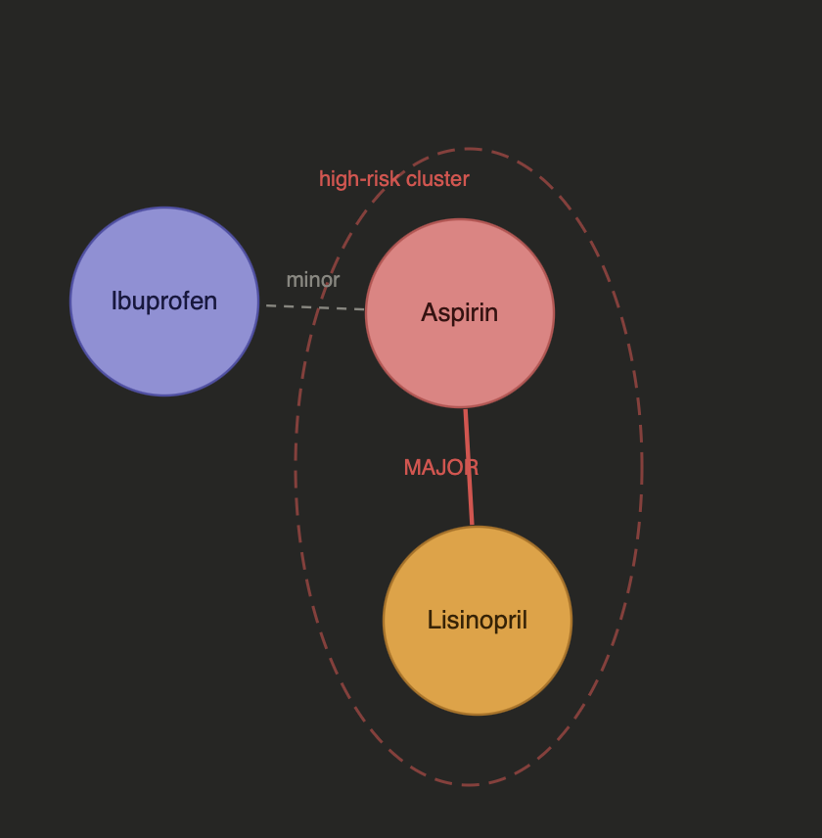
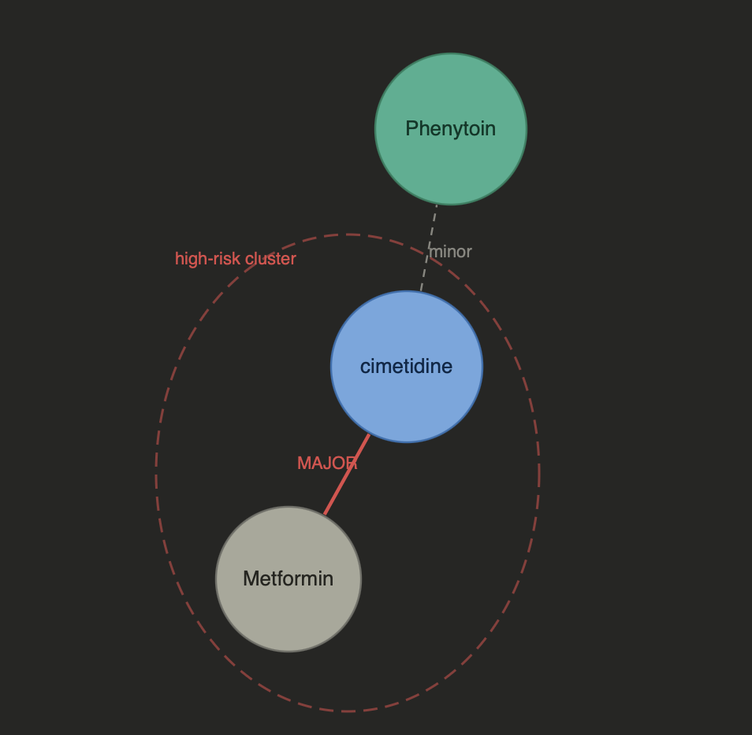
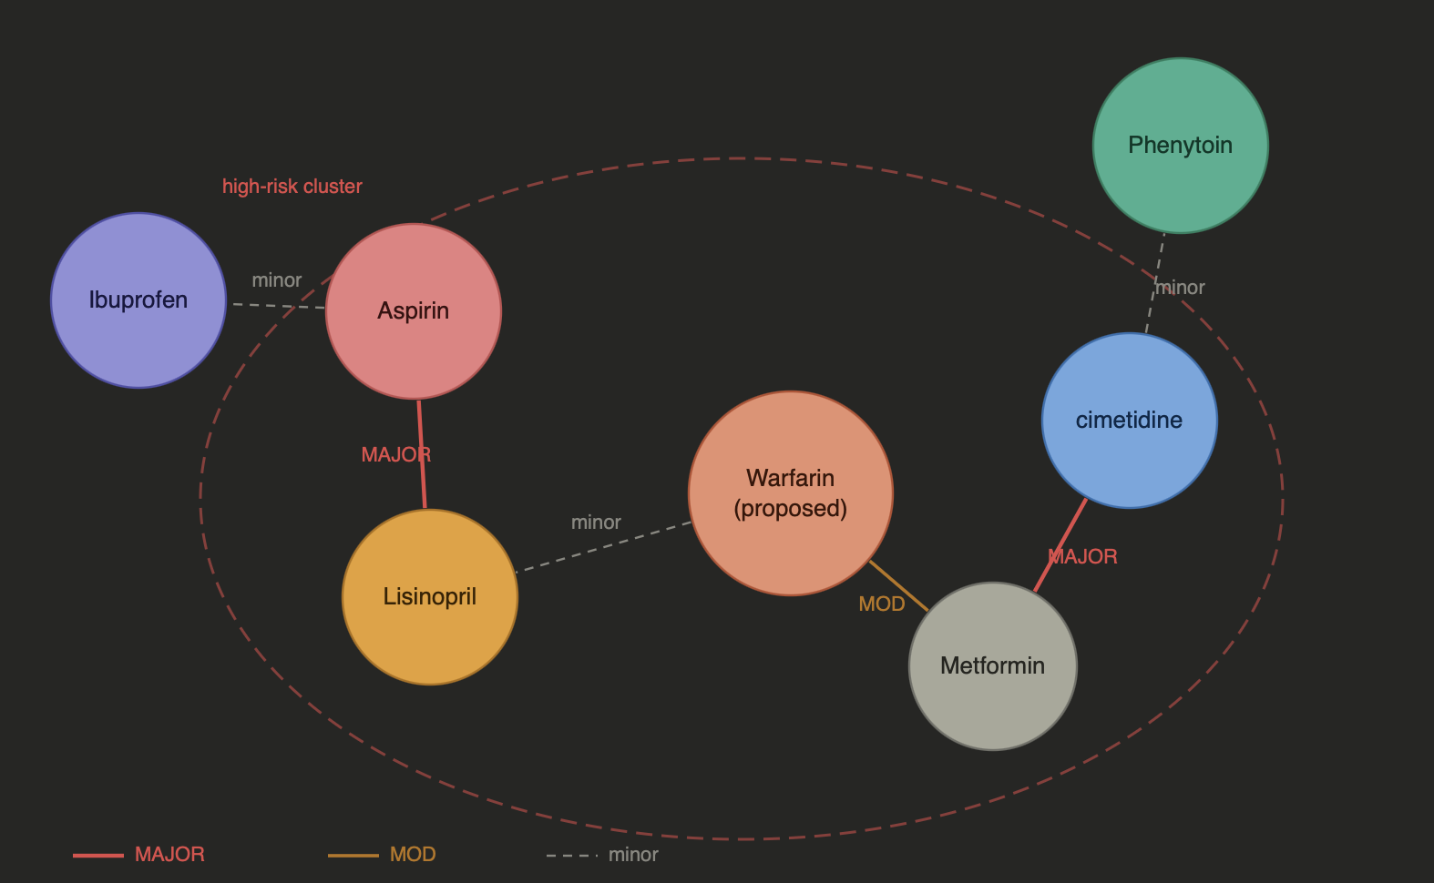
Neo4j — Why a Graph Database?
Cluster 1
Cluster 2
Interactions are inherently a graph
Drug A interacts with Drug B which shares a pathway with Drug C. Modeling this in relational tables requires expensive self-joins that degrade with depth.
Polypharmacy Risk
Finding all drugs reachable within 2 hops from a proposed drug — i.e. indirect polypharmacy interaction risks — in a single query, instead of a recursive CTE.
Heterogeneous relationships
The same node (a drug) participates in INTERACTS_WITH, HAS_SIDE_EFFECT, and IS_ALTERNATIVE_FOR edges — graph schema handles this naturally.
Polypharmacy effect
Notes:
graph has linear time traversals whereas sql query grow sequentially Now, for Neo4j, we have the following:
The SQL approach to drug interaction checking is a SELECT with IN clauses on both drug_a and drug_b, but that has time complexity of O(n squared). Every time you add a medication to the patient's list, the query complexity explodes. And at depth two — finding drugs that interact with other drugs that in turn interact with the proposed drug — you will end up using a deeply nested SQL self-join otherwise.
With Neo4j, drugs are nodes and interactions are edges, so traversing INTERACTS_WITH from a proposed drug only touches its local neighborhood rather than scanning the whole table, and scales with that drug’s degree and the number of hops, not linearly with total graph size.
We loaded DrugBank interaction data, which had Drug nodes, INTERACTS_WITH edges with severity, and SIDER side-effect data, which had SideEffect nodes and HAS_SIDE_EFFECT edges. check_interactions() function combine these two datasets into a single Cypher query, it effectively answers which current and existing drug relationships exist, and with what severity/description.

Slide 7
Neo4j — What We Built
What it models
Example Graph Query
Drug nodes with interaction edges (Drugbank)
Side-effect nodes linked to drugs (SIDER)
Graph traversal for multi-hop interaction paths
Aspirin
Metformin
INTERACTS_WITH
INTERACTS_WITH
Warfarin
(proposed)
HAS_SIDE_EFFECT
Bleeding
(side effect)
Apixaban
(safer alt)
Key Functions
ALTERNATIVE
check_interactions(current_meds, proposed_drug)
get_side_effects(drug_name)
7
Notes:
This is what we built for Neo4j, genuinely powerful for polypharmacy. A patient is on Aspirin, Ibuprofen, Lisinopril, and Metformin. We propose adding Warfarin. In a single Cypher traversal, Neo4j finds that Warfarin has a MAJOR interaction with Aspirin and a MAJOR interaction with Ibuprofen simultaneously — making Warfarin a bridge drug that connects two separate risk nodes into one dangerous cluster. The polypharmacy cluster algorithm counts MAJOR and MODERATE edges in the subgraph and flags any proposed drug that bridges multiple high-risk nodes. Three-node cluster, two MAJOR edges, cluster risk score HIGH. This is a graph-native problem — there is no SQL equivalent that scales.

Slide 8
Qdrant — Why Vector Search?
FAERS reports are free-text, not structured
Exact Match vs. Vector Search
Adverse event narratives don't fit rows and columns. Exact keyword matching on reaction terms misses synonyms and clinical paraphrases.
Query
65F, Ibuprofen, body pains
Similarity, not equality
"Patient 65F on warfarin with bleeding" should match a report about "elderly female anticoagulant hemorrhage" - only vector cosine similarity can surface this.
Keyword hit
BioLORD captures clinical meaning
Reports mentioning Ibuprofen AND body pair
BioLORD-2023 is pre-trained on biomedical literature and clinical notes. General-purpose embeddings like OpenAI ada miss the domain specificity needed here.
Vector hit
Sub-second search over millions of reports
Reports semantically similar to patient profile with mentions of pain relief or cramps
Qdrant's HNSW index makes approximate nearest-neighbor search scalable. A SQL LIKE scan over millions of FAERS text fields is not.
8
Notes:
So, Qdrant answers a different question entirely — what actually happened to real patients who took this drug? We use openFDA FAERS, the FDA's adverse event reporting system.
The problem with SQL is its similarity matching. For example, when we search for ibuprofen, which is a common painkiller, it does not match with pain relief, cramps, or same reactions with a different terminology, but we can do that with Vectordb .
Patients with similar profiles and similar drug reactions end up close together in the vector space. Qdrant has it’s own index which allows us to search through millions of reports in under a second. A SQL LIKE scan over the same data, on the other hand, would not be viable.
We use BioLORD-2023 which is a biomedical sentence-transformer that encodes clinical text into 768-dimensional vectors.
For recommending safer alternatives, we use BioLORD cosine similarity to rank replacements. For example, the safer alternatives recommended for ibuprofen are Aceclofenac and Diclofenac which are other common painkillers. Any score below 0.40 is filtered out since it would be too dissimilar to be a real therapeutic alternatives.

Slide 9
Qdrant — What We Built
How it works
Similarity Search Flow
openFDA FAERS reports are embedded using BioLORD-2023, a clinical sentence-transformer (768-dim)
Each report captures: patient age/sex, drugs, reactions, seriousness, and outcome
At query time, a patient summary is embedded and the most similar real-world cases are retrieved
Results are filtered by proposed drug, outcome severity, and patient demographics
Patient Summary
age, sex, active meds
▼
BioLORD-2023
768-dim embedding
▼
Qdrant Vector DB
adverse_events collection
▼
Key Functions
Top-K FAERS Cases
find_similar_adverse_events(patient_summary, drug)
get_drug_faers_summary(drug_name)
compute_drug_similarity(drug1, drug2)
similar real-world reports
9
Notes:
For Qdrant, this is what we did:
We got full patient clinical profile from PostgreSQL. We serialized that to text, embedded it with BioLORD , and extracted similar adverse events which combined semantic vector similarity with cosine distance to match patients with similar medical history. We ask Qdrant for the top‑K most similar cases, and then we aggregate those results to get a picture of how real patients outcomes were when they took this drug.

Slide 10
MongoDB — Why Document Store?
FAERS JSON is variable by design
FAERS Document Structure
Each adverse event report has different numbers of drugs, reactions, and outcomes. A relational schema would require nullable columns for hundreds of possible fields.
{
"_id": "12345678",
"safetyreportid": "12345678",
"patient": {
"patientage": 65,
"patientsex": "2",
Raw evidence must stay raw
"drug": [
{ "medicinalproduct":
For auditability, we need the original API response verbatim — not normalized into tables where information can be silently lost. MongoDB stores the full JSON blob.
"WARFARIN", ... },
{ "medicinalproduct":
"ASPIRIN", ... }
],
"reaction": [
{ "reactionmeddrapt":
Audit trail needs flexible inputs
"Haemorrhage" }
]
Each safety check run logs a different combination of inputs, outputs, and model versions. A document per run is the natural fit.
},
"serious": "1"
}
10
Notes:
MongoDB serves two distinct purposes here.
First, it stores raw JSON files from the openFDA API exactly as received — these reports are deeply nested, one patient can have anywhere from one to twenty-plus drugs and an arbitrary number of reactions. A relational schema would need redesigning every time openFDA changes their format. We store them as-is in raw json documents, immutable, with id set to the safetyreportid. We save the normalized json documents with simplified drug names, reactions, outcomes, and narrative text. This is what gets fed into BioLORD for embedding. We reuse the same JSON report IDs across Qdrant and MongoDB, so Qdrant matches can be looked up directly in the MongoDB JSON documents for full evidence.

Slide 11
MongoDB — What We Built
faers_raw
faers_normalized
safety_check_audit
Collection
Collection
Collection
Raw API response for every FAERS report. Retained for full traceability back to original source data.
Flattened summaries (drugs, reactions, text) used to build Qdrant embeddings. Same IDs for cross-DB lookup.
One record per run: inputs (patient_id, proposed_drug, meds), outputs, data versions, and run_id for retrieval.
Why MongoDB?
FAERS reports are semi-structured JSON. MongoDB's flexible schema handles variable fields (different drugs, reactions, outcomes) without forcing a rigid relational schema.
11
Notes:
The audit trail is the second purpose.
Every time we run a safety check, we call log_safety_check function. That writes a single document into MongoDB’s safety_check_audit collection with the patient’s ID and name from PostgreSQL, the proposed drug, their current medications, the risk level and score, and—crucially—the exact JSON report IDs that Qdrant returned. That means every warning in our app can be traced all the way back to specific real‑world FDA reports. Each run document stores a different combination of inputs and outputs — a fixed relational schema would require nullable columns for every possible combination. So, a document per run is the natural fit.

Slide 12
Putting it all together
The Unified Safety Report
Given a patient ID and a proposed drug, four databases collaborate to answer: is this safe?
Notes:
So We've covered all four databases individually till now. Now we can look at what they produce together

Slide 13
Unified Safety Report — Orchestration Flow
Patient Profile
Similar
FAERS Cases
Evidence
Retrieval
Interaction
& Side Effects
Safety
Report
▶
▶
▶
▶
PostgreSQL
Neo4j
Qdrant
MongoDB
Output
Step 1
Active meds, conditions, allergies, recent labs from Synthea EHR
Step 2
Graph traversal: does proposed drug interact with any current med? Known serious side effects?
Step 3
Embed patient summary → retrieve top-K FAERS reports with similar profile + same drug
Step 4
Fetch raw FAERS evidence for matched reports; log run with data/model versions to audit collection
13
Notes:
Step one: PostgreSQL pulls the active medication list and full patient profile.
Step two: Neo4j checks every drug pairwise interaction and scores the polypharmacy cluster
Step three: Qdrant finds most similar patient profiles and their top reactions and ranks safer alternatives by BioLORD cosine similarity(which is our embedding model)
Step four: MongoDB fetches the raw evidence for each matched report and logs the entire run.
Together we get a single unified safety report from one patient ID and one proposed drug.

Slide 14
Demo - Streamlit App
Five tabs, one interface
Technology Stack
Full Safety Check
Patient ID + proposed drug → combined report from all 4 databases
Data Source
Synthea (EHR) · RxNav · SIDER · openFDA FAERS
Patient Data
Embeddings
Browse patients, view profiles, active meds, timeline (PostgreSQL)
BioLORD-2023 (sentence-transformers, 768-dim)
Drug Knowledge
Alternatives
Graph visualizations: interaction networks, side-effect chains (Neo4j)
DrugBank XML + openFDA NDC API
FAERS + Alternatives
UI
Similar adverse events, drug alternatives ranked by BioLORD similarity (Qdrant)
Streamlit · hospital-style theme
Language
Evidence & Audit
Python — psycopg2 · neo4j · pymongo · qdrant-client
Retrieve past runs by run_id or patient name; view raw FAERS docs (MongoDB)
14
Notes:
Now, we will go to the demo.

Slide 15
Thank you
Any questions?

