Slide 1
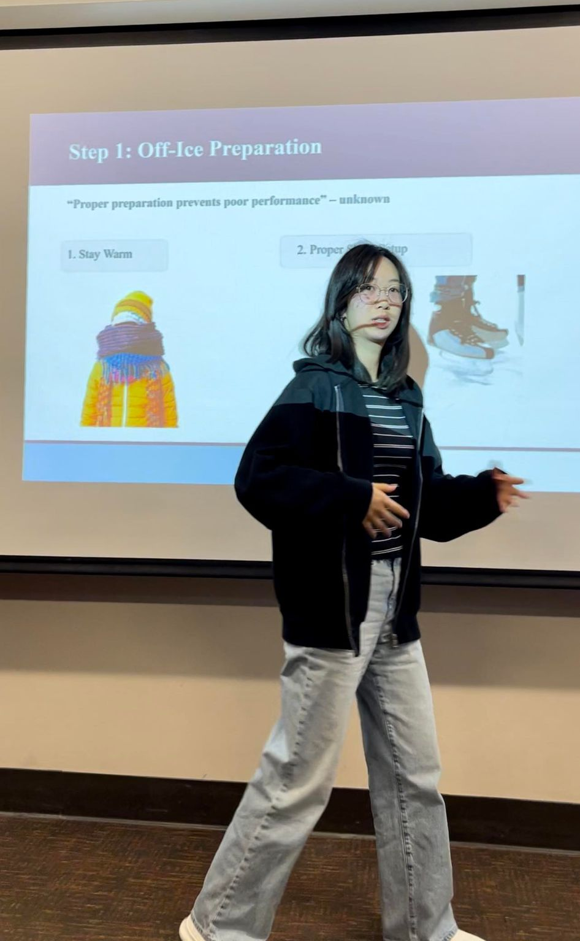
Slides created for assignment in
Eng 503x: Oral Communication Skills
for Engineering PhD Students with Prof. Elizabeth Fife
Learning a lot, would recommend
Notes:
What I did well: (8 mins+q&a 5 mins)
Outlined steps and summary
Repetition of key ideas
Friendly that anyone can do it and it is hard
Simple and easy to follow organization
Referred to previous presentations and drew analogies
Got audience participation
Smiled and covered the space and moved around
Improvements:
Slow down and pause.

Slide 2
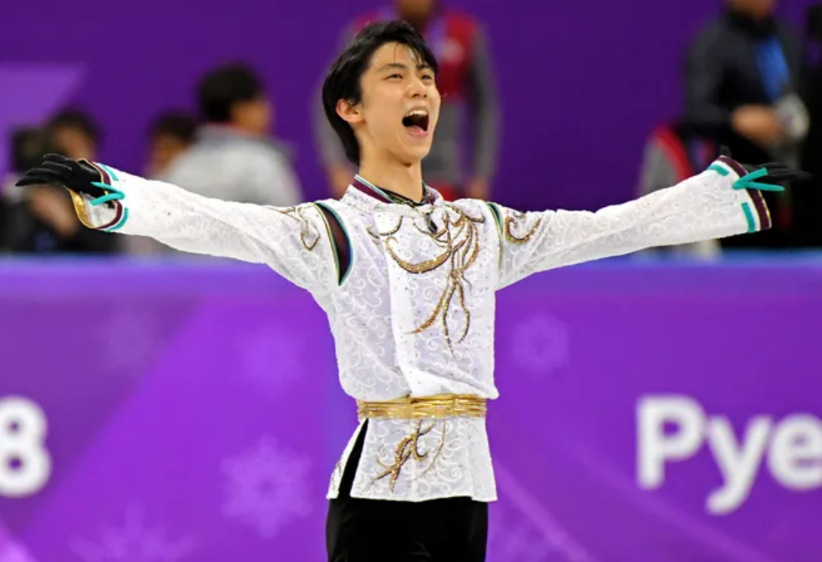
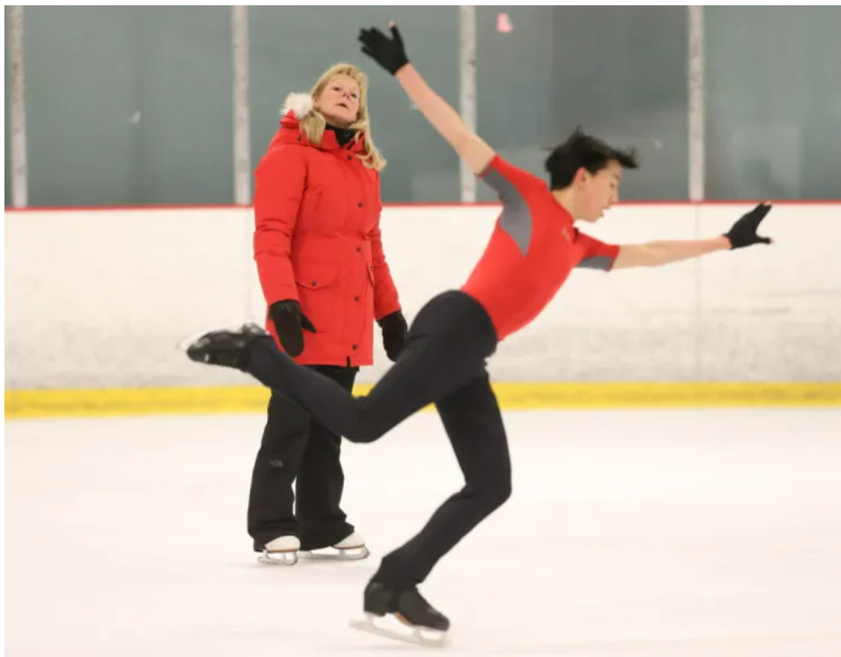
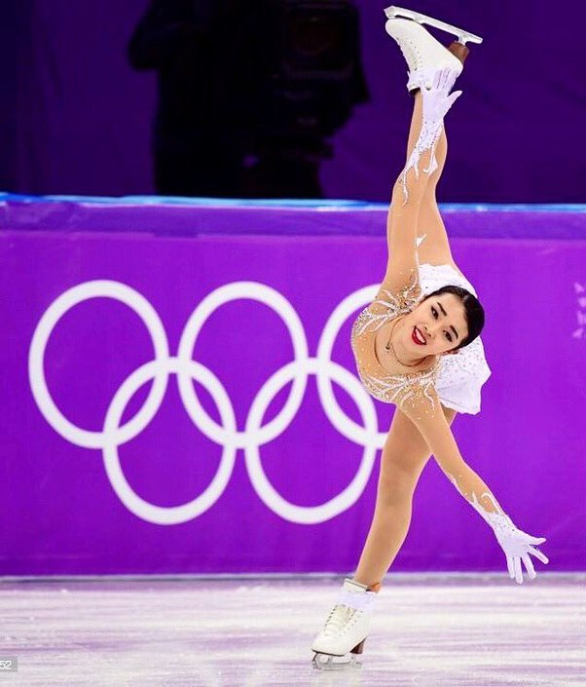
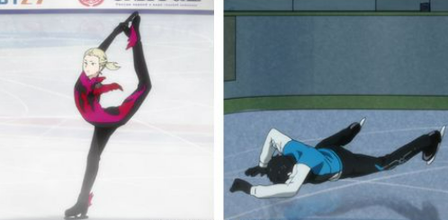
HOW TO Ice Skate: For First TimE Skaters Emily Nguyen Eng 503x Phd oral communications with Prof. Fife Apr 4, 2024
Photos: Robert Deutsche, USA Today Sports, Stan Lim, Anime - Yuri on Ice

Slide 3
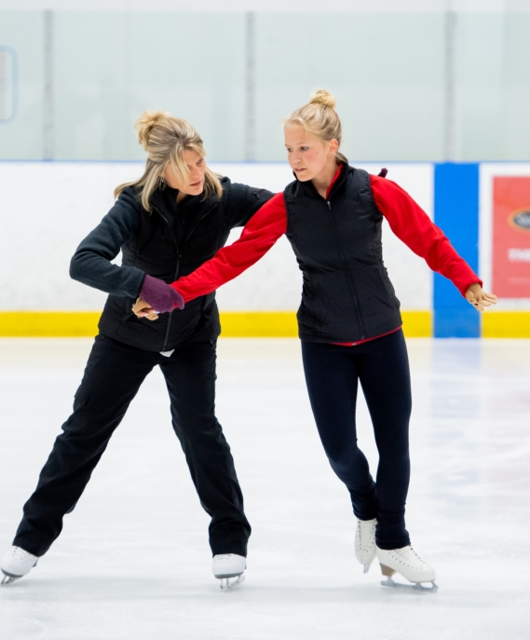
Overview
Introduction to ice skating
Step 1: Off-Ice Preparation
Step 2: Learning How to Fall
Step 3: Learning How to Stand
Step 4: Taking the First Steps
Step 5: Gliding & A Cool Trick ⛸️⛸️
Final tips & takeaway
Photo: Skate Canada

Slide 4
About Me
15 years competitive experience
US Figure Skating Double Gold Medalist
4 years experience Skate Academy coach
2+ years private coach
Photo: Skate Canada

Slide 5
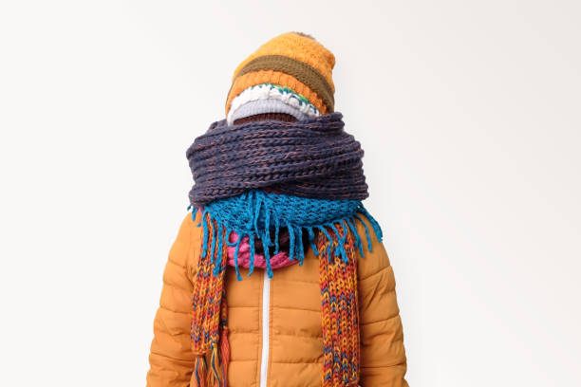
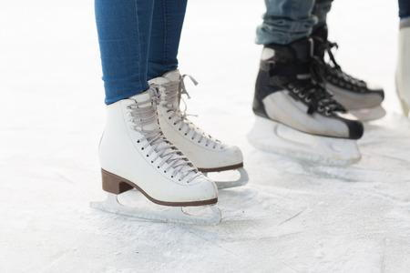
Step 1: Off-Ice Preparation
“Proper preparation prevents poor performance” – unknown
1. Stay Warm
2. Proper Skate Setup

Slide 6
Step 1: Off-Ice Preparation
“Proper preparation prevents poor performance” – unknown
1. Stay Warm
Bring:
Warm jacket
Gloves
Bandages
2. Proper Skate Setup
Ensure:
Skates are the right size
Laces are sufficiently tight
No buckling of the ankles

Slide 7
Step 1: Off-Ice Preparation
“Proper preparation prevents poor performance” – unknown
1. Stay Warm
Bring:
Warm jacket
Gloves
Bandages for comfort
2. Proper Skate Setup
Ensure:
Skates are the right size¹
Laces are sufficiently tight²
No buckling of the ankles
1. Know your tennis shoe size and ask the skate rental counter staff for sizes to try.
Right size should feel snug with no toe curling or 1+ finger space at the heel.
2. tight laces should mean that you cannot fit a finger between the laces and boot

Slide 8

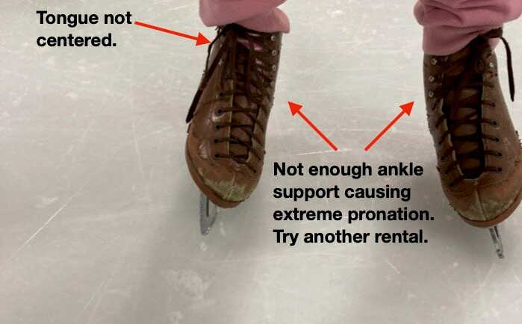

Step 1: What Not to Do for Off-Ice Preparation
1. Have Tense Muscles
2. Have This Improper Skate Setup
Ensure:
Skates are the right size
Laces are sufficiently tight
No buckling of the ankles
Photo: Dan Hollander

Slide 9
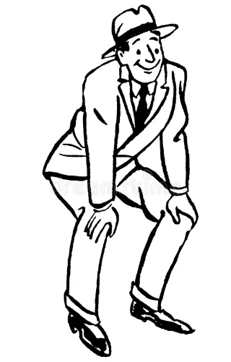
Step 2: Learning How to Fall
Prevention: If you feel like you are going to fall, put your hands on your knees
Photo: living fantasy

Slide 10
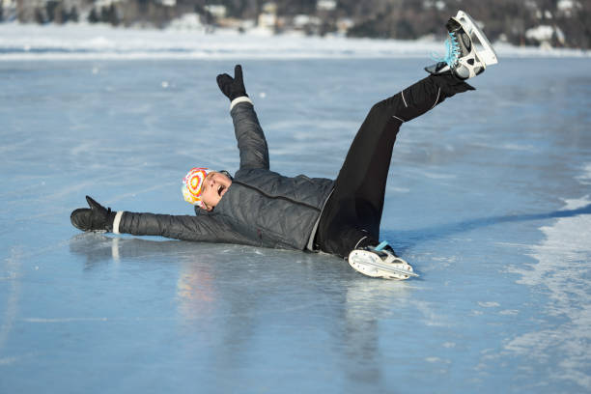
Step 2: Learning How to Fall
Prevention: If you feel like you are going to fall, put your hands on your knees
While Falling:
Do NOT break your fall with your hands
Do NOT grab onto others
i.e Do NOT panic
Photo: istock

Slide 11

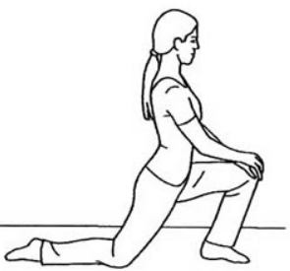
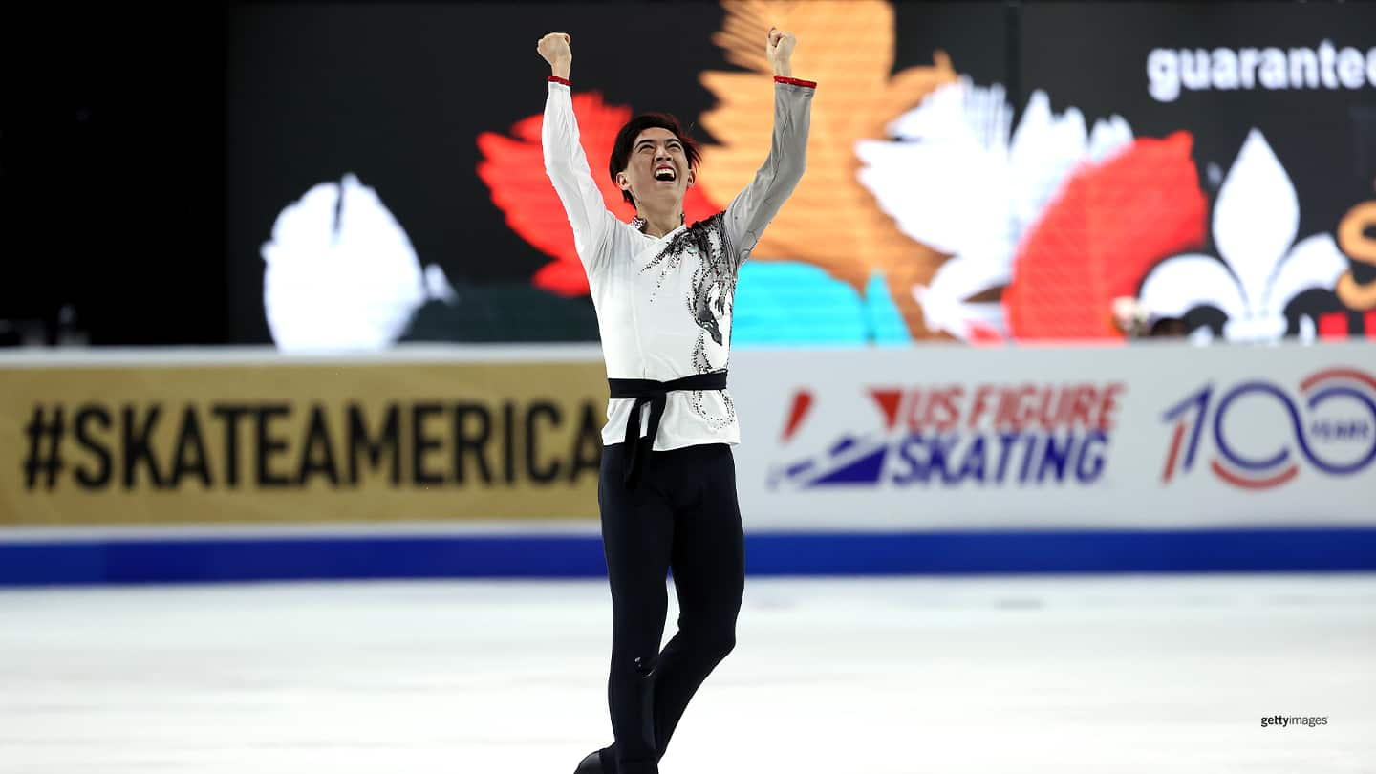
Step 2: Learning How to Fall
Prevention: If you feel like you are going to fall, put your hands on your knees
While Falling:
Do NOT break your fall with your hands
Do NOT grab onto others
Getting Up:
Get on all fours
Put one leg up to be half kneeling
Stand up
3a)
3b)
3c)
Photo istock,AP Images

Slide 12

Step 3: Learning How to Stand – Head to Toe
Head: Look where you want to go (not down)

Slide 13
Step 3: Learning How to Stand – Head to Toe
Head: Look where you want to go (not down)
Arms: Hold arms in front of body (V-shape)
Hips: Keep hips under your body

Slide 14
Step 3: Learning How to Stand – Head to Toe
Head: Look where you want to go (not down)
Arms: Hold arms in front of body (V-shape)
Hips: Keep hips under your body
Knees: Bend knees slightly (no locking)
Feet: Place feet shoulder width apart

Slide 15
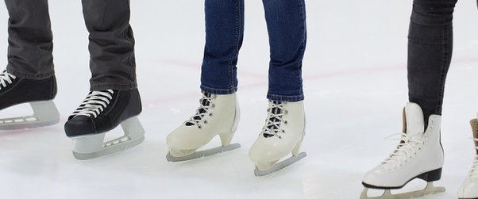
Step 3: Learning How to Stand
Toes point straight ahead
Feet look like the number 11

Slide 16
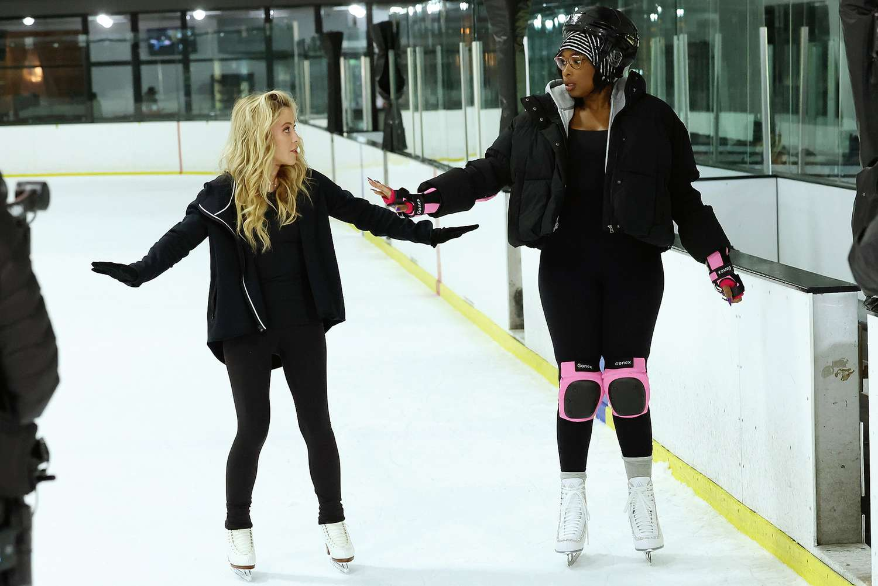
Step 4: Taking the First Steps by Marching
Step 3: Standing
Step 4: Marching
PHOTO: CHRIS MILLARD/WARNER BROS

Slide 17
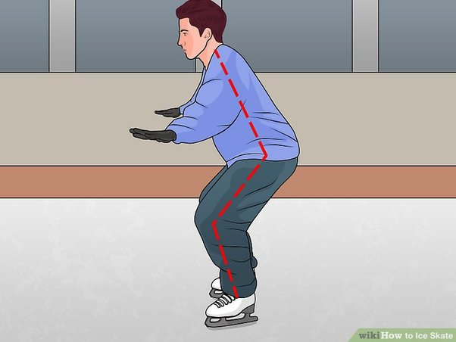
Step 5: Gliding & A Cool Trick
Step 3
Step 4: Marching
Step 5: Glide & Squat
PHOTO: CHRIS MILLARD/WARNER BROS

Slide 18
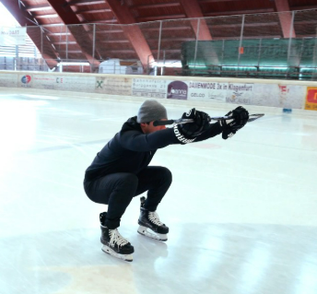
Step 5: Gliding & A Cool Trick
Step 5: Glide & Squat
Feeling Brave? Squat lower
PHOTO: Ignite Performance Hockey

Slide 19

Moving Forwards
Skills we covered:
Forward marches
Two-foot glide
Squats
Skills that build on these basics:
Stopping (not by running into the wall)
One-foot glide
Backward ‘wiggles’

Slide 20
Final Tips & Takeaways
Step 1: Off-Ice Preparation
Step 2: Learning How to Fall
Step 3: Learning How to Stand
Step 4: Taking the First Steps
Step 5: Gliding & A Cool Trick ⛸️⛸️
Photo: Skate Canada

Slide 21
Questions?
Contact: emilysk8nguyen@berkeley.edu
Off-Ice Skate Preparation
Falling & Getting Up
Standing & Balancing
Marching
Gliding & Doing a Squat

Slide 22
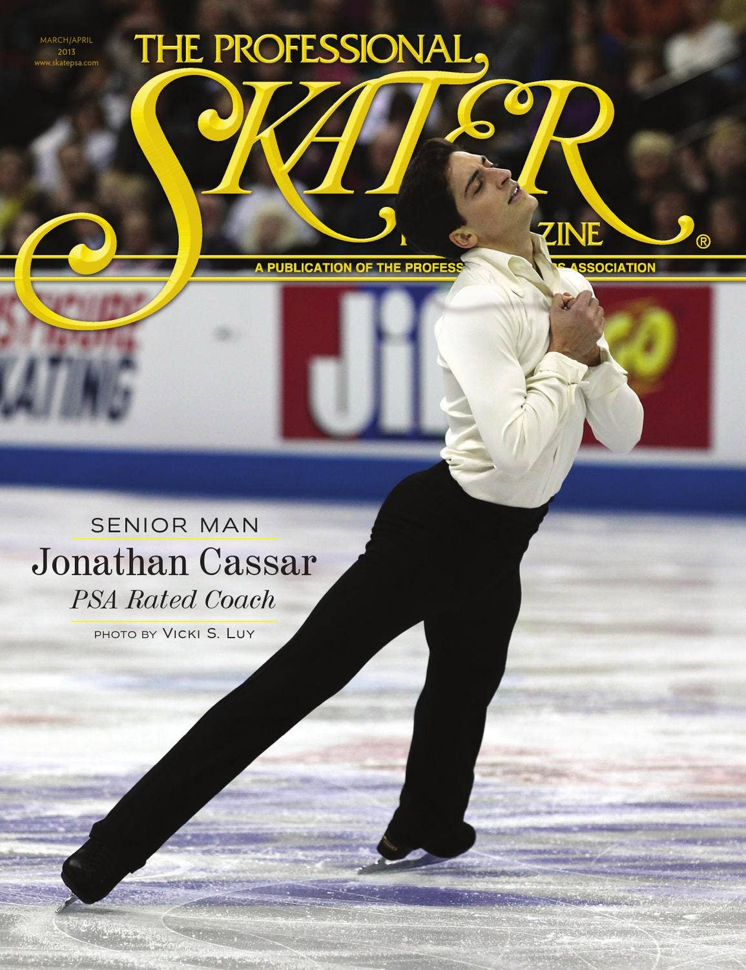
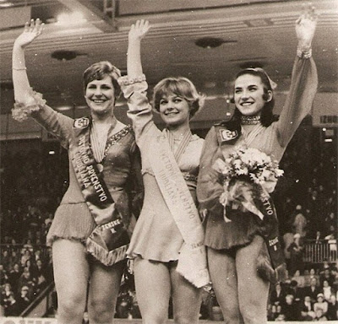


Acknowledgements
Special thanks to Jonathan Cassar, Julie Newman, IceTown Carlsbad, and Prof. Fife.
Coach Jonathan Cassar
Coach Julie Newman (right)
Prof. Elizabeth Fife

Slide 23
Notes:
What I did well: (8 mins+q&a 5 mins)
Outlined steps and summary
Repetition of key ideas
Friendly that anyone can do it and it is hard
Simple and easy to follow organization
Referred to previous presentations and drew analogies
Got audience participation
Smiled and covered the space and moved around
Improvements:
Slow down and pause.

