Slide 1
Cyclistic Bike Share Program:
Converting casual riders into annual members
Xi Lu
July 2021

Slide 2
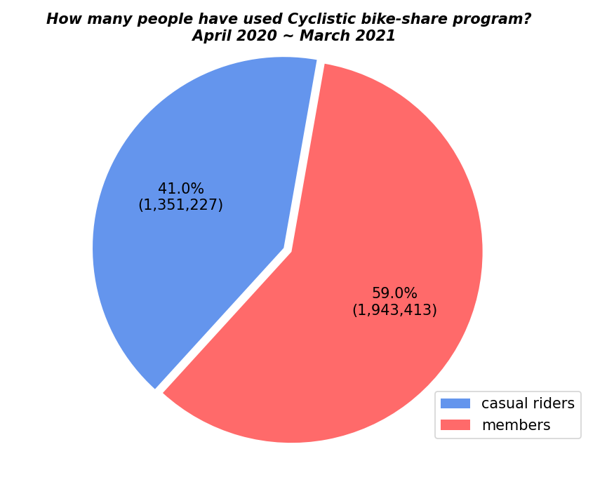
The challenge
Company
From April 2020 to March 2021, 41% of Cyclistic bike users were casual riders.
Therefore, it is essential to design marketing strategies targeted at maximally converting casual riders into annual members.

Slide 3
Business task
Company
Analyze Cyclistic's historical bike trip data from April 2020 to March 2021 to identify trends on how annual members and casual riders used Cyclistic bikes differently, and generate 3 recommendations for Cyclistic's marketing team to design marketing strategies for converting casual riders into members.

Slide 4
Members vs. Casual riders
Company
First, let’s reveal how annual members and casual riders use Cyclistic differently via their preferences on:
season
bike types
bike ride lengths
weekdays versus weekends
bike stations

Slide 5
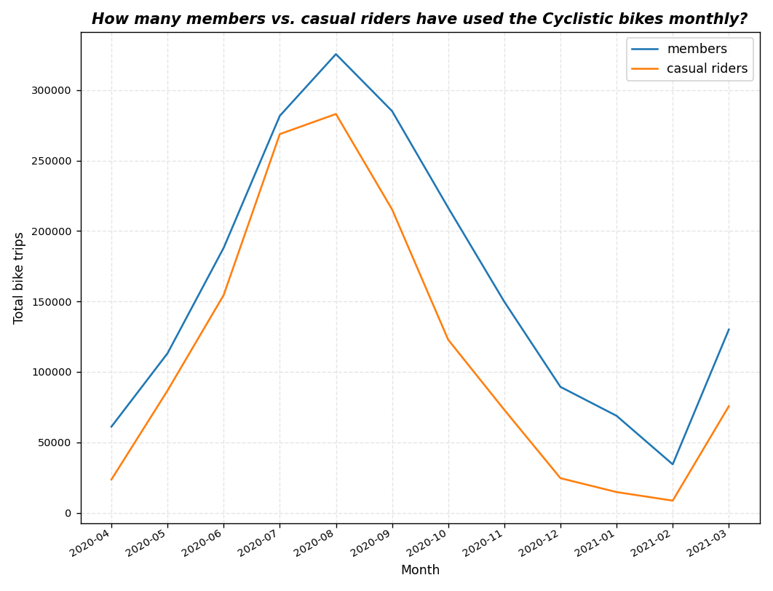
Seasons
Company
Between August and January, the number of Cyclistic bikes used by members and casual riders has been declining.
According to Wikipedia, this declining has correlated to Chicago’s weather that starting August the temperature is decreasing until next January.

Slide 6
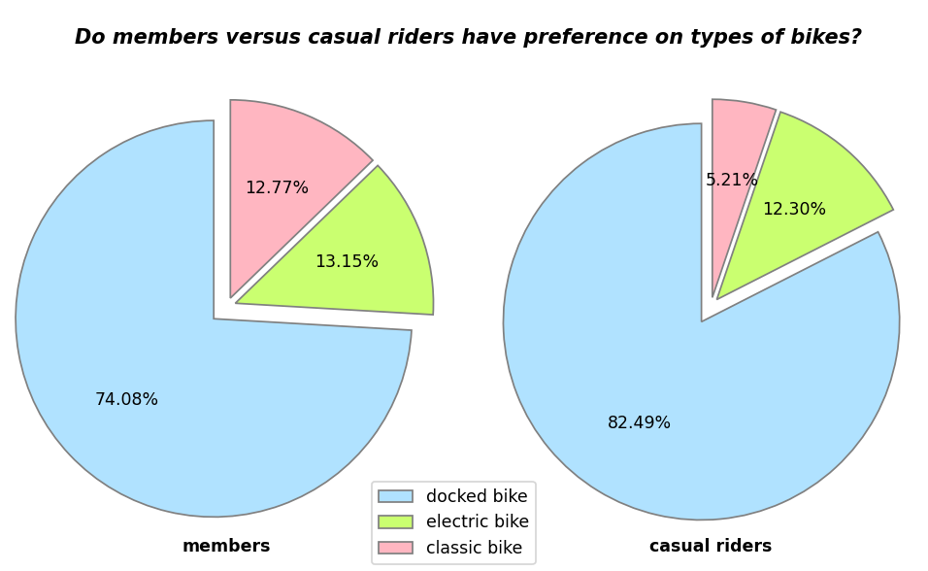
Bike types
Company
82% of casual riders used docked bikes, as compared to 74% of members used this type.

Slide 7
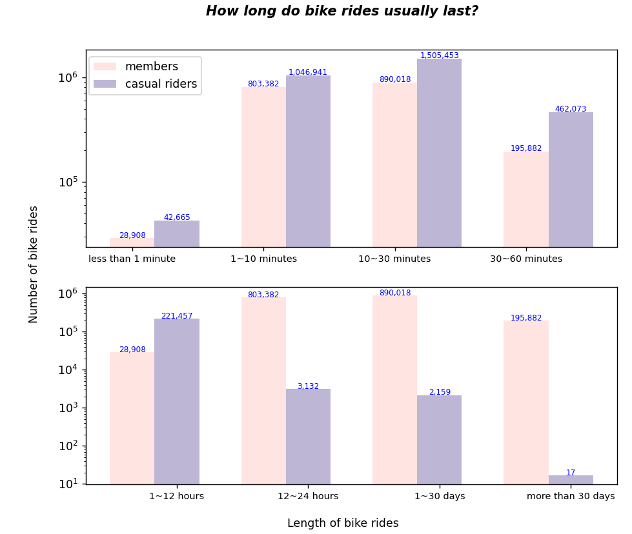
Bike ride lengths
Company
For bike rides lasting within 12 hours, the amount of casual riders are more than members;
However, for bike rides lasting more than 12 hours, the amount of members are significantly more than casual riders.

Slide 8
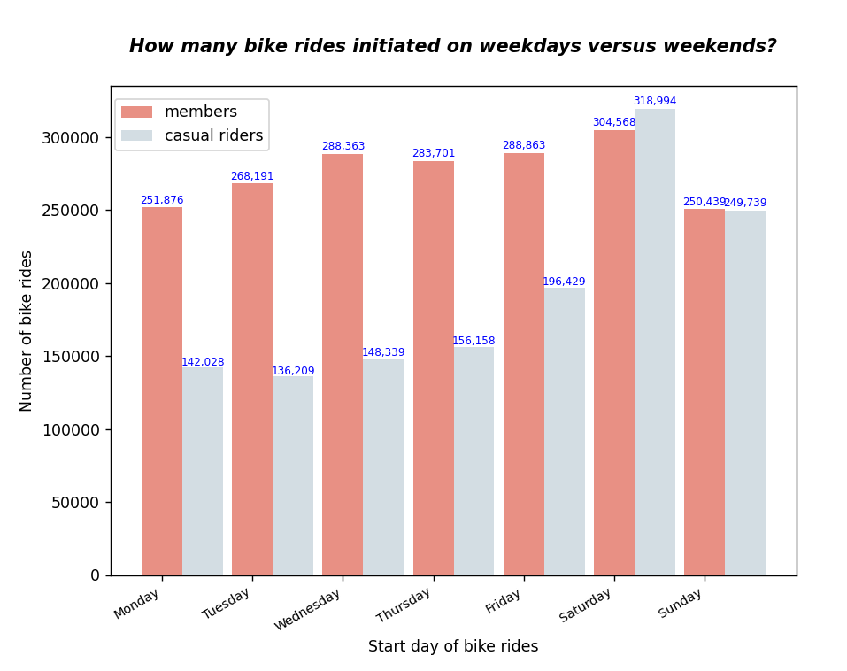
Weekdays vs. weekends
Company
On weekdays, the amount of members used Cyclistic bikes are significantly more than casual riders;
However, the amount gap is less wide on weekends, and more casual riders used Cyclistic bikes than members.

Slide 9
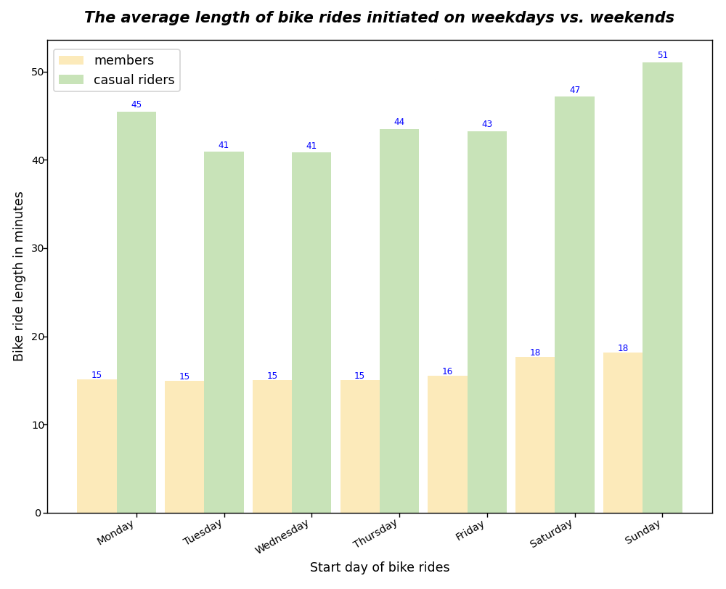
Weekdays vs. weekends
Company
The average length of bike rides of casual riders is less than 20 minutes;
However, the average length of bike rides of members is over 40 minutes.

Slide 10
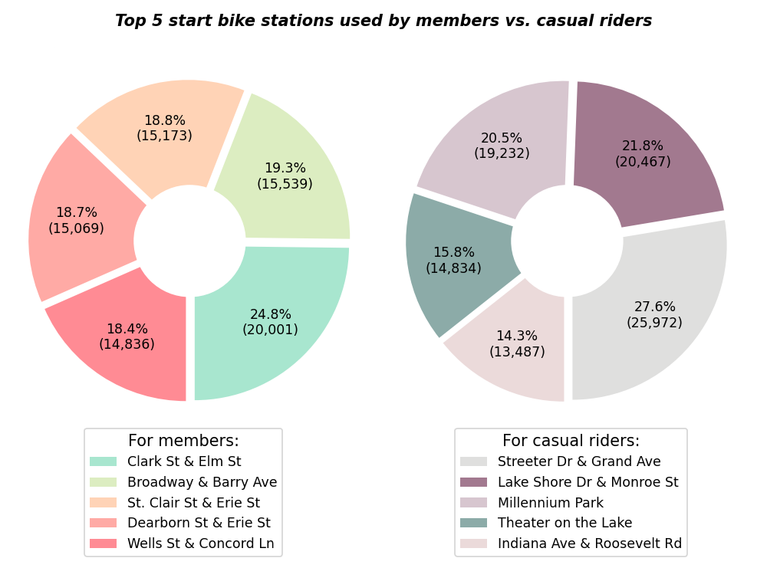
Bike stations
Company
The top 5 bike stations casual riders start their bike rides are different from the top 5 stations members usually start their bike rides.

Slide 11
3 Recommendations
Company
Offer fare discounts to casual riders using Cyclistic bikes shorter than 12 hours for each ride and/or on weekends.
Design promotions specifically targeted at casual riders between February to July.
Launch digital and non-digital ads at the 5 bike stations that casual riders used most, and put more docked bikes at these stations.

Slide 12
Thank You !
For more details and codes, please go to my GitHub at:
https://github.com/eemonte/Cyclistic_bike_share

