Slide 1
Water Level Controller
Lecturer: Mehmet Salih Dinleyici
Supervisor: Esra Tunçer
Group 5
Ahmet Yasin Bulut - 250206001
Barbaros İnak – 250206004
Emre Nedim Hepsağ - 250206012
Notes:
Hello, my name is ahmet, and there are barbaros and emre. In this presentation we are going to show how we designed our water level controller.

Slide 2
Outline
Introduction
Our solution idea
Solutions for each splitted part
Solution Details
Implementation details
Design Targets & Test Results
Conclusion
Results & Main ideas
Notes:
This is our outline with intro, solution parts, and conclusion.

Slide 3
Our Solution
Detection of Water Level
Capacitive Element
Meaningful information
Adjusting the Desired Level
Potentiometer
Driving Motor for Water Pump
PWM
L298 Motor Driver
Focusing simple and basic system
555 IC
Notes:
In this system we needed to solve three major design problems,
Firstly, to control to pump we need detection, and this should be turned to a meaningful information.
Secondly, we should change desired water level.
Finally, to use these informations in the motor, we need to drive it. We choose pulse width modulation and a motor driver circuit for this design problem.
These systems can be more efficient and sensitive with different implementations, but we decided to focus on designing a basic and cheap system.
Also, both the detection and the PWM parts need oscillators, we designed a wien bridge and crystal oscillator circuits, but chose 555 IC to make it basic.
Barbaros will start decribing parts in detail.

Slide 4
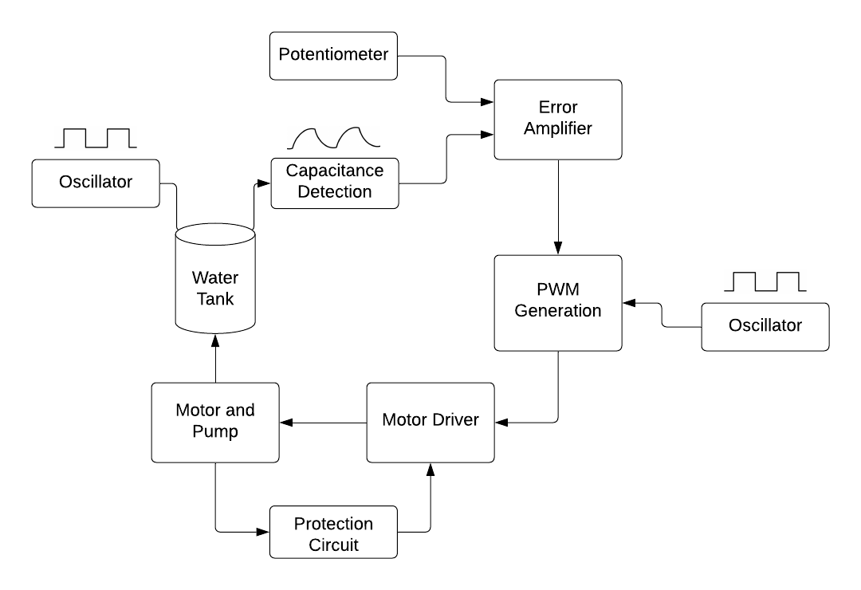


Solution Details
Capacitance detection
Potentiometer and ErrAmp
PWM generation
Oscillators
Motor Driver
Notes:
We designed a detection circuit by using changing water level's
effect on capacitance, and after we created DC signal from delay ,
then we compared dc signal with intended value. As seen from our
Block diagram, the error amplifier's output goes to PWM generator and
the circuit produce different duty cycles depending on desired
water level. Motor driver uses PWM directly to pump the water with
DC motor. Also we have used 2 555IC oscillators.

Slide 5
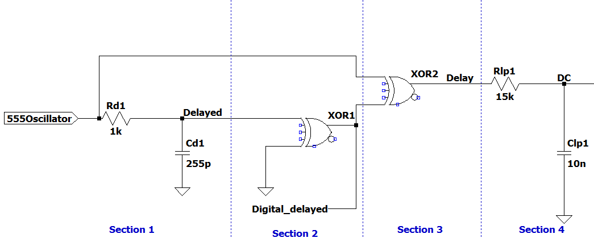
Water Level Detection
Notes:
And I am going to continue with water level detection part.
We divided this part into 4 sections.

Slide 6
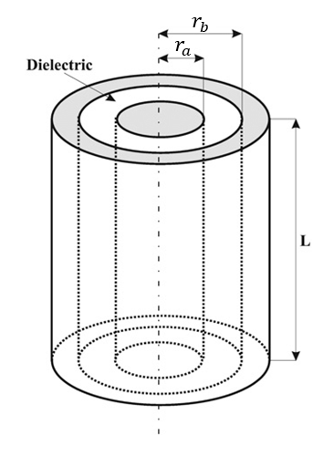
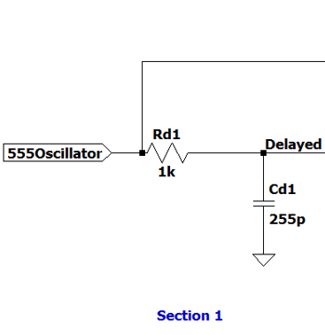
Delayed Circuit
Notes:
In section 1, firstly we decided capacitor's structure.
Between all possible structures we choose to work with coaxial
cylindrical structure, due to its better performance. Lastly in this section delayed signal get from capacitor.

Slide 7
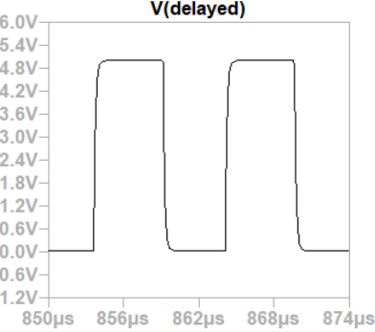
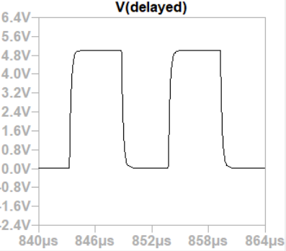
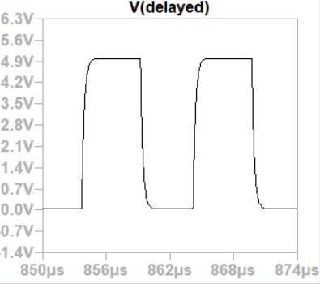
Delayed Circuit’s Output Signal 125 pF
Delayed Circuit’s Output Signal 175 pF
Delayed Circuit’s Output Signal 255 pF
Notes:
The curve on the edges happened due to water level in capacitor.
We can see three sample signals.

Slide 8
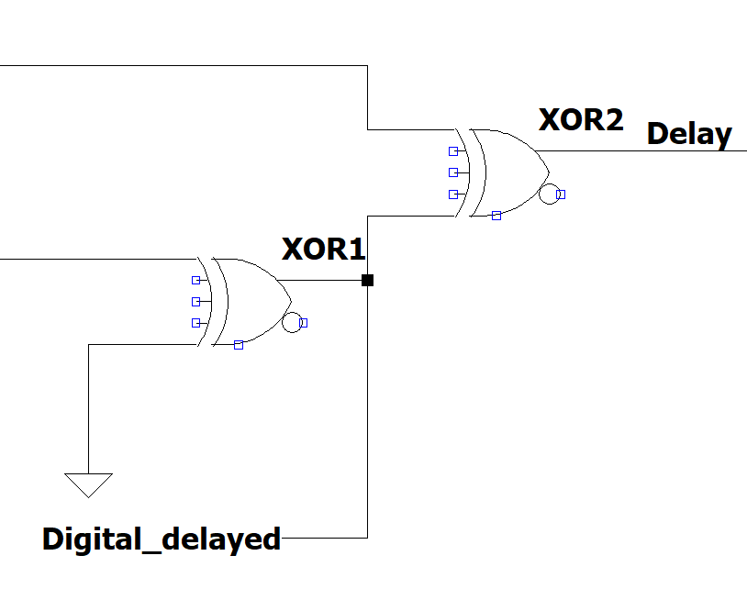
Digitalizer Circuit and Delay Circuit
Notes:
I would like to talk about section 2 and 3 together.
Firstly, for using less component and cost management we used XOR gates. Purpose of the delay signal is to see
differences between input square wave signal and digital delayed signal.

Slide 9
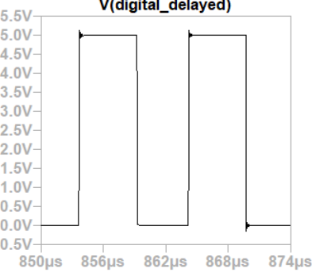
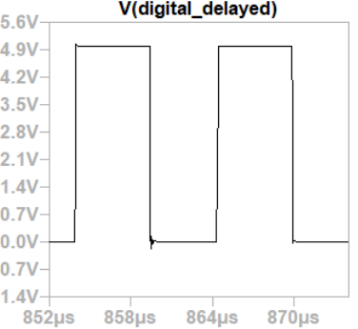
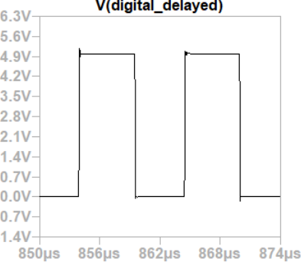
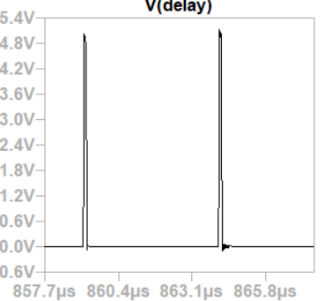
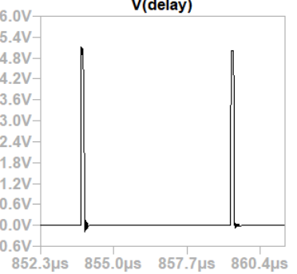
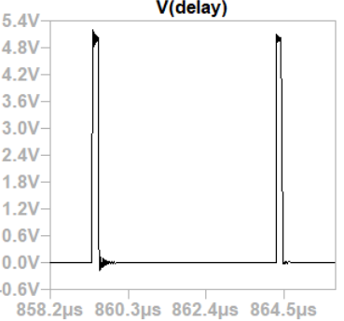
Capacitance at 125 pF
Capacitance at 175 pF
Capacitance at 225 pF
Delay Circuit’s Output Signal
Notes:
You can see here different digital delayed signal and delay samples
below for differnet capacitance values.

Slide 10
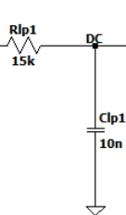

DC Circuit
Notes:
Lastly as already said for comparing results we've changed
delay signal into DC signal. For getting DC signal we designed
a low pass filter. Resistance and Capacitance values are determined
according to their easy accessibality and their results. From here
as you can see corner frequency is around 1 kHz.we choose to
work with a simple RC circuit.

Slide 11
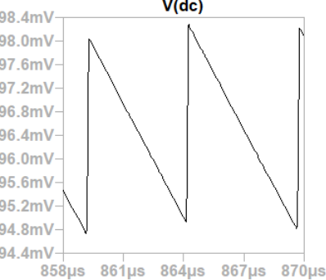
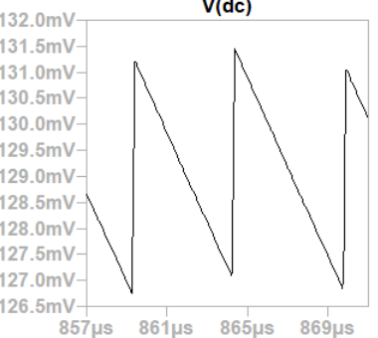
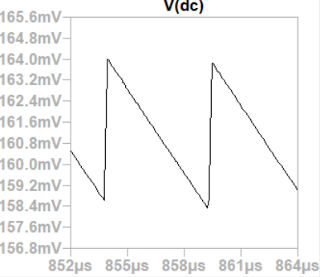
Capacitance at 125 pF
Capacitance at 175 pF
Capacitance at 225 pF
Notes:
From these graphs we can see different dc signals for different
capacitance values at section 1.

Slide 12
Design Targets and Test Results
Water Level Detection Design Targets
Description of Design Targers | Min. | Max. | Unit
Oscillator Frequency | 98 | 102 | kHz
Detector Response Time | 125 | 225 | ns
Detector output at 5 cm water level | 90 | 100 | mV
Detector output at 15 cm water level | 180 | 190 | mV
Ripple Voltage | 2.7 | 5.7 | mV
Water Level Detection Test Results
Design Target | Measured Values | Unit
Oscillator Frequency | 101.01 | kHz
Detector Response Time | 184.26 - 380 | ns
Detector output at 5 cm water level | 94.87 – 98.08 | mV
Detector output at 15 cm water level | 181.06 – 187.06 | mV
Ripple Voltage | 3.21 - 6.01 | mV
Notes:
When we compared test results and design targets in common we see that we are in between intended design
targets. But in ripple voltage and response time parts we have error.
These errors happens due to unexpected resistance that comes from loading effect and now Emre is going to continue.

Slide 13
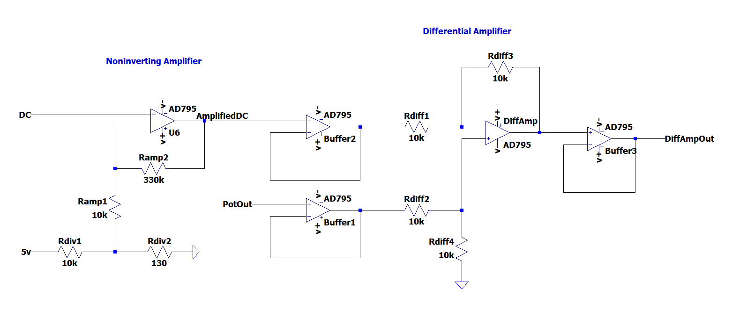
Error Amplifier
DC Amplification
Differentiation
Notes:
Hi I am Emre. In this part of the experiment, Our aim is to raise the DC signal up to usable voltage range and controlled by potantiometer.
For that purpose we used combined noninverting amplifier and differential amplifier as you can see in the figure.

Slide 14
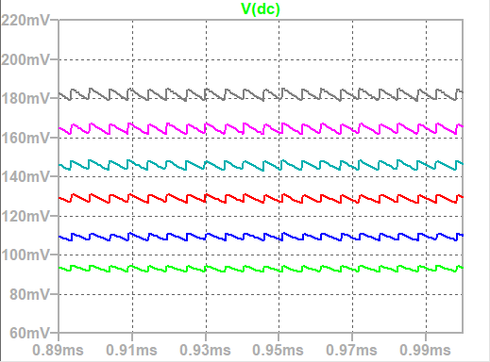
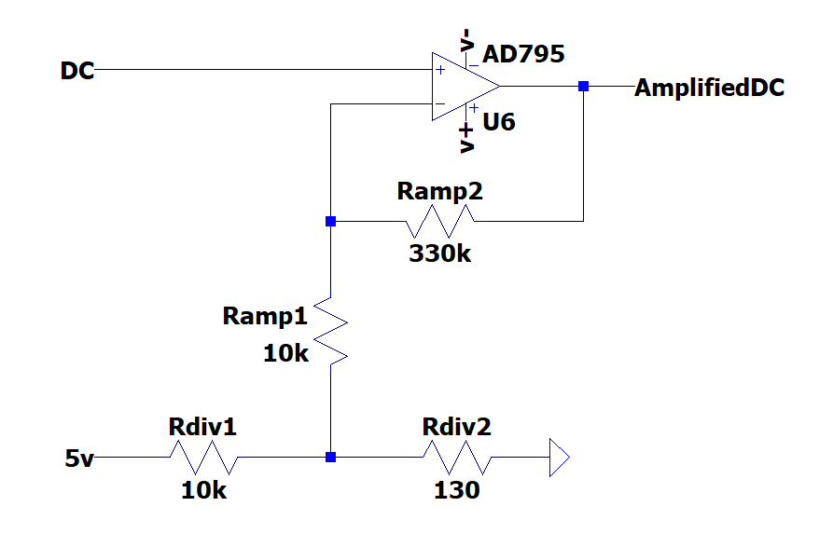
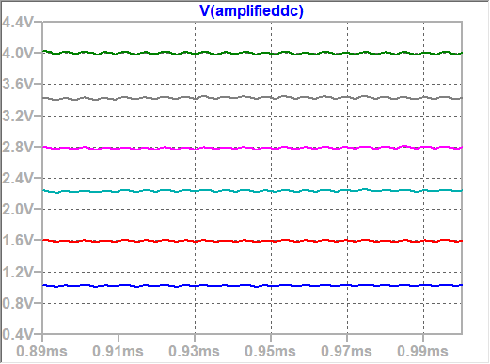

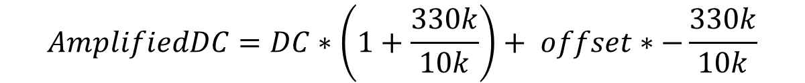
Noninverting Amplifier
$$offset$$
$$AmplifiedDC=DC∗\left(1+\frac{330k}{10k}\right)+ offset∗−\frac{330k}{10k}$$
Notes:
At noninverting amplfier, the voltage range of DC signal raises from mV to volt ranges.
It was not possible to do this properly without an offset arrangement.
Due to superposition principle, our DC signal is being amplified by noninverting amplifier and offset by inverting amplifier.

Slide 15
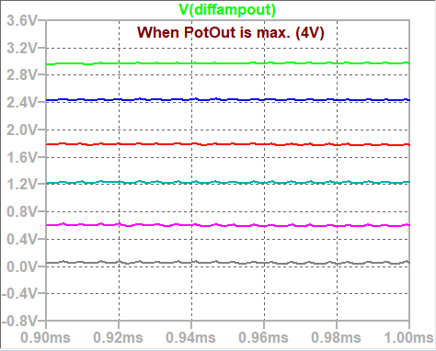
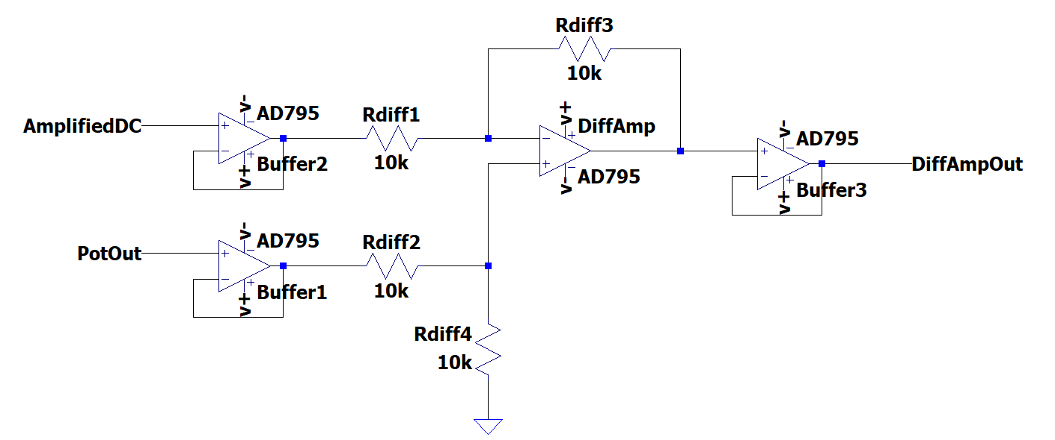
Differential Amplifier
$$DiffAmpOut=PotOut −AmplifiedDc$$
Notes:
To directly substract the amplifiedDC from PotOut signal, we built a differetial amplifer with 4 identical resistors.
We avaoided the real lifer errors by adjusting the voltage of PotOut as 1 to 4 volts .
Also, we observed this curcuit as sensitive to the loading affect.
To prevent possible erros, we added buffer circuits.

Slide 16
Design Targets and Test Results
Error Amplifier Design Targets
Description of design target | Min. | Max. | Unit
Noninverting Amplifier Output Low voltage | 1 | 1.1 | V
Noninverting Amplifier Output High voltage | 3.8 | 4.2 | V
Noninverting Amplifier Gain | 33 | 35 | -
Potentiometer Output | 0.5 | 4.5 | V
Output Low Voltage | -2.8 | -3.1 | V
Output High Voltage | 2.9 | 3.2 | V
Error Amplifier Test Results
Design Targets | Measured Value | Units
Noninverting Amplifier Output Low voltage | 1.061 - 1.082 | V
Noninverting Amplifier Output High voltage | 4.070 - 4.108 | V
Noninverting Amplifier Gain | 33.3 - 34.5 | -
Potentiometer Output | 0.5 - 4.5 | V
Output Low Voltage | 2.88 - 2.90 | V
Output High Voltage | -3.11 - -3.08 | V
Notes:
As you can see in these graphs, we did not observe any unexpected test result.

Slide 17
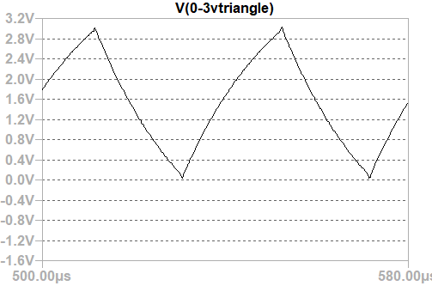
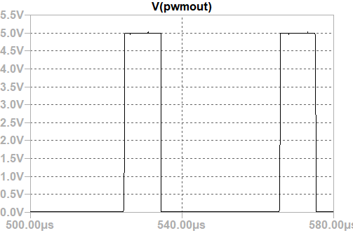
PWM Generation
Desired pump level
Generated signal (triangle)
Comparator Output
Notes:
To drive a motor we should generate a PWM signal.
Comparing a dc signal with linearly changing signal can generate a different duty cycled signals.
With these signal aims, we designed...

Slide 18
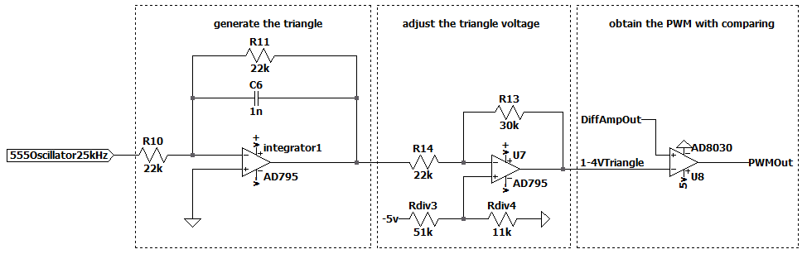
Designed Solution for PWM Generation
Pulse Wave
Triangle Wave
Adjusted Triangle
Pulse Modulated Wave
Notes:
…the PWM generator to first generate a triangle signal then adjust it to the desired range, finally obtain the pwm with comparator

Slide 19
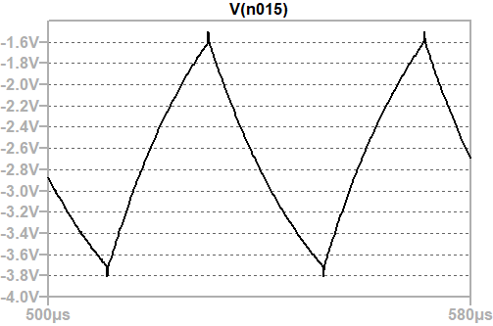
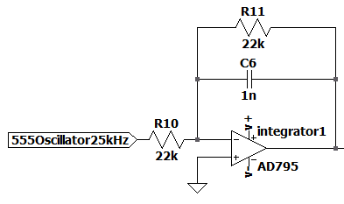

Triangle Generation
25kHz Pulse Wave
Integrator with feedback resistance
Symmetric Triangle
Notes:
Triangle needs a pulse oscillation at input, motor driver can use maximum 40(forty)kHz signal, so we designed a 25(twenty-five)kHz pulse wave for this operation.
The integrator circuit converts pulse to a triangle, with feedback capacitance, we also put a feedback resistance to avoid saturation to the negative supply voltage.
The time constant and other values are calculated to make a symmetrical triangle, so the charge and the discharge equations is equal at these component values.

Slide 20
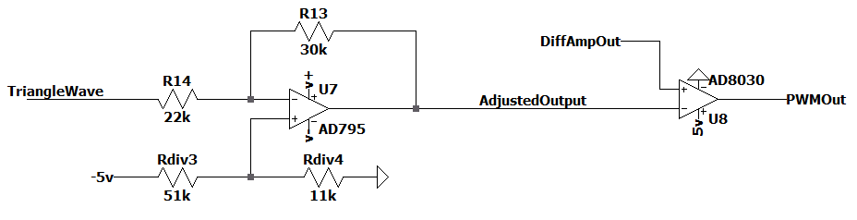
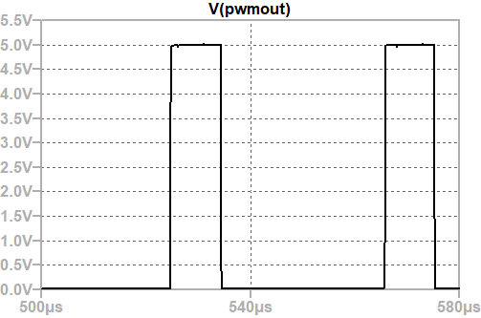
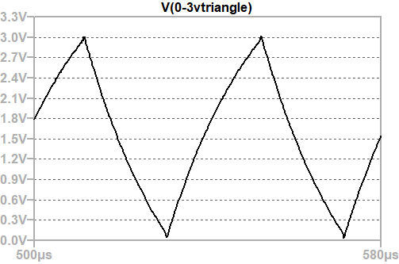
Inverting Opamp & Comparator
Notes:
With an inverting op-amp we can adjust the triangle wave to (zero-three volt range)0-3V. We choose a fast opamp for big slew rate at comparator, and it gives us the 25(twenty-five)kHz output and supply voltage peaks, driver can work properly at these values.

Slide 21
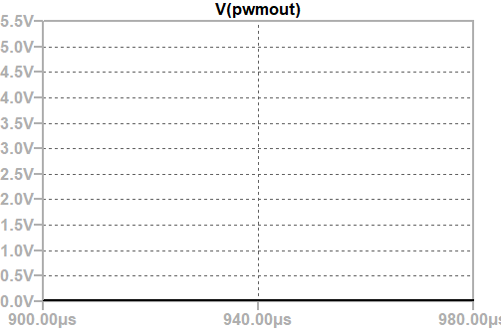
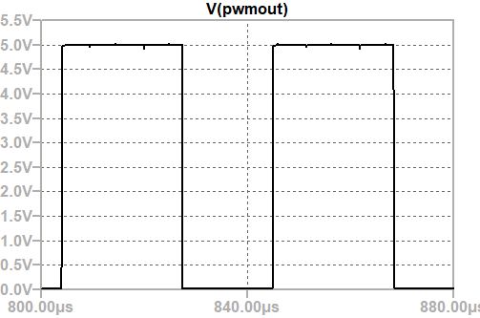
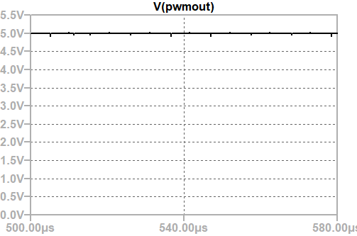
Desired water – 0cm
Desired water – 2cm
Desired water – 6cm
Desired water – 10cm
Notes:
The resulting pwm signal examples are like that.

Slide 22
Design Targets and Test Results
PWM Generator Design Targets
Description of Design Targets | Min. | Max. | Units
PWM frequency | 24.5 | 25.5 | kHz
Integrator time constant | 25.5 | 29.8 | s
Triangle wave slew rate (increasing & decreasing) | ±0.075 | ±0.125 | V/us
Inverting opamp peak-top-peak gain | 0.98 | 1.47 | -
Inverting opamp DC offset | 0.50 | 0.92 | V
PWM comparator input for %0 duty cycle | -0.20 | 0.33 | V
PWM comparator input for %100 duty cycle | 2.18 | 4.00 | V
PWM Generator Test Results
Design Targets | Measured Value | Units
PWM frequency | 24.53 | kHz
Integrator time constant | 26.52 | s
Triangle wave slew rate (increasing & decreasing) | ±0.112 | V/us
Inverting opamp peak-top-peak gain | 0.67 - 0.83 | -
Inverting opamp DC offset | 0.83 | V
PWM comparator input for 0% duty cycle | 0.20 - 0.07 | V
PWM comparator input for 100% duty cycle | 2.65 - 3.05 | V
Notes:
Test results provide values for properly generate the PWM.

Slide 23
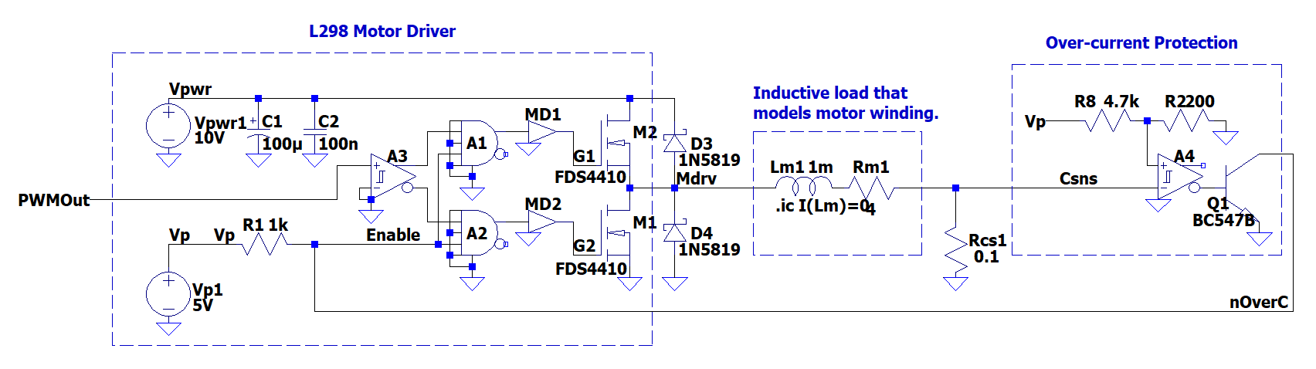
Motor Driver and Protection
Motor Driver
Over-Current Protection
Notes:
Our Project is working based on voltage signal, however, DC motor works with current.
For that reason we used L298 motor driver IC and over-current protection circuit to drive the DC motor.

Slide 24
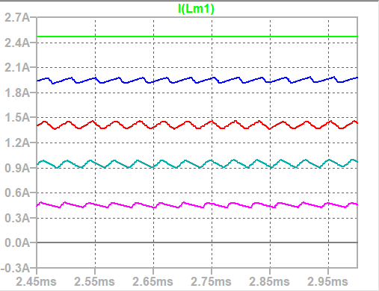
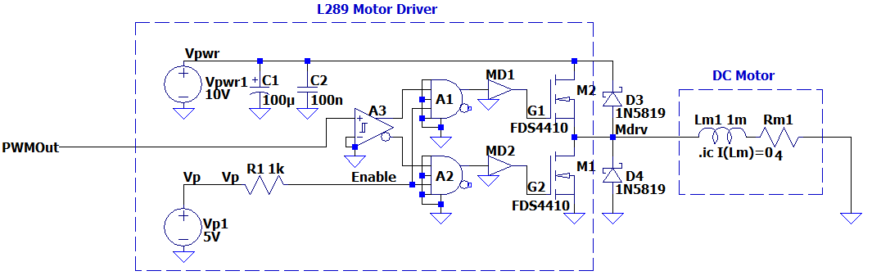
Motor Driver
Notes:
Without the portection circuit, we obtained up to 2.5 amperes current.
However, over 2 amperes is not desired at our circuit to protect the DC motor.

Slide 25
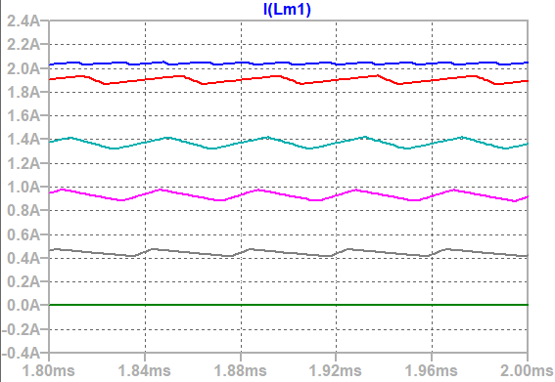
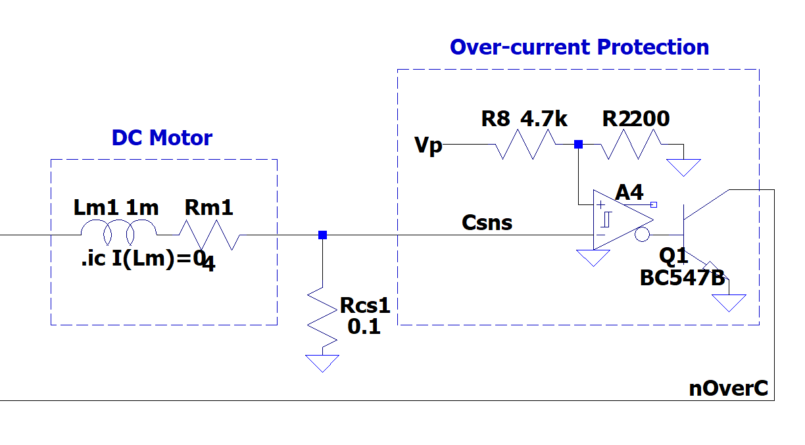
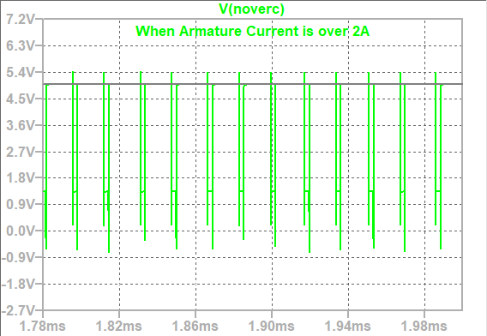
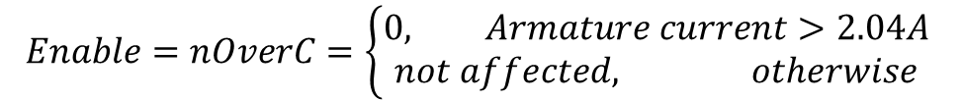
Over-current Protection
$$Enable=nOverC=\left\{\begin{aligned}0, Armature current>2.04A \\ not affected, otherwise \end{aligned}\right.$$
Notes:
Thus, over-current protection circuit is added to pull the enable pin of the IC down to the ground when the armature current is over 2 amperes.
Simply, this circuit Works as an on/off control circuit to perevent the over-current.

Slide 26
Design Targets and Test Results
Motor Driver and Protection Design Targets
Description of design target | Min. | Max. | Unit
Maximum output current without protection | 2.3 | 2.5 | A
Expected ripple current depending on motor inductance | 0 | 100 | mA
Expected average output current at maximum output | 2.03 | 2.05 | A
Overcurrent Protection Current Threshold | 2.02 | 2.06 | A
Overcurrent Protection Response Time | 5.5 | 7.5 | us
Motor Driver and Protection Test Results
Design Targets | Measured Value | Units
Maximum output current without protection | 2.406 - 2.421 | A
Expected ripple current depending on motor inductance | 0 - 92.44mA | mA
Expected average output current at maximum output | 2.038 | A
Overcurrent Protection Current Threshold | 2.051 | A
Overcurrent Protection Response Time | 6.279 | us
Notes:
As we can see in these graph, we obtained test results within design targets.

Slide 27
Conclusion
Detection
Adjusting desired level
Controlling Motor
Notes:
In conclusion, at every problem of this project, we had to overcome the obstacles with different circuit concepts.
To detect the water level, we used oscillators, digital electonics and RC filters.
To adjust desired lever, we used opamp circuits.
And finally, to control the motor, we used motor driver IC and overcurrent protection circuit with current sense resistor.
That was the end of our presentation. Thank you for listening to us.

Slide 28
References
https://www.researchgate.net/figure/Cylindrical-capacitor_fig4_314304591

