Slide 1
GTU CSE496 ECG Classification Using Transformer Networks
CSE496
First Presentation
Emre Güven
Project Advisor: Prof. Dr. Yusuf Sinan AKGÜL
March 2024

Slide 2
Contents
Description of The Project
Motivation
Flow Diagram
Project Requirements
Project Timeline
Success Criteria
References

Slide 3
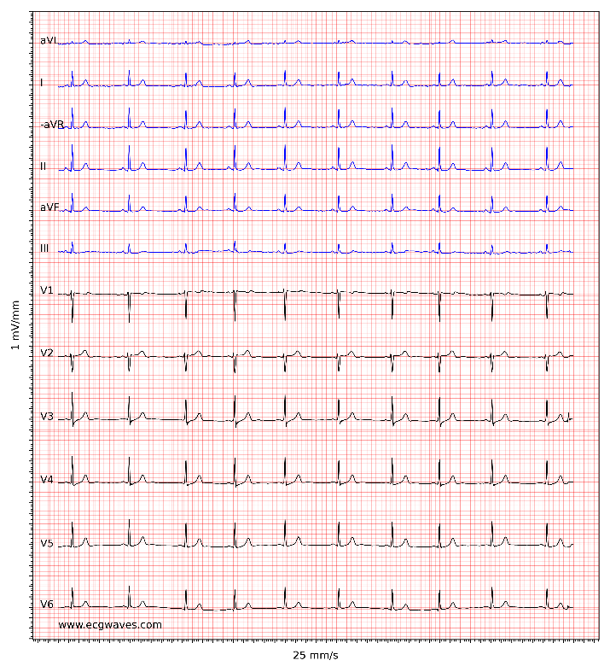
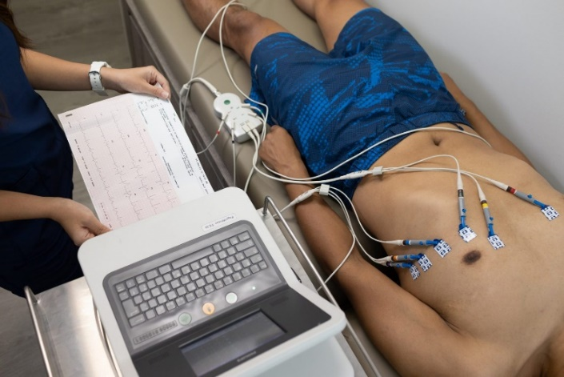
Description of The Project
ECG signals represent the electrical activity of the heart and are essential in diagnosing cardiovascular diseases (CVDs).
Manual interpretation of ECG signals, being time-consuming and requiring extensive expertise, may lead to potential misdiagnoses and delays in treatment.
Analyzing 12-channel ECG recordings to improve diagnostic processes using Transformer networks optimized for ECG signals.

Slide 4

Motivation
Manual ECG analysis prone to human error and time-consuming.
Critical need to improve accuracy and efficiency of ECG analysis in healthcare.
Transformer networks offer superior capabilities compared to RNN, LSTM, and CNN in processing sequential data.

Slide 5
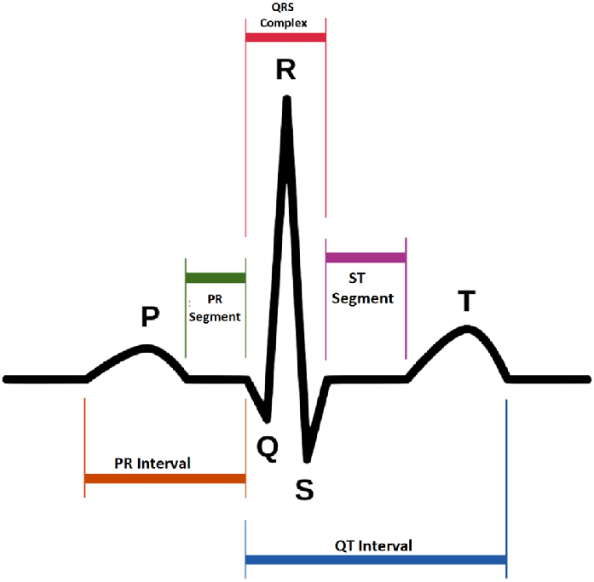
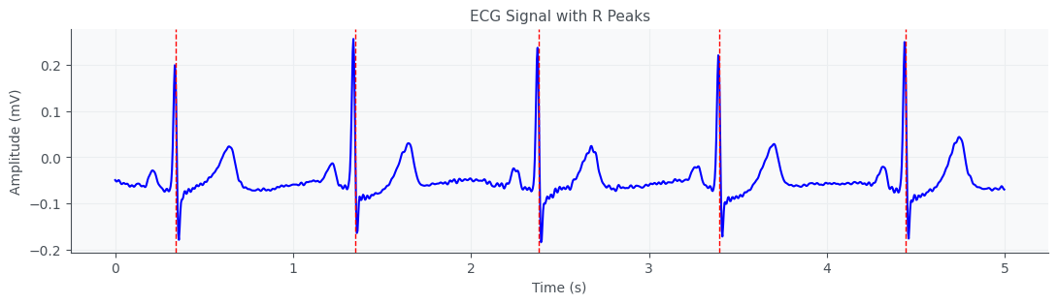
Motivation
Previous studies used convolutional or fully connected layers for feature extraction in Transformer-based ECG classification.
Enhancing model performance through positional encoding based on temporal distances between cardiac cycles and their peaks, to capture important temporal dependencies in ECG signals.

Slide 6
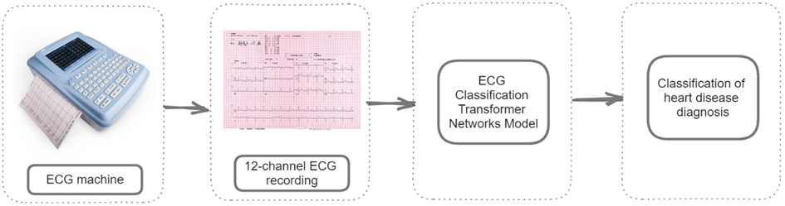
Flow Diagram

Slide 7
Project Requirements
Data collection: Obtain a comprehensive dataset of 12-channel ECG recordings from reliable sources like the PhysioNet website.
Data cleaning: Carefully select recordings to ensure clarity and accuracy in analysis.
Data standardization: Ensure uniformity by standardizing record lengths to 10 seconds and sampling rates to 500Hz.
Detecting cardiac cycles, particularly R-peaks, and extracting relevant information from them.
Transformer networks model development: Implement input embedding, positional encoding, and additional layers.
Utilize PyTorch and TensorFlow for implementing the model.
Utilize Google Colab as the development and training environment.

Slide 8
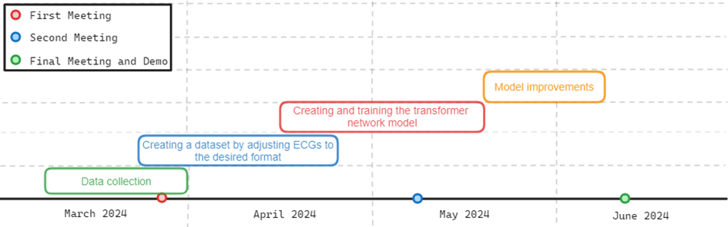
Project Timeline

Slide 9
Success Criteria
Reach a minimum classification accuracy of 85% and an F1 score of 0.8.
Preserve the integrity of the data by adjusting it appropriately when oversampling to 500Hz from sampling rates such as 100Hz and 257Hz.
Ensure that the model provides results within 10 seconds at most when given an ECG recording as input.

Slide 10
References
Vaswani, A., Shazeer, N., Parmar, N., Uszkoreit, J., Jones, L., Gomez, A. N., Kaiser, L., & Polosukhin, I. (2017). Attention Is All You Need. https://doi.org/10.48550/arXiv.1706.03762
G. Yan, S. Liang, Y. Zhang and F. Liu, "Fusing Transformer Model with Temporal Features for ECG Heartbeat Classification," 2019 IEEE International Conference on Bioinformatics and Biomedicine (BIBM), San Diego, CA, USA, 2019, pp. 898-905, https://doi.org/10.1109/BIBM47256.2019.8983326
Perez Alday, E. A., Gu, A., Shah, A., Liu, C., Sharma, A., Seyedi, S., Bahrami Rad, A., Reyna, M., & Clifford, G. (2022). Classification of 12-lead ECGs: The PhysioNet/Computing in Cardiology Challenge 2020 (version 1.0.2). PhysioNet. https://doi.org/10.13026/dvyd-kd57
Yakushenko, E. (2008). St Petersburg INCART 12-lead Arrhythmia Database (Version 1.0.0) https://doi.org/10.13026/C2V88N

