Slide 1
GTU CSE496 ECG Classification Using Transformer Networks
CSE496
Second Presentation
Emre Güven
Project Advisor: Prof. Dr. Yusuf Sinan AKGÜL
May 2024

Slide 2
Contents
Project Overview
Done
Done – Data Collection
Done – Data Cleaning and Standardization
Done – Filtering and R-Peaks Detection
Done – Splitting
Evaluation of Dataset Using CNN Model
Project Timeline
Success Criteria
References

Slide 3

Project Overview
ECG signals, or electrocardiogram signals, represent the electrical activity of the heart.
Analyzing 12-channel ECG recordings with Transformer networks optimized for ECG signals to enhance diagnostic accuracy and efficiency.

Slide 4
Done – Data Collection
Collected ECG records in 3 diagnoses from different datasets in the PhysioNet website. Diagnoses are Myocardial Infarction(MI), Hypertrophy(HYP) and Healthy Controls(NORM).
 | PTB (1000Hz, 120 secs) | PTB-XL (100Hz, 10 secs) | INCART (257Hz, 30 mins)
Healthy (NORM) | 80 | 9513 | 0
Myocardial Infarctus (MI) | 368 | 5148 | 14
Hypertrophy (HYP) | 7 | 2649 | 11

Slide 5
Done – Data Cleaning and Standardization
PTB dataset records are split into 10-second segments.
Cleaned PTB-XL dataset with multiple diagnoses records is upsampled to 1000Hz using the Fourier method.
INCART dataset is upsampled to 1000Hz, and records are split into 10-second segments.
 | PTB |  | PTB-XL |  | INCART |  | NEW TOTAL
Healthy (NORM) | 80 | 817 | 9513 | 8577 | 0 | 0 | 9394
Myocardial Infarctus (MI) | 368 | 3550 | 5148 | 3829 | 14 | 2509 | 9888
Hypertrophy (HYP) | 7 | 73 | 2649 | 535 | 11 | 1982 | 2590

Slide 6
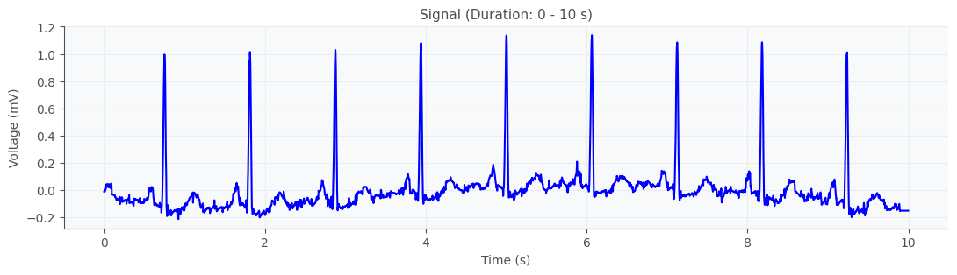
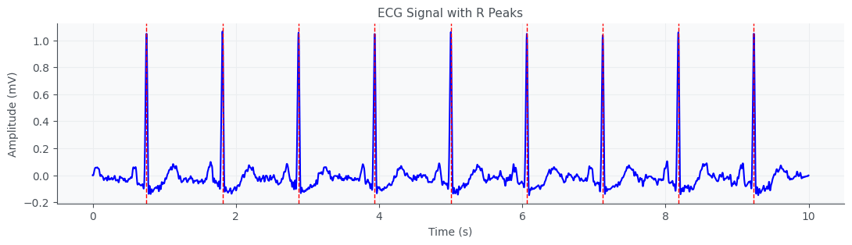
Done – Filtering and R-Peaks Detection
Base-Wander filter is applied and R-peaks are detected.

Slide 7
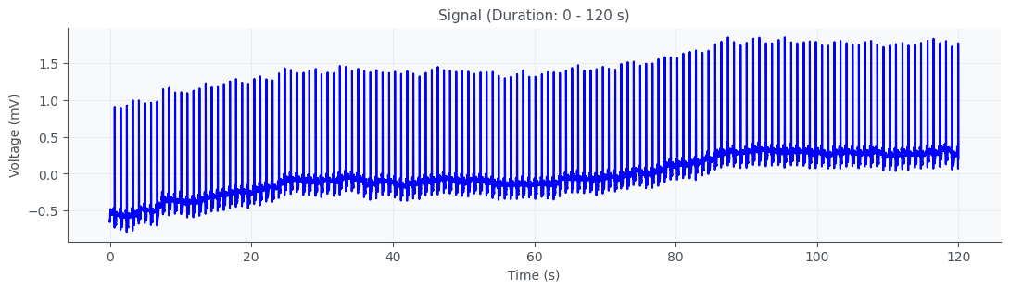
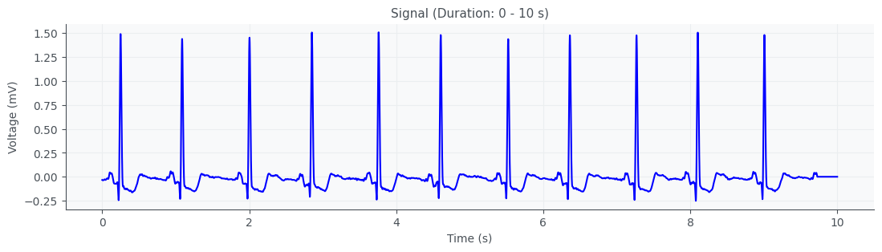
Done – Splitting
Splitting the long duration signals into 10-seconds segments.

Slide 8
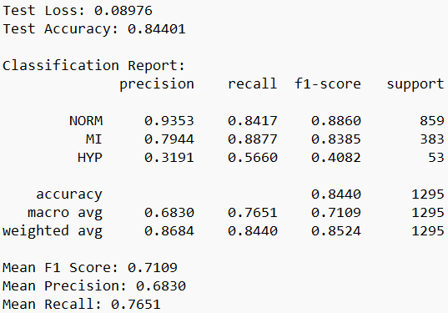
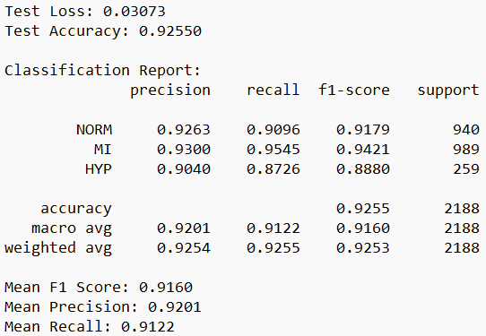
Evaluation of Dataset Using CNN Model
CNN Model with 5 Conv1D layers , SGD optimizer and focal loss function
PTB-XL 100Hz Combined 1000Hz

Slide 9
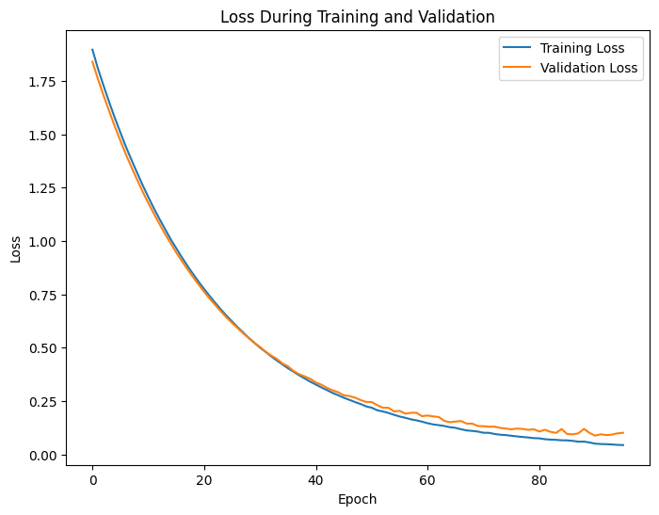
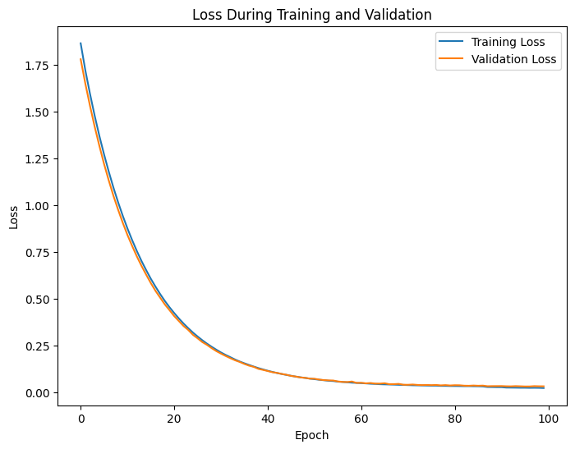
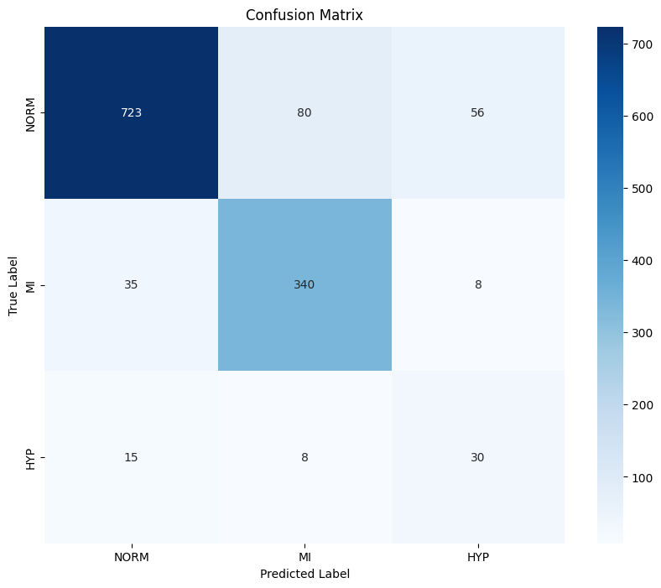
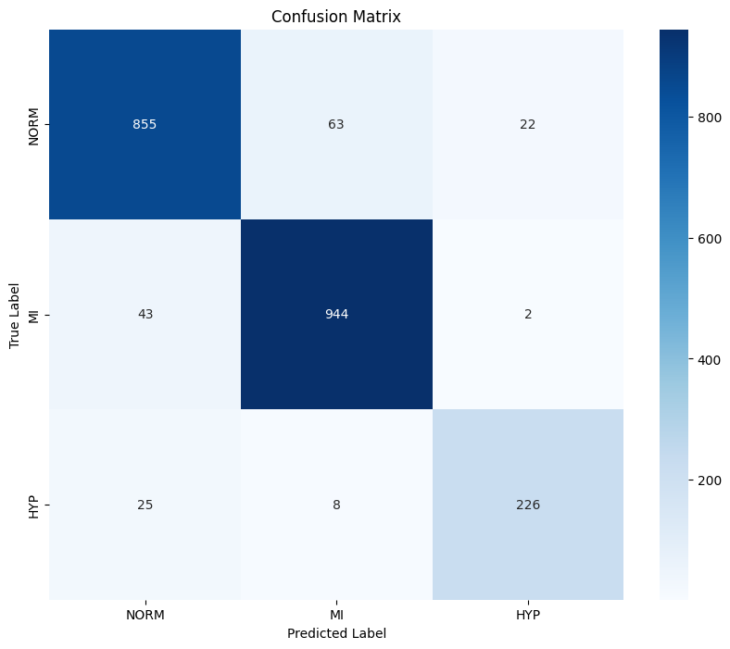
Evaluation of Dataset Using CNN Model
PTB-XL 100Hz Combined 1000Hz

Slide 10
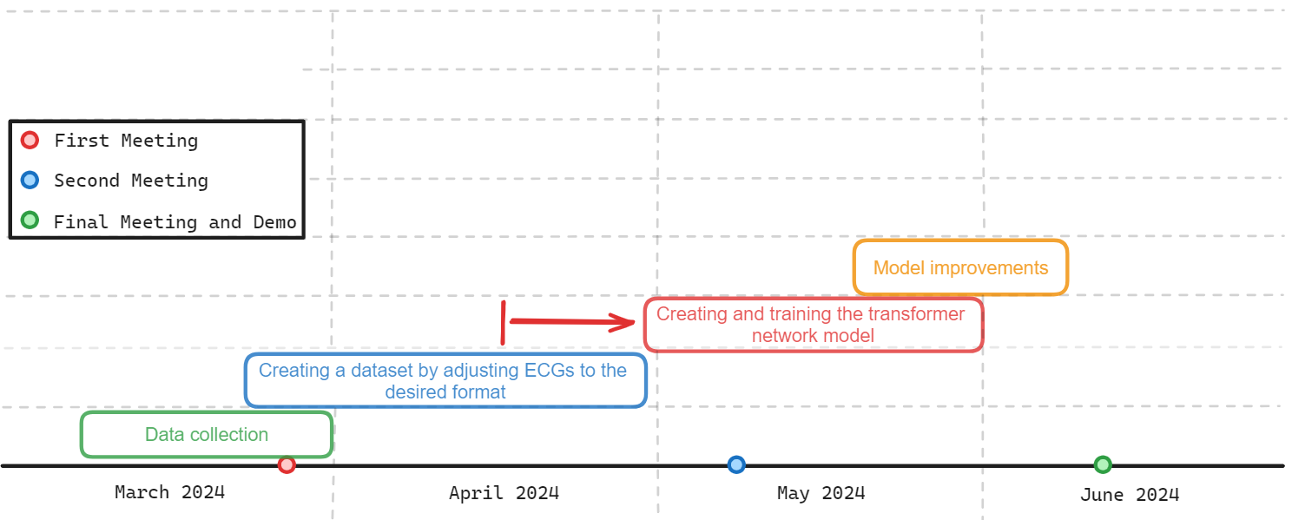
Project Timeline

Slide 11
Success Criteria
Preserve the integrity of the data by adjusting it appropriately when oversampling to 500Hz from sampling rates such as 100Hz and 257Hz.
Creating a dataset from various sources, which signals are adjusted to 1000Hz and 10-seconds duration.
Reach a minimum classification accuracy of 85% and an F1 score of 0.8.
Ensure that the model provides results within 10 seconds at most when given an ECG recording as input.

Slide 12
References
Wagner, P., Strodthoff, N., Bousseljot, R., Samek, W., & Schaeffter, T. (2022). PTB-XL, a large publicly available electrocardiography dataset (version 1.0.3). PhysioNet. https://doi.org/10.13026/kfzx-aw45.
PTB Diagnostic ECG Database (Sept. 25, 2004, midnight). https://doi.org/10.13026/C28C71
St. Petersburg Institute of Cardiological Technics 12-lead Arrhythmia Database (May 1, 2008, midnight). https://doi.org/10.13026/C2V88N

