Slide 1
GTU CSE496 ECG Classification Using Transformer Networks
CSE496
Final Presentation
Emre Güven
Project Advisor: Prof. Dr. Yusuf Sinan AKGÜL
June 2024

Slide 2
Contents
Project Overview
Dataset Preparation
Transformer Network Model
Input Embedding Layers
Encoder And Classifier Layers
Data Preprocessing – Windows
Positional Encoding
Tests
No R-Peaks Enhancement
R-Peaks Enhancement
Project Timeline
Success Criteria
References

Slide 3
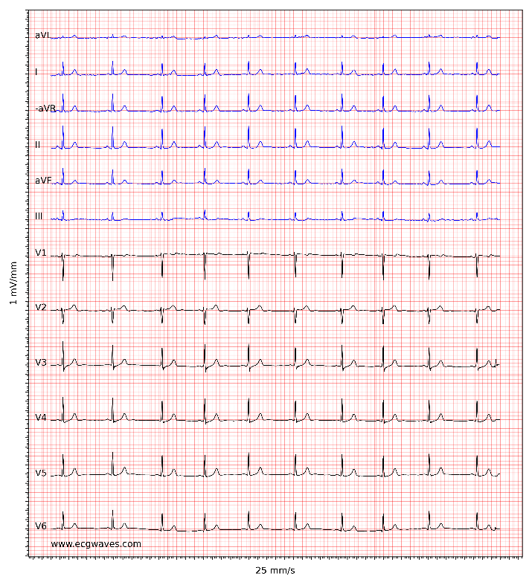
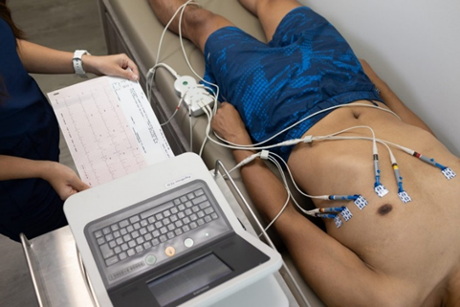
Project Overview
ECG signals, or electrocardiogram signals, represent the electrical activity of the heart.
Analyzing 12-channel ECG recordings with Transformer networks optimized for ECG signals to enhance diagnostic accuracy and efficiency.

Slide 4
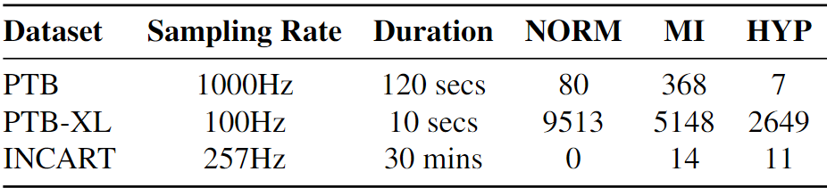
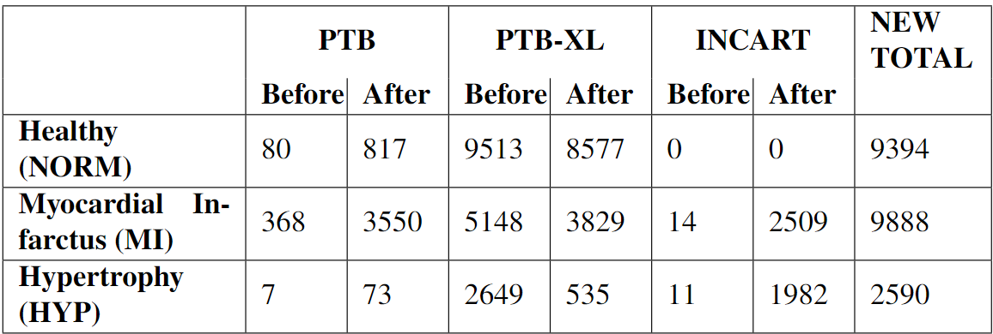
Dataset Preparation
Data segmentation and standardization applied to recordings.
Base-Wander filter is applied and R-peaks are detected.
Content of raw datasets
Content of prepared dataset

Slide 5
Transformer Network Model
Input Embedding Layers
Input Signal Windows Shape: (number_of_windows, window_size, num_channels)
Input Rpeaks Mask Shape: (number_of_windows, window_size, num_channels)
Embedding Layers: Applies 1D convolution to embed the each input window.
Positional Encoding: Positional encodings are generated and added to the input embeddings, providing each signal with unique positional information. This process also amplifies the R-peak points in the embedded windows, enhancing their importance.

Slide 6
Transformer Network Model
Encoder And Classifier Layers
Transformer Encoder Layer:
Applies multi-head attention to capture relationships between different positions in the input sequence.
This is followed by layer normalization and a feed-forward neural network to enhance the feature representation.
Both the attention output and FFN include residual connections to preserve input information.
Classifier Layers:
Global Average Pooling: Reduces the features to a smaller size.
Dense Layer: A dense layer with 108 units and the specified activation function.
Output Layer: The final dense layer with a softmax activation function to classify the input into one of the specified classes.

Slide 7
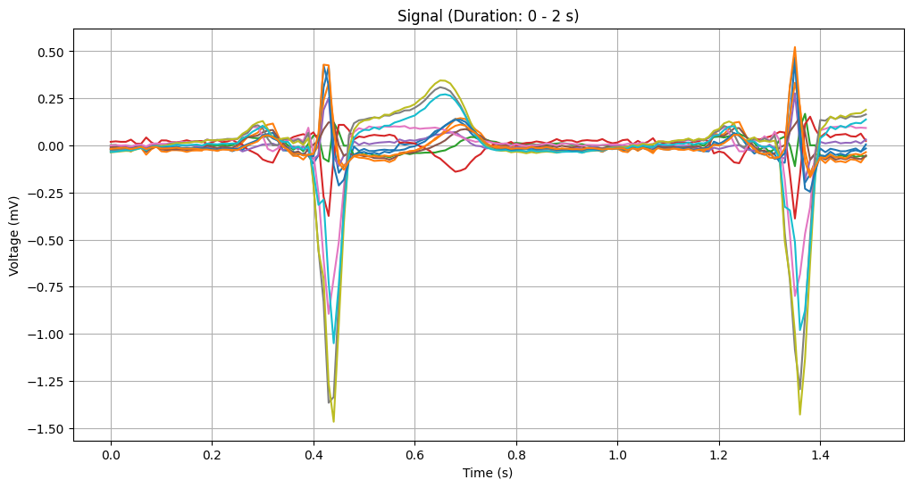
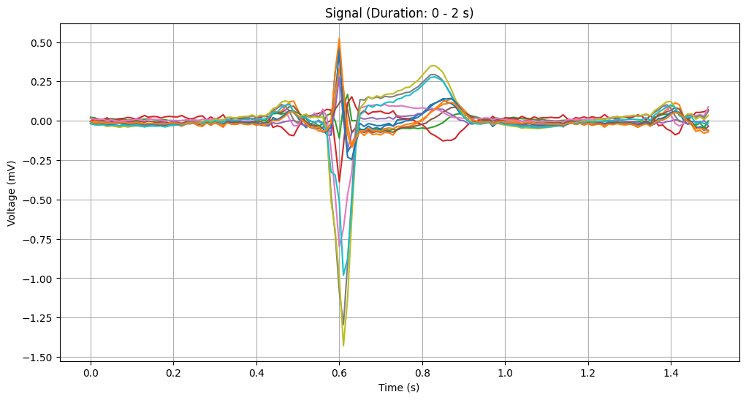
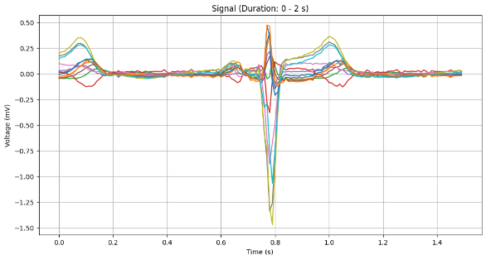
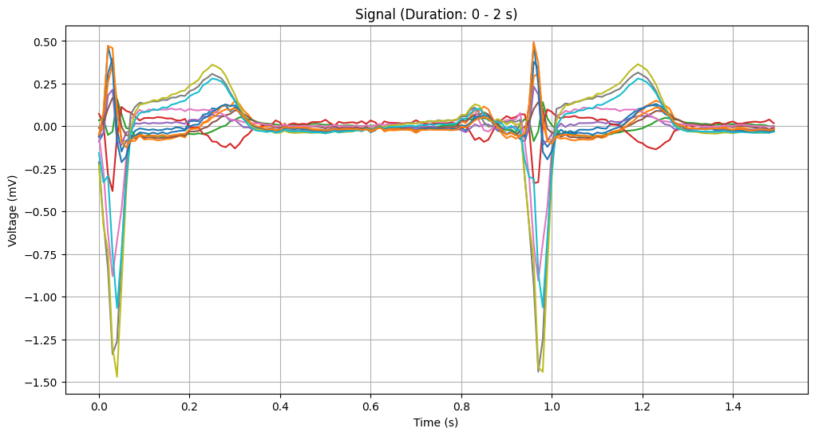
Data Preprocessing - Windows
Window Size 150 sample

Slide 8
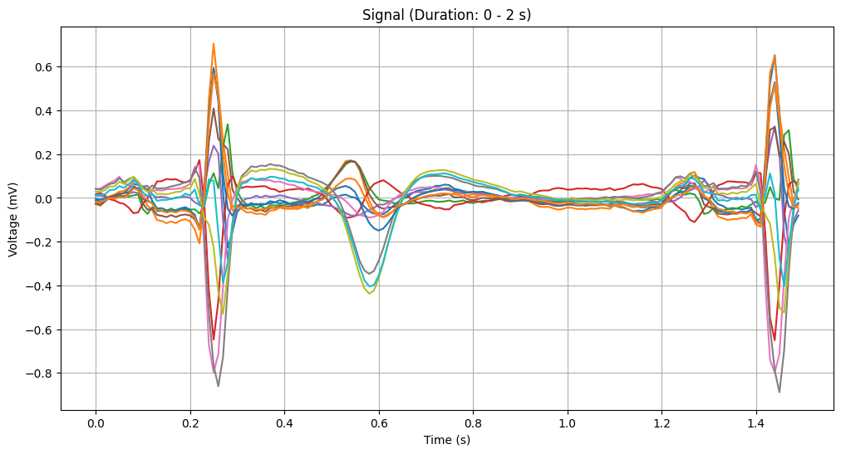
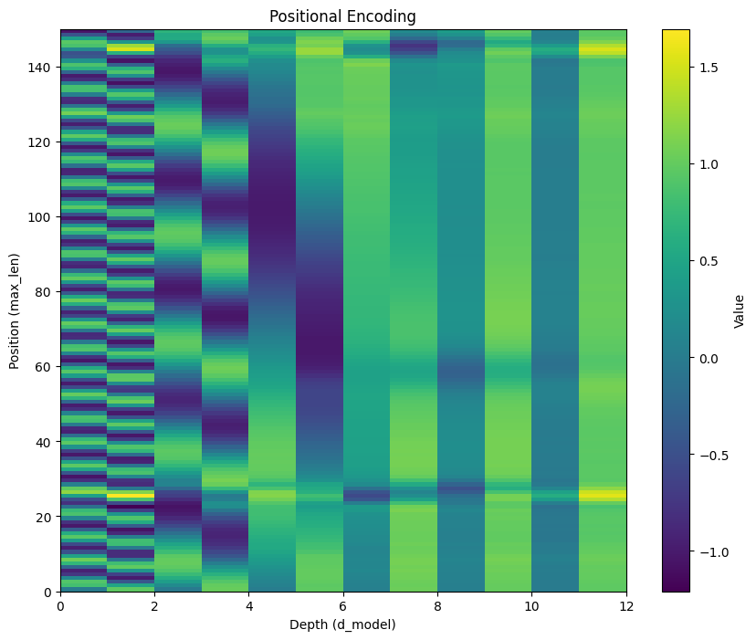
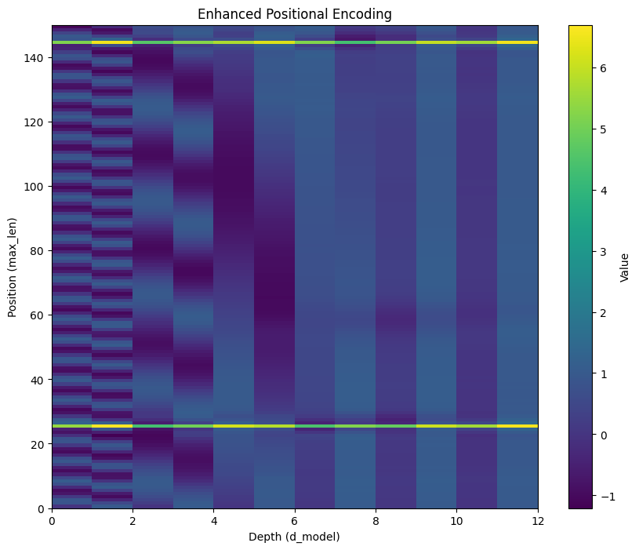
Positional Encoding
Window Size 150 sample

Slide 9
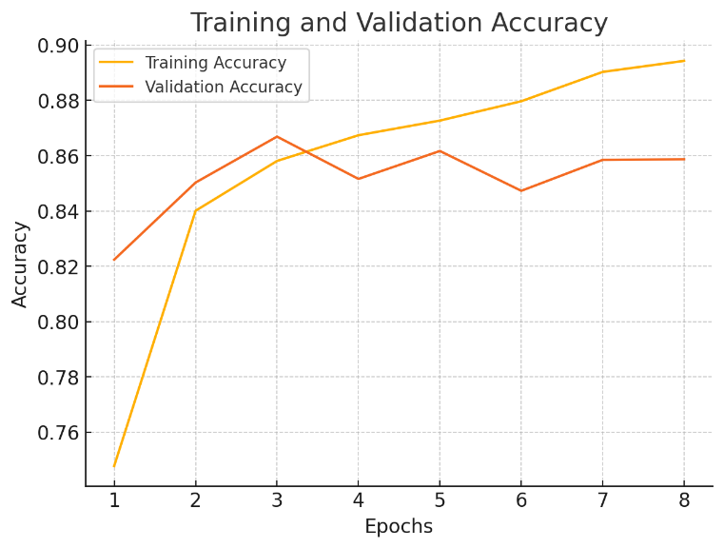
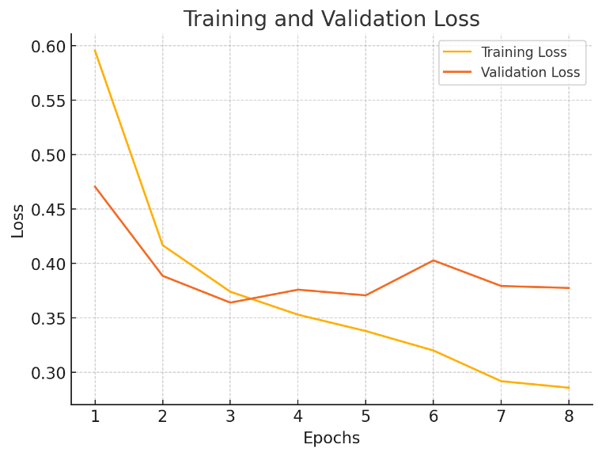
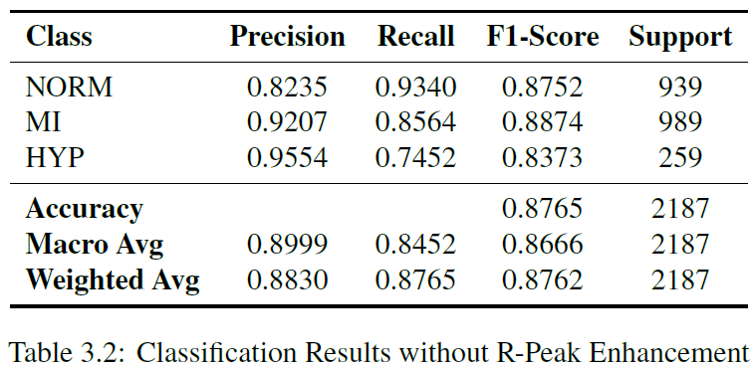
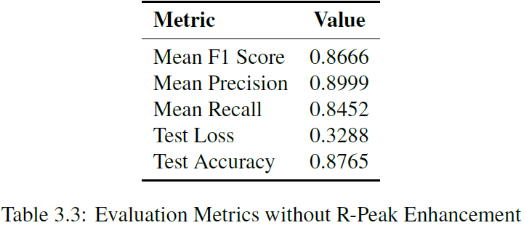
Tests – No R-Peaks Enhancement
Window Size 150 sample

Slide 10
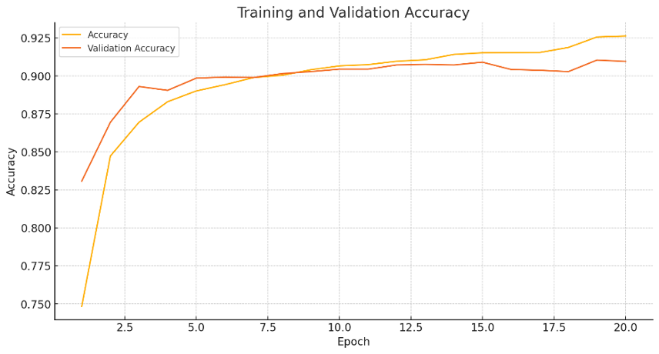
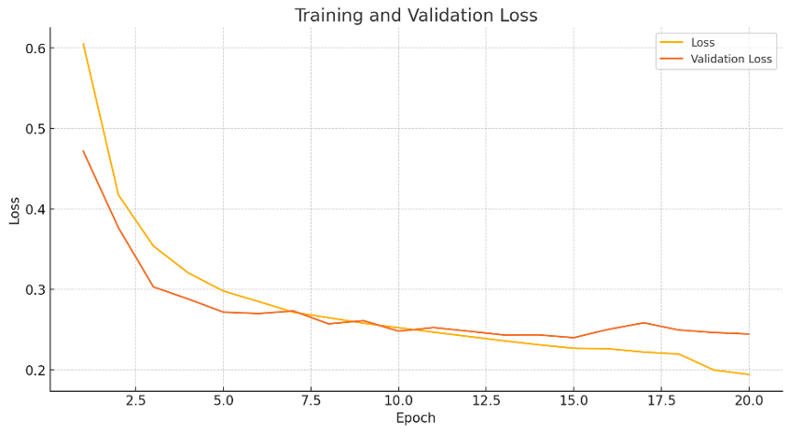
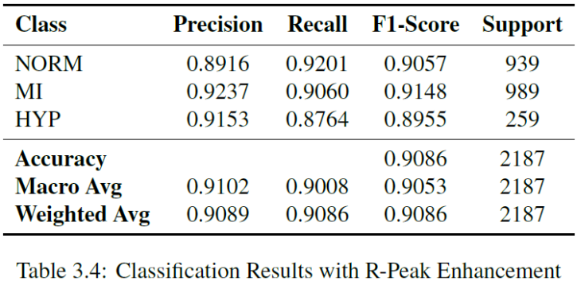
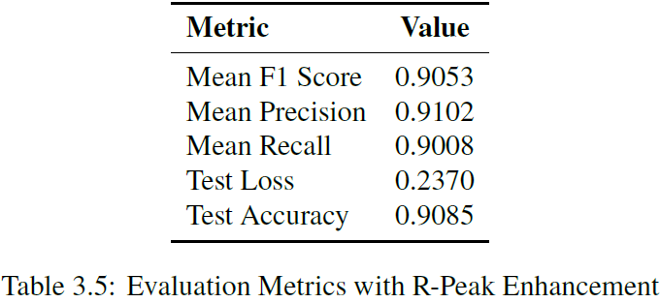
Tests – R-Peaks Enhancement
Window Size 150 sample

Slide 11
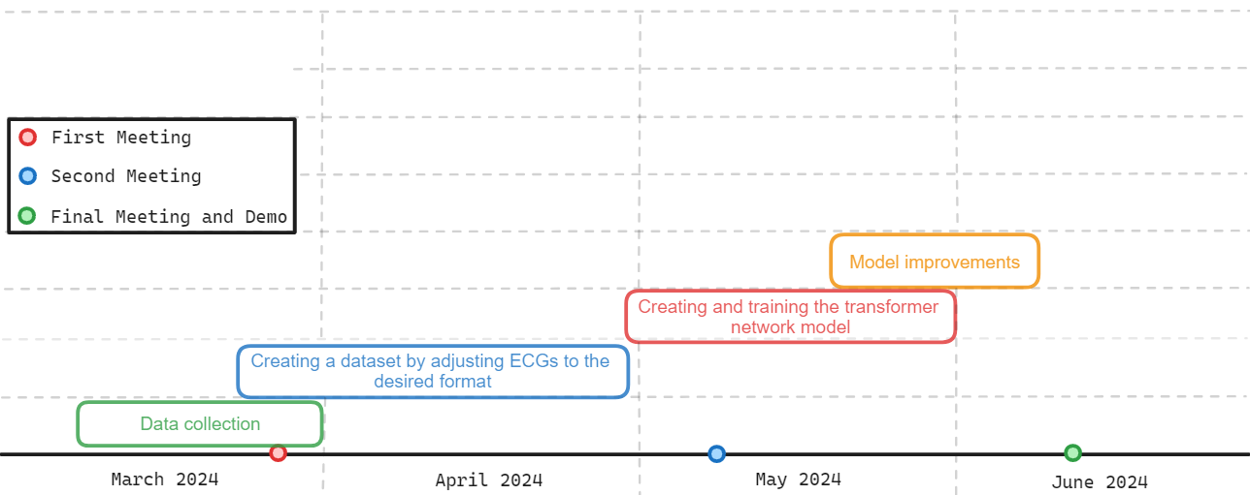
Project Timeline

Slide 12
Success Criteria
Creating a dataset from various sources, which signals are adjusted to 1000Hz and 10-seconds duration.
Reach a minimum classification accuracy of 85% and an F1 score of 0.8.
Ensure that the model provides results within 10 seconds at most when given an ECG recording as input.

Slide 13
References
Wagner, P., Strodthoff, N., Bousseljot, R., Samek, W., & Schaeffter, T. (2022). PTB-XL, a large publicly available electrocardiography dataset (version 1.0.3). PhysioNet. https://doi.org/10.13026/kfzx-aw45.
PTB Diagnostic ECG Database (Sept. 25, 2004, midnight). https://doi.org/10.13026/C28C71
St. Petersburg Institute of Cardiological Technics 12-lead Arrhythmia Database (May 1, 2008, midnight). https://doi.org/10.13026/C2V88N
G. Yan, S. Liang, Y. Zhang and F. Liu, "Fusing Transformer Model with Temporal Features for ECG Heartbeat Classification," 2019 IEEE International Conference on Bioinformatics and Biomedicine (BIBM), San Diego, CA, USA, 2019, pp. 898-905, doi: 10.1109/BIBM47256.2019.8983326.
Google Colab

