Slide 1
Graduation Thesis
Comparing the Performance of Ensemble Methods in Admission Prediction in Emergency Department Using Machine Learning Tecniques.

Slide 2
Introduction
01
I.S in Healthcare
04
Challenges in ED
Transforming Healthcare with Machine Learning
Introduction to the intersection of technology, healthcare data, and machine learning
How these advancements are revolutionizing healthcare information management?
Key technologies and tools used in healthcare information systems:
Health Information Exchanges (HIEs)
Telemedicine platforms
Clinical Decision Support Systems
Electronic Health Records (EHRs)
Administrative and financial tools
The role of these systems in improving patient outcomes and streamlining healthcare workflows
Unique challenges in emergency care
Patients with acute illnesses, injuries, or life-threatening conditions requiring immediate attention
Emergency departments play a vital role in our healthcare system
Challenges faced by healthcare workers in the Emergency Department (ED)
Increasing patient volumes
Limited resources
Need for quick decision-making
Machine learning as a solution
Innovative approaches to address challenges in emergency care
Improve effectiveness and efficiency
02
Machine Learning in ED
Unique challenges in emergency care
Importance of emergency departments in providing immediate care for acute illnesses, injuries, and life-threatening conditions
Challenges faced by healthcare workers in the Emergency Department (ED):
Rising patient volumes
Limited resources
Need for quick decision-making
Role of machine learning in addressing these challenges and enhancing emergency care effectiveness and efficiency

Slide 3
The Purpose of The Study
Study approach & findings
Main goal & importance
Study approach:
Carefully examine each ensemble method's effectiveness and accuracy in handling healthcare data
Identify patterns and differences among the methods
Impact of study findings:
Improve understanding of which ensemble methods are most useful in specific situations
Help researchers and practitioners make better decisions and enhance patient outcomes
Commitment to thorough analysis:
Goal of contributing new knowledge and sharing valuable insights
Audience engagement:
Open to questions and discussions to further explore the topic
Main goal of the study: Thoroughly analyze ensemble methods used in admission prediction in Emergency Departments
Importance of the study:
Fill the research gap in comparing ensemble methods in healthcare data analysis
Provide useful information for researchers and practitioners
Ensemble methods in healthcare data analysis:
Combine multiple models or algorithms for better predictions and improved results
Vs

Slide 4
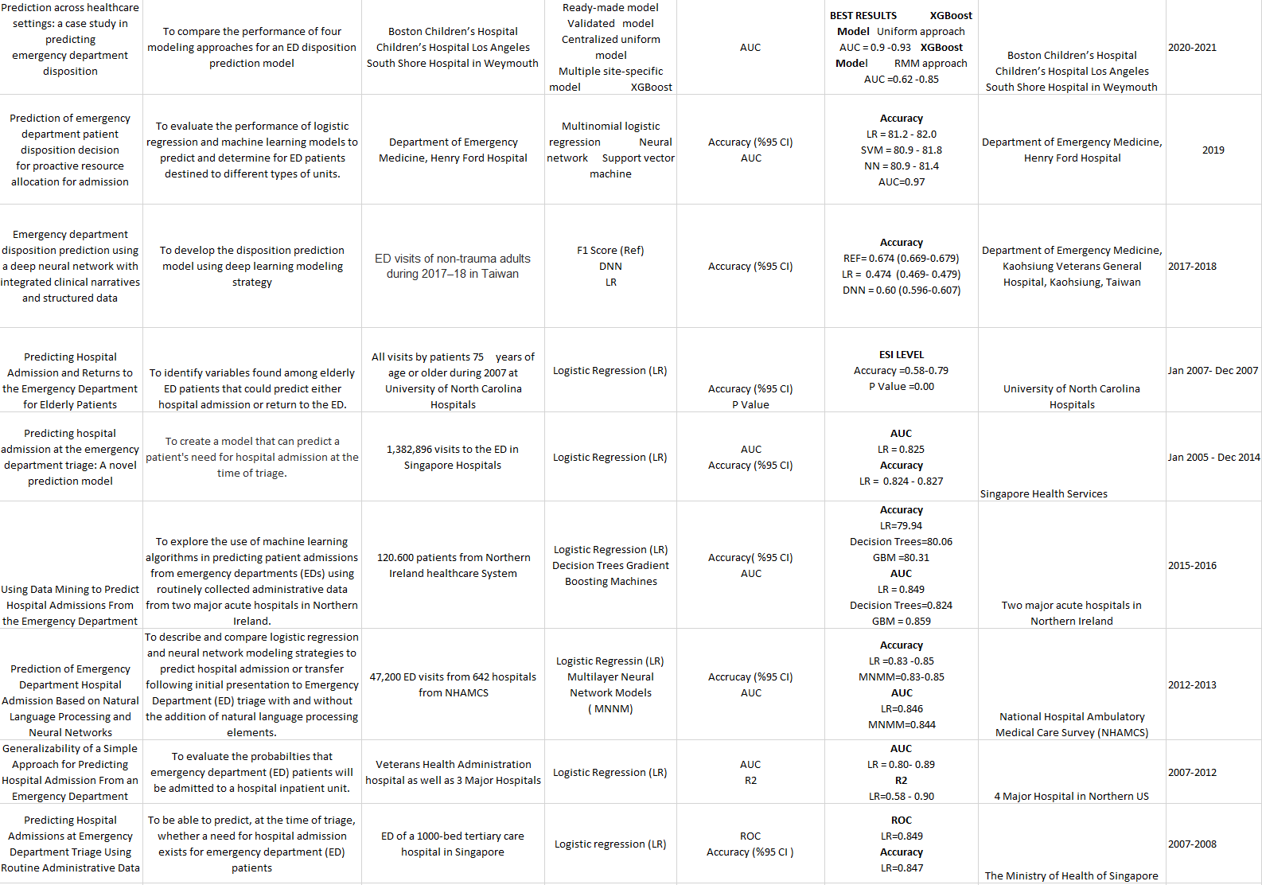
Literature Research
FINDINGS
Literature review:
Extensive reading and studying of existing literature conducted before starting the study
Findings from the literature review provided valuable insights and formed the basis for further research.
Observation on Admission Prediction studies:
Majority of studies in the field of Admission Prediction utilize xGboost as the primary ensemble method
xGboost is a popular choice among researchers for its effectiveness in predictive modeling.
Gap in research:
Limited information and research on other ensemble methods such as Adaboost, Gentleboost, and Rusboost in the context of Admission Prediction
These methods are not commonly explored or employed in existing studies.
Study
Observation
Literature Research

Slide 5
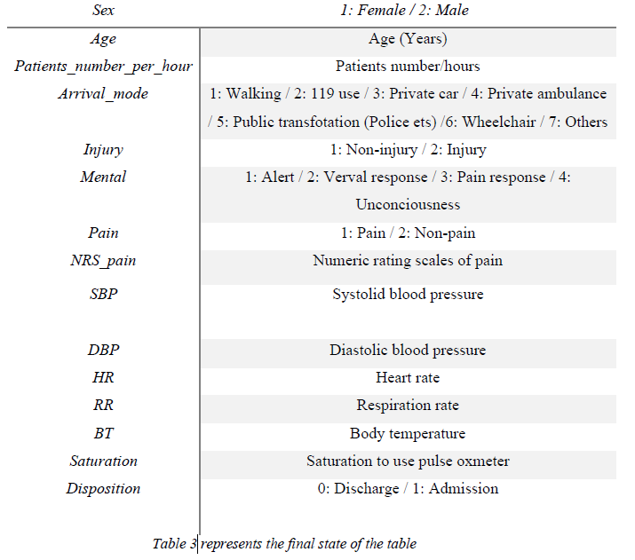
Methodology
Dataset
Data Preprocessing
Dataset details:
Includes 1267 records of adult patients
Collected from two emergency departments
Data collected from October 2016 to September 2017
Information provided in the dataset:
Patient characteristics, diagnoses, treatments, and outcomes
Value of the dataset:
Valuable for researchers and healthcare professionals
Provides insights into emergency department admissions
Dataset cleaning process:
Detailed research conducted to ensure data quality
NA values removed
Missing or outlier values deleted
Disposition value modified from 1 to 7 to 0 and 1 for modeling suitability

Slide 6
Modelling
01 | Logistic Regression
 | Venus has a beautiful name, but it’s hot
02 | Adaboost
 | Despite being red, Mars is a cold place
03 | Gentleboost
 | The Earth is the third planet from the Sun
04 | Logitboost
 | Mercury is the closest planet to the Sun
05 | Rusboost
 | Pluto is considered a dwarf planet

Slide 7
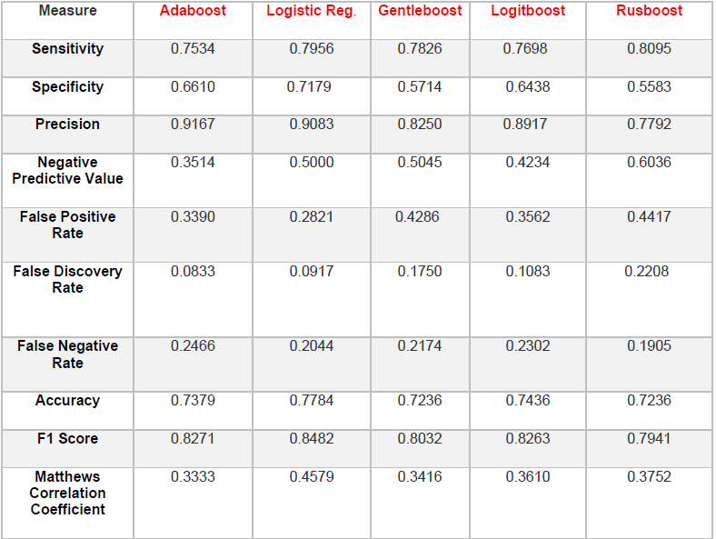
Results
AdaBoost model:
Decent performance with room for improvement
Reasonably high sensitivity (0.7534)
Comparatively lower specificity (0.6610)
High precision (0.9167)
Relatively low negative predictive value (0.3514)
Moderately high false positive rate (0.3390)
Low false discovery rate (0.0833)
Room for improvement in false negative rate (0.2466)
Accuracy of 0.7379
F1 score of 0.8271
Moderate Matthews Correlation Coefficient of 0.3333
Logistic Regression model:
Reasonably good performance
High sensitivity (0.7956)
Good specificity (0.7179)
High precision (0.9083)
Moderate negative predictive value (0.5000)
Relatively low false positive rate (0.2821)
Low false discovery rate (0.0917)
Low false negative rate (0.2044)
Accuracy of 0.7784
F1 score of 0.8482
Moderate Matthews Correlation Coefficient of 0.4579
GentleBoost model:
Mixed performance with room for improvement
Decent sensitivity (0.7826)
Struggles with specificity (0.5714)
Relatively high precision (0.8250)
Moderate negative predictive value (0.5045)
Relatively high false positive rate (0.4286)
Relatively low false discovery rate (0.1750)
Moderate false negative rate (0.2174)
Accuracy of 0.7236
F1 score of 0.8032
Moderate Matthews Correlation Coefficient of 0.3416
LogitBoost model:
Reasonable level of performance
Decent sensitivity (0.7698)
Reasonable specificity (0.6438)
High precision (0.8917)
Moderate negative predictive value (0.4234)
Moderately high false positive rate (0.3562)
Relatively low false discovery rate (0.1083)
Moderate false negative rate (0.2302)
Accuracy of 0.7436
F1 score of 0.8263
Moderate Matthews Correlation Coefficient of 0.3610
RusBoost model:
Mixed level of performance
Relatively high sensitivity (0.8095)
Struggles with specificity (0.5583)
Moderate precision (0.7792)
Relatively high negative predictive value (0.6036)
Relatively high false positive rate (0.4417)
Moderately high false discovery rate (0.2208)
Low false negative rate (0.1905)
Accuracy of 0.7236
F1 score of 0.7941
Moderate Matthews Correlation Coefficient of 0.3752

Slide 8
Conclusion
 | Best performed methods
01 | Logistic Regression | good performance with relatively high sensitivity, specificity, precision, and accuracy.
02 | AdaBoost | it struggled with specificity, negative predictive value, false positive rate, false negative rate, and overall accuracy
03 | LogitBoost | there is room for improvement in terms of specificity, negative predictive value, false positive rate, and overall accuracy.
04 | RusBoost | The Rusboost model presented a mix of strengths and weaknesses.
05 | GentleBoost | struggled with specificity and false positive rate.
06 | Customer segmentation | Jupiter is the biggest planet of them all

