Slide 1

Architecture Exploration for ALU Implementations using Multi-Modular Arithmetic
Maya Khangembam (2021EEN2020)
Master of TECHNOLOGY​
​
Supervisor:
Prof. Kaushik Saha​
Department of electrical engineering
Indian institute of technology

Slide 2
outline
Abstract
Introduction and Motivation
Residue Number System
Periodicity Based Residue Generator
Chinese Remainder Theorem
New Chinese Remainder Theorem-I
Experimental Setup and Results
Conclusion and Future Scope
References

Slide 3
Abstract
Carry propagation between data paths for arithmetic operations in number systems based on 2’s complement place a fundamental constraint on the speed, power, and area of hardware implementing it. By dividing the number into smaller parts, Residue Number System (RNS) overcomes these constraints as arithmetic operations on these parts can be performed in parallel, eliminating delay due to lengthy carry propagation chains. Systems implementing RNS, therefore, have been proposed as a means of enhancing the performance of arithmetic circuitry. However, restrictions in the expression of arithmetic operations in terms of the RNS system and overheads associated with operations involving 2’s complement arithmetic make it difficult to design a programmable processor capable of benefiting from the properties of RNS. In this work we explore possible hardware efficient architectures for the conversion from binary-to-RNS and RNS-to-binary for utilizing the advantages of the RNS system to achieve arithmetic operations. We also report our implementation of the converters for any general set of moduli.

Slide 4
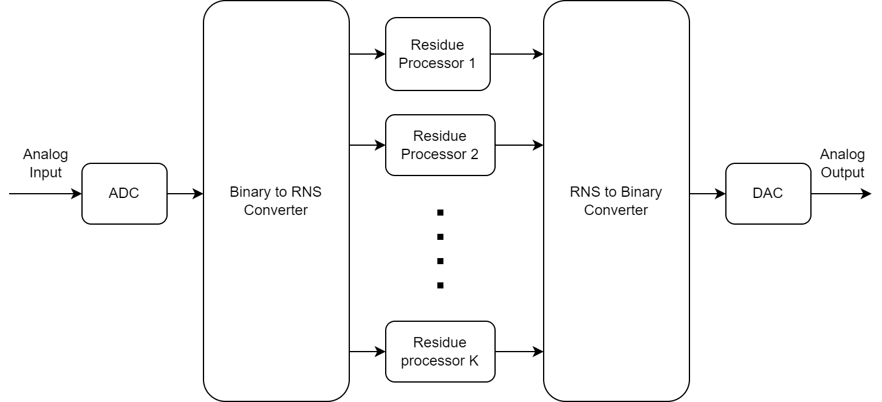
Introduction and motivation
Need alternatives to two’s complement system
RNS is non-weighted: speeds up arithmetic operations by breaking carry propagation chain
More area efficiency, less interconnections complexity, less switching activity
RNS suitable for operations involving intense arithmetic computations, e.g DSP
RNS suffers from inefficient inter-modulo operations: magnitude comparison, division, scaling, sign and overflow detection, RNS-to-binary conversion
Special moduli sets are fast but choices of dynamic range are limited
Need efficient hardware for implementing arbitrary residue generation and conversion
Fig. 1. An example of a basic signal processor using RNS

Slide 5


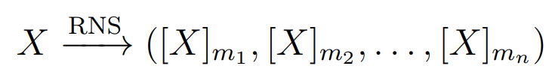
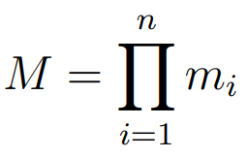
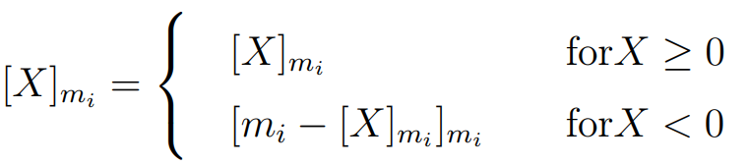
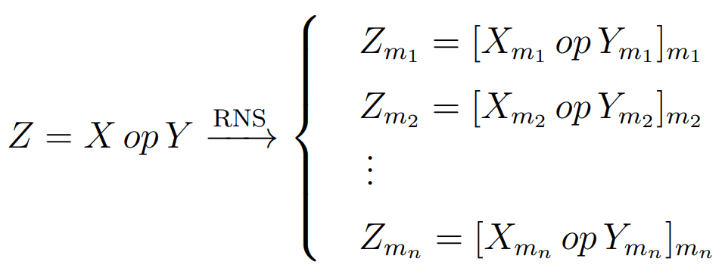
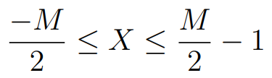
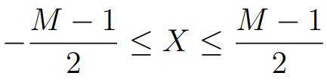
Residue Number System (RNS)
For integers X , A and m, the modulo operation x = X mod A is given as
In RNS, any X < M can be uniquely represented using the moduli set (m₁, m₂,…, m_{n}), where GCD(m_{i}, m_{j}) = 1 for i ≠ j
For conversion of signed numbers
Arithmetic operations in RNS can be parallelly computed for different moduli
For even M:
For odd M:

Slide 6

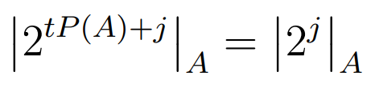
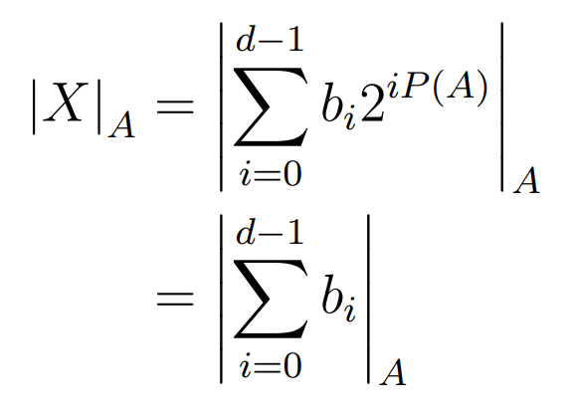

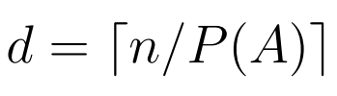
Periodicity Based Residue Generator
Periodicity of A (P(A)) is the minimum distance between two distinct 1's in the sequence of residues of 2^{i} mod A
Using this periodicity property, the implemented residue generator is as follows
 |  | 1 | 1 | 1 | 1 | 1
 |  | 1 | 1 | 1 | 1 | 1
 |  | 1 | 1 | 1 | 1 | 1
 |  |  |  |  |  | 1
1 | 0 | 1 | 1 | 1 | 1 | 0
Property of P(A):
1111111111111111 = 65535 (16-bit)
≡ 1 (mod 31)
For any X of length n divided into P(A)-bit bytes B_{i}, b_{i} being the decimal value of B_{i}, X mod A is
1011110 = 94 (7-bit)
≡ 1 (mod 31)
 |  | 1 | 1 | 1 | 1 | 0
 |  |  |  |  | 1 | 0
 | 1 | 0 | 0 | 0 | 0 | 0
100000 = 32 (6-bit)
≡ 1 (mod 31)

Slide 7
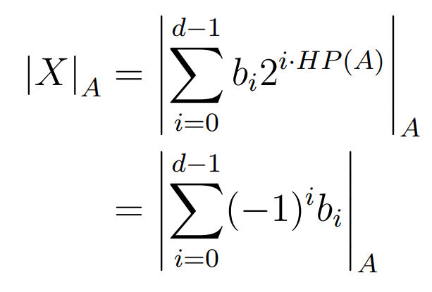


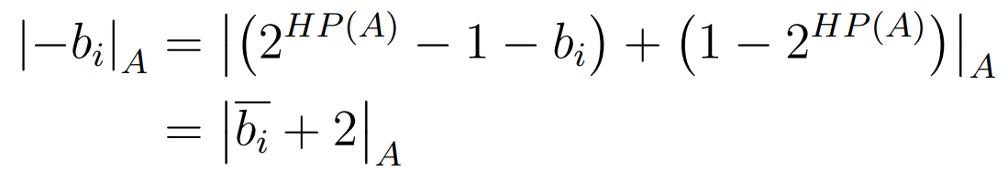
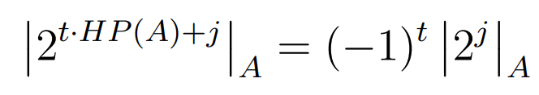

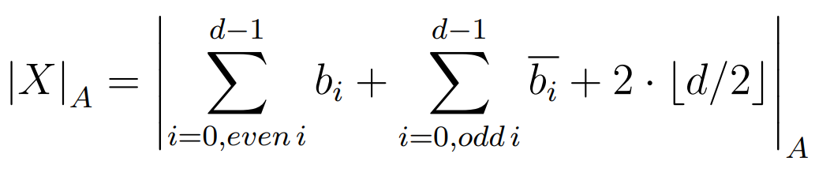
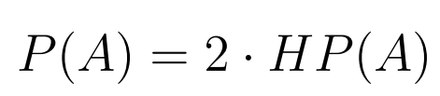
Half - Periodicity Based Residue Generator
Half-periodicity of A (HP(A)) is the minimum distance between pairs of 1 and A-1 in the sequence of residues of 2^{i} mod A
Property of HP(A):
If it exists, relation to HP(A):
Half-periodicity based residue generator was constructed which calculates modulus by dividing n-bitlength input X to d HP(A)-words, complementing the odd-ith words and adding all words plus a correction term and then repeating the cycle on the obtained sum until an equivalent number of satisfactory bit-length is obtained.

Slide 8
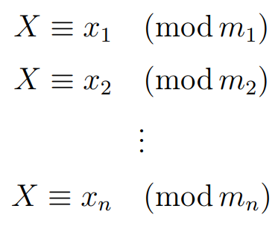
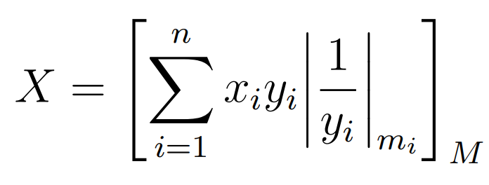
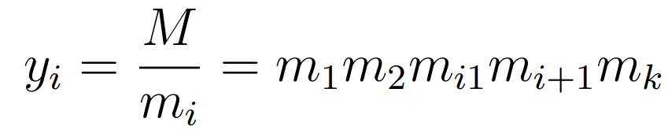
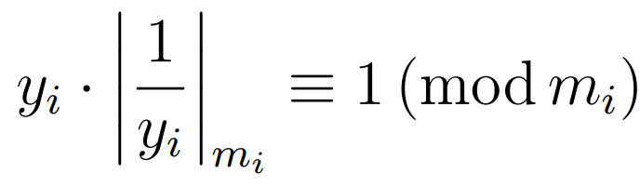
Chinese Remainder Theorem
Most common method of RNS-to-binary conversion
The CRT is used to find a unique solution for simultaneous linear congruences with coprime moduli
Modulo inverse of y_{i}
The modulo inverses y_{i} were precomputed using Euclid’s extended algorithm in a MATLAB script and implemented as an LUT. The large values of y_{i} makes the final modulo computation difficult.

Slide 9
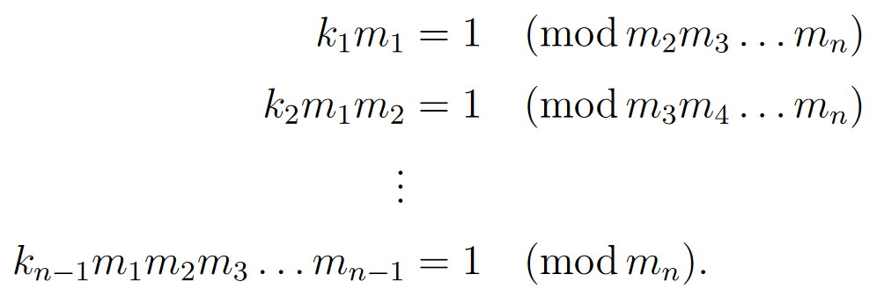
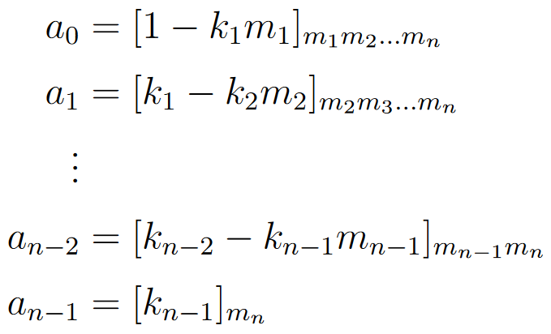
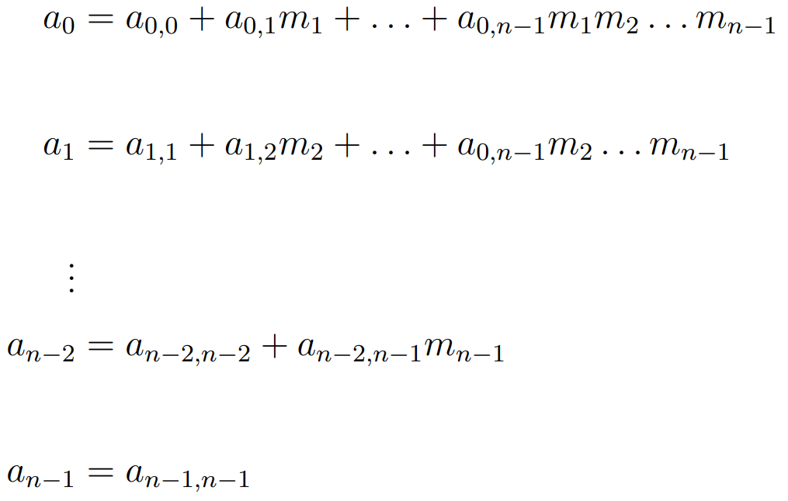
New Chinese Remainder Theorem-I
For a moduli set (m₁, m₂,…, m_{n}) and RNS form (x₁, x₂,…, x_{n}), decimal value X is
(a₁, a₂,…, a_{n}) is unique to the moduli set and is representable in mixed radix form as

Slide 10

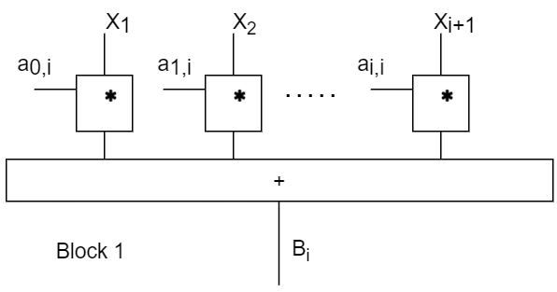
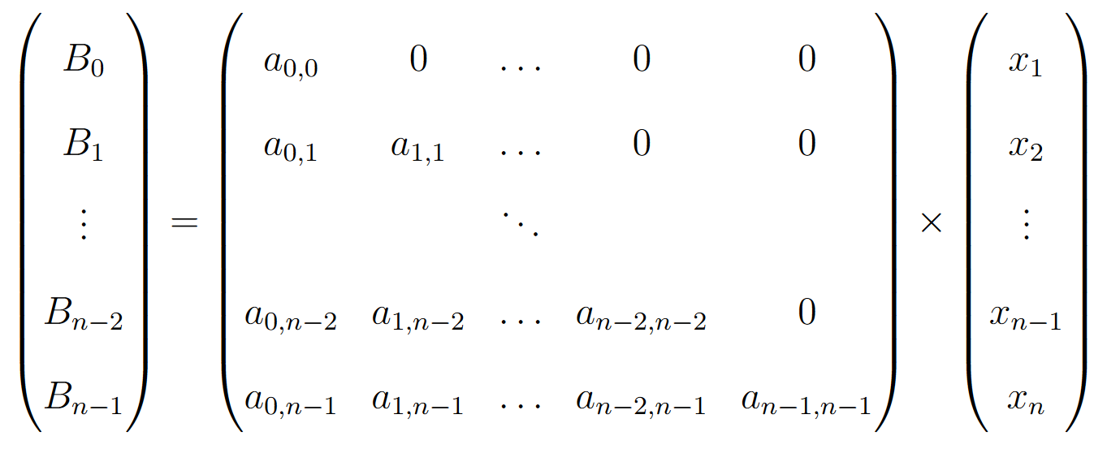
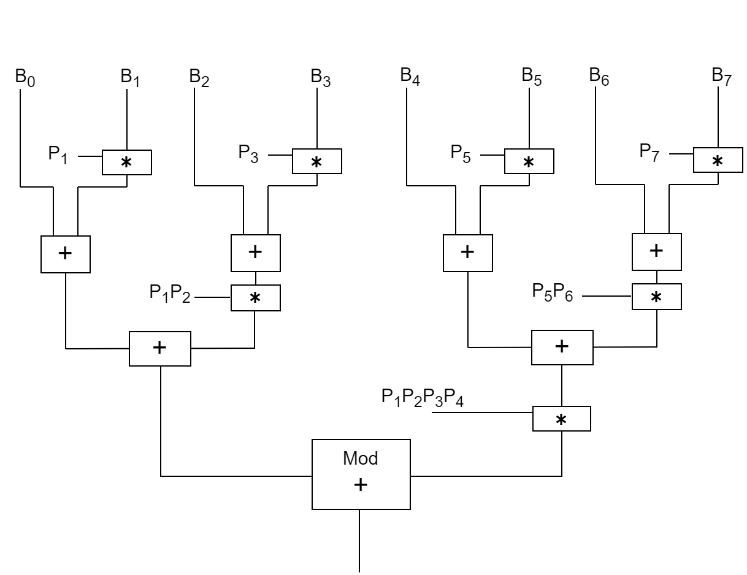
A is characteristic matrix of given moduli set and B is called the first-order radix
Fig. 2. Computation of B_{i}
X is computed as
Matric A is pre-computed and loaded as an LUT. B is realised using a group of adders and multipliers. Size of LUTs required for calculation of final X value is small since elements of matrices A and X are bound by size of the moduli, i.e., m_{i} making elements of B whose mod is to be taken small.
Fig. 3. Computation of X

Slide 11
Experimental Setup and Results
Synthesis results obtained using Cadence Encounter RTL Compiler:
Residue Generator
Synthesized Block | Area (λ²) | No. of NAND-2 equivalent instances | Power (mW) | Delay (ns) | P × D
Period based residue generator | 124.90 | ~ 100 | 0.006 | 2.34 | 0.014
Half-period based residue generator | 144.36 | ~ 100 | 0.007 | 2.39 | 0.016
Table 1. Synthesis results of implemented residue generator

Slide 12
Binary-to-RNS Converter
Synthesized Block | Area (λ²) | No. of NAND-2 equivalent instances | Power (mW) | Delay (ns) | P × D
Traditional CRT | 6660.4 | ~ 4K | 0.162 | 10.19 | 1.65
New CRT-I (32, 31, 21, 5) | 499.7 | ~ 300 | 0.03 | 2.92 | 0.085
New CRT-I (32, 17, 13, 11) | 1440.7 | ~ 1K | 0.12 | 3.37 | 0.40
Table 2. Synthesis results of implemented binary-to-residue converters
RNS-to-Binary Converter
Synthesized Block | Area (λ²) | No. of NAND-2 equivalent instances | Power (mW) | Delay (ns) | P × D
Traditional CRT | 23870.5 | ~ 16K | 0.88 | 11.24 | 9.89
New CRT-I (32, 31, 21, 5) | 9246.2 | ~ 6K | 0.32 | 7.88 | 2.54
New CRT-I (32, 17, 13, 11) | 9686.8 | ~ 6K | 0.34 | 7.98 | 2.72
Table 2. Synthesis results of implemented residue-to-binary converters

Slide 13
Conclusion and future scope
The conclusions to be made from the implemented model and results of this project work are:
Implemented model successfully computes complicated inter-modulo operations for with just a sequence of adders and multipliers.
Results show significant improvement in the area, power and delay of the converters implemented using the proposed residue generator and the new CRT-I method to traditional CRT.
Points for future work have been identified below:
Consistent adder width and depth for moduli for different periodicities.
Improved algorithm to achieve the reduced equivalent sum in a single stage in residue generator.
Design of arithmetic circuitry to process convolution operation for RNS-based DSP processor and neural networks.

Slide 14
references
[1] R. Chokshi, K. S. Berezowski, A. Shrivastava, and S. J. Piestrak, “Exploiting residue number system for power-efficient digital signal processing in embedded processors,” in Proceedings of the 2009 International Conference on Compilers, Architecture, and Synthesis for Embedded Systems, (New York, NY, USA), p. 19–28, Association for Computing Machinery, 2009.
[2] A. Hiasat, “A residue-to-binary converter for the extended four-moduli set {2 n − 1, 2 n + 1, 2 2n + 1, 2 2n+p},” IEEE Transactions on Very Large Scale Integration (VLSI) Systems, vol. 25, no. 7, pp. 2188–2192, 2017.
[3] K. V. Vardhan, G. Sailakshmi, S. Musala, and A. Srinivasulu, “Analysis and design of high speed residue to binary reverse converter for the moduli set 2n+ 1, 2n,2n-1,” in 2020 IEEE Recent Advances in Intelligent Computational Systems (RAICS), pp. 53–56, 2020.
[4] P. Patronik, “On reverse converters for arbitrary multi-moduli rns,” Integration, vol. 75, pp. 158–167, 2020.
[5] S. Piestrak, “Design of residue generators and multioperand modular adders using carrysave adders,” IEEE Transactions on Computers, vol. 43, no. 1, pp. 68–77, 1994.
[6] A. Avizienis, “Arithmetic error codes: Cost and effectiveness studies for application in digital system design,” IEEE Transactions on Computers, vol. C-20, no. 11, pp. 1322– 1331, 1971.
[7] Y. Wang, “Residue-to-binary converters based on new chinese remainder theorems,” IEEE Transactions on Circuits and Systems II: Analog and Digital Signal Processing, vol. 47, no. 3, pp. 197–205, 2000.

Slide 15
Thank you

