Slide 1
I(t)
in-phase
0°
f_{c}
y(t)
90°
Q(t)
quadrature

Slide 2
Bias-T
C
AWG
R
DAC
100nF
1M
Device

Slide 3
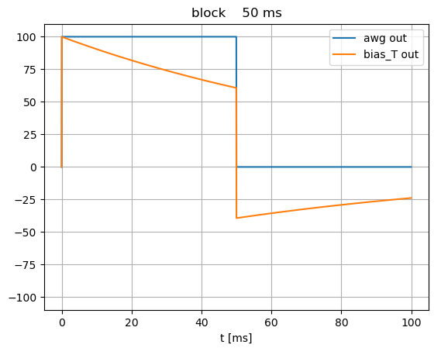
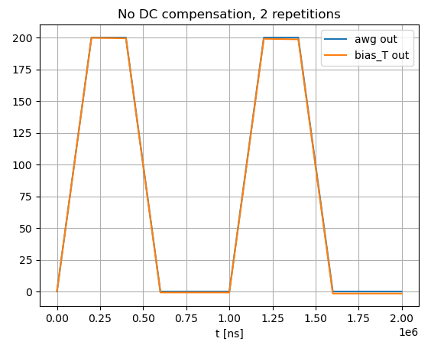
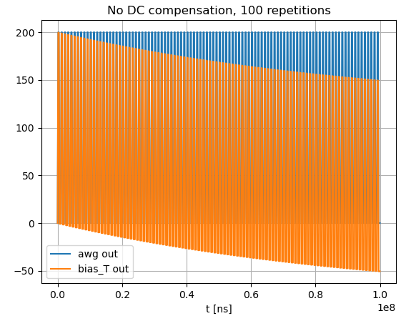
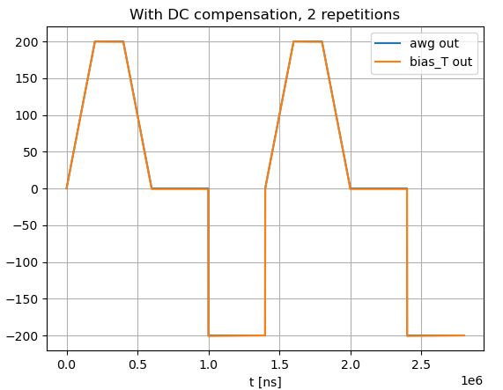

Slide 4
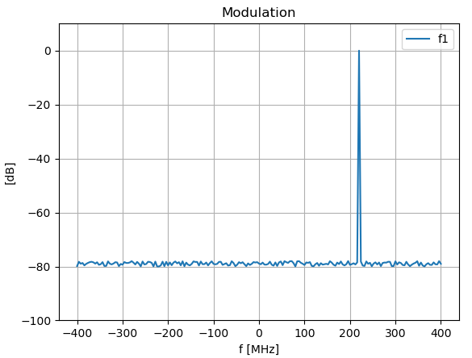
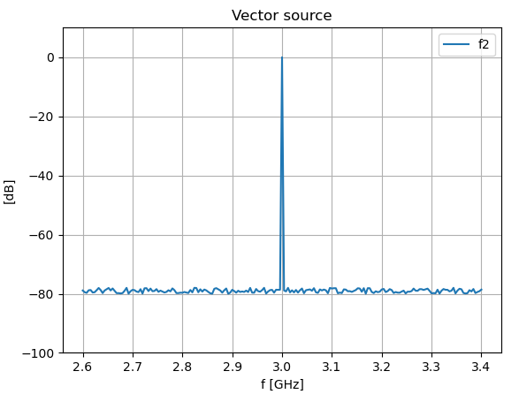
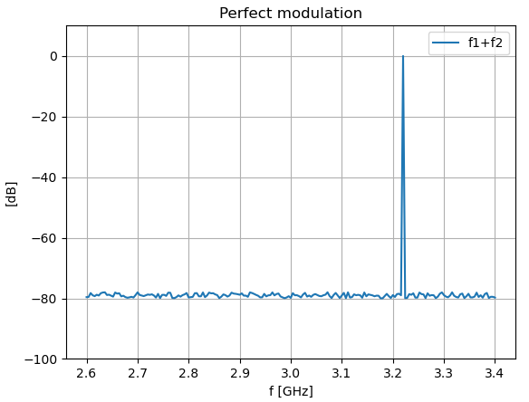
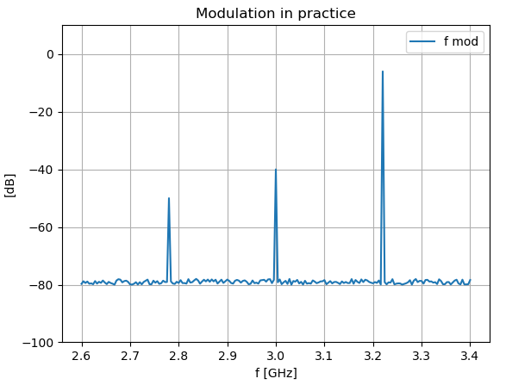

Slide 5
0
P1 (awg)
100
0
P2 (awg)
100
0
SD1 (digitizer)
100
0
P1 (awg)
100
0
P2 (awg) delay = -10
100
0
SD1 (digitizer) delay = +20
100
0
10
samples
110
130

Slide 6
0
P1 (awg)
100
0
P2 (awg)
100
0
SD1 (digitizer)
100
0
P1 (awg)
100
0
P2 (awg) delay = -10
100
0
SD1 (digitizer)
100
0
10
samples
110
0
P1 (awg)
100
0
P2 (awg) delay = -10
100
0
SD1 (digitizer)
100
0
10
samples
110

