Slide 1
I(t)
in-phase
0°
f_{c}
y(t)
90°
Q(t)
quadrature

Slide 2
Bias-T
C
AWG
R
DAC
100nF
1M
Device

Slide 3
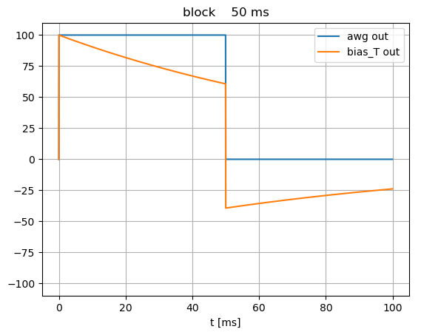
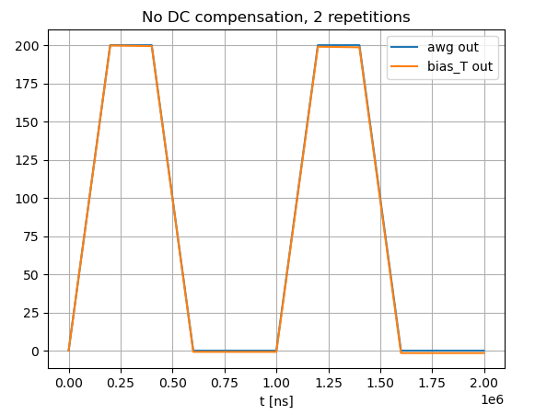
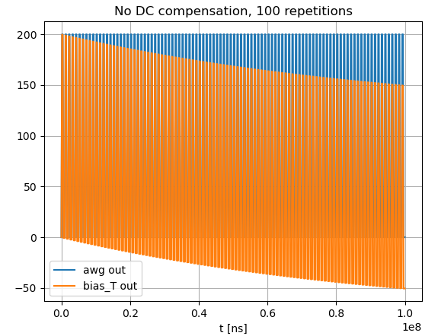
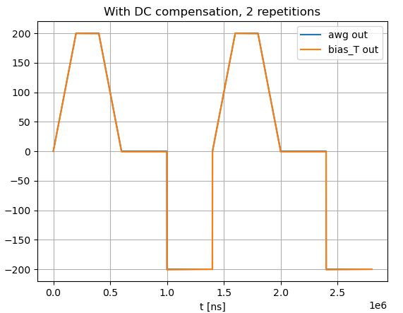

Slide 4
