Slide 1
Ethics, risk and the law
Dr P A Robinson
600091 Honours Stage Project

Slide 2
Ethics
Alongside your PDD, you must complete the online ethics checklist
AKA the Twelve Questions Of Doom
This concerns the research ethics of doing your project
It does not consider the effects of your project’s output on the wider world
You’ll address that in your final report
So what do you need to think about?

Slide 3
What do you need to consider?

Slide 4
Some ethical issues
Data Privacy and Confidentiality
Bias and Fairness in Algorithms
Informed consent
Digital Accessibility
Misuse or dual use of technology
Accountability and Transparency
Academic integrity

Slide 5
Research ethics
All research at the University requires ethical approval
In advance
What is research?
Creation of new knowledge.
Collection of data.

Slide 6
University Ethics
University code of ethics
https://share.hull.ac.uk/Services/Governance/PolicyDocuments/University%27s%20Code%20of%20Ethics.docx
University research ethics policy:
https://share.hull.ac.uk/Services/RI/RI%20Documents/Research%20Ethics%20Policy%201.0.pdf
Research ethics is most apposite

Slide 7
Your ethics checklist
Are you going to use other people in your work?
Testing your software
Giving feedback
As test subjects for whatever your software does
If “No”: <smiley face>
If “Yes”, answer the Twelve Questions Of Doom

Slide 8
Ethics check questions
Will participants be exposed to any risks greater than those encountered in their normal working life?
Will the experimental materials be paper-based, or comprise software running on standard hardware?
Will participants give explicit consent?
Will incentives be offered to the participants?

Slide 9
Ethics check questions
Will information about the evaluation or materials be intentionally withheld from the participants?
Will any participant be under the age of 16?
Will any participant have an impairment that may limit their understanding or communication?
Are you or your supervisor in a position of authority or influence over any of the participants?

Slide 10
Ethics check questions
Will all participants be informed that they can withdraw at any time?
Will all participants be informed of your contact details?
Will the evaluation will not be discussed with all the participants at the end of the session, with the opportunity for them to to ask questions?
Will all the data collected from the participants be stored securely in an anonymous form?

Slide 11
Your options
Your project does not involve other people in the collection of information
No ethical review required
Your project does involve other people, but complies with the entire twelve point ethical checklist
No ethical review required
Your project does not comply with all of the twelve points in the checklist and
Ethical review required. Complete and submit ethical approval form. Do not do the research until it is approved.
Your project does not comply with all of the twelve points in the checklist, but your supervisor already has ethical approval for this research
No new ethical approval required

Slide 12
Ethical review
Undergraduate students are not permitted to conduct high ethical risk research.
Review by module lead and programme lead
Recommend outcome
Faculty ethics panel makes decision
University has a policy on conduct of student surveys
Check with your supervisor

Slide 13
Risky business?
What risks might endanger your project?

Slide 14
What is a risk?
Discrete events
Hard disk fail
File corruption
Supervisor/customer/client departure
Project requirements change
Ill health
Evolving situations
Falling behind because of inaccurate estimation
Deteriorating relationship with client
Think about warning signs and triggers in advance

Slide 15
Potential project risks
Scope creep
Time management
Inaccurate estimation
Schedule issues
External changes
I can’t get hold of…
It doesn’t work!
Time overrun
This is not a comprehensive list

Slide 16
Types of risk
Technical
External
Organisational
Project management

Slide 17
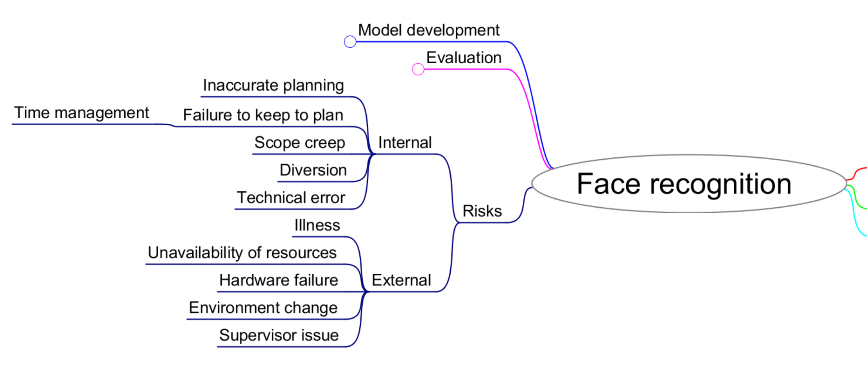
Use your mind(map)

Slide 18
A small aside about risk assessments
IF your project involves activities which might cause harm:
Manufacturing processes
Soldering, cutting,…
Operating equipment
Flying drones, driving robots
Using VR equipment
Interacting with external software services
THEN you will need to complete risk assessments for these activities before you do them
This is separate to the risk analysis for your PDD

Slide 19
Risk analysis
Identify risks
Assess impact of risks
Mitigate critical risks
Control residual risk
Keep risks up to date

Slide 20
Risk impact - Likelihood
How likely is it that this risk will happen?
Low, Medium, High (1, 2, 3)
Big earthquake in the UK – Low likelihood
Hard drive failure – Medium likelihood
Illness due to common cold – High likelihood
Global pandemic…

Slide 21
Risk impact - Severity
How substantial will the consequence of the event be?
Very low – very high (1 - 5)
Very low – inconvenient; need to restore from backup; lose an hour’s work
Medium – delay to project; final result affected
Very high – project failure

Slide 22
Risk impact
Risk impact = likelihood × severity
Resultant number is meaningless, but serves to rank risks
Make provision for the most important ones first
Accept the least important?

Slide 23
Risk matrix
Risk | Likelihood | Severity | Impact
Computer failure | 2 | 4 | 2 × 4 = 8
Illness for more than a week | 1 | 3 | 1 × 3 = 3
Technical issue (be specific) | 2 | 3 | 2 × 3 = 6
Inability to get training data for ML | 1 | 5 | 1 × 5 = 5
…
Identify most important risks
80:20 rule as bare minimum
Describe mitigation strategy for each
Determine residual risk

Slide 24
You need a mitigation plan
You’ve identified a set of risks
What will you do to prevent them?
What will you do if they happen?
What will the effects be?
How will you minimise or overcome the effects?
What if you can’t?

Slide 25
Dealing with risks (mitigation)
Avoid
Do you need to do this particular thing?
Is there an alternative approach?
Transfer
Can someone else take the risk?
Don’t claim credit for the work of others, though!
Reduce
Can you reduce the likelihood of the risk happening?
Don’t store your work on a single memory stick
Can you reduce the severity?
Keep backups so if it happens you don’t lose much
Accept
Sometimes you just have to
Contingency
Build extra time into critical tasks just in case
Remember Parkinson’s law!

Slide 26
Residual risk
Risk | Raw risk | Mitigation | L | S | Residual risk
Computer failure | 8 | Ensure development environment is available on multiple computers | 2 | 1 | 2 × 1 = 2
Illness for more than a week | 3 | Include contingency time in project | 1 | 2 | 1 × 3 = 2
Technical issue (be specific) | 6 | Investigate possible alternatives in advance | 2 | 2 | 2 × 2 = 4
Inability to get training data for ML | 5 | Ensure data sets are available from other sources | 1 | 1 | 1 × 5 = 1
…
Describe mitigation strategy for each
Determine residual risk
Repeat if necessary
Update the register at intervals – risks change!

Slide 27
What to do
You need a risk review in your PDD
Use the project plan to inform it
Make sure you have mitigation plans
Keep it up to date
Give it some proper thought
You also need to think about data!

Slide 28
Legal matters
Your project must comply with the law
But what laws are relevant?
What legal matters must you consider?

Slide 29
Legal matters you might consider
Data protection and the GDPR
Intellectual property
Copyright and licensing
Computer misuse
Confidentiality
Health and safety
Discrimination and equality

