Slide 1
Project planning
Dr P A Robinson
600091 Honours Stage Project

Slide 2

Planning
“Planning is an unnatural process; it is much more fun to do something. The nicest thing about not planning is that failure comes as a complete surprise, rather than being preceded by a period of worry and depression.”
Sir John Harvey-Jones

Slide 3
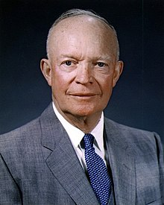
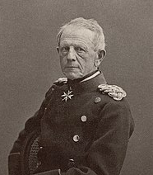
Planning
“In preparing for battle I have always found that plans are useless, but planning is indispensable.”
Dwight D. Eisenhower
“No battle plan ever survived contact with the enemy”
Field Marshal Helmuth von Moltke (the elder)

Slide 4
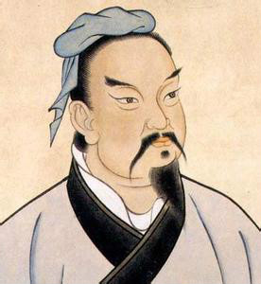
Planning
“Those who are victorious plan effectively and change decisively. They are like a great river that maintains its course but adjusts its flow.”
Sun Tzu

Slide 5
Aims and objectives
Aims
High level targets
What the project as a whole will try to do
Expresses desired outcome
Objectives
More detailed and specific items
Easy to determine if complete/successful
Primary and secondary objectives
Not too many!

Slide 6
Objectives
Objectives must be SMART:
Specific
Is the objective well defined and clear? Can it be understood by anyone with basic knowledge of the project?
Measurable
Can you measure progress towards the objective? How will you know when it is complete?
Appropriate
Does the objective fit with and contribute to the overall aims of the project? Has it been agreed by all?
Realistic
Within the resource constraints of the project, can this goal be achieved?
Time-based
When will the goal be completed? Is there enough time to achieve the goal? Is there too much time (consider Parkinson’s law).

Slide 7

Creating a cunning plan
Work breakdown
Time estimates
Identifying milestones
Sequencing activities
Scheduling
Replanning
Using the right tools

Slide 8
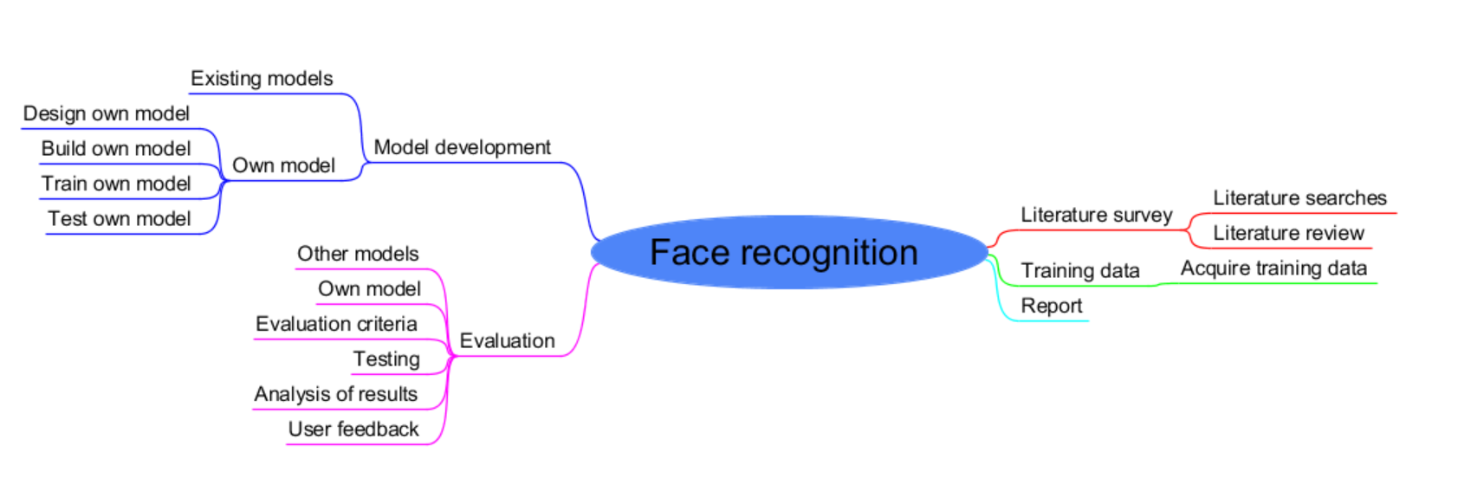
Mind map

Slide 9
Work breakdown
Face Recognition DL project
Literature survey
Develop DL model
Get training data
Evaluation
Complete report
Literature search
Literature review
Train DL model
Use other models
Analyse results
User feedback
Investigate DL models
Design DL system
Develop and test DL System
Review tests
Analyse / evaluate
Analyse user feedback
Propose changes
Estimate time for lowest level tasks

Slide 10
Work breakdown
Face Recognition DL project
Literature survey
Develop DL model
Get training data
Evaluation
Complete report
Literature search
Literature review
Train DL model
Use other models
Analyse results
User feedback
Investigate DL models
Design DL system
Develop and test DL System
Review tests
Analyse / evaluate
Analyse user feedback
Propose changes
Estimate time for lowest level tasks

Slide 11
Work breakdown
Face Recognition DL project
Literature survey
Develop DL model
Get training data
Evaluation
Complete report
Literature search
Literature review
Train DL model
Use other models
Analyse results
User feedback
Investigate DL models
Design DL system
Develop and test DL System
Review tests
Analyse / evaluate
Analyse user feedback
Propose changes
Estimate time for lowest level tasks

Slide 12
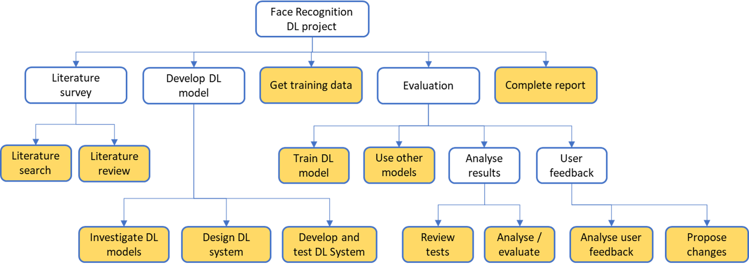
Time estimates
Activity | Time (weeks)
Literature search | 8
Literature review | 4
Investigate DL models | 4
Design DL system | 4
Develop and test DL system | 2
Get training data | 1
Train DL model | 1
Use other models | 2
Review tests | 2
Analyse/evaluate | 4
Analyse user feedback | 2
Complete report | 8
Total effort | 42

Slide 13
Not enough time?
You have an end date (Week 11 of semester 2)
Work backwards
Adjust the scope of the project to fit the time?
Better than running out of time at the end
Adjust the balance of time between components?
Improve estimates by more detailed breakdown?
Be realistic!
Remember there’s an interim review in January

Slide 14
Identify milestones
Intermediate goals to help measure progress
Focus points for effort
May be deliverables
Project completion is always one!
What should they be?
May be project objectives
Literature review? DL model? Final report?
How many?
Depends on project length. Five or six?

Slide 15
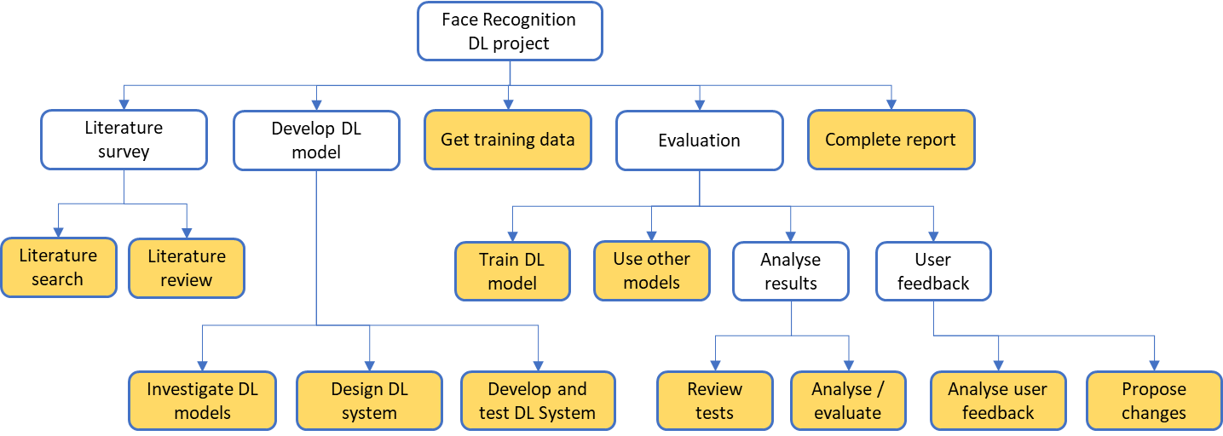
Sequencing activities
Literature search
Literature review
1
Use other models
Get training data
Review tests
Analyse / evaluate
Train DL model
Propose changes
Complete report
2
Develop and test DL System
Analyse user feedback
Investigate DL models
Design DL system

Slide 16
Sequencing activities
Literature search
Literature review
1
Use other models
Get training data
Review tests
Analyse / evaluate
Train DL model
Propose changes
Complete report
2
Develop and test DL System
Analyse user feedback
Investigate DL models
Design DL system

Slide 17
Sequencing activities
Literature search
Literature review
1
Use other models
Get training data
Review tests
Analyse / evaluate
Train DL model
Propose changes
Complete report
2
Develop and test DL System
Analyse user feedback
Investigate DL models
Design DL system
Shows dependencies
Indicates critical activities and path
(only if timings included)
And shows up problems?
Can tasks be done in parallel?

Slide 18
But what are my tasks?
Depends on your project
There are some common tasks (from a scheduling perspective):
Literature review (deliverable?)
Requirements capture
Requirements specification (milestone?)
Software/hardware design (deliverable?)
Implementation
Subtasks depending on project
Include sprints and other ceremonies
Include deliverables or milestones for prototypes

Slide 19
What? There are more?
Experiments and testing
Don’t forget to include time after these to make changes
Evaluation
User evaluation of product
Requires time to plan, prepare, implement and consider the results
And time to make changes if appropriate
Self-evaluation of project (reflection)
Writing the report
Schedule time for writing, feedback and corrections
Don’t forget to include holidays!
Don’t assume you will work over the Christmas break

Slide 20
Scheduling – Gantt charts
Use the right tools for the job
Microsoft Project
Available on university image
Project Libre
Free download
Please don't use Excel. Or Word.

Slide 21
MSP demo

Slide 22
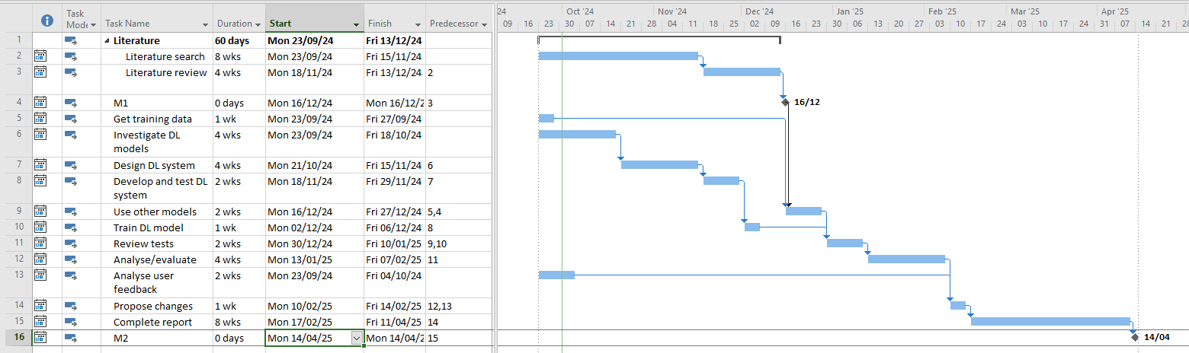
Gantt chart

Slide 23
Agile planning
I’m doing agile development! I don’t need a plan!
Yes, you do.
Though it may be less detailed
When will you do your sprints?
When will you deliver incremental versions?
When will you do testing? Research? Report writing…
Agile is not an excuse for chaos

Slide 24
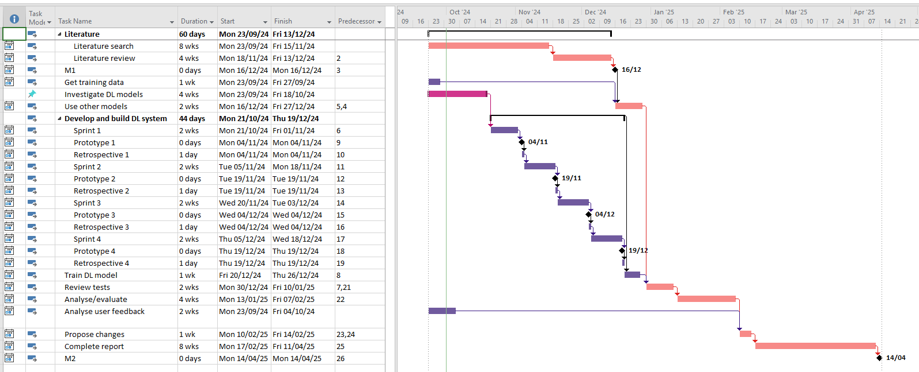
MSP agile Gantt

Slide 25
USE the plan!
Make sure you are doing what you should be
Are you falling behind?
Keep it up to date
Update progress on tasks
Change the plan over time
Add detail as time goes on
Mid-way progress report is a good time to replan

Slide 26
Methodologies
Waterfall?
Spiral?
Incremental?
Prototyping?
Agile?
Which one is most appropriate for your project?
Choose one
Stick with it
Actually do it

Slide 27
Helpful advice
Keep a log – You’ll be glad you did
Look at Obsidian, or Notable, or others
Use referencing software
Endnote, Zotero…
You’ll be very glad you did
Use source control
Git and GitHub
Use the right tools for the job
MS Project
Freeplane

Slide 28
Questions?

