Slide 1

Caffeine

Slide 2
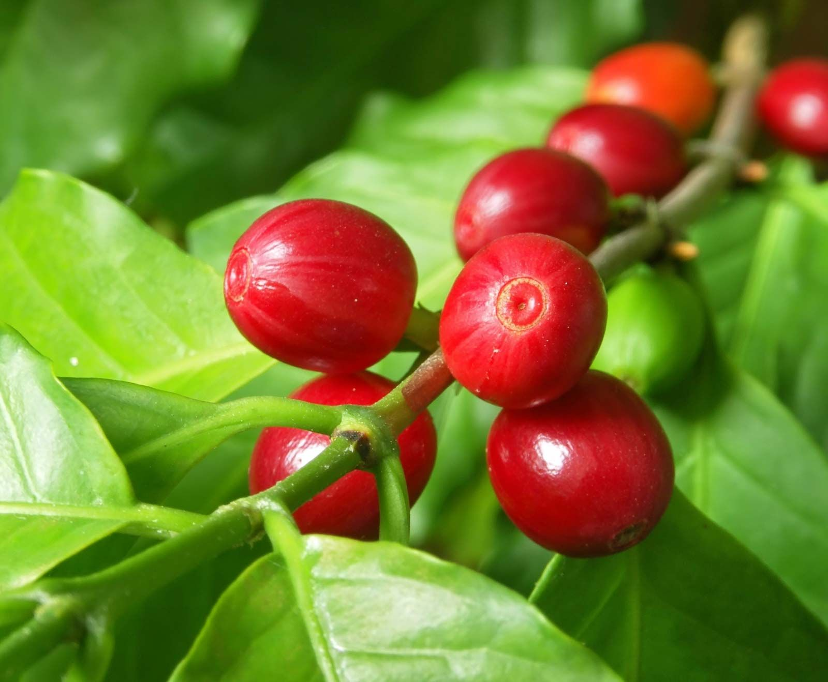
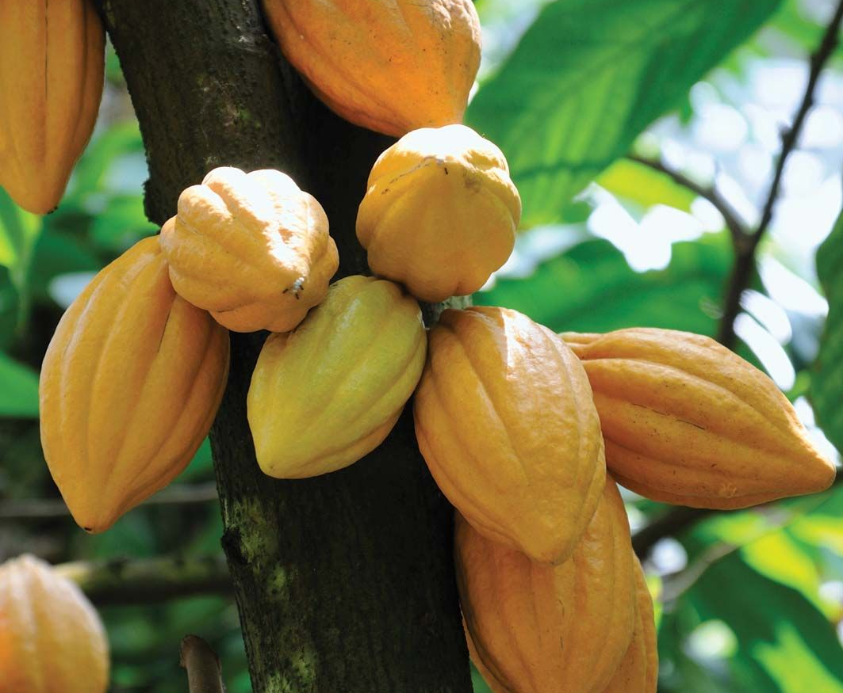
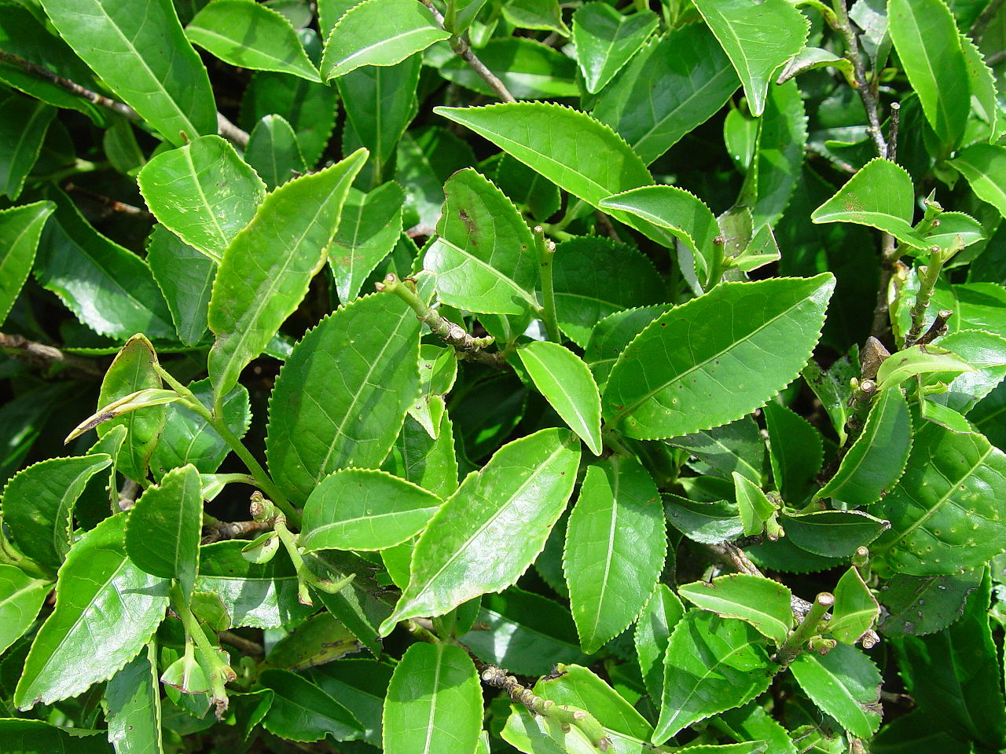
Natural sources of caffeine
coffee
cacao
tea

Slide 3
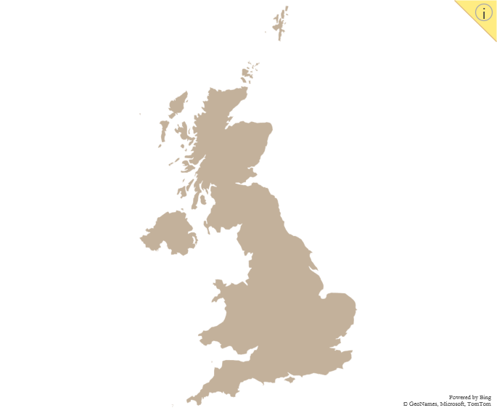
PREVALENCE OF CAFFEINE
Every day, the UK consumes*:
4,000 kg of caffeine from tea
5,700 kg of caffeine from coffee
9,700 kg / 67,330,000 people = 144 mg / person
The EFSA considers a daily intake of up to 400mg to be safe for adults.
*source: drugwise.org.uk/caffeine

Slide 4
CAFFEINE as a Stimulant
rapidly enters the bloodstream from the gut
binds to adenosine to receptors in the brain
blocks adenosine molecules responsible for fatigue
increases activity in the central nervous system

Slide 5
CAFFEINE In THE Blood
Reaches peak level 30-60 mins after consumption
Increases heart rate & blood pressure
Has a half-life of 3 – 6 hours

