Slide 1
Case Study
Data Science smava GmbH
CONFIDENTIAL

Slide 2
Tasks: Discussion
1. Predict probabilites
  I’ve built a single predictor. It will be seen: that “bank” is a relatively important feature, but two features dominate.
3. All Banks
  It can be seen, that some of the values of the x fields do vary with each “bank”.
  To check if a customer should approach a bank, we should use the x fields for that bank.
  When there is no record, for that customer at that bank, the values could be imputed from the train and test dataset.
    For each bank, use its x values, and impute values for customer who have no record for that bank
  So we should have a predictor for each bank

Slide 3
Train Dataset
Well-curated
Not imbalanced
Only one field has NA
Two category features
Already quantified
No NZV features
Feature interestRate
  Only appears when accepted
Feature x2
  When null it is null for all of the customer’s banks
  Suggests it is a customer feature
Near Zero Variance
  And zero information

Slide 4
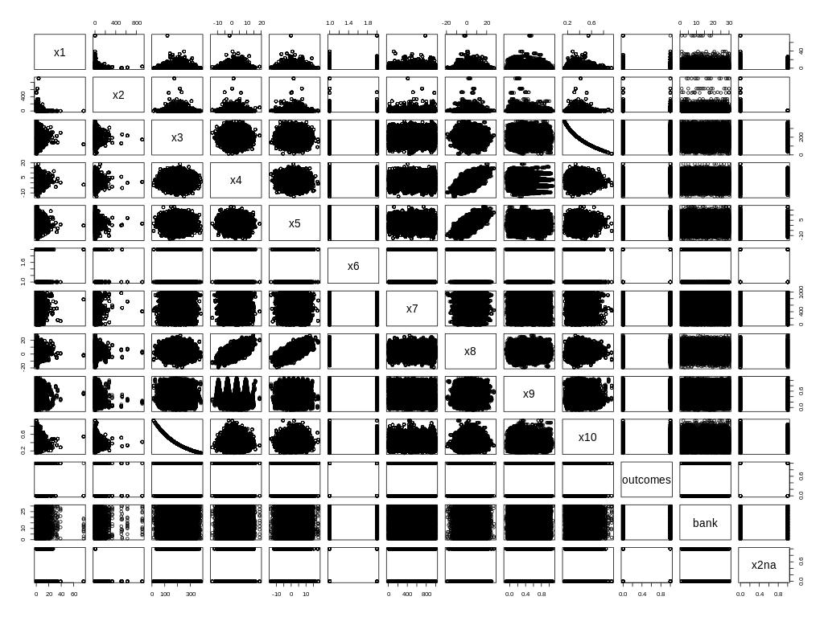
Pair Plot
X3 and x10

Slide 5
Imputation: x2
Add a flag field that is set when the field is null
Assign the mean value of x2 when it is null
  Mean is less meaningful that median
Results: x2 is not that important
  Using a GBM predictor with bank feature, unscaled
  Dataset only records when x2 is non-null: 66% accuracy
  Dataset with x2na feature: 66% accuracy

Slide 6
Results: 1 – predictions.rdata
Build a GBM predictor
  Global predictor with bank as a feature
  Discard x3 as too highly correlated to x10
  From a fit to train.rdata using x2na
  Predict against test.rdata

