Slide 1

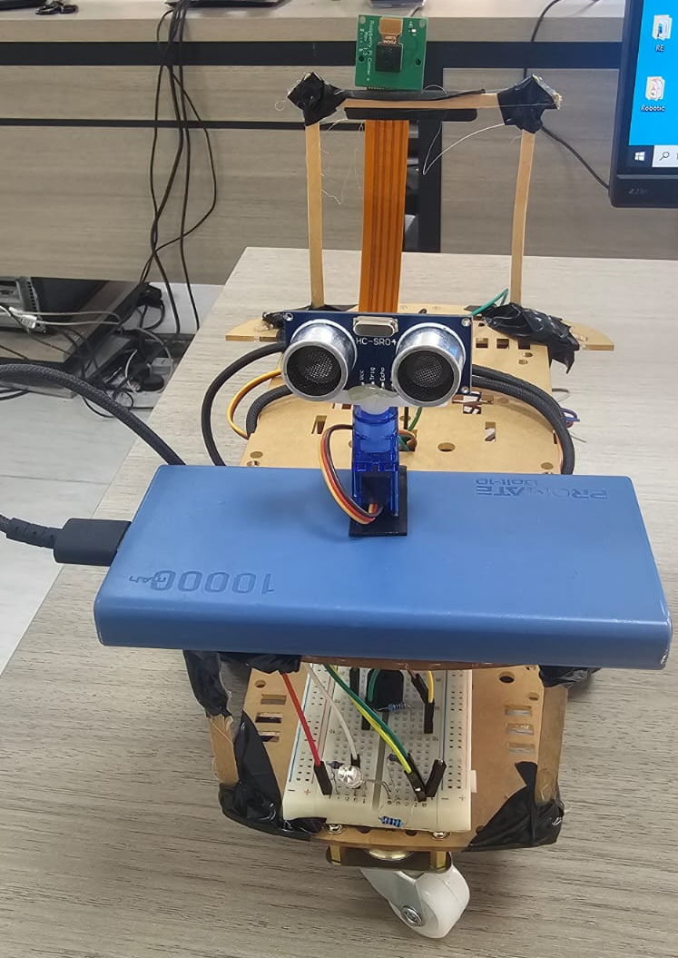
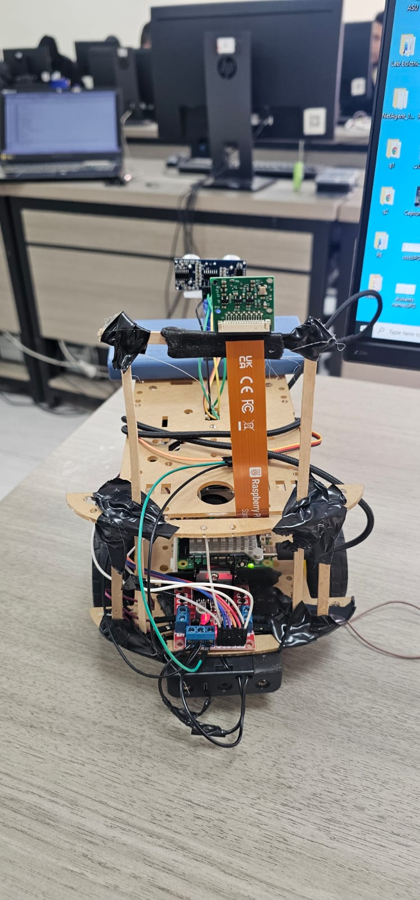
WAll-e
An Autonomous Surveillance Robot
By Mohammad Thaher

Slide 2

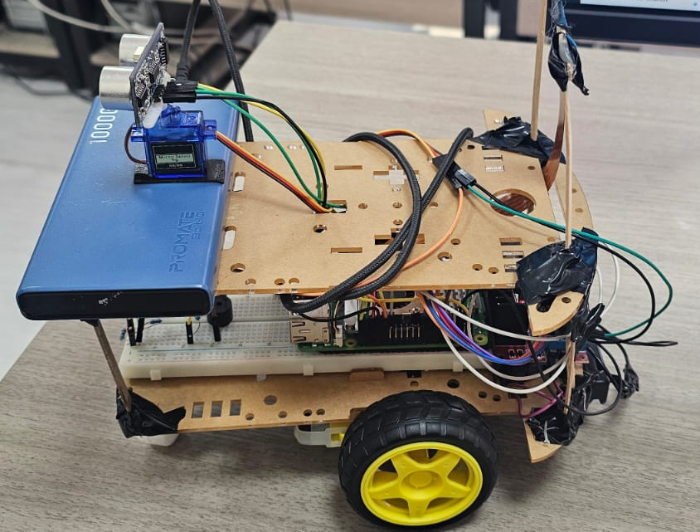
Abstract: The Vision of WAll-e
WAll-e is an autonomous obstacle-avoiding surveillance robot that utilizes a Raspberry Pi as its central processing unit. By integrating an HC-SR04 ultrasonic sensor with a servo motor, the robot can scan its surroundings to identify the safest path.
The system features advanced motor control techniques, including PWM-based pulsed motion and soft-start mechanisms, to ensure operational stability.
Furthermore, the robot enhances security by capturing images of detected obstacles and transmitting them to users via the Telegram platform.

Slide 3

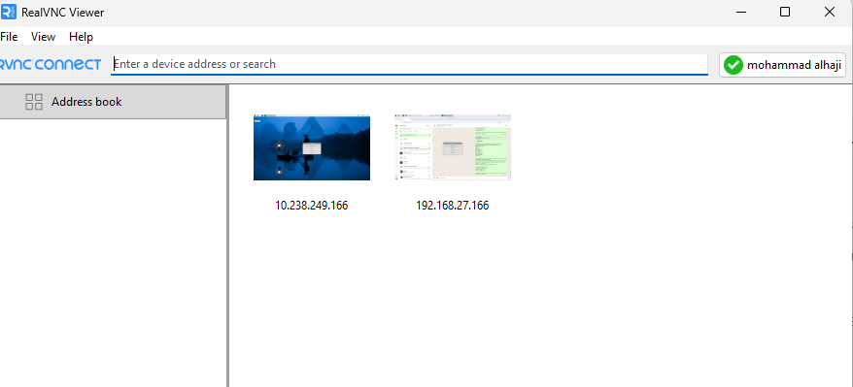
Introduction: Autonomous Surveillance
In modern applications such as safety monitoring and industrial inspection, autonomous mobile robots are becoming indispensable due to their ability to operate without constant human supervision.
Project Aim
The WAll-e project specifically addresses these needs by building a platform that integrates road traffic collision avoidance, object detection, and real-time observation using Python and the gpiozero library.

Slide 4

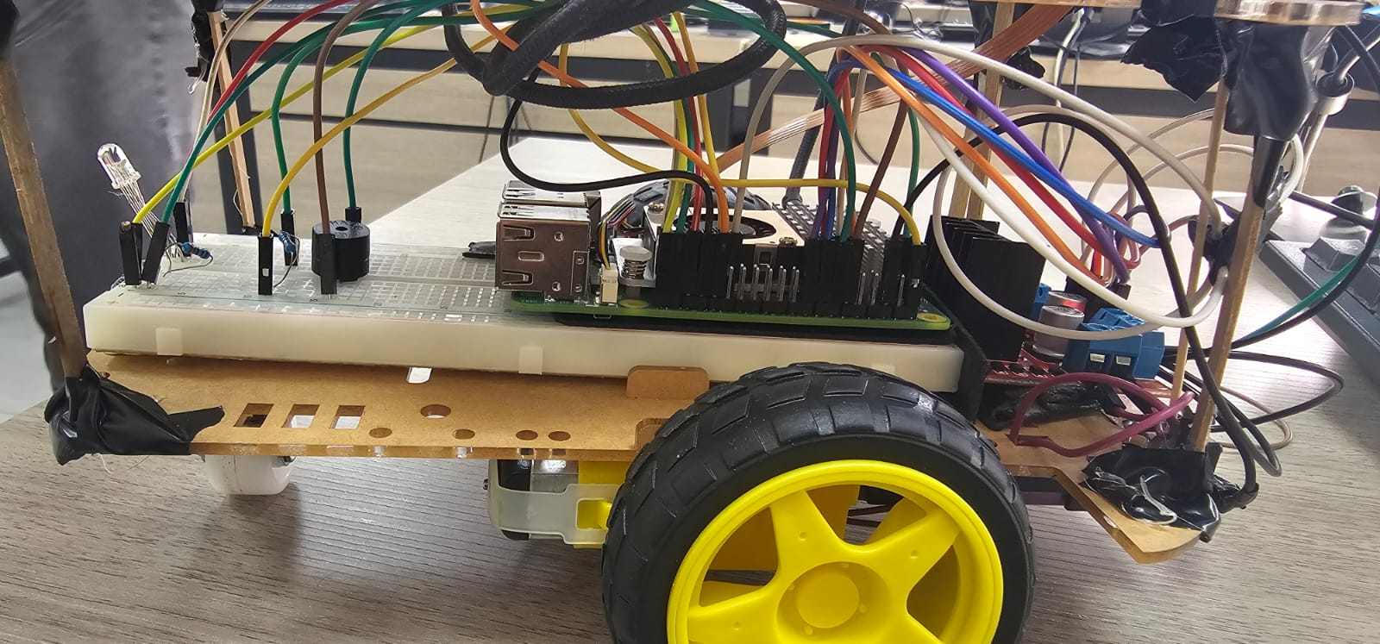
Hardware Architecture
Processing & Power
Sensing & Actuation
Raspberry Pi: The central brain managing sensor data and actuator commands.
HC-SR04 Sensor: Mounted on a servo for wide-angle environmental feedback.
Power System: Three (3.7v) 18650 Lithium batteries provide portable, autonomous operation for the entire system.
L298N Module: High-current driver for precise control of two DC motors.

Slide 5

Software Architecture: The Control Loop
01
02
03
Main Control Loop
Data Processing
Decision Logic
The software operates as a continuous, infinite loop managing sensing, decision-making, and movement in real-time. It ensures the robot remains responsive to environmental changes.
To ensure reliability, the system employs a median filtering technique. It processes five consecutive distance readings to eliminate signal spikes and environmental noise.
The robot evaluates filtered data to decide between forward motion or an avoidance sequence: stopping, scanning 180°, and selecting the path with maximum clear distance.
Filter Logic
Rejects outliers to prevent false obstacle detection.

Slide 6

Control Algorithms: Precision and Stability
Motor Control
Scanning Logic
Safety Zones
PWM Regulation
Wide-Angle View
Threshold Logic
Pulse Width Modulation ensures precise
Servo-mounted sensors provide
Predefined distance zones (Critical, Slow,
low-speed adjustments and smoother
environmental scanning across a broad
Far) dictate immediate robotic
motion.
angular range.
responses.
Soft-Start Mechanism
Path Selection
Real-Time Reaction
Gradual acceleration reduces
The system identifies the path with the
Continuous processing allows for
mechanical stress and prevents sudden
maximum clear distance for optimal
instantaneous adjustments to
jumps during startup.
navigation.
environmental changes.

Slide 7

Distance Zones & Logic
Zone
Distance Threshold
Robot Response
Critical
< 65 cm
Stop, scan surroundings, capture photo, and execute a turn.
Slow
65 – 145 cm
Enter caution mode with significantly reduced movement speed.
Far
> 145 cm
Maintain normal cruising speed and continue forward motion.
The robot's behavior is governed by these predefined thresholds to ensure safe navigation while optimizing operational efficiency in varying environments.

Slide 8

Testing & Results: Validation
Sensor Accuracy
Navigation
Median Filtering Success
Autonomous Path Selection
Comprehensive testing confirmed that median filtering successfully stabilized sensor readings, effectively eliminating signal spikes and preventing unnecessary stops.
The robot consistently identified the optimal path during avoidance sequences and resumed its mission without manual intervention in all test cases.
Stability
Communication
Motion Precision
Telegram Alert Reliability
The transition to pulse-based PWM control and soft-start mechanisms significantly improved low-speed precision and reduced mechanical stress.
The alert system proved highly responsive, delivering captured images and status updates to the user with minimal latency and high reliability.

Slide 9
Lessons Learned: Engineering Insights
Sensor Data Handling
Motion Control
Software Organization
Noise Management
Stability vs. Speed
Modular Architecture
Real-world sensor data is inherently
Direct motor activation is jerky. Pulse-
Breaking the program into separate
noisy. Robust filtering, such as the
based PWM control and soft-start
functions for sensing, movement, and
median filter, is essential for reliable
mechanisms are necessary for achieving
alerts simplifies debugging and testing.
decision-making.
stable movement.
Error Handling
Environmental Factors
Mechanical Strain
Integrating remote communication like
Testing in diverse environments
Gradual acceleration not only improves
Telegram requires robust error handling
highlighted the need for adaptable
precision but also significantly reduces
to prevent system crashes during
thresholds to maintain consistent
mechanical wear on the robotic chassis.
network issues.
performance.

Slide 10

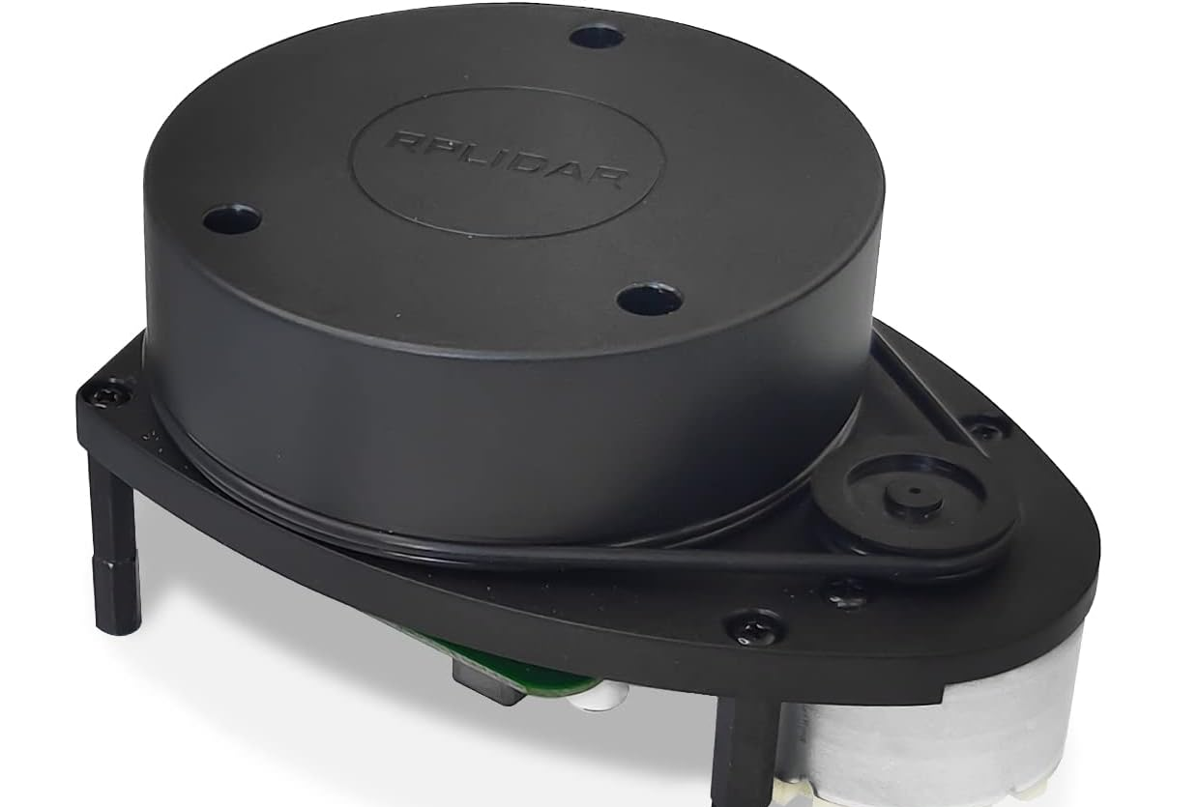
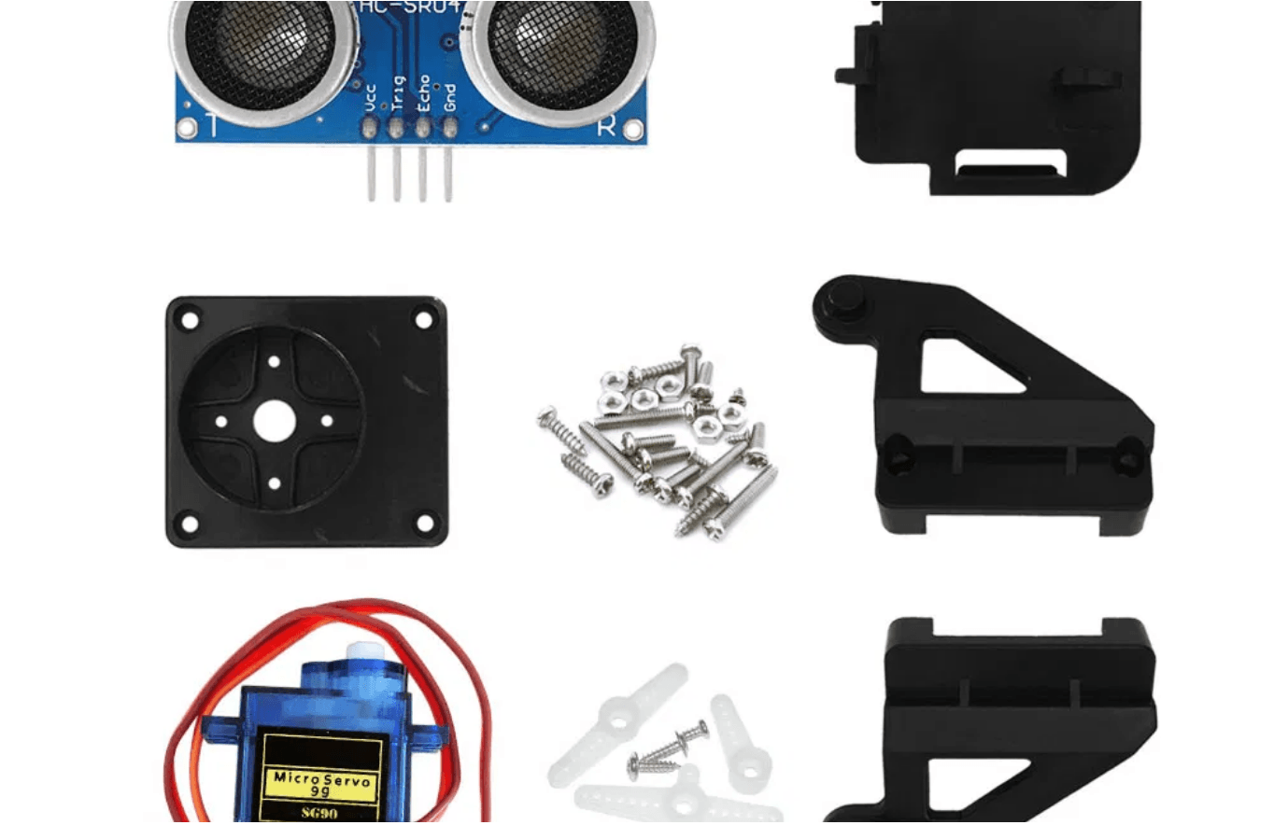
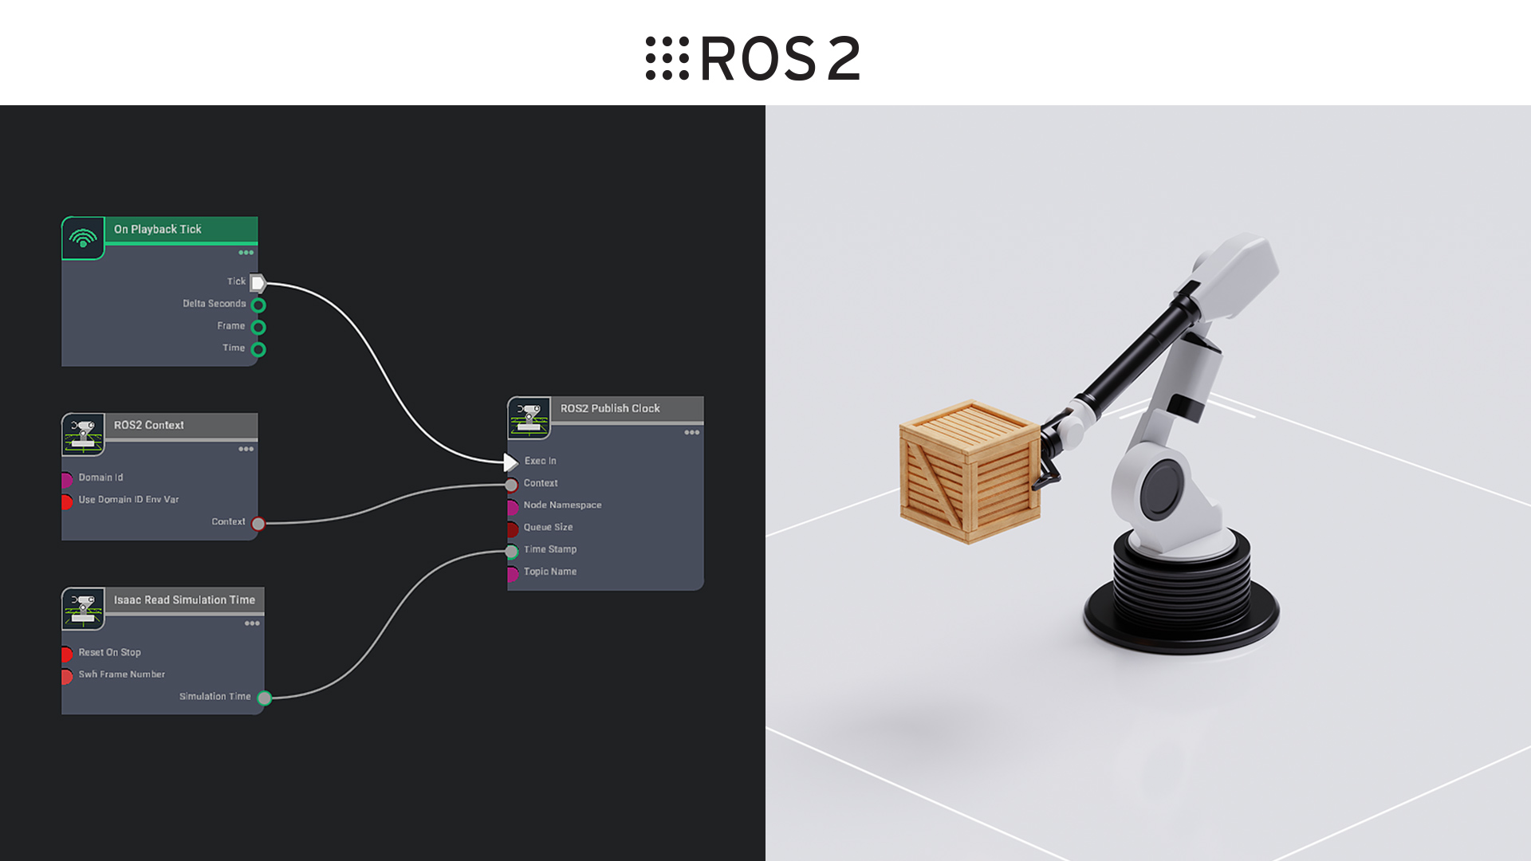
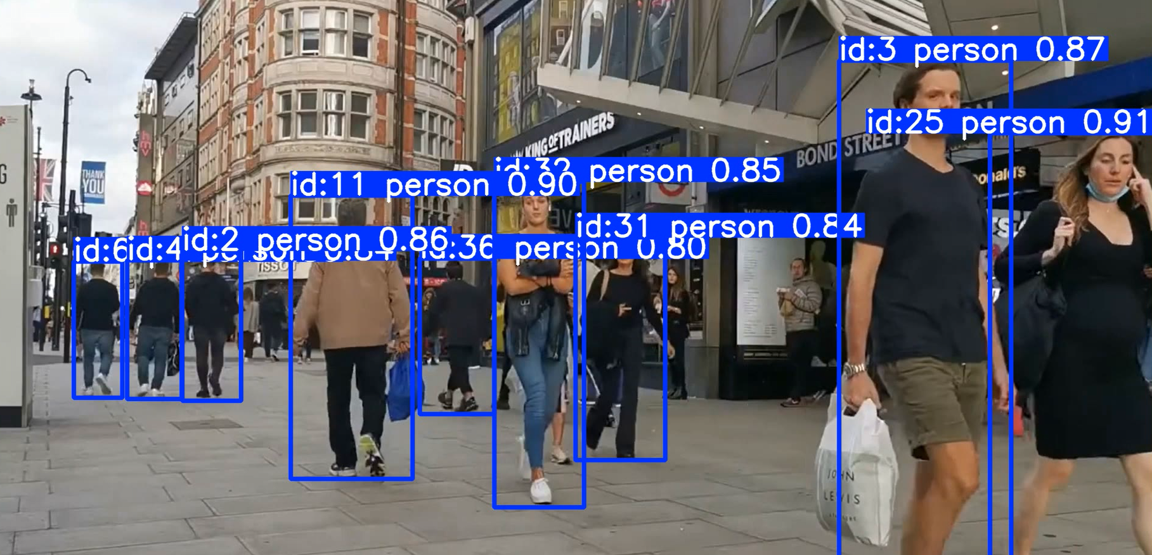
Future Enhancements: Scaling Up
Hardware Evolution
Intelligence & Vision
System Architecture
Advanced Sensing
Object Classification
Modular Framework
Integration of RPLIDAR for 360-degree mapping and Arduino Uno for low-level task offloading to improve real-time response.
Implementing OpenCV and YOLOv5-tiny for real-time identification of people and objects in captured surveillance images.
Transitioning to ROS2 (Robot Operating System) to create a scalable, modular architecture for complex multi-sensor missions.

Slide 11

Conclusion: Project Impact
The WAll-e project successfully demonstrates the integration of real-time sensing, autonomous decision-making, and wireless communication in a mobile robotic platform.
Key Achievement
WAll-e proves that intelligent control logic can transform simple hardware into a sophisticated autonomous system.
It has provided invaluable hands-on experience in embedded systems and robotics engineering, serving as a robust foundation for future developments.
Project Completed Successfully

