Slide 1
College Review Website
Group 7
Craig Mc Iver
Mai Nguyen
Erika Ergart
Stefanie Walsh
Theodore Ginting

Slide 2

Client: Niche.com
Large database of US schools.
Many different filtering options for website users.
Well-established in the college review market, but many competitors.
Generates revenue from universities promoting themselves in the search results as well as from other advertisers.
Notes:
1700 partnered schools

Slide 3

Objective
Expand upon the current dataset.
Introduce international universities.
Carry these tasks out efficiently to reduce strain on Niche.com.
Swiss Federal Institute of Technology, Zurich

Slide 4
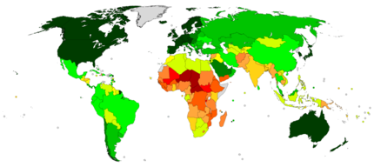
Datasets
World University Rankings set
Salaries By College Type set
Top_schools
Country_data
Read in through MySQL’s import wizard
Human Development Index World Map

Slide 5
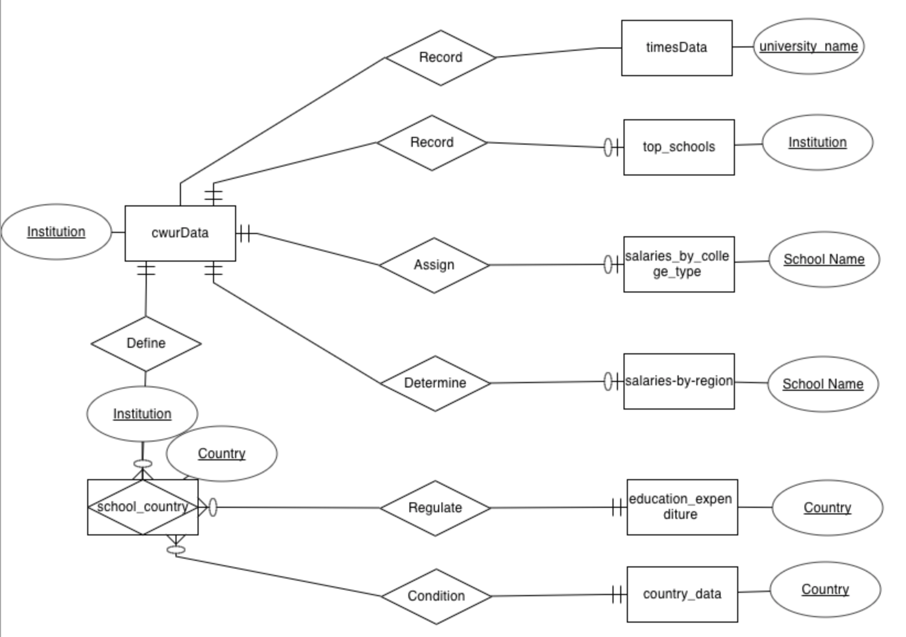
Entity Relationship Diagram

Slide 6
Factors that Impact College Rankings

Slide 7
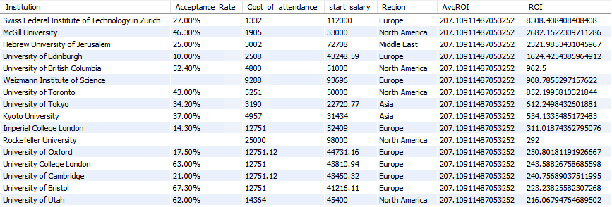
What are the top schools by ROI?
European universities tend to have the highest return on investment.
Acceptance rates for top ROI schools are average, compared to competitiveness of the Ivy League universities.
Notes:
Identifying institutions that have return on investment between starting salary and cost of attendance that are higher than the average return on investment among top schools across different regions.

Slide 8
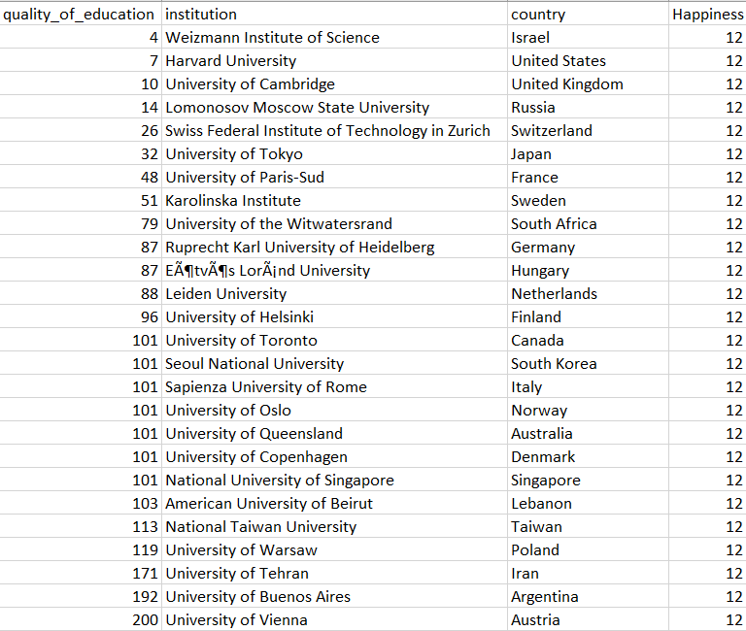
How does happiness index affect college quality of education?
Higher happiness index results into better quality of education in each country.
Happiness motivates us to go to classes, participate in activities, and collaborate

Slide 9
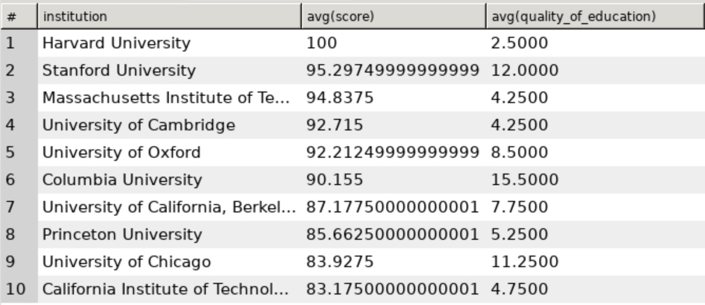
Is there a relationship between Total Score and Quality of Education?
There does not seem to be a strong relationship between quality of education and average score for schools that are strong overall.
We suggest our client look at other factors to see if there is a stronger relationship elsewhere.

Slide 10
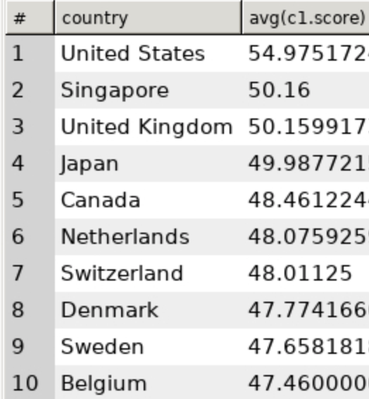
What is the average score by country?
The United States leads
Surprisingly, Singapore comes in second.
Since Singapore is less common for US high school students to study at, it might make sense for our client to promote Singapore as an up-and-coming education center.

Slide 11
Salary Analysis

Slide 12
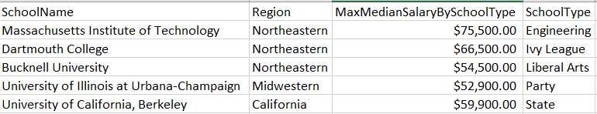
Which region results into the highest starting median salary?
Northwestern region breeds the highest starting median salary.
First schools in the United States emerged in the 13 colonies, which are located in the Northeastern region.
The older the college is, the more time it took for the teach staff to perfect their craft

Slide 13
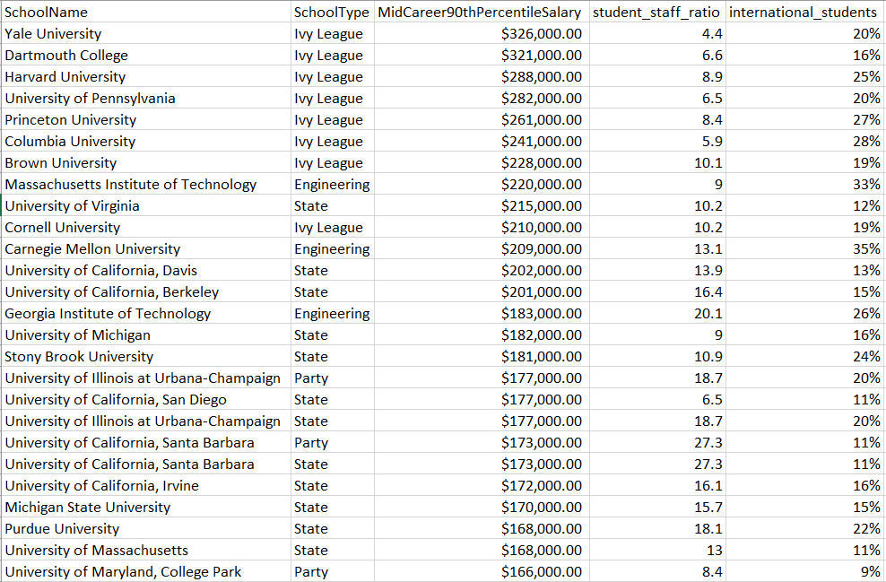
Is having a higher rate of international students and smaller student to staff ratio related to higher Mid-Career 90th Percentile Salary?
Lower student to staff ratio leads to more personal relationships professors develop with students, which results into:
More questions answered
Assisting with finding higher paying jobs
Higher international student ratio leads to:
More diverse learning experience
Better professional expertise

Slide 14
Quality of Education Analysis

Slide 15
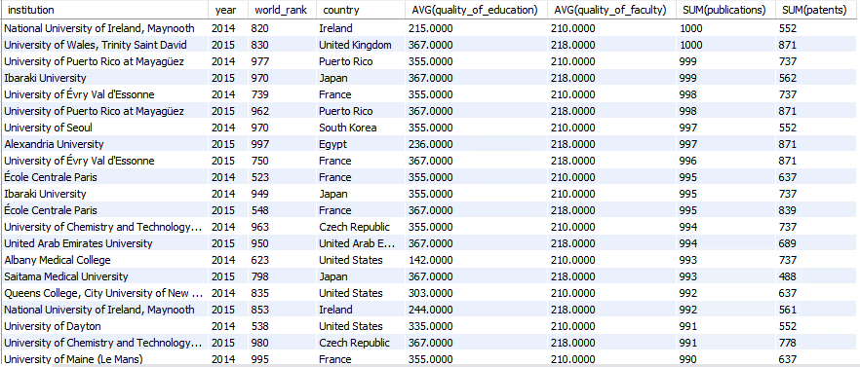
Which universities have good research resources?
Listed are the universities with number of publications and patents gained per year
Observe how those relate to quality of education and quality of faculty in the same year
Disclaimer: This table shows that the ranking of the university does not necessarily result in high quality of education and more publications getting published. Instead, the quality of education and quality faculty directly affects the number of publications and patents that schools achieve. This is a good reference for research scholars when it comes to choosing a research university that fits their needs.

Slide 16
Education Expenditure

Slide 17
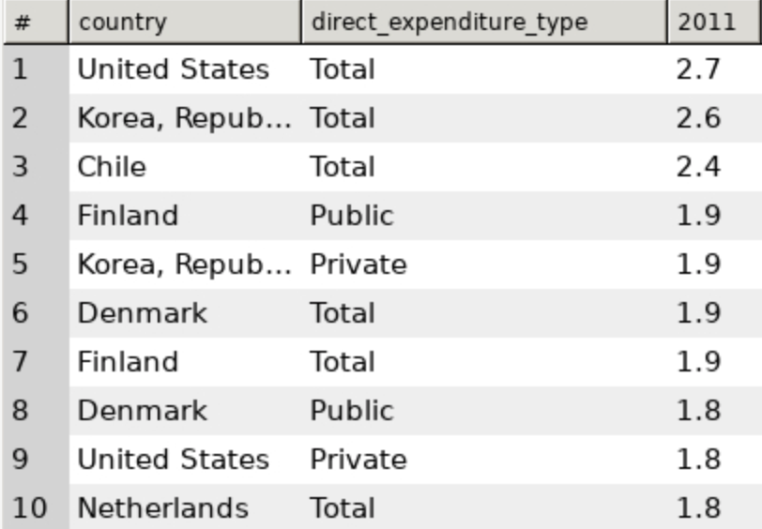
What is the education expenditure by country?
Countries like Korea, Finland, and Denmark have high expenditures given the size of their country.
Our client could decide to focus some exploration into schools in those countries, assuming that higher spending on education leads to better education outcomes.
The analysis would be further benefitted by including population size as a variable to get expenditure per capita.

Slide 18
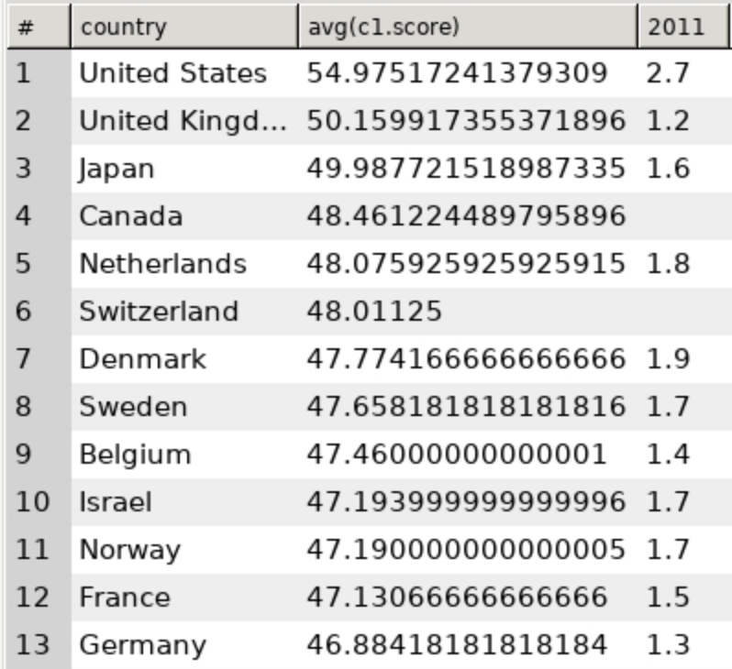
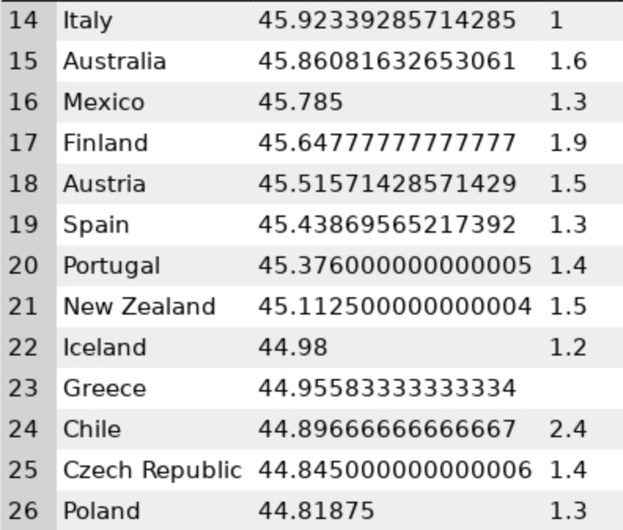
What is the relationship between expenditure and score by country?
There might be a small correlation between expenditure and score.
The average is around 1.3 to 1.9.
Chile spends the second most money on education but is ranked 24 out of 26.
It is important for our client to not always assume that expenditure is equal to outcome.

