Slide 1
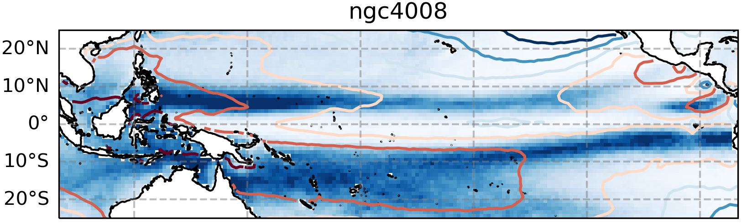
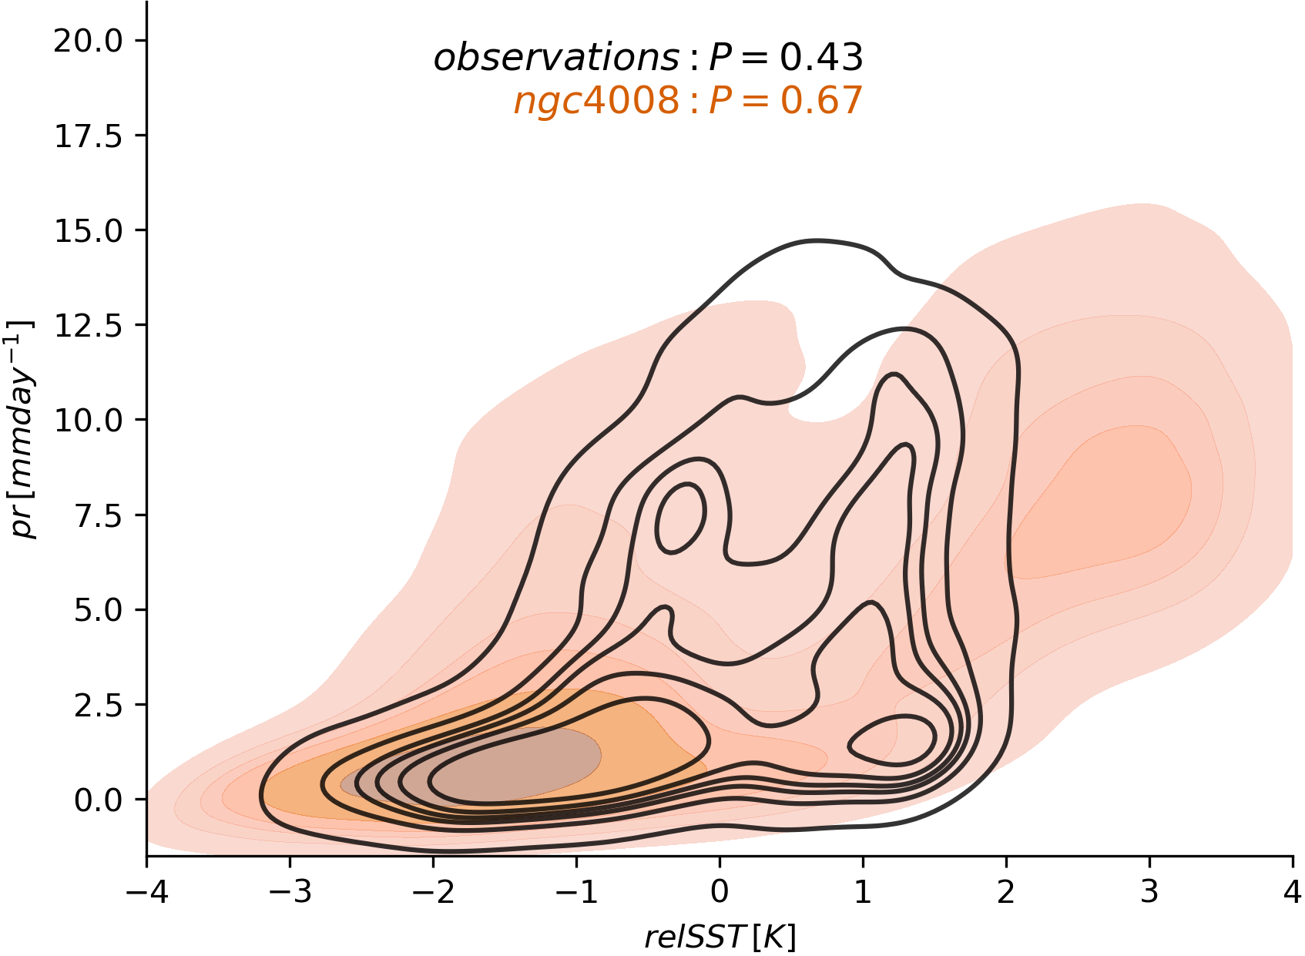
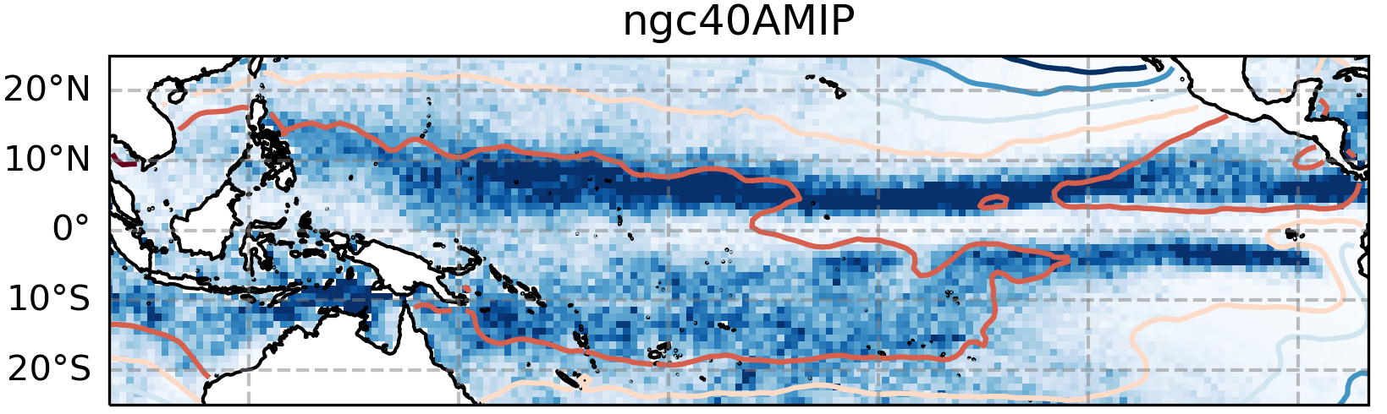
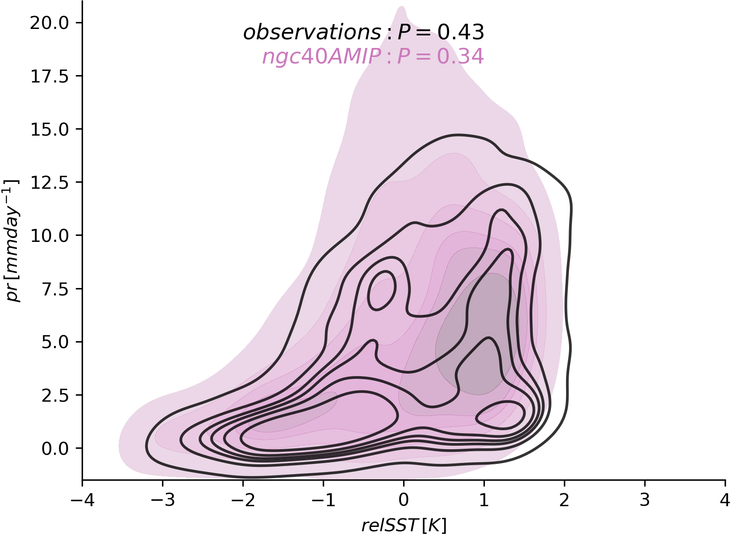
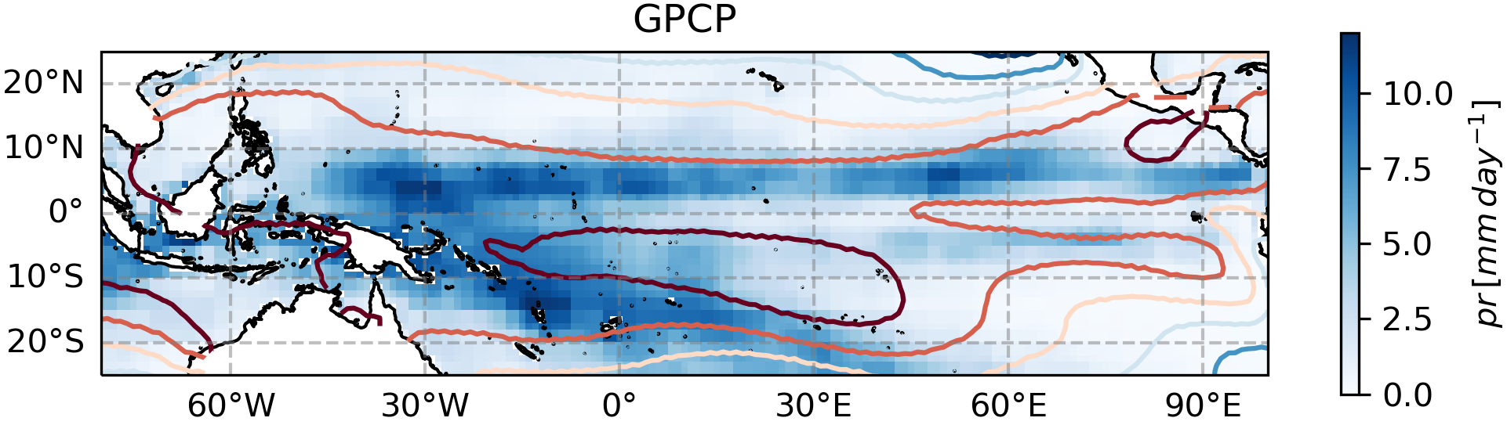
Aprilic Pacific ITCZs in ICON-ngc4008 and -AMIP
Sebastian K. Müller and Simona Bordoni - Uni Trento
A): ngc4008 dry and cold along the Equator → Pacific cold tongue stretches too far
B): ngc4008 overestimating SSTs, and overestimating precipitation SST scaling
→fixing SSTs helps much in fixing precipitation biases

Slide 2
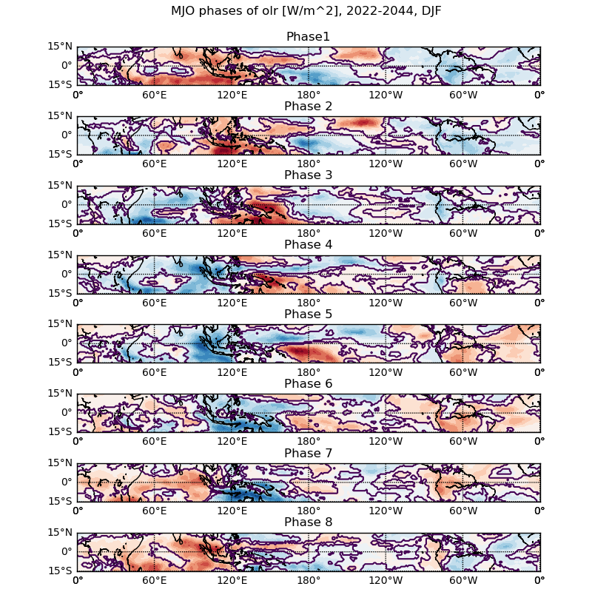
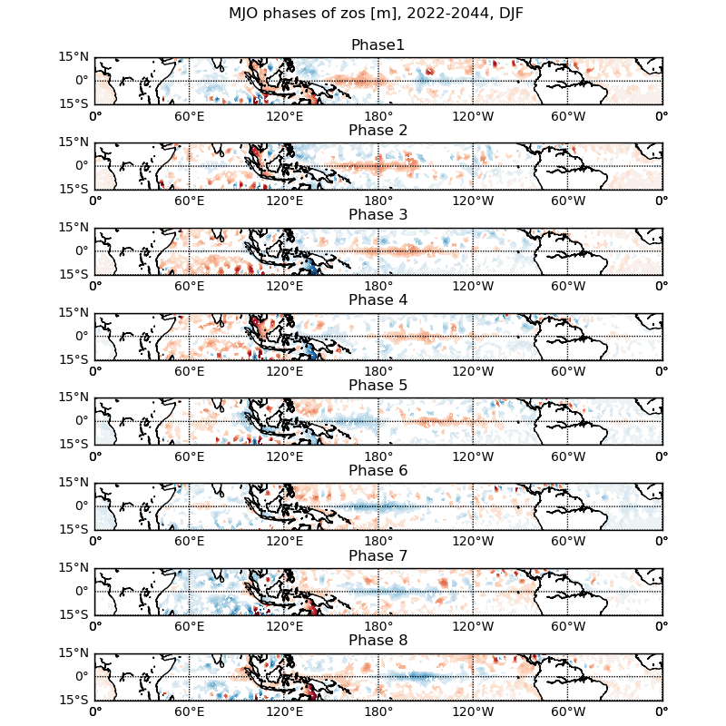


Madden Julian Oscillation (IFS_9-FESOM_5-production)

Slide 3
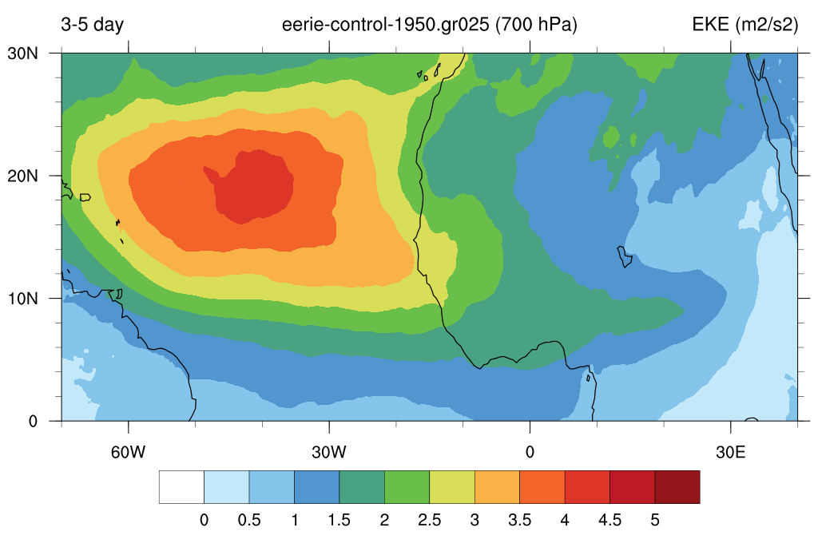
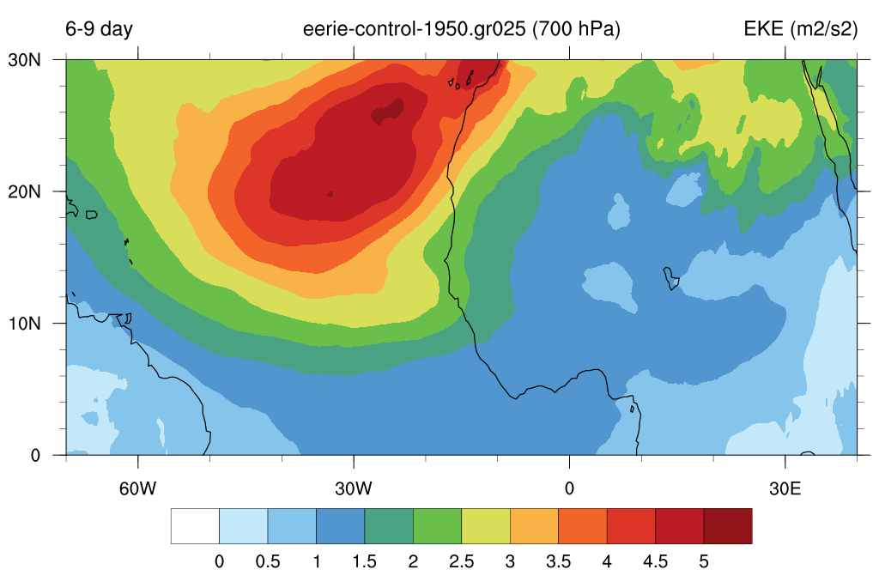
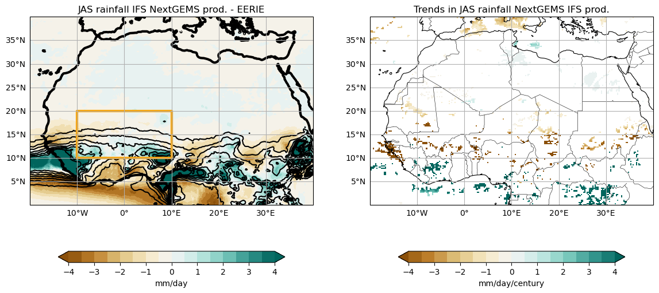
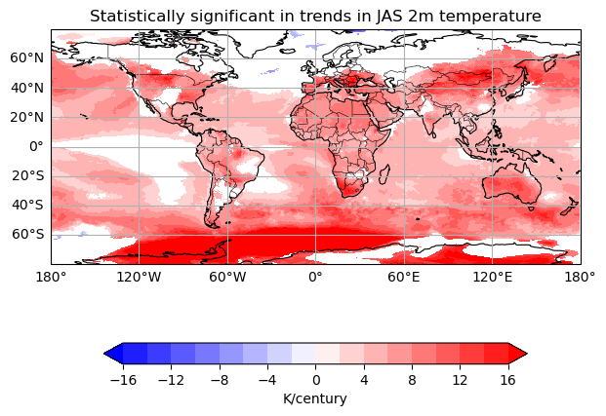
West African Monsoon in IFS c4 simulations
African Easterly Waves in IFS EERIE 1950-Ctrl
Climate Change in IFS

