Slide 1
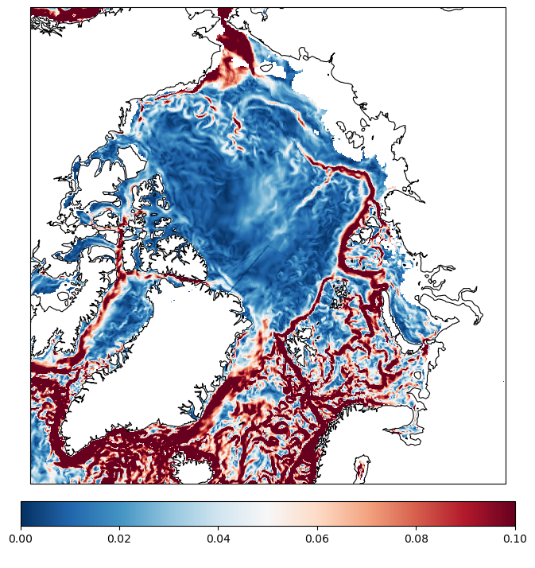
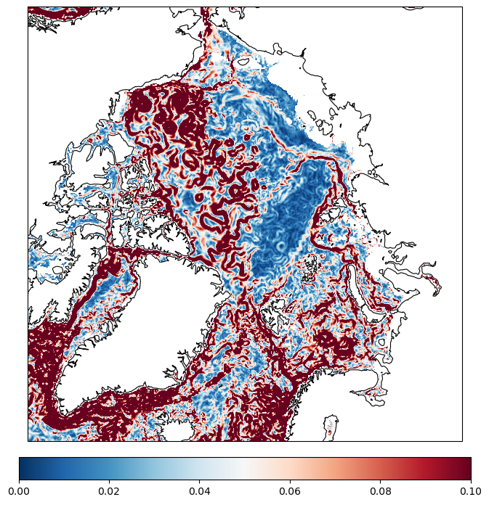
Ocean speed at 40 m depth
IFS-FESOM
First timestep of simulations
ICON

