Slide 1
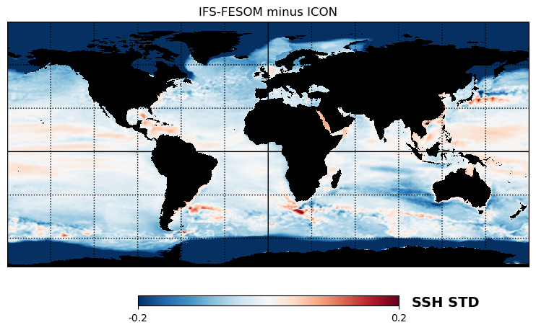
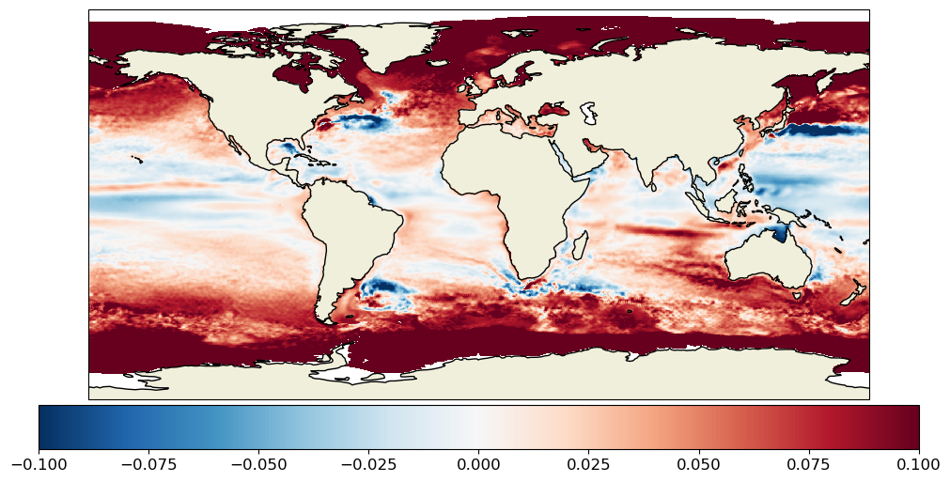
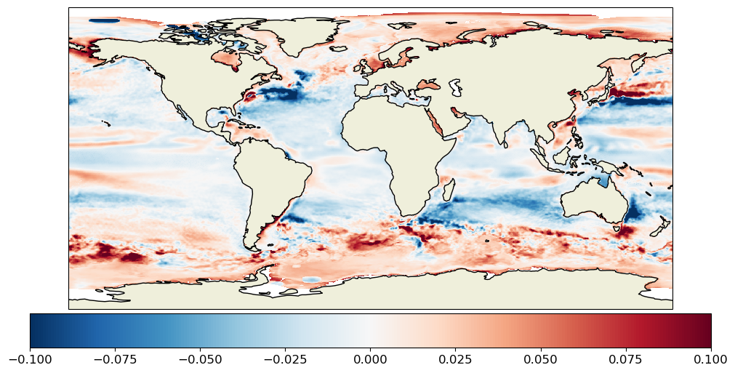
ICON 2020 to 2031
IFS-FESOM 2020 to 2045
AVISO 2000 to 2022
ICON-AVISO
IFS-FESOM - AVISO

