Slide 1
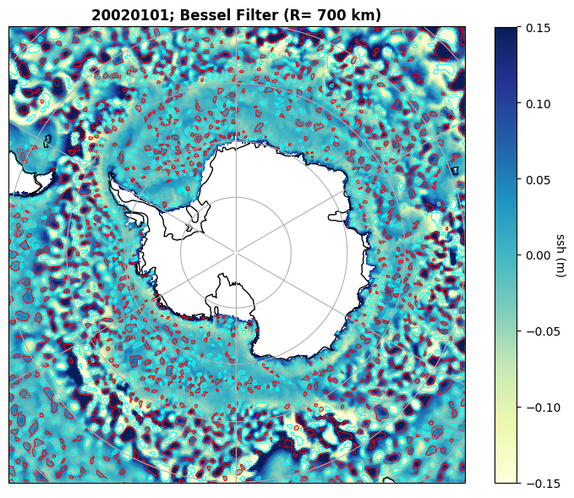
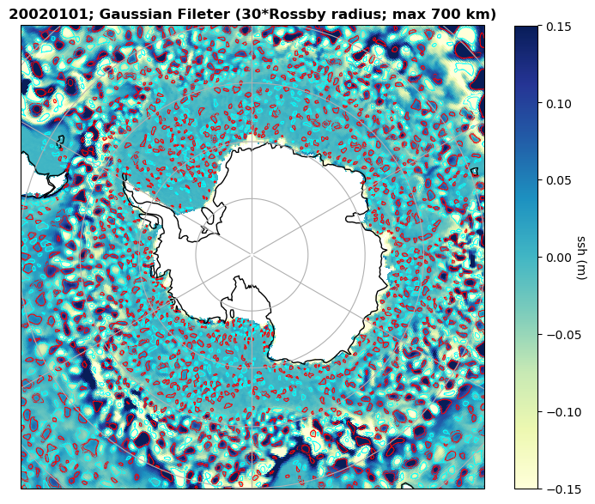
Testing the eddy identification based on ssh anomalies with different high-pass spatial filters
Testing the eddy identification based on ssh anomalies with different high-pass spatial filters
Ting-Chen Chen

Slide 2
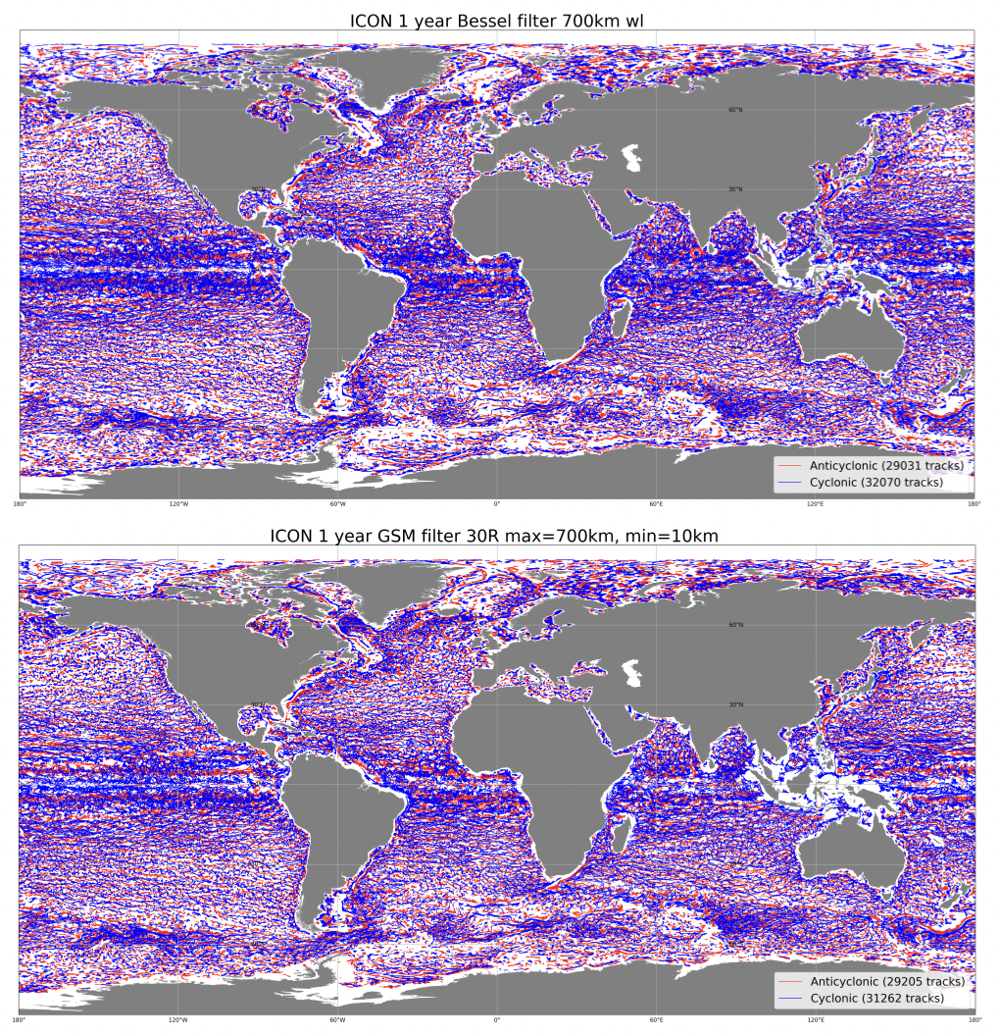
Stella Berzina

