Slide 1
Schematics

Slide 2
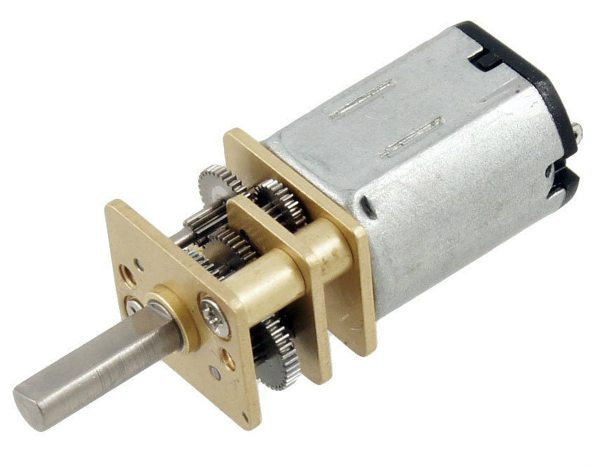
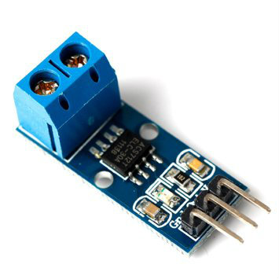
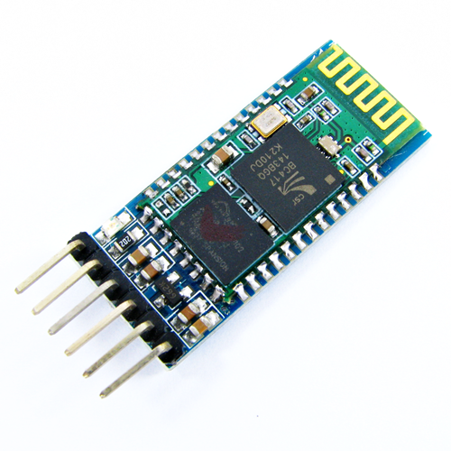
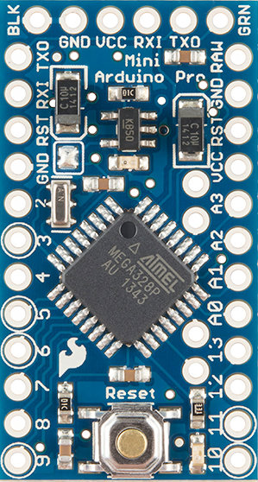
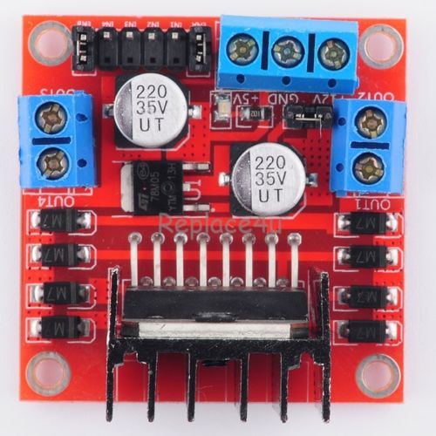
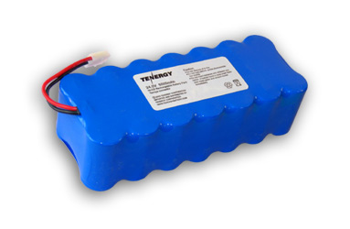
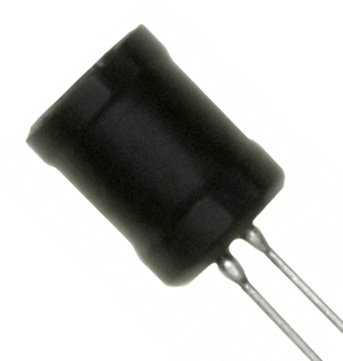
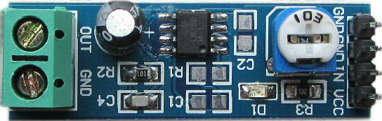
Robot schematics
DC Motor 30rpm
Current sensor
Bluetooth
OUT
TX
RX
Arduino Pro Mini
Motor driver
TX
RX
Battery
IN4
ENB
IN2
IN3
ENA
IN1
D2
A3
D3
A2
Inductor
A1
Voltage
D5
A0
D6
D11
D10
Audio amplifier
DC Motor 30rpm
Current sensor
OUT
GND
IN
OUT

Slide 3
Base station schematics
Bluetooth
Perimeter wire
TX
RX
Arduino Pro Mini
Perimeter wire driver
IN4
ENB
IN2
IN3
ENA
IN1
RX
TX
D7
D8

Slide 4
Connectivity
Serial over bluetooth
Base station
Serial
PC
Robot
Smartphone

Slide 5
Controller smartphone app
Robomower
SELECT
START

