Slide 1

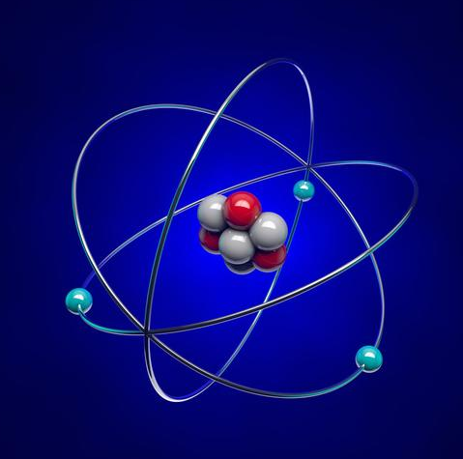

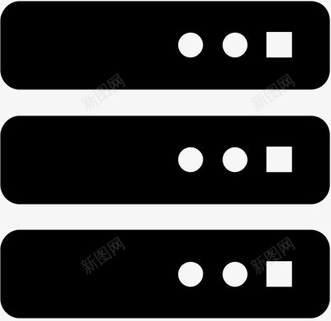


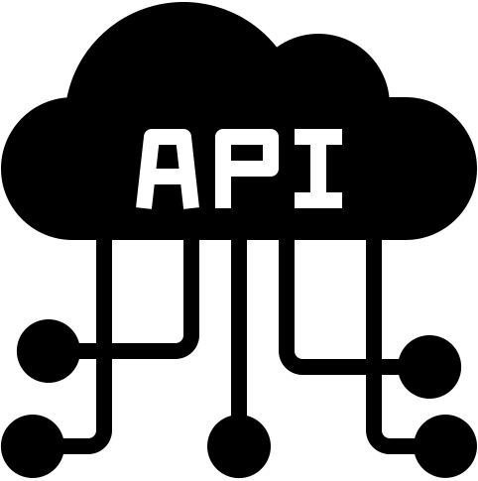

Game Engine
Game Logic
CLI Server
Build with Docker
Server Image
Playback
Message Writer
Game Records
gRPC Server
Network
Web
Playback File
gRPC Stub
Build with Docker
Client Image
Message Reader
Game Records
Unity
CAPI
Debugger
Clients

