Slide 1
Team 10: Experiment
202532004 경규진
202522008 김재현
202628049 최이설

Slide 2
Topic 2:
Human Presence Detection using Radar

Slide 3
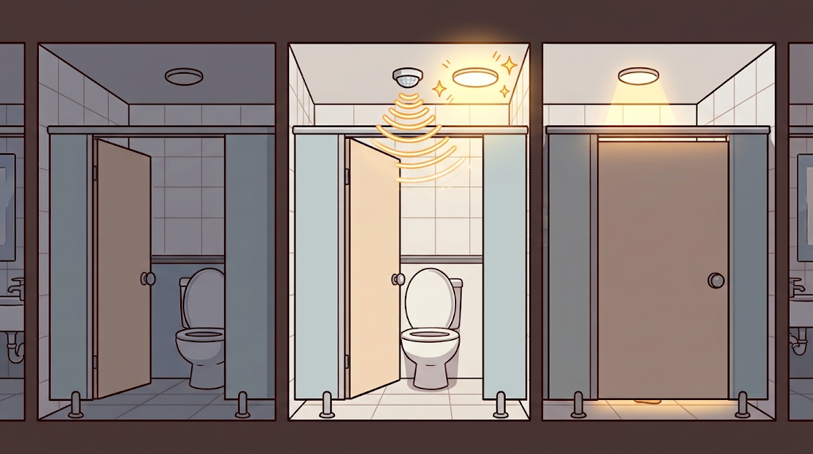
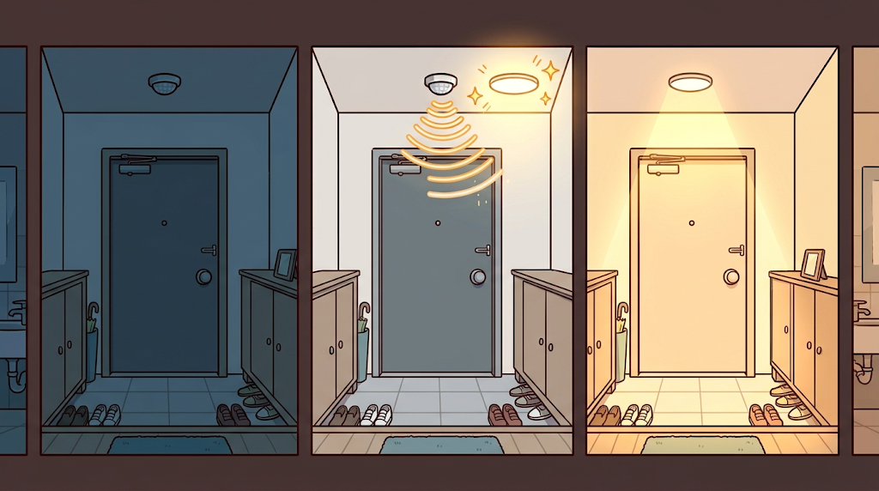
Topic 2-1: Human Presence Detection using Radar in Large Room
Motivation
Passive Infrared (PIR) sensors have a limited detection range and require human movement.

Slide 4
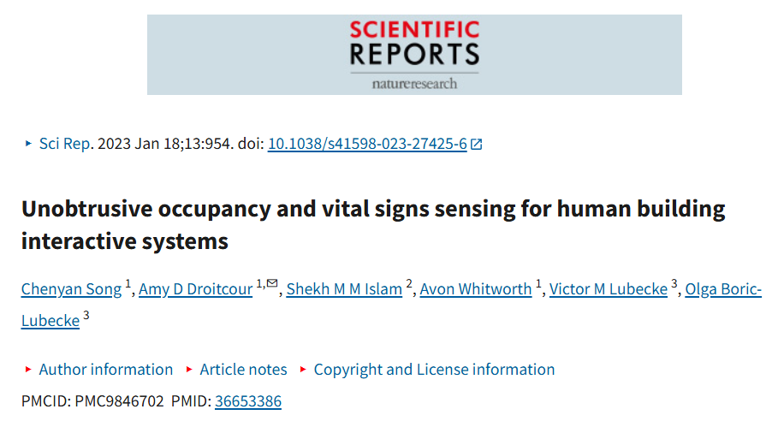
Topic 2-1: Human Presence Detection using Radar in Large Room

Slide 5
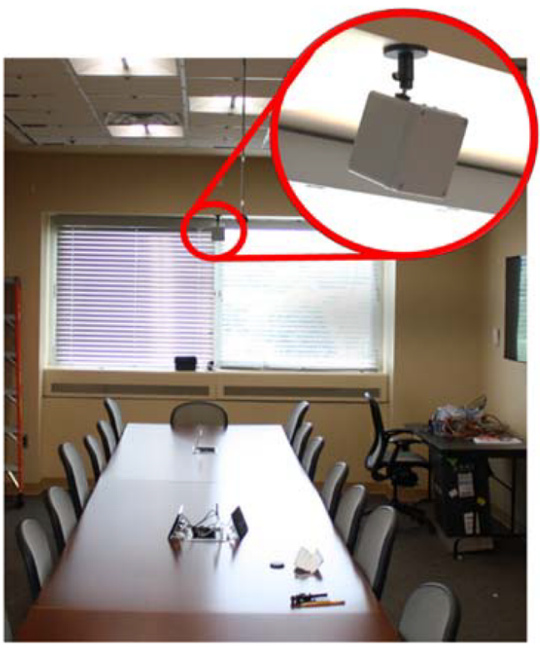
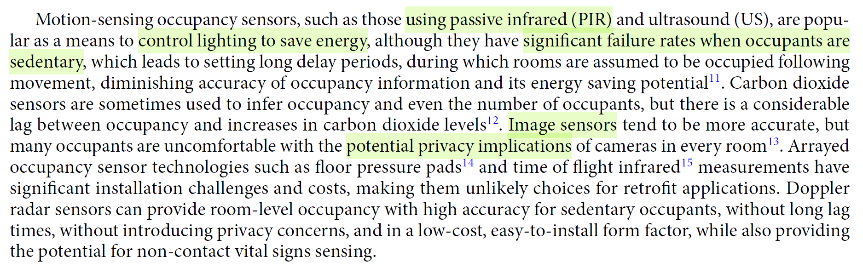
Topic 2-1: Human Presence Detection using Radar in Large Room

Slide 6
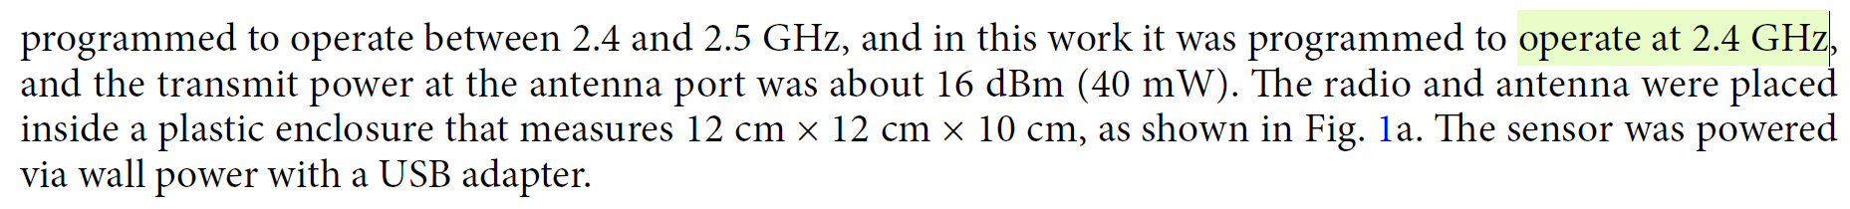
Topic 2-1: Human Presence Detection using Radar in Large Room
Research Question
Does 2.4 GHz penetration lead to false detections through walls, such as detecting people in adjacent rooms?
How should the radar be selected based on room size and wall material?

Slide 7
Topic 2-1: Human Presence Detection using Radar in Large Room
Independent Variables
  Room/Subject/Radar Specification
Dependent Variables
  Light On/Off Status

Slide 8
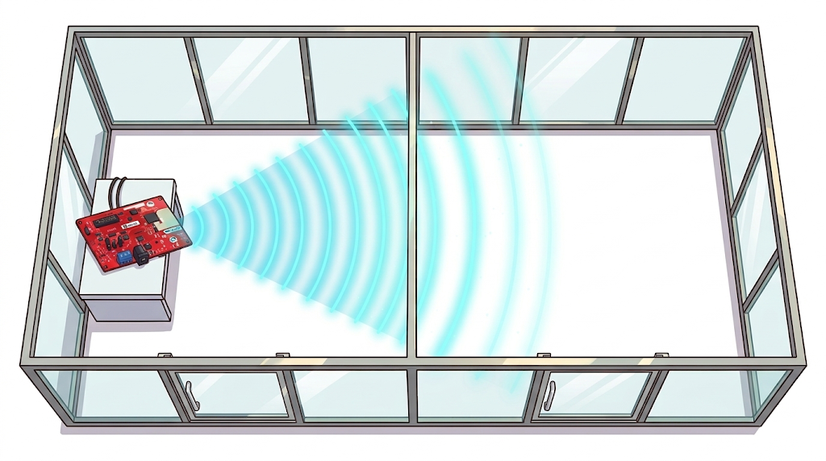
Topic 2-1: Human Presence Detection using Radar in Large Room
Experiment
Room E3 423
Room E3 424
2.4Ghz
24Ghz
70Ghz

Slide 9
Topic 2-2: Human Presence Detection using Radar in Bathroom
Motivation
Passive Infrared (PIR) sensors have a limited detection range and require human movement.

Slide 10
Topic 2-2: Human Presence Detection using Radar in Bathroom
Research Question: Can stationary occupants be reliably detected to prevent unintended light shutoff?
Independent Variables
  Person / Measurement Time / Movement Status
Dependent Variables
  Number of Light-Off Events During the Measurement Period

Slide 11

Topic 2-2: Human Presence Detection using Radar in Bathroom
Experiment
PIR vs Radar

