Slide 1
BIS Standards Recommendation Engine
Team BrainFreeze
GitHub code link: https://github.com/eesha-kamath/bis-standards-recommendation-engine
Demo video link: https://youtu.be/yuJFtrS6XGI

Slide 2
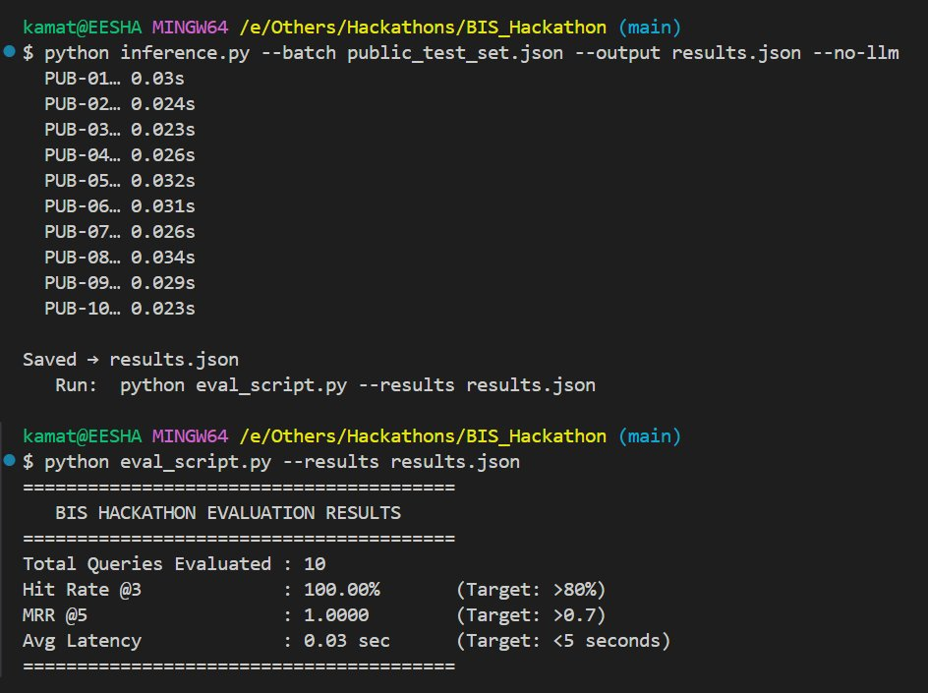
BIS Standards Recommendation Engine
100%
1.0
0.03s
Hit Rate @3
MRR @5
Avg Latency
Hybrid BM25 + TF-IDF search over SP 21 building materials standards
Target: Hit Rate >80%, MRR >0.70, Latency <5s All 3 exceeded

Slide 3
Solution Overview
Parse SP 21
Hybrid Search
Query Expansion
No Hallucinations
569 IS standards pulled from 929 pages. Regex header detection. Longest entry kept to skip table of contents stubs.
BM25 for exact keyword match plus TF-IDF trigrams for phrase overlap. Fused 50/50. No GPU. No neural model.
30 domain shortcuts expanded before search. OPC becomes Ordinary Portland Cement. SRPC becomes Sulphate Resisting. Etc.
3 independent guards: LLM only sees 8 candidates, prompt blocks invented codes, code validation drops anything not retrieved.

Slide 4
System Architecture
BUILD - runs once
SP 21
PDF
Extract
Text
Parse +
Dedup
Alias
Enrich
Build
Index
›
›
›
›
929 pages
pdftotext
569 standards
18 IS codes
BM25 + TF-IDF
QUERY - every search
Product
Description
Expand
Query
BM25 +
TF-IDF
Top 8
Candidates
Llama 3.3
Rationale
Validate
Output
›
›
›
›
›
plain English
30 aliases
fused score
retrieved
via Groq API
no hallucination
OUTPUT Top 3 to 5 IS Standards Rationale Confidence Score Compliance Checklist
No LLM mode: fully offline, 0.03s response, no API key needed
With Groq API: Llama 3.3 generates plain English rationales, under 3 seconds

Slide 5
Chunking and Retrieval Strategy
How we parsed SP 21
Retrieval Fusion
1
IS Header Detection
BM25
TF-IDF Trigrams
Regex finds every IS XXXX : YYYY block. 569 standards extracted.
exact keyword match
phrase cosine match
2
Drop Table of Contents Stubs
▼
▼
PDF has short TOC entries for every standard. We keep only the longest version, which is always the full summary.
0.5 x BM25 + 0.5 x TF-IDF = Final Score
3
Alias Injection
Top 8 candidates selected
Pure numpy operations, no GPU
Sparse beats dense for IS terminology
18 key standards get trade names added directly. IS 269 gets OPC 33. IS 455 gets PSC. Closes the vocabulary gap.
4
1400 Character Cap
Each document trimmed to 1400 chars plus aliases to keep the index fast.

Slide 6
Evaluation Results
100%
1.0
0.03s
Hit Rate @3
MRR @5
Avg Latency
Target was over 80%
Target was over 0.70
Target was under 5s

Slide 7
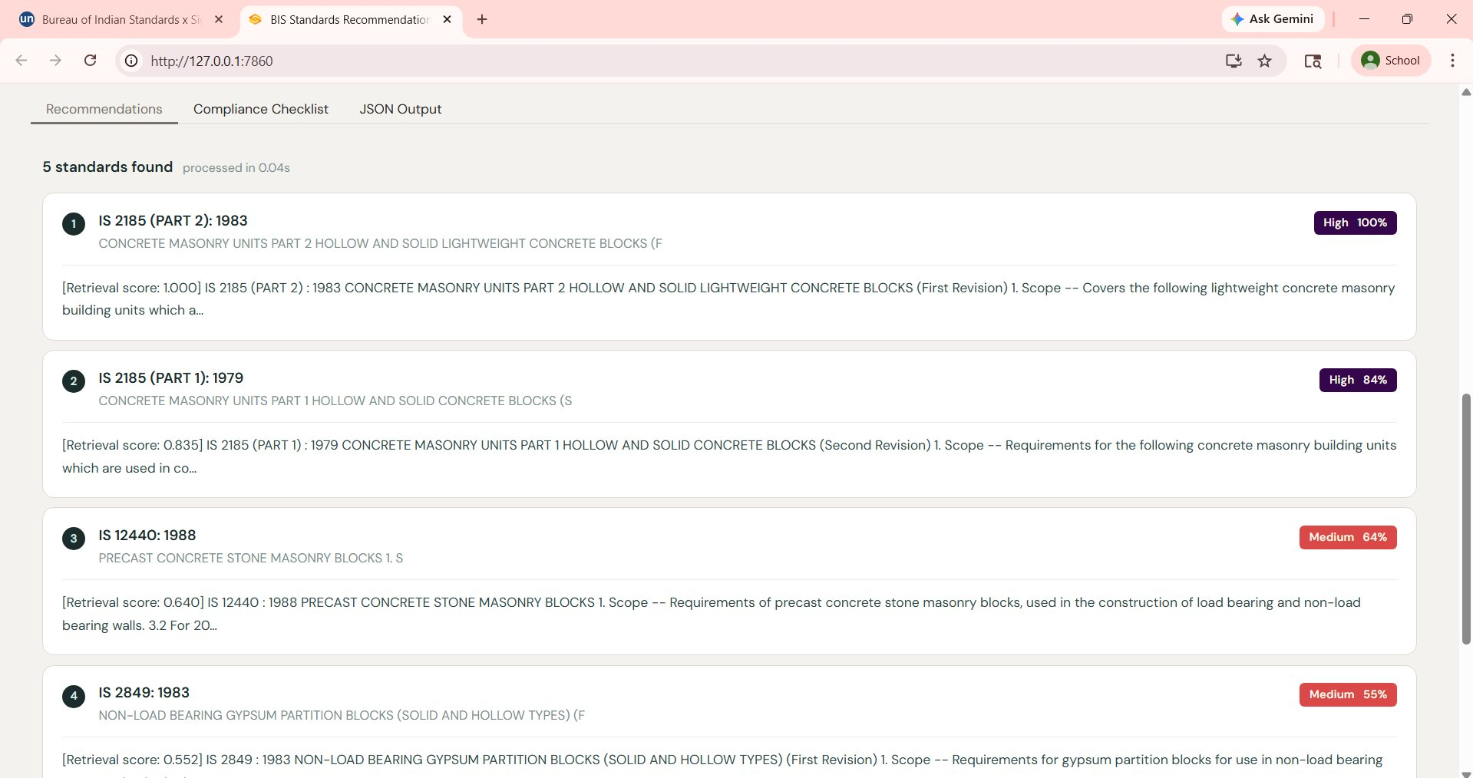
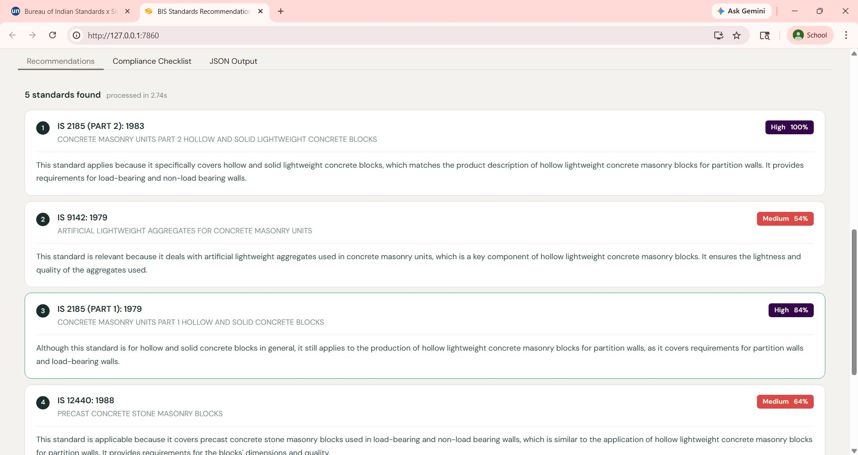
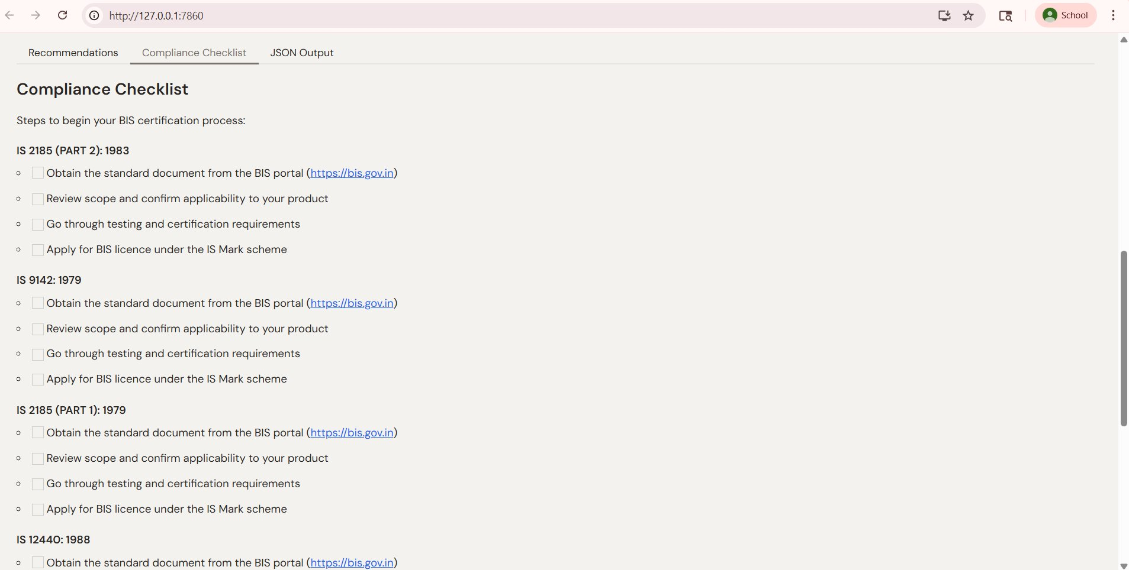
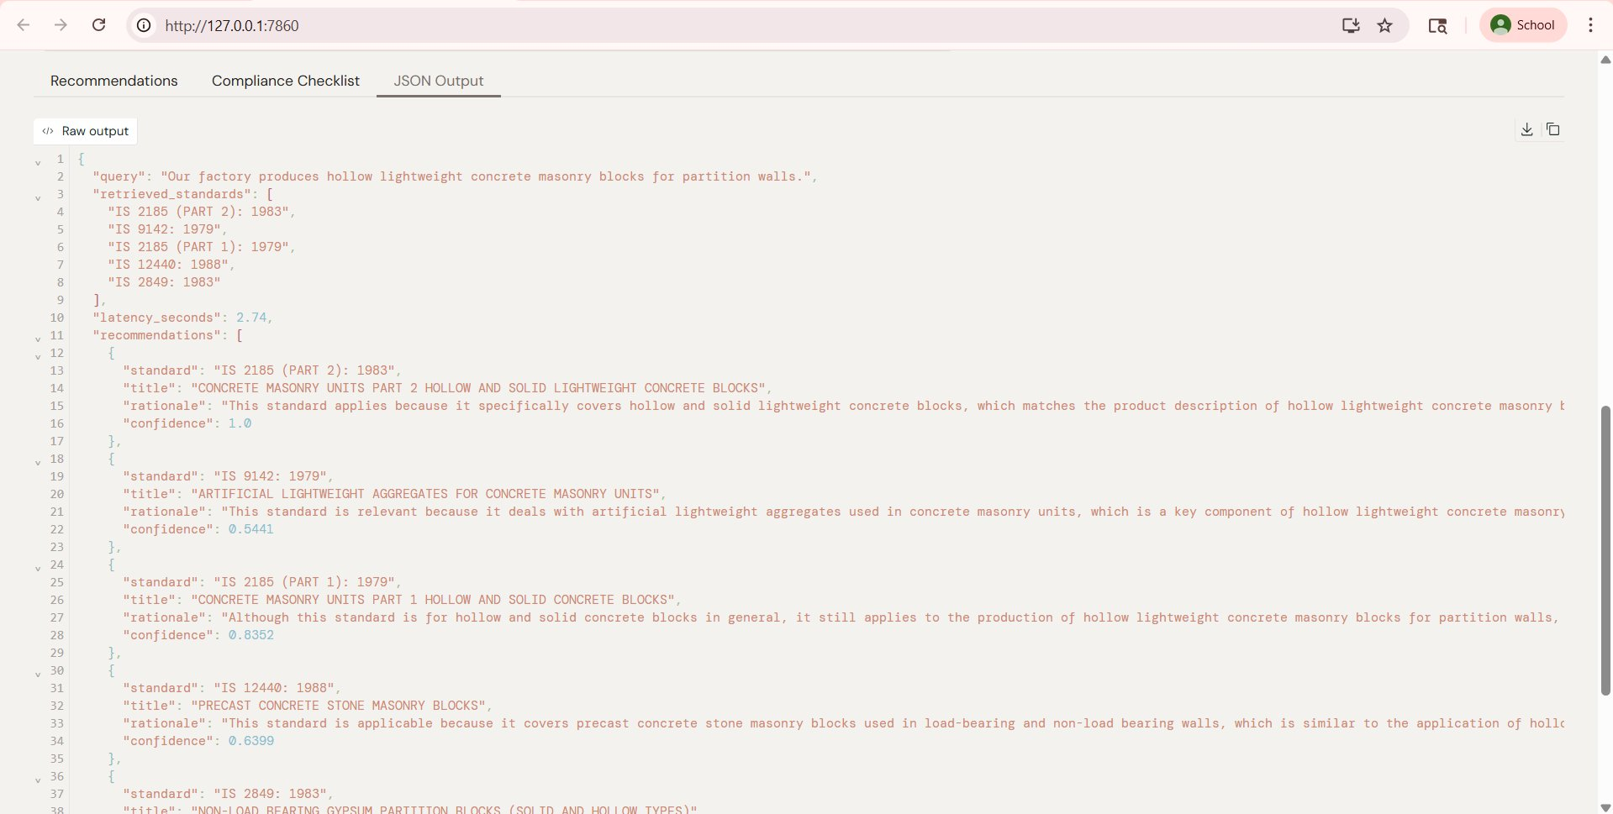
Demo Highlights
Retrieval only (0.04s, offline)
With Groq rationales (2.74s)
Compliance checklist tab
JSON output tab

Slide 8
How We Score on Every Criterion
PRIMARY METRICS: Automated against hidden test set
Hit Rate @3
Target >80%
MRR @5
Target >0.70
Avg Latency
Target <5 sec
We got 100%
We got 1.00
We got 0.03s
SECONDARY METRICS: Manual review by judges
Relevance Score (10 pts)
No Hallucinations (10 pts)
Judge picks 5 random queries and rates our top 3 results on a 1 to 5 scale.
Binary check per response. Any invented IS code = 0. Score = clean responses divided by total.
Our rationales are specific, sourced from SP 21, and explain exactly why each IS code applies to that product.
We have 3 independent layers. The LLM physically cannot see or return any standard outside the 8 retrieved. Guaranteed clean.
SUBJECTIVE: Code quality, Innovation, UI, Presentation
Technical
Excellence
Innovation
Usability
and Impact
Presentation
Clean 4-file codebase. One command runs everything. requirements.txt included.
Hybrid sparse retrieval. Alias injection. TOC dedup fix. Offline mode. Deliberate architectural choices.
Gradio UI, 3 tabs, confidence scores, compliance checklist. Works offline on any laptop.
This deck. Live demo on Google Meet.

Slide 9
Impact on MSEs and Team
Real world impact
Team BrainFreeze Tech Stack
BEFORE to AFTER with BrainFreeze
► SP 21 BIS PDF (sole source)
x Weeks searching BIS documents
v Seconds with a product description
► pdftotext (text extraction)
► rank-bm25 (keyword retrieval)
x Risk of picking the wrong standard
v 3 layer hallucination prevention
► scikit-learn (TF-IDF trigrams)
► Groq API Llama 3.3 70B
x Need to understand BIS terminology
v Plain English rationales and checklists
► Gradio (web UI)
► Python 3.10+ no GPU needed
x Need internet and paid APIs
v Offline mode on any factory laptop
One command. 0.03 seconds. The right BIS standard. Every time.

