Slide 1
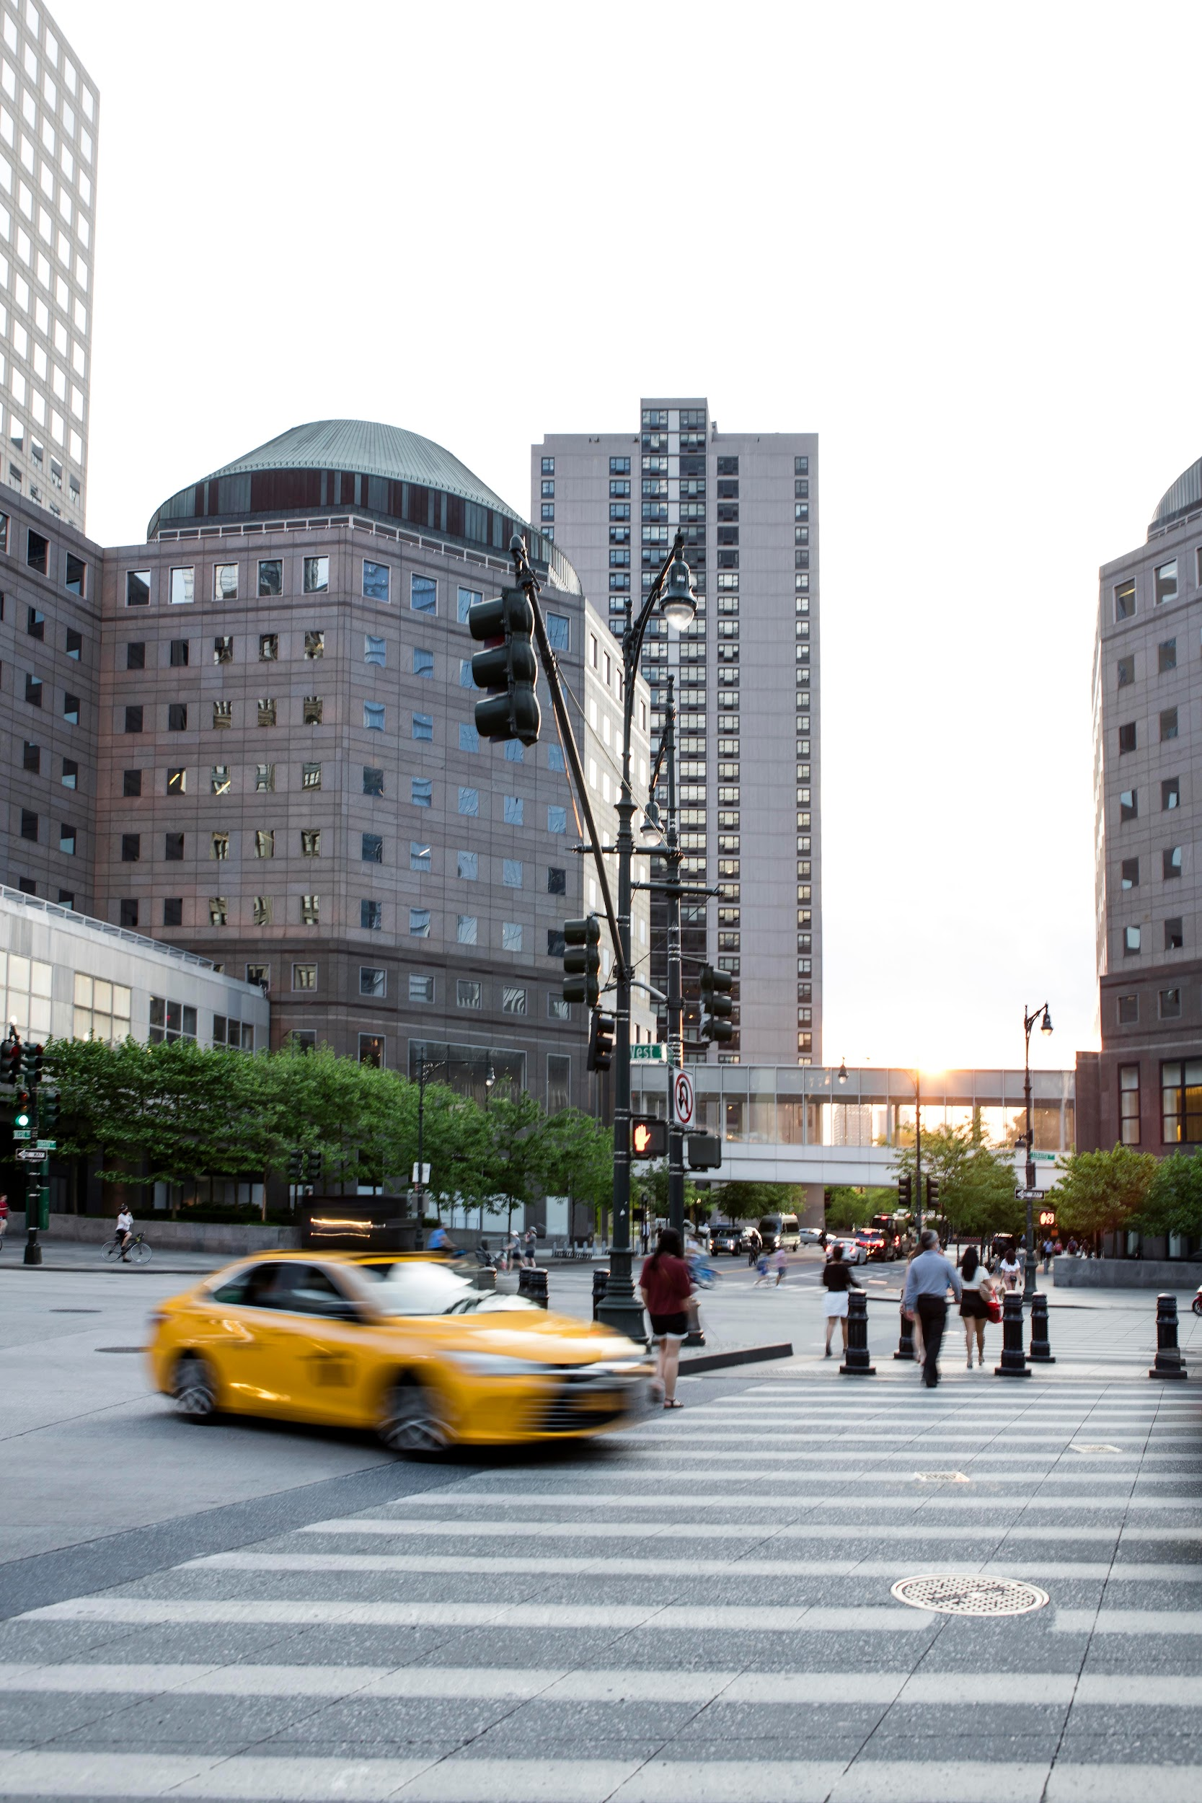
Green Spaces and Gentrification: How Community Gardens Unintentionally Displace Their Creators
S. Dedhia, E. Iyer
ICEE 2025
Penn State Altoona

Slide 2
Contents of the presentation
Research Motivation | 1-2
Data & Methodology | 3-5
Results | 6-8
Interpretations | 11
Policy Implications | 12
Conclusion & QnA | 13-14

Slide 3
Research Motivation
Community gardens often aim to serve marginalized communities.
Increasing evidence suggests they may trigger gentrification.
This study investigates whether grassroots greening leads to demographic shifts and in-migration of more affluent groups.

Slide 4
Key Research Questions
Do community-led green spaces contribute to gentrification?
How does in-migration shift following greening?
Are these effects consistent across cities and racial groups?

Slide 5
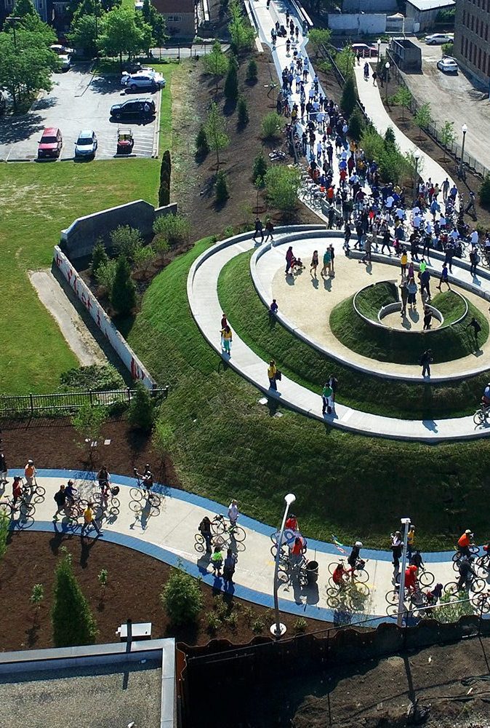
Case Selection
Chicago
606 Trail (2015)
El Paseo Community Garden (2009)
Los Angeles
Echo Park Community Garden (2015)
East Hollywood Garden (2019)
Sites selected for grassroots origins and environmental justice framing.

Slide 6
Data Sources
Data
ACS 5Y Estimate
ZCTA
Migration Data
Table S0701, 2005–2022
Zip Code Tabulation Areas
By – race, income, origin

Slide 7
Methodology
Difference - in - difference
Y_{it} = α + β·Post_{it} + γ_{i} + δ_{t} + ε_{it}
Outcome: Share of in-migrants by subgroup (e.g., White, Asian)
Post_{it} = 1 after green space creation in ZIP i
ZIP and year fixed effects included
Separate models for each site and subgroup

Slide 8
Garden | Period | Mean In-Migration (%) | Group
606 Chicago | Pre | 7.63 | White
606 Chicago | Post | 10.90 | White
East Hollywood | Pre | 2.64 | White
East Hollywood | Post | 6.61 | White
Echo Park | Pre | 1.74 | White
Echo Park | Post | 6.57 | White
Pilsen | Post | 3.54 | White (no pre data)
606 Chicago | Pre | 5.71 | Asian
606 Chicago | Post | 11.27 | Asian
East Hollywood | Pre | 2.29 | Asian
East Hollywood | Post | 7.94 | Asian
Echo Park | Pre | 0.98 | Asian
Echo Park | Post | 8.82 | Asian
Pilsen | Post | 7.86 | Asian (no pre data)
--table

Slide 9
Difference-in-Differences Estimates
Subgroup | Garden | Pre (%) | Post (%) | DiD Estimate (β)
White (Out-of-State) | 606 Chicago | 7.63 | 10.66 | 3.324✱✱
White (Out-of-State) | East Hollywood | 2.64 | 6.45 | 3.510✱✱✱
White (Out-of-State) | Echo Park | 1.74 | 6.28 | 3.986✱✱✱
Asian (Out-of-State) | 606 Chicago | 5.71 | 11.00 | 3.717✱✱✱
Asian (Out-of-State) | East Hollywood | 2.29 | 7.84 | 5.137✱✱✱
Asian (Out-of-State) | Echo Park | 1.74 | 6.28 | 3.986✱✱✱

Slide 10
Difference-in-Differences Estimates
Statistically significant increases in all cases:
White: +3.3 to +4.0 pp
Asian: +3.7 to +5.1 pp
Effects persist after controlling for ZIP and year fixed effects.

Slide 11
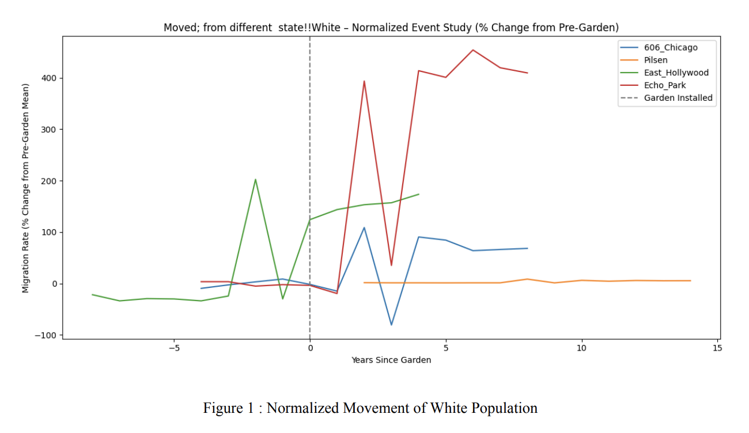
Visualization – DiD

Slide 12
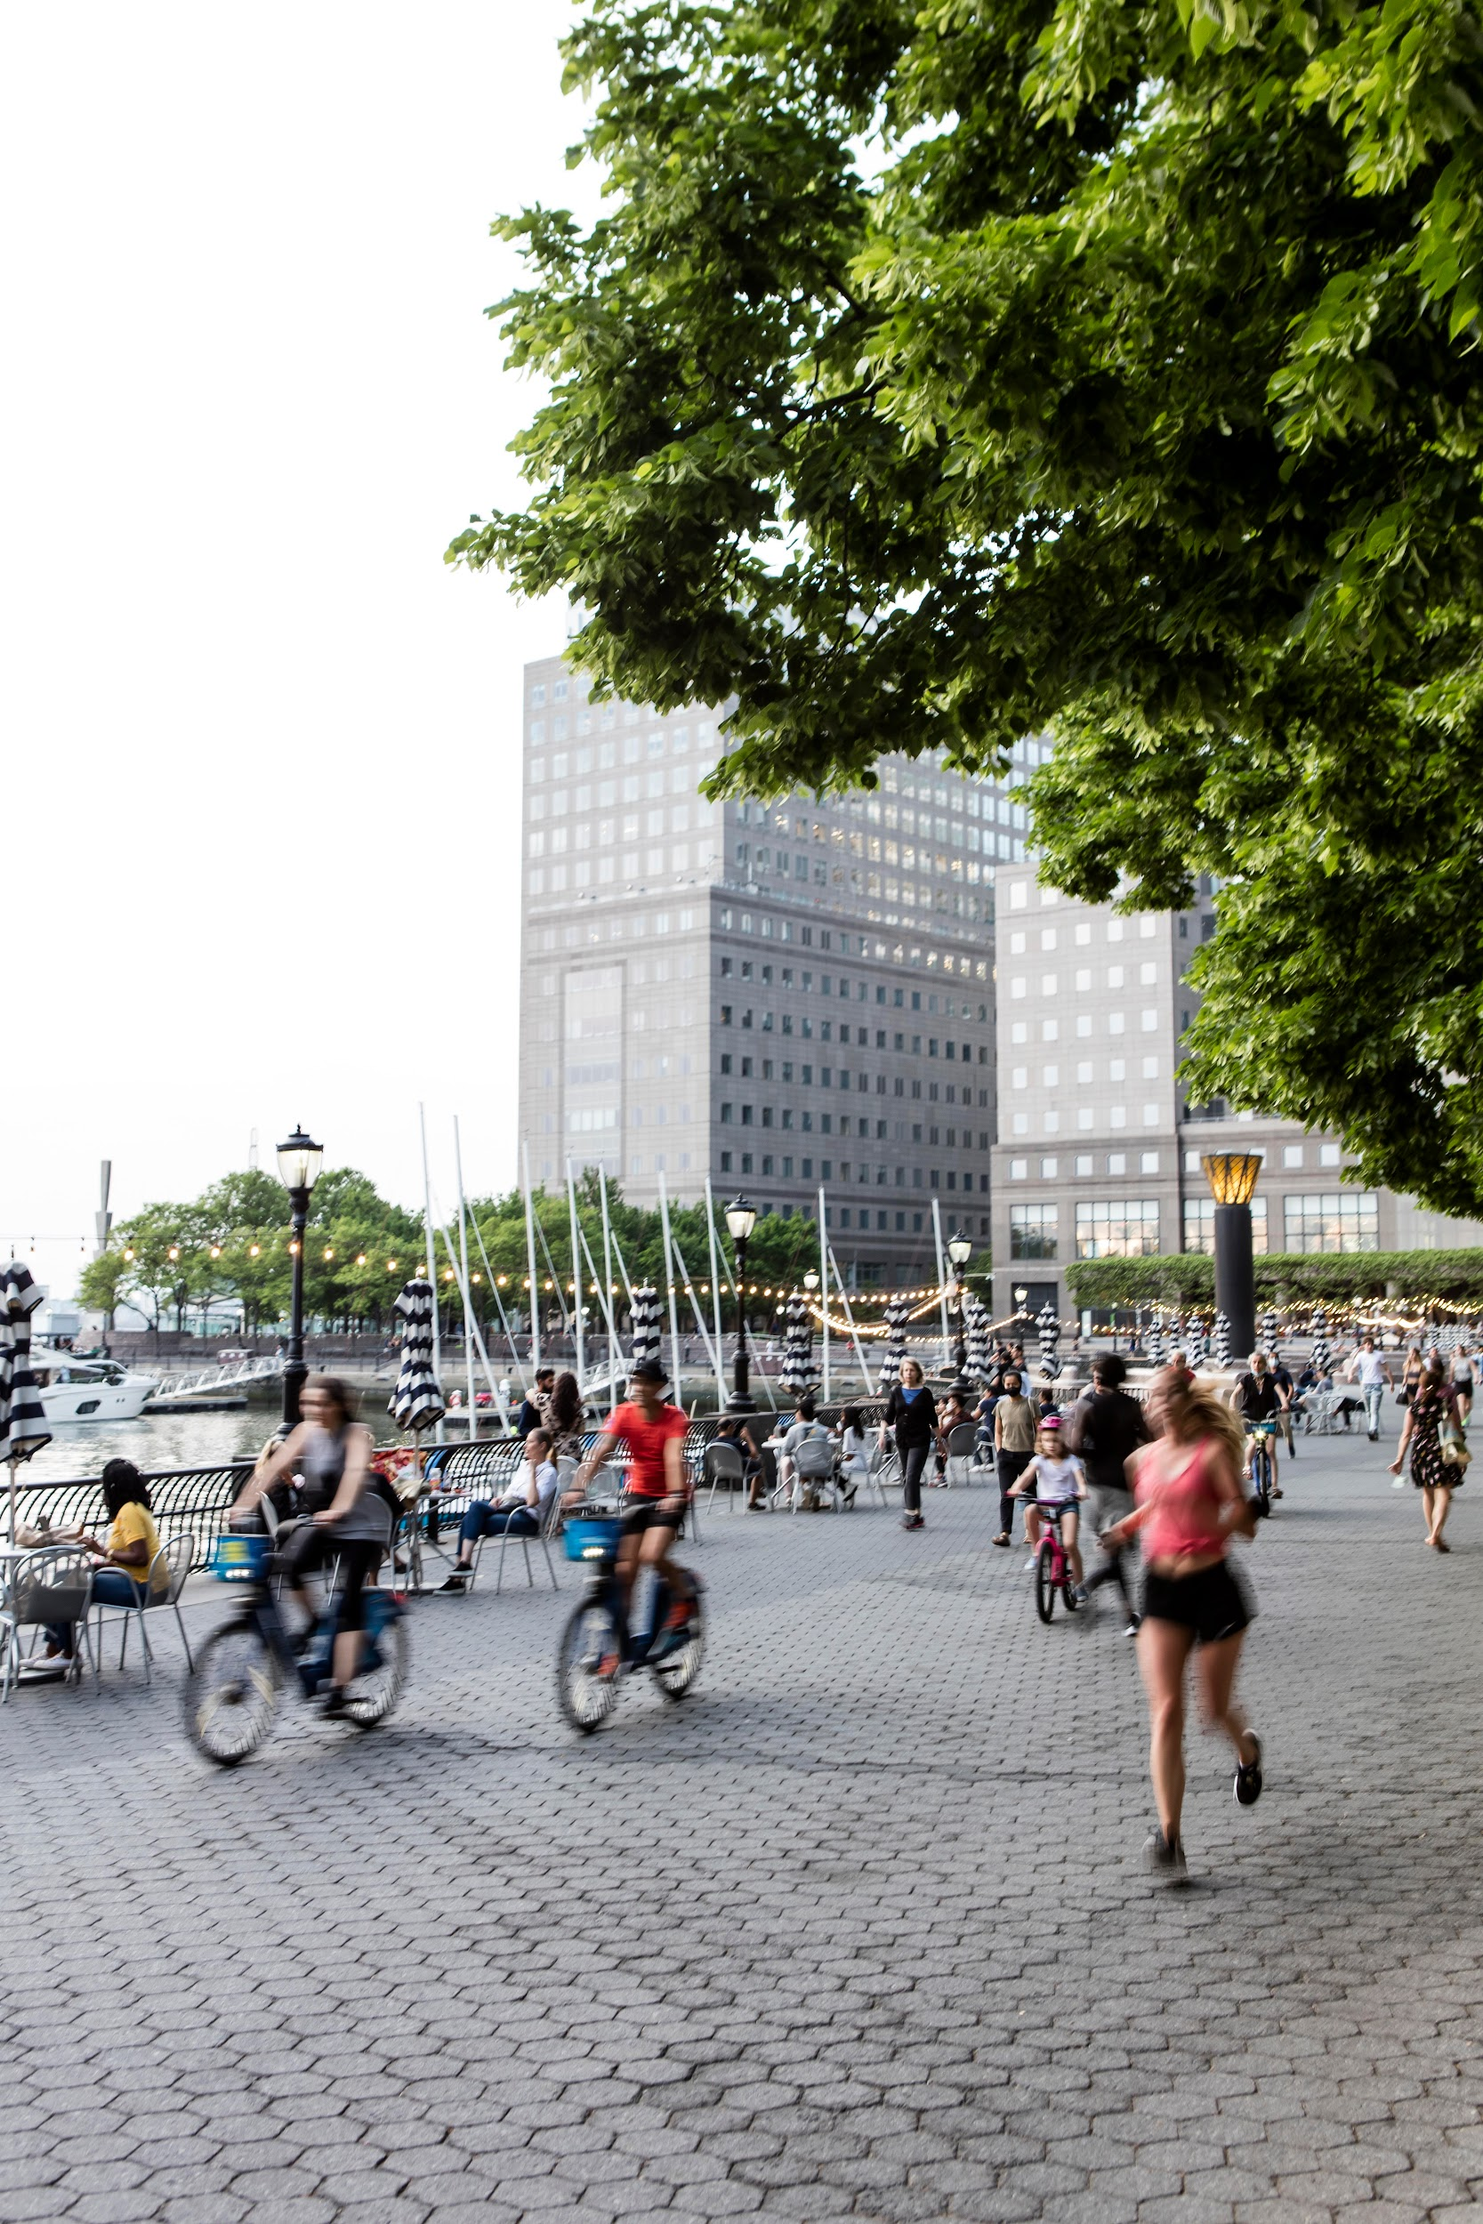
Interpretation of Findings
Even community-led greening attracts out-of-state, affluent newcomers.
Timing aligns closely with green space openings.
Greening acts as a signal of neighborhood revitalization.

Slide 13
Policy Implications
Require affordability and anti-displacement tools near green spaces.
Promote community land trusts and stewardship models.
Ensure greening does not accelerate exclusion.

Slide 14
Conclusion
Community gardens can unintentionally displace their own creators.
Greening must be integrated with housing justice.
Future research: granular migration flows, governance structures.

Slide 15
Thank you!
Questions?

