Slide 1
CA-3 VISION-BASED APPLICATION TASK
Geometric Consistency Analysis for Detection of Synthetic Imagery
Vanishing-Point and Shadow-Based Cues Across Generator Generations
Team: <Name, PRN> | <Name, PRN> | <Name, PRN>
Course: Computer Vision | Department of <Department>, <Institute>
Academic Year 2026-27
Notes:
Open with the one-line idea: a real photo is made by one camera, an AI image is not, and that difference can be measured in degrees and pixels.

Slide 2
Problem Statement
Given a single image, decide whether its geometry fits ONE pinhole camera. Report any mismatch as a residual in readable units, compare it with real photographs, and use the result to compare image generators.
THE CLAIM UNDER TEST
Parallel 3D lines meet at one vanishing point.
Every part of the image implies the same focal length and lens centre.
All shadows point away from one light source.
No real camera can break these.
• Not “is this image fake?” but “which camera rule does it break, and by how much?”
• Residuals in degrees and ratios, never an opaque score
• Every comparison measured against real photographs
Notes:
These rules come from projective geometry, not from habits of photographers, so every real camera obeys them.

Slide 3
Motivation and Background
Forensic
Scientific
Applied (Robotics)
Pixel and frequency detectors get worse as generators improve. A broken geometry rule stays broken however good the texture is.
Which rules a model follows tells us what it has learned about 3D space.
Visual servoing, navigation and structure from motion assume projective geometry. Synthetic training data must obey it.
Background: a generator learns what photographs look like from data. Nothing inside it stores an optical centre, a focal length or a principal point. So whether its images obey camera geometry is an open question we can measure.
Notes:
The robotics link is the syllabus tie-in: active perception and autonomous vehicles depend on projective consistency.

Slide 4
Objectives
O1
Build and validate a pipeline for vanishing-point concurrency and single-camera coherence
O2
Measure the normal range of every residual on a hand-picked benchmark and on ordinary internet photos
O3
Build generated image sets with matched content from four models, settings logged
O4
Define an applicability rule that never looks at the answer, and validate it
O5
Compare generators under matched content and camera settings; test standard classifiers
O6
Implement the shadow rule as a linear program and validate it on synthetic scenes
O7
Build an app that measures any image, explains the result and gives a calibrated score
Notes:
O4 is what separates this project from a naive implementation. O7 is the demo.

Slide 5
Literature Review
What is established, and by whom
Work | Contribution | Relevance here
Sarkar et al., CVPR 2024 | Classifiers on geometric features only (lines, perspective fields, shadows); AUC 0.88 to 0.94 | Anchor paper: proves the cue exists, but not which rule fails
Kee, O'Brien and Farid, TOG 2013 | Shadow consistency as a linear program over wedge constraints | Exact formulation used for our shadow rule
Criminisi, Reid and Zisserman, 2000 | Single-view metrology from vanishing points | Mathematical basis of the camera test
Schindler and Dellaert, CVPR 2004 | Atlanta world: one vertical, several horizontal directions | Why our main measure works on real streets
Denis, Elder and Estrada, ECCV 2008 | York Urban Database: 102 calibrated images with true vanishing points | Our hand-picked real reference and validation set
Consensus: generated images break projective geometry. Open: which rule, by how much, and measured against which real photographs.
Notes:
Sarkar et al. is the paper we extend: from detection to diagnosis.

Slide 6
Identified Research Gap
1
Detection, not diagnosis
2
One real reference
Learned classifiers say a violation exists, not which rule failed or by how much.
Studies compare against one hand-picked dataset. Whether the conclusion depends on that choice is unexamined.
3
Local vs global unmeasured
4
Applicability ignored
No study separates getting the scene's directions wrong from getting the camera wrong.
The three-vanishing-point test does not apply to non-box-shaped scenes, yet it is applied to them anyway.
This project addresses gaps 1 to 3, and solves gap 4 as part of the method.
Notes:
Gap 4 turned out to change the results the most.

Slide 7
Proposed Methodology
Each level is one rule a pinhole camera cannot break
Level | Rule | Residual | Status
L2 | Lines parallel in 3D meet at one vanishing point | Angle (deg) | Built
L3 | Three directions at right angles fix one focal length and principal point | Deviation from 90 deg | Built (secondary)
L3b | Every horizontal direction gives the same focal length with the vertical | Spread of log focal length | PRIMARY measure
L7 | All cast shadows agree with one light source | LP violation (px) | Geometry validated
L1, L4 to L6, L8, L9 | Straightness, horizon, cross-ratio, conics, reflections | Various | Future work
Key design decision: the vanishing-point finder is never told to look for right angles. The camera test asks whether the directions are at right angles, so building that in would make the test meaningless.
Notes:
If asked why L3b is primary: it works in Atlanta worlds (angled streets), where L3 does not.

Slide 8
System Architecture and Workflow
Image
LSD line
detection
RANSAC VP
estimation
Applicability
rule
Residuals
L2 / L3 / L3b / L7
Compare with real
photographs
Images that fail the rule are reported as a selection rate: how often one camera can even be identified is itself a result about the generator.
APPLICABILITY RULE (evidence only)
WHY IT IS NOT CIRCULAR
• 3 line families, each ≥ 8% of the line length
• each vanishing point pinned to < 1° (bootstrap)
• each pair ≥ 10° apart and ≥ 5× its uncertainty
• each family spread over ≥ 12% of the diagonal
• Right angles, focal length and the orthocentre are EXCLUDED
• Admitted images: 90% of vanishing points within 5° of the truth (57% for rejected)
• Unit test: injecting a camera violation does not change the decision
Notes:
The non-circularity test is the answer if anyone asks whether we cherry-picked images.

Slide 9
Implementation
ENVIRONMENT
PACKAGE projgeo
VALIDATION (25 TESTS)
• Python 3.14
• OpenCV 4.13 (LSD, morphology)
• NumPy, SciPy (LP, least squares)
• scikit-learn, statsmodels
• PyTorch 2.14 + CUDA 13
• diffusers 0.40
• Streamlit 1.58 (demo app)
• RTX 5060 Laptop, 8 GB VRAM
• lines: LSD detection
• vp: RANSAC + refinement
• selection: applicability rule
• camera: focal length, Atlanta test
• explain: one image, end to end
• stats: confidence intervals
• appmodel: the app's score
• shadows, synth: L7 and tests
• Synthetic scenes with known cameras
• 4 violation injectors: concurrency, VP shift, drift, two-camera split
• Each residual must react to its OWN rule and stay flat for the others
• Residuals must rise steadily with the injected violation
Notes:
explain.py is the single implementation of the measurement: the report's numbers, the robustness checks and the app all call it, so they cannot disagree.

Slide 10
Data Acquisition
Matched content by construction; every setting logged
Dataset | Size | Role
York Urban | 102 images | Hand-picked real reference with true vanishing points
Wikimedia Commons | 358 images, 135 camera models | Ordinary real photos, many cameras, EXIF focal lengths
Stable Diffusion 1.5 | 450 images | Older open model, run on our GPU
SDXL | 650 images | Newer open model, plus 1:1 and 16:9 variants
Gemini (“nano banana”) | 181 images | Closed frontier model, September 2026
ChatGPT image model | 51 images | Closed frontier model, September 2026
Synthetic scenes | on demand | Ground truth for testing
Three prompt sets. Set 1: building fronts, streets, corridors (also used for Gemini and ChatGPT). Set 2: corners, to guarantee three directions; too few lines, so selection fell from 40% to 30%. Set 3 adds repeating straight features (tiles, shelving, window grids) and reaches 48%. Every comparison uses a single prompt set.
Notes:
Comparing a model on one prompt set against another model on a different set would mix up the model with the scene type, so we never do it.

Slide 11
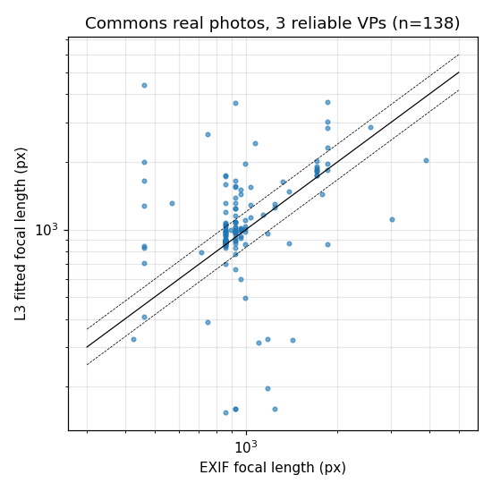
Results 1: The Tool Is Trustworthy
Validation before any comparison
0.3°
< 1%
81 / 94%
1.02
vanishing-point error on synthetic scenes with known cameras
focal-length error on synthetic scenes
of York Urban's true vanishing points found within 2° / 5°
median ratio of fitted to TRUE focal length (IQR 0.99 to 1.05)
The pipeline finds the real camera in real photos.
Left: fitted focal length against EXIF focal length for photos from 135 camera models. Dashed lines mark a ±20% band.
We need this before trusting anything the tool says about AI images.
Notes:
Without this slide every later number would be uninterpretable.

Slide 12
Results 2: The Real Reference Decides the Verdict
Measured naively, ORDINARY real photos score 12.2° on the right-angle test: worse than SD 1.5 and far worse than SDXL.
Taken at face value, AI images would look more camera-consistent than photos.
Why: angled streets and facades have three clear directions that are simply NOT at right angles.
These are Atlanta worlds. The right-angle test does not apply to them. The fault is in the test, not the photos.
12.2°
2.82°
0.15
ordinary real photos, no applicability rule
same photos, after the rule
log-focal spread, Atlanta measure
So the main measure became Atlanta focal consistency, which works on both kinds of scene.
Notes:
This is the method lesson of the project. No filtering on evidence removes the tail: a stricter threshold makes it worse, and 98% of those photos are uncropped.

Slide 13
Results 3: Primary Finding
Atlanta focal consistency on images that pass the applicability rule
Quantity | York Urban (real) | Commons (real) | SD 1.5 | SDXL
Images admitted by the rule | 72 | 121 | 92 | 112
Usable for log-focal spread | 65 | 91 | 53 | 65
Log-focal spread, median [95% CI] | 0.142 [0.106, 0.221] | 0.152 [0.093, 0.220] | 0.465 [0.324, 0.709] | 0.355 [0.272, 0.529]
Images with an impossible pair | 28% | 44% | 68% | 58%
In a real photo the horizontal directions agree on ONE focal length to within about 15%. In AI images they disagree by 35 to 60%. (p ≈ 3×10⁻⁵ against either real set)
• The two real sets agree with each other, so the result does not depend on which real photos are used.
• Both generators sit clearly above both real sets, with non-overlapping intervals.
Notes:
This is the slide to defend. Intervals are bootstrap (2000 resamples); proportions use Wilson intervals; the test is Mann-Whitney. Line-rich prompt set.

Slide 14
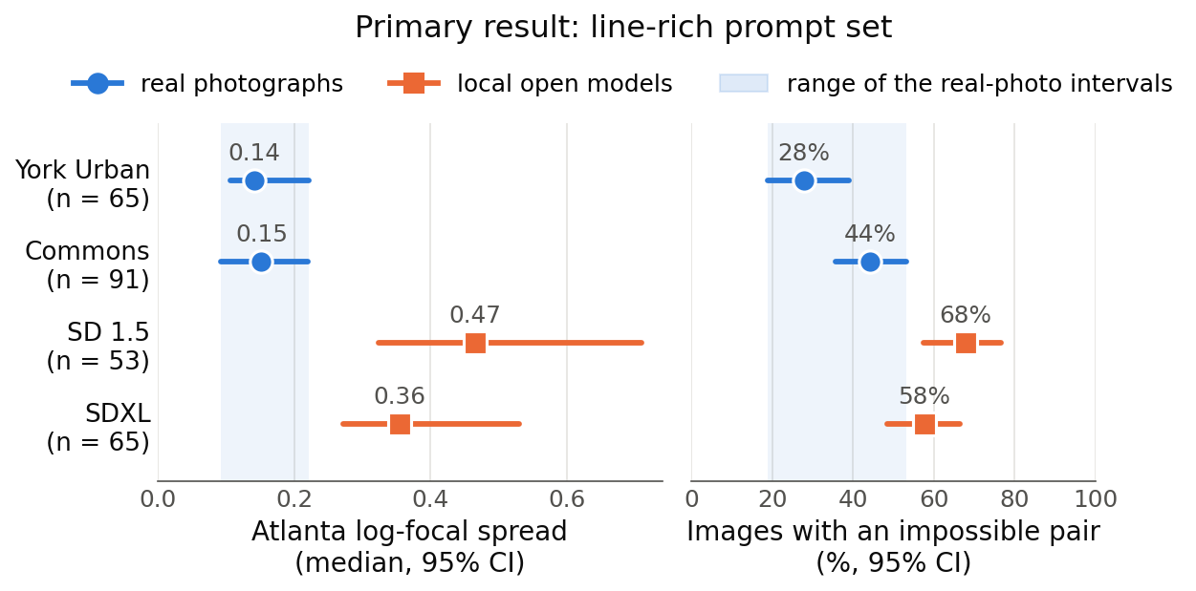
Results 4: Distributions and Scaling
SD 1.5 → SDXL
Same prompts, matched field of view and line density, 250 images per model.
Orientation: 2.93° → 1.94° (p = 0.0002, improves)
Focal coherence: 0.465 → 0.355 (p = 0.55, UNCHANGED)
A bigger model gets the directions right. It does not learn to commit to one camera.
Dots: medians. Lines: 95% intervals. Grey band: the range of the real-photo intervals. Left: focal disagreement. Right: share of images with a pair no camera could produce.
Notes:
Say clearly that the focal result is a null, not a reversal. An earlier claim that scaling made it worse was withdrawn after we found it used an invalid statistic.

Slide 15
Results 5: Is It an Artefact?
Two checks, both suggested by looking closely at single images
CHECK 1: THE WRONG “VERTICAL”
CHECK 2: LEVEL CAMERAS
A corridor's far end, near the image centre, can be picked as the vertical vanishing point by mistake.
Require the vertical point to be at least one image height away: 0 to 5% of images change, every result holds.
A level camera makes focal length noisy, and AI images are level far more often (76 to 80% vs 31 to 51% of real photos).
Keep only clearly tilted cameras: AI is still 2 to 3 times worse.
Condition | York Urban | Commons | SD 1.5 | SDXL | Largest p vs real
As published | 0.142 | 0.152 | 0.465 | 0.355 | 0.0001
Vertical point ≥ 1 image height from centre | 0.142 | 0.149 | 0.465 | 0.355 | 0.0001
Clearly tilted cameras only | 0.135 | 0.135 | 0.423 | 0.285 | 0.008
Verdict: the main result survives both checks.
Notes:
Both checks use only the position of the vertical vanishing point, never the focal length, so they cannot bias the test. Numbers are median log-focal spread, line-rich prompts.

Slide 16
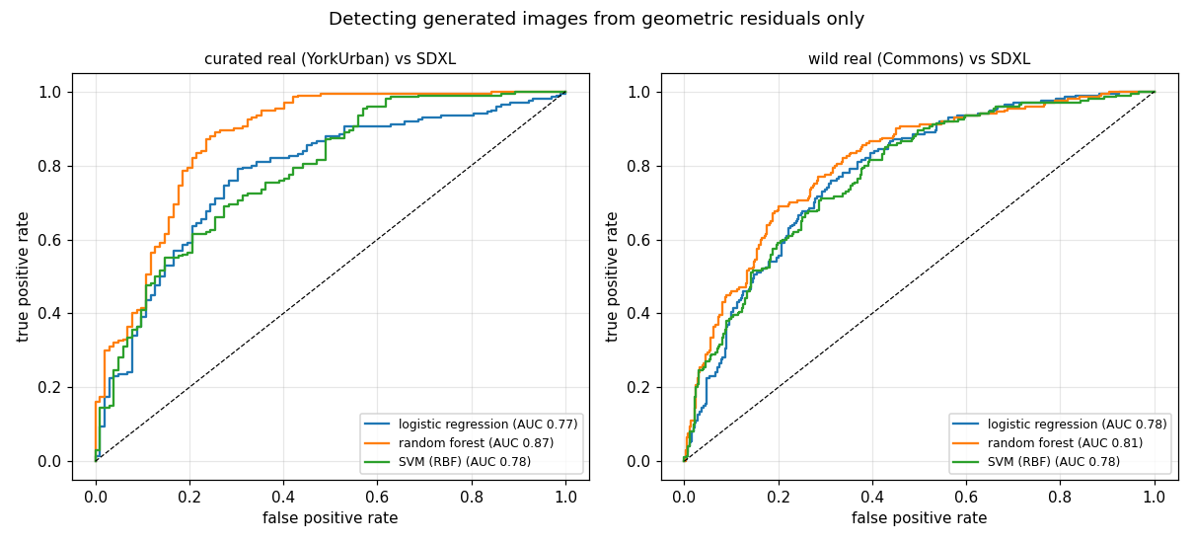
Results 6: Detection from Residuals Alone
Syllabus Unit 3 classifiers on the residuals, never on pixels
Task (best AUC) | All | Admitted
York Urban vs SDXL | 0.875 | 0.903
York Urban vs SD 1.5 | 0.919 | 0.926
Commons vs SDXL | 0.807 | 0.808
Field of view matched | 0.814 | 0.863
Sarkar et al. report 0.88 to 0.94 with LEARNED features. Readable residuals reach the same band.
Top feature: the orthocentre offset, i.e. where the lens centre sits. Invalid focal features were removed; AUC moved by at most 0.04.
Notes:
Six algorithms: logistic regression, decision tree, SVM, random forest, naive Bayes, kNN. Five-fold stratified cross-validation. The random forest was best in every task.

Slide 17
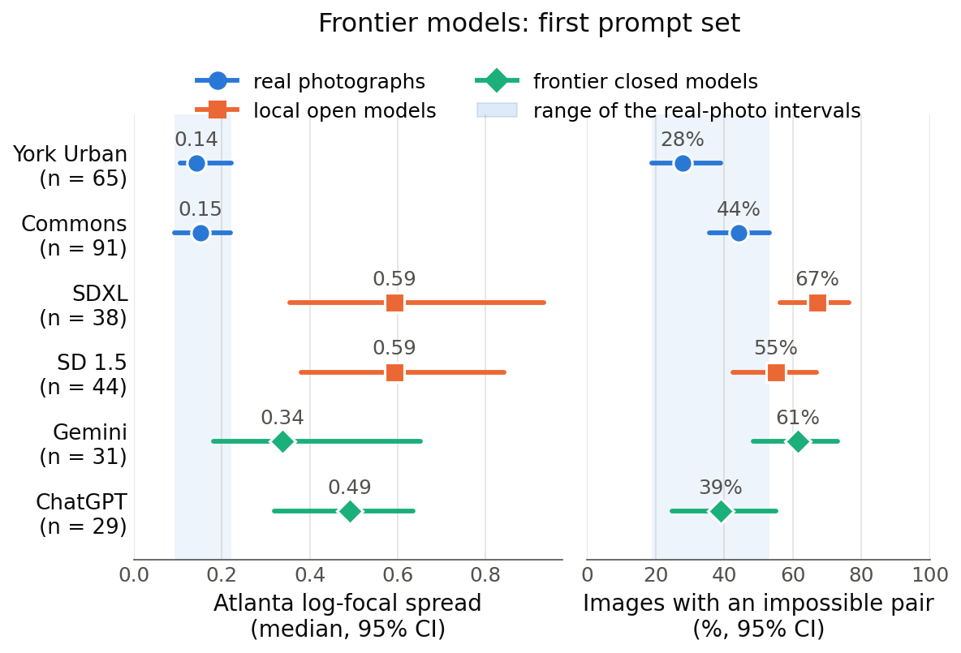
Results 7: The Newest Models
Gemini and ChatGPT on the same prompts as SD 1.5 and SDXL
WHAT IT SHOWS
• Both still fail: p ≈ 0.015 against both real sets
• Not yet shown to be better than SD 1.5 or SDXL (p = 0.14 to 0.26)
• Small samples: 31 and 29 usable images
• ChatGPT's impossible-pair rate (39%) looks real; its focal spread does not
The 2026 claim that the geometric giveaway has disappeared does not hold on this measure.
Notes:
Gemini (nano banana, via Antigravity) and ChatGPT images were made in September 2026 from the first prompt set, so they are compared with the SD and SDXL images from that same set. Next step: 250 line-rich prompts per model at full resolution.

Slide 18
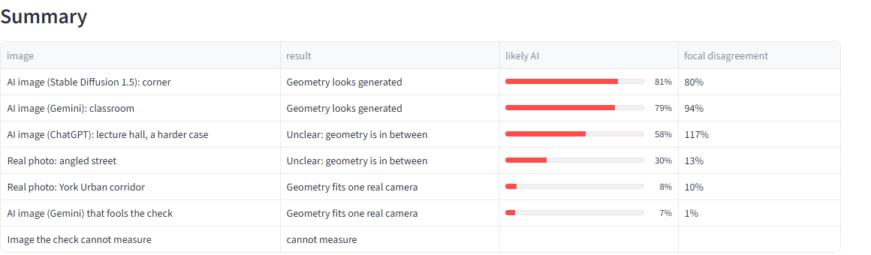
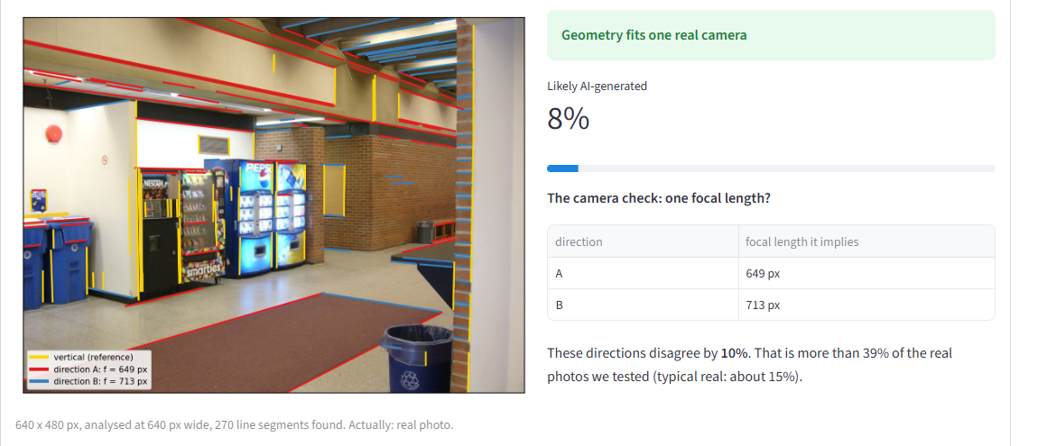
Demonstration: One Camera or Not?
Live app: any image in, a measured and explained answer out
RUN
python -m streamlit run app/streamlit_app.py
localhost:8501/?examples=all
DEMO ORDER (3 MINUTES)
• Real corridor: 649 and 713 px vs a true 675 px
• Gemini classroom: directions disagree by 94%
• ChatGPT lecture hall: “unclear”, the hard case
• A Gemini image that fools it: a check, not proof
• An image it cannot measure, and why
• An image from the audience
Score: AUC 0.80, well calibrated. Flags 78% of AI images, clears 71% of real photos. Built-in examples were held out of training.
Notes:
The app runs the same code as the report. Bookmark the examples link before presenting. If someone uploads a landscape or a portrait, it will say it cannot measure it: that is the applicability rule working, not a bug.

Slide 19
Conclusion
Generators reproduce orientation, not the camera
Right angles are close to real photos after control; focal agreement is 2.5 to 3 times worse.
The result does not depend on the real reference
A hand-picked benchmark and ordinary internet photos give the same answer.
Scale is not closing the gap
SD 1.5 → SDXL improves orientation and leaves camera coherence unchanged.
The newest models still fail
Gemini and ChatGPT remain worse than both real sets; whether they improved is not yet known.
Applicability must be tested, not assumed
The right-angle test does not apply to angled streets; ignoring that flips the verdict.
Thesis: an AI image looks photographic locally, but there is no single camera behind it.
Notes:
If asked for one sentence, use the line at the bottom.

Slide 20
Future Scope
Powered frontier test
Shadow association
Remaining levels
250 line-rich prompts per model at full resolution, plus Midjourney. Prompts and instructions are ready.
SSIS or SAM 2 to pair shadows with objects; the wedge LP above it is built and validated.
Horizon, cross-ratio, conics, reflections and agreement with depth networks.
Mechanism
Atlanta-style regional fit
Perception study
Why does scale not fix the camera? Aspect ratio is ruled out; resolution and receptive field remain.
Redo the regional analysis without assuming every vanishing point pair is at right angles.
Which violations are severe in the maths but unnoticed by people.
Notes:
The powered frontier test is the highest-value next step and needs no new code.

Slide 21
References
[1] A. Sarkar et al., “Shadows Don’t Lie and Lines Can’t Bend! Generative Models don’t know Projective Geometry…for now,” CVPR, 2024.
[2] R. Hartley and A. Zisserman, Multiple View Geometry in Computer Vision, 2nd ed., Cambridge University Press, 2004.
[3] E. Kee, J. F. O’Brien and H. Farid, “Exposing photo manipulation with inconsistent shadows,” ACM TOG, vol. 32, no. 3, 2013.
[4] A. Criminisi, I. Reid and A. Zisserman, “Single view metrology,” IJCV, vol. 40, no. 2, pp. 123-148, 2000.
[5] J. M. Coughlan and A. L. Yuille, “Manhattan world,” ICCV, 1999.
[6] G. Schindler and F. Dellaert, “Atlanta world,” CVPR, 2004.
[7] P. Denis, J. H. Elder and F. J. Estrada, “Efficient edge-based methods for estimating Manhattan frames in urban imagery,” ECCV, 2008.
[8] R. Grompone von Gioi et al., “LSD: a fast line segment detector with a false detection control,” IEEE TPAMI, vol. 32, no. 4, 2010.
[9] B. Efron and R. J. Tibshirani, An Introduction to the Bootstrap, Chapman & Hall, 1993.
[10] L. Breiman, “Random forests,” Machine Learning, vol. 45, no. 1, 2001.
[11] D. Podell et al., “SDXL: improving latent diffusion models for high-resolution image synthesis,” ICLR, 2024.
[12] R. Rombach et al., “High-resolution image synthesis with latent diffusion models,” CVPR, 2022.
Dataset credits: York Urban Database (Elder Laboratory, York University); Wikimedia Commons photographs under CC licences, per-image attribution in the project metadata.
Notes:
The full list (26 references) is in the report. Check details against publisher records before submission.

