Slide 1
Employee Asset Management System
Internship project demo
Eesha Beladi

Slide 2
Introduction
Project :
Employee Asset Management System
Objective :
Streamline the management of IT assets within the organization, including allocation, deallocation, and approval processes.

Slide 3
Tools & Technologies
Version Control: Git
Front End : Angular 18 (HTML, CSS, Bootstrap)
Back End: ASP.NET Core Web API 8
Database: Microsoft SQL Server
ORM Tool: Entity Framework
Server Management: SQL Server Management Studio (SSMS)

Slide 4
Project Scenario
User Roles:
Admin, IT Infrastructure Users, Manager, Employee
Main Features :
Maintain IT asset information/inventory.
Maintain employees, employee asset, asset allocation and deallocation details.
Regulate employee asset requests.
Implement authorization and authentication.
Generate reports.

Slide 5
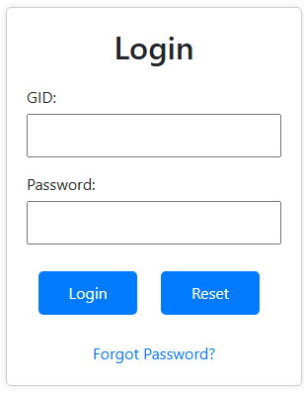
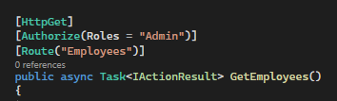
Authentication and Authorization
Authentication : Basic authentication, with credentials encoded in base64
Authorization : Role based authorization in backend.

Slide 6
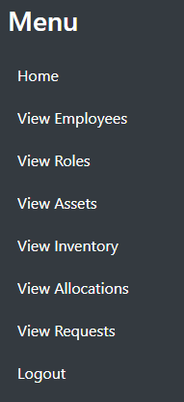
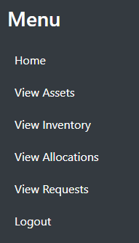
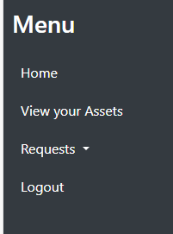

Dashboard Overview
ADMIN
IT INFRASTRUCTURE USER
EMPLOYEE
MANAGER

Slide 7
Website Pages Overview
IT Infrastructure and Admin pages:
Asset Management:
Can manage all IT assets, including laptops, monitors, mice, keyboards, etc.
Requests Management:
Can view and manage all asset requests made by employees.
Asset Allocation Management:
Can allocate and deallocate assets to employees and track the history of asset allocations.
Inventory Management:
Can maintain an up-to-date inventory of all assets.

Slide 8
Website Pages Overview
Admin-Specific Management:
Employee Management:
Admins can add, update, or remove employee details.
Roles Management:
Admins can manage user roles and assign specific permissions to different roles.
Manager-Specific Management:
Requests Management:
Managers can view employee asset requests, approve or reject them.

Slide 9
THANK YOU

