Slide 1
Recursion
In order to understand recursion, first understand recursion!

Slide 2
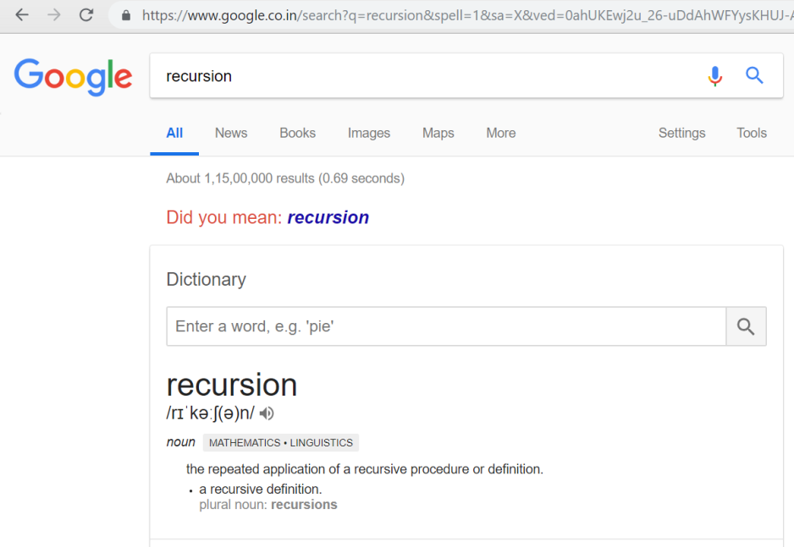
Even Google has a sense of humour ☺

Slide 3
Definition
WE USE RECURSION WHEN ONE OUTPUT DEPENDS UPON ANOTHER OUTPUT OF SAME NATURE, BUT OF SMALLER SIZE.
Recursion problems are similar to PMI (Principle of Mathematical Induction)
Where F(n) is proved to be true for ALL N.
We Assume : 1) Its already proved true for F(0) or F(1). /*Base Case*/
2) Also F(k) is true. /*Processing Logic*/
We need to prove that F(k+1) is also true. /*Recursive Call*/

Slide 4
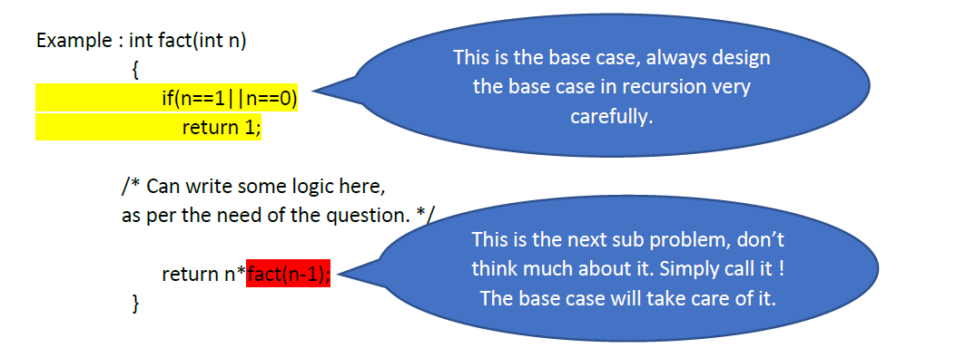
Find Factorial of N using recursion N ! = N*N-1*N-2*……*3*2*1.

Slide 5
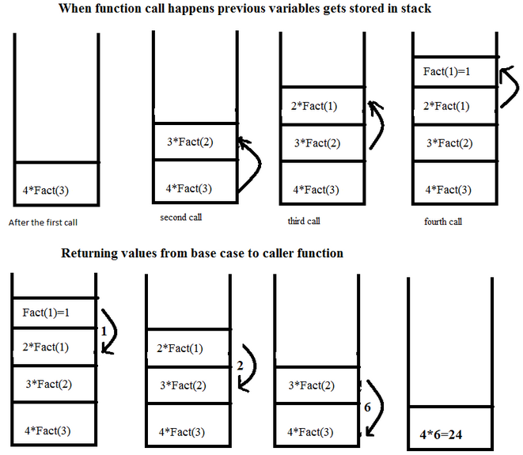
Space Complexity: O(n)

Slide 6
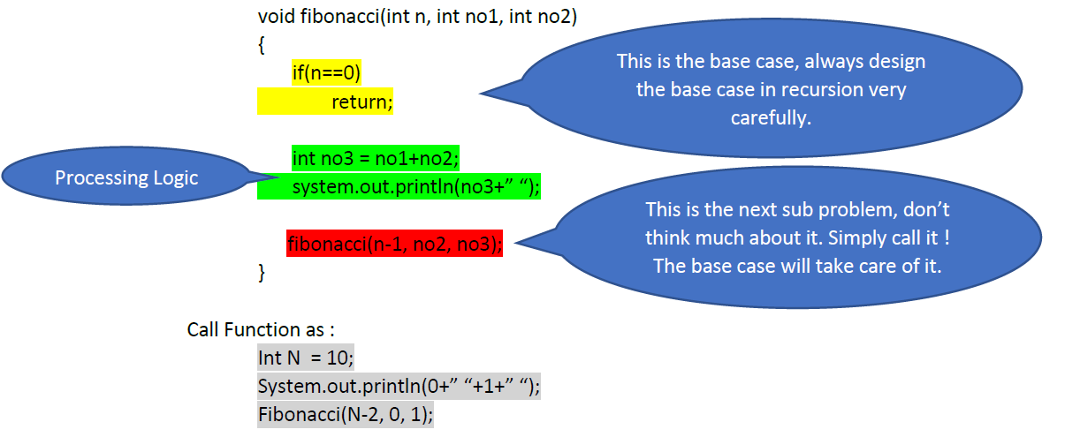
Find Fibonacci serious of First N nos. In Fibonacci series, next number is the sum of previous two numbers for example 0, 1, 1, 2, 3, 5, 8, 13, 21, 34, 55 etc. The first two numbers of Fibonacci series are 0 and 1.

Slide 7
Continued..
Drawing recursive calls as a tree – great way to figure out runtime of a recursive algorithm
Total no of nodes in the tree represents runtime
Fibonacci has a runtime of O(2^n) [How?]
In actual, slightly better than O(2^n), i.e., O(1.6^n) [Why?]
But still, exponential!

Slide 8
Pro-Tips:
1.) formulate the problem into much smaller problem and try building recursive relation. 2.) identify the base cases which help you to terminate recursion. Base cases are nothing but smaller problem.
Always remember after identifying the sub problem of the question simply call the function to next sub problem, without thinking much how the next sub problem will solve the question.

Slide 9
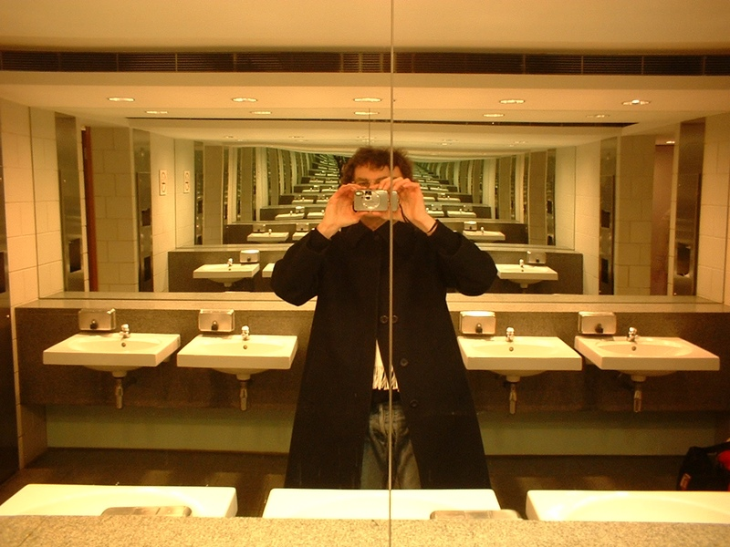
Proper base condition is just too important! Otherwise..

Slide 10
Questions6
Given two integers m & n, calculate and return their multiplication. You can only use subtraction and addition for your calculation. No other operators are allowed.
Given an integer n, count and return the number of zeros that are present in the given integer using recursion.
Write a recursive function that returns the sum of the digits of a given integer.
A child is running up a staircase with n steps, and can hop either 1 step, 2 steps or 3 steps at a time. Implement a method to count how many possible ways the child can run up to the stairs. You need to return all possible number of ways. (Microsoft)

Slide 11
Continued..
Check if a given String S is palindrome or not (using recursion). Return true or false.
Given a string, compute recursively a new string where all 'x' chars have been removed.
Given a string, compute recursively a new string where all appearances of "pi" have been replaced by "3.14".
(Intuit, Amazon)
Suppose you have a string made up of only 'a' and 'b'. Write a recursive function that checks if the string was generated using the following rules:
The string begins with an 'a' .
Each 'a' is followed by nothing or an 'a' or "bb" .
Each "bb" is followed by nothing or an 'a'
If all the rules are followed by the given string, return true otherwise return false. (Adobe)

