Slide 1
Dynamic Programming
Practice after you go home!

Slide 2
FIBONACCI SERIES (RECURSIVE)
int fib(int n)
{
if (n <= 1)
return n;
return fib(n-1) + fib(n-2);
}

Slide 3
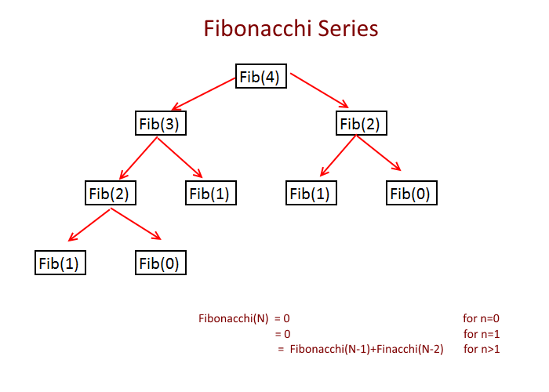
Time Complexity
T(n) = T(n-1) + T(n-2)
It is exponential

Slide 4
Use Dynamic Programming
int fib(int n)
{
/* Declare an array to store Fibonacci numbers. */
int f[n+2]; // 1 extra to handle case, n = 0
int i;
/* 0th and 1st number of the series are 0 and 1*/
f[0] = 0;
f[1] = 1;
for (i = 2; i <= n; i++)
{
/* Add the previous 2 numbers in the series
and store it */
f[i] = f[i-1] + f[i-2];
}
return f[n];
}

Slide 5
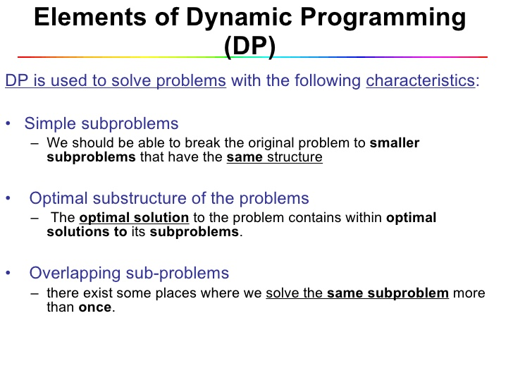
When to use Dynamic Programming

Slide 6
Questions?

Slide 7
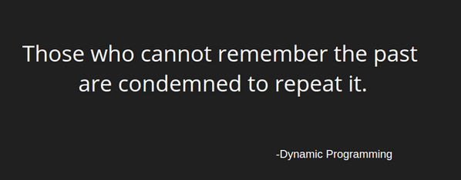
Remember!

Slide 8
Practice
1. Given a value N, if we want to make change for N cents, and we have infinite supply of each of S = { S1, S2, .. , Sm} valued coins, how many ways can we make the change? The order of coins doesn’t matter.
For example, for N = 4 and S = {1,2,3}, there are four solutions: {1,1,1,1},{1,1,2},{2,2},{1,3}. So output should be 4. For N = 10 and S = {2, 5, 3, 6}, there are five solutions: {2,2,2,2,2}, {2,2,3,3}, {2,2,6}, {2,3,5} and {5,5}. So the output should be 5.

Slide 9
Practice
2. Given two sequences, find the length of longest subsequence present in both of them.
For example: LCS for input Sequences “ABCDGH” and “AEDFHR” is “ADH” of length 3. LCS for input Sequences “AGGTAB” and “GXTXAYB” is “GTAB” of length 4.
3. Find LCS for three strings.
4. Given two strings ‘X’ and ‘Y’, find the length of the longest common substring.
Input : X = "zxabcdezy", y = "yzabcdezx" Output : 6 The longest common substring is "abcdez" and is of length 6.

Slide 10
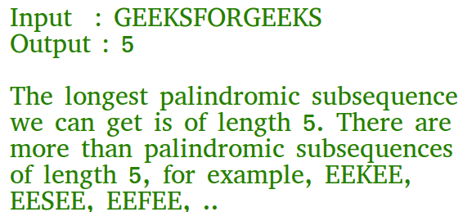
Practice
5. Given a sequence, find the length of the longest palindromic subsequence in it.

