Slide 1
Retrieval-Augmented Generation for Educational Applications: A Systematic Survey
Presented By:
Bondada Eesalini – 22B01A4215
Shri Vishnu Engineering College for Women
Under the guidance of:
Mrs.K Kalyani
Asst.Professor
Department of AI
Shri Vishnu Engineering College for Women
Authors:
Z. Li
Z. Wang
W. Wang
K. Hung
H. Xie
F. L. Wang

Slide 2
Introduction
The rapid advancement of Large Language Models (LLMs) has significantly influenced educational technology, enabling intelligent tutoring, automated assessment, and interactive learning assistants. However, standalone LLMs often generate responses based solely on internal parametric knowledge, which may lead to hallucinations, outdated information, or lack of syllabus alignment. In educational settings, factual correctness and reliability are critical to ensure effective learning outcomes. Retrieval-Augmented Generation (RAG) has emerged as a promising solution by integrating external knowledge retrieval with language generation. By grounding responses in verified academic sources, RAG enhances factual accuracy and contextual relevance. This paper provides a systematic survey of RAG applications in education, analyzing existing architectures, use cases, challenges, and future research directions.

Slide 3
Literature Survey
Applications of Large Language Models in Education
Recent studies demonstrate the growing use of LLMs in intelligent tutoring systems, automated grading, student feedback generation, and interactive learning assistants. These systems improve accessibility and engagement but often suffer from factual inconsistencies due to parametric knowledge limitations.
Limitations of Standalone LLM-Based Educational Tools
Traditional LLM-driven educational tools rely on pre-trained knowledge and lack dynamic access to updated academic materials. This may result in hallucinated responses, lack of syllabus alignment, and reduced trust in academic environments.
Integration of Retrieval-Augmented Generation
RAG-based educational systems incorporate external academic sources such as textbooks, lecture notes, and curated knowledge bases. This integration improves factual grounding, ensures contextual relevance, and supports curriculum-aligned responses.
Emerging Use Cases in Educational Settings
RAG has been applied in AI tutors, adaptive learning assistants, automated assessment systems, and academic Q&A platforms. These systems demonstrate improved accuracy and contextual awareness compared to standalone generative models.
Research Challenges and Future Trends
Despite promising results, challenges remain in knowledge indexing, retrieval efficiency, scalability, evaluation metrics, and ensuring fairness and transparency in educational AI systems.

Slide 4
Dataset Collection
The surveyed RAG-based educational systems utilize domain-specific academic data sources to support reliable content generation. These include digital textbooks, lecture notes, scholarly articles, curriculum-aligned knowledge bases, and institutional learning materials.Rather than retraining large language models on task-specific datasets, most systems rely on retrieval from curated academic repositories. The external knowledge sources are indexed using dense embeddings to enable semantic similarity search.Educational datasets often include question-answer pairs, short-answer grading datasets, interactive tutoring logs, and structured course materials. These resources allow RAG systems to provide syllabus-aligned and contextually relevant responses.By separating knowledge storage from language generation, retrieval-based approaches reduce the need for large labeled training datasets while maintaining academic reliability.

Slide 5
Methodology
Pre-trained Language Model Foundation
Most RAG-based educational systems utilize large pre-trained transformer models as the base generation engine. These models provide strong natural language understanding and enable interactive responses in tutoring and academic support tasks.
Educational Domain Adaptation
To ensure syllabus alignment, systems are adapted to specific educational domains such as mathematics, science, or programming. This adaptation focuses on aligning responses with curriculum standards and structured academic content.
Retrieval-Augmented Generation Framework
The surveyed approaches integrate neural retrieval mechanisms to fetch relevant academic documents before response generation. Retrieved content is passed as contextual input to the language model, improving factual grounding and reducing hallucination.
Architectural Variants in Educational RAG
Different implementations vary in retrieval techniques, document chunking strategies, context fusion mechanisms, and evaluation metrics. Some systems prioritize response accuracy, while others focus on personalization and adaptive feedback.

Slide 6
Methodology
External Academic Knowledge Integration
Educational RAG systems retrieve content from curated academic repositories such as textbooks, lecture notes, and institutional knowledge bases. This external grounding improves factual correctness and ensures curriculum-aligned responses.
Context Selection and Management
Only the most relevant retrieved documents are provided to the language model. Effective filtering and chunking strategies help maintain response clarity while preventing irrelevant information from influencing generation.
Evaluation in Educational Settings
Surveyed studies evaluate RAG systems using metrics such as answer relevance, factual accuracy, grading consistency, and student satisfaction. Comparative analysis with standalone LLMs demonstrates improvements in reliability and trust.
Personalization and Adaptive Support
Some RAG-based educational systems incorporate student performance data to provide adaptive explanations and tailored feedback. This enhances learning effectiveness and engagement.
Scalability and Deployment Challenge
Challenges include maintaining efficient retrieval for large educational corpora, ensuring fairness in automated assessment, and designing transparent systems that support educators rather than replace them.
18-02-2026
SVECW | Department of Artificial Intelligence| Seminar

Slide 7
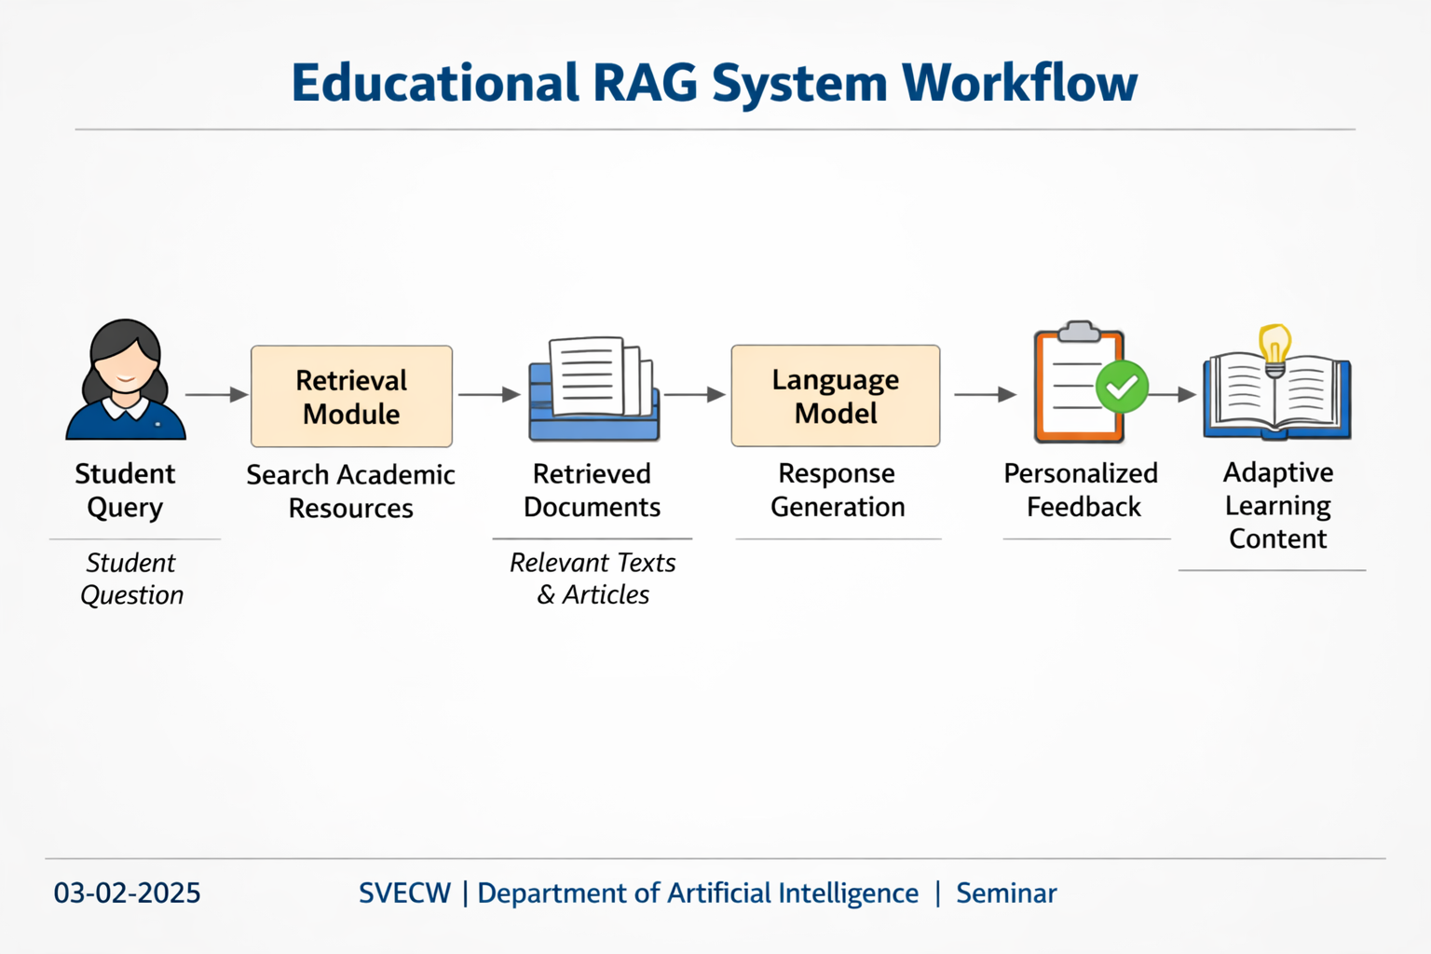
Workflow diagram

Slide 8
Results
Surveyed studies demonstrate that RAG-based educational systems significantly improve factual grounding compared to standalone LLM-based tools.
Integration of external academic knowledge enhances syllabus alignment and response reliability in tutoring systems.
RAG-based grading and assessment tools show improved consistency in evaluating short-answer responses.
Educational chatbots using retrieval mechanisms reduce hallucination and increase student trust.
Adaptive tutoring systems leveraging RAG provide more context-aware and personalized feedback.
Key challenges identified include retrieval efficiency, evaluation standardization, and ensuring fairness in automated academic support systems.

Slide 9
Conclusion
Provides a comprehensive survey of Retrieval-Augmented Generation applications in educational environments.
Highlights the importance of grounding large language models in verified academic knowledge sources.
Demonstrates that RAG-based systems improve factual reliability and syllabus alignment in tutoring and assessment tasks.
Identifies personalization, adaptive learning, and automated grading as major application areas.
Emphasizes ongoing challenges related to retrieval optimization, scalability, and evaluation metrics.
Suggests that RAG will play a crucial role in building trustworthy and student-centered AI learning systems.

Slide 10
References
[1] W. Shi, Y. Zhuang, Y. Zhu, H. J. Iwinski, J. M. Wattenbarger, and M. D. Wang, “Retrieval-Augmented Large Language Models for Adolescent Idiopathic Scoliosis Patients in Shared Decision-Making,” in Proc. ACM Conf., 2023. doi: 10.1145/3584371.3612956
[2] P. Lewis, E. Perez, A. Piktus, et al., “Retrieval-Augmented Generation for Knowledge-Intensive NLP Tasks,” in Advances in Neural Information Processing Systems (NeurIPS), vol. 33, pp. 9459–9474, 2020. doi: 10.5555/3495724.3496517
[3] Z. Li, Z. Wang, W. Wang, K. Hung, H. Xie, and F.-L. Wang, “Retrieval-Augmented Generation for Educational Applications: A Systematic Survey,” Computers and Education: Artificial Intelligence, vol. 8, 100417, 2025. doi: 10.1016/j.caeai.2025.100417
[4] Y. Chu, P. He, H. Li, H. Han, K. Yang, Y. Xue, J. Krajcik, and J. Tang, “Enhancing LLM-Based Short Answer Grading with Retrieval-Augmented Generation,” arXiv preprint, 2025. doi: 10.48550/arXiv.2504.05276
[5] Y. Chen and H. Li, “Personalized Intelligent Tutoring Systems Based on Student Performance Analysis,” IEEE Transactions on Learning Technologies, vol. 14, no. 4, pp. 489–502, 2021. doi: 10.1109/TLT.2021.3078532

Slide 11
Thank you

