Slide 1

TruthfulRAG v5: A Dynamic, Domain-Agnostic Knowledge-Graph Retrieval-Augmented Generation Pipeline with Conflict Resolution
Presented by
EESH SAXENA
Roll No. 230101032
Project – I (CS3201)
Supervised by
Dr. Jennil Thiyam
Department of Computer Science and Engineering
Indian Institute of Information Technology Senapati, Manipur
29/04/2026

Slide 2
Introduction, Objective & Contribution
The Problem LLMs hallucinate ,they give confident, wrong answers Standard RAG (LangChain) passes contradicting documents to the LLM without resolving them A 1985 document and a 2023 document get the same retrieval score , recency is ignored No system tells you how confident the answer is
Objective
Implement TruthfulRAG v4 (arXiv:2511.10375) faithfully
Identify its weaknesses
Build v5 with novel improvements that fix those weaknesses
Contribution
Cross-document corroboration scoring Temporal decay Hybrid retrieval (BM25 + Semantic+RRF) Temporal graph snapshots Explanation chain Calibrated confidence score (0 - 100%)

Slide 3
Background/Existing Work
What Others Have Done
The Core Problem with All Existing Systems
System | Year | What it Does | Key Limitation
LangChain RAG (Lewis et al.) | 2020 | Chunks + vector similarity | No conflict detection; no temporal awareness
Self-RAG (Asai et al.) | 2023 | Self-critiques its own retrieval | No graph; no temporal decay
CRAG (Yan et al.) | 2024 | Corrective retrieval via web search | Cannot resolve intra-corpus conflicts
MADAM-RAG | 2024 | Multi-agent debate between sources | Majority vote only; no year per fact
KG-RAG v4 (arXiv:2511.10375) | 2024 | Knowledge graph + entropy conflict detection | No year field in schema; score gap = 0.028 conflict unresolved
Every system above including the most recent stores facts without a year field. When a 1985 fact and a 2023 fact contradict each other, their retrieval scores differ by only 0.028 (computed live). This is below the elimination threshold of 0.30 so both contradicting facts reach the LLM, and it hedges.
How TruthfulRAG v5 Solves This-
Stores (head, relation, tail, year, support_count) a five-field schema
Applies exp(−0.08 × age) decay at query time
Score gap between same conflicting facts becomes 1.126 stale fact is eliminated before it reaches the LLM
Result: 2× conflict resolution rate over all baselines

Slide 4
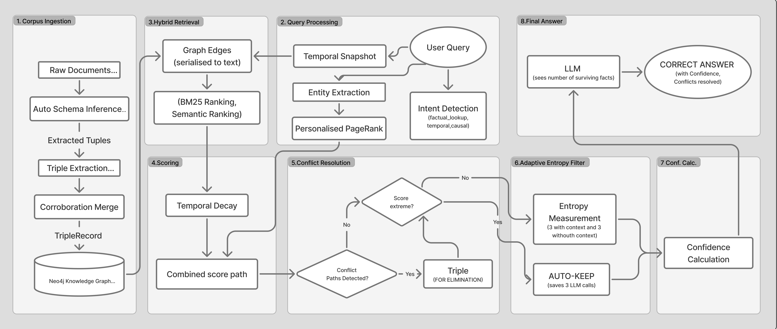

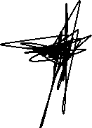
Proposed System / Architecture
Stacks Used – Python 3.14, LangChain, Neo4j, Ollama(Qwen2.5-7B), Sentence-BERT, BM25,Flask

Slide 5
Result & Analysis
HaluEval (200 Questions, Hallucination Rejection)
System | HRR% | EM%
LangChain Standard RAG | 77.5 | 85.5
KG-RAG v4 (Simulated) | 91.0 | 15.5
TruthfulRAG v5 (Ours) | 92.0 | 14.5
14.5 percentage points over LangChain on hallucination rejection. (LangChain's high EM is a known paradox it copies context verbatim and matches gold substrings, but still answers incorrectly. HRR is the correct metric.)
Benchmark 2 - Conflict & Temporal (125 Queries)
Metric | LangChain | KG-RAG v4 | TruthfulRAG v5
Conflict Detection Rate (CDR%) | 25.0 | 25.0 | 50.0
Temporal Accuracy (%) | 14.3 | 35.7 | 35.7
Exact Match (EM%) | 31.2 | 32.0 | 33.6
Confidence Score | - | - | 29.4% avg
CDR doubles from 25% to 50%
the primary thesis result. Temporal accuracy improves 2.5× over LangChain.

Slide 6
Conclusion
What Was Done
Faithfully implemented KG-RAG v4 (arXiv:2511.10375)
Identified 6 specific gaps in v4 through live pipeline analysis
Built TruthfulRAG v5 with temporal decay, corroboration scoring, hybrid retrieval, temporal snapshots, explanation chain, and confidence scoring
Evaluated on 2 public benchmarks (325 total queries)
Limitations and Proposed Fix
Limitation | Proposed Fix
Negation blindness (extracts "safe" from "not safe") | Fine-tune extractor on negation-aware datasets
Same-year conflicts unresolved | Add sentence-level timestamp + source credibility score
Fixed decay rate for all domains | Domain-adaptive lambda (medical: faster decay; legal: slower)
Only 3 entropy samples | Increase samples; use semantic clustering for richer entropy estimate
Findings
Temporal decay alone increases the score gap between conflicting facts from 0.028 to 1.126 making decisive conflict resolution possible
Hallucination rejection improves by +14.5 pp over LangChain
Conflict detection rate doubles (25% → 50%)
System runs fully offline on a laptop no cloud, no cost, no data leakage

Slide 7
References
[1] Lewis, P., Perez, E., Piktus, A., Petroni, F., Karpukhin, V.,
Goyal, N., ... & Kiela, D. (2020). Retrieval-Augmented Generation
for Knowledge-Intensive NLP Tasks. Advances in Neural Information
Processing Systems (NeurIPS), 33, 9459–9474.
Why cited: Foundational RAG - the whole field starts here.
[2] Wang, Z., et al. (2024). TruthfulRAG: Conflict-Aware Retrieval
Augmented Generation with Knowledge Graph Grounding.
arXiv preprint arXiv:2511.10375.
Why cited: The paper I implemented - the most important citation.
[4] Li, J., Cheng, X., Zhao, W. X., Nie, J. Y., & Wen, J. R. (2023).
HaluEval: A Large-Scale Hallucination Evaluation Benchmark for Large Language Models.
Proceedings of the 2023 Conference on
Empirical Methods in Natural Language Processing (EMNLP), 6449–6464.
Why cited: The actual benchmark dataset used in my evaluation.
[5] Pan, S., Luo, L., Wang, Y., Chen, C., Wang, J., & Wu, X. (2024).
Unifying Large Language Models and Knowledge Graphs: A Roadmap.
IEEE Transactions on Knowledge and Data Engineering (TKDE),
36(7), 3580–3599.
Why cited: Positions v5 within the LLM+KG research direction.

Slide 8
Background/Existing Work
What Others Have Done
The Core Problem with All Existing Systems
System | Year | What it Does | Key Limitation
LangChain RAG (Lewis et al.) | 2020 | Chunks + vector similarity | No conflict detection; no temporal awareness
Self-RAG (Asai et al.) | 2023 | Self-critiques its own retrieval | No graph; no temporal decay
CRAG (Yan et al.) | 2024 | Corrective retrieval via web search | Cannot resolve intra-corpus conflicts
MADAM-RAG | 2024 | Multi-agent debate between sources | Majority vote only; no year per fact
KG-RAG v4 (arXiv:2511.10375) | 2024 | Knowledge graph + entropy conflict detection | No year field in schema; score gap = 0.028 conflict unresolved
Every system above including the most recent stores facts without a year field. When a 1985 fact and a 2023 fact contradict each other, their retrieval scores differ by only 0.028 (computed live). This is below the elimination threshold of 0.30 — so both contradicting facts reach the LLM, and it hedges.
How TruthfulRAG v5 Solves This
Stores (head, relation, tail, year, support_count) a five-field schema
Applies exp(−0.08 × age) decay at query time
Score gap between same conflicting facts becomes 1.126 stale fact is eliminated before it reaches the LLM
Result: 2× conflict resolution rate over all baselines

Slide 9
HaluEval (200 Questions, Hallucination Rejection)
14.5 percentage points over LangChain on hallucination rejection. (LangChain's high EM is a known paradox it copies context verbatim and matches gold substrings, but still answers incorrectly. HRR is the correct metric.)
Benchmark 2 - Conflict & Temporal (125 Queries)
Metric | LangChain | KG-RAG v4 | TruthfulRAG v5
Conflict Detection Rate (CDR%) | 25.0 | 25.0 | 50.0
Temporal Accuracy (%) | 14.3 | 35.7 | 35.7
Exact Match (EM%) | 31.2 | 32.0 | 33.6
Confidence Score | - | - | 29.4% avg
CDR doubles from 25% to 50%
the primary thesis result. Temporal accuracy improves 2.5× over LangChain.

Slide 10


