Slide 1

Playing with S.J.
Supersizing Social Justice through Games

Slide 2

Concept Introduction
What is Social Justice?
“Institutions in society should allow equal opportunities to all people without engaging in discrimination. Social Injustices occur when a person, people or groups of people are treated unfairly based upon a certain characteristic of that person or group of people such as race (racism), age (ageism), gender (sexism), religion and sexuality (heterosexism).
~Social Justice Lesson for Kids: Definition, Issues & Examples, Chapter 17, Lesson 6. (https://study.com/academy/lesson/social-justice-lesson-for-kids-definition-issues-examples.html )

Slide 3
The installation is inspired by the social justice boardgames in the Kislak Center at the University of Miami’s Special Collections. And is to be presented in collaboration with the Kislak Center, School of Comm Interactive Media Program and the Miami Law.
Games in the Kislak Center collection include:
What shall I be? the exciting game of career girls. 1966 (Career opportunities for the modern woman.)
Woman & man the classic confrontation. 1971 "Developed by Psychology Today to draw attention to "the way one sex has managed to squelch the other," the game aims to correct this blind spot. Men are encouraged to play the game as a woman and "feel what it's like to be a mere female to compete in a frustrating world that caters to men." But women are also encouraged to change roles and "get a taste of male supremacy, and compete with the sweet certainty that the world is made in a male image." --description from The Book Shop LLC
The rainbow gayme. 1992
Gayopoly 1981

Slide 4
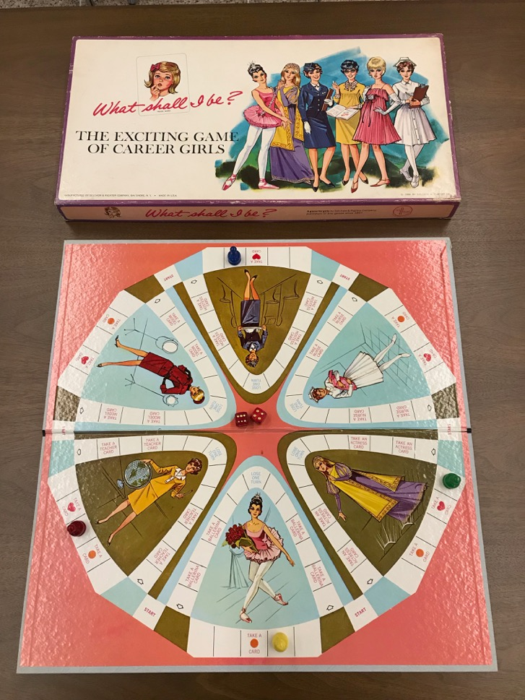
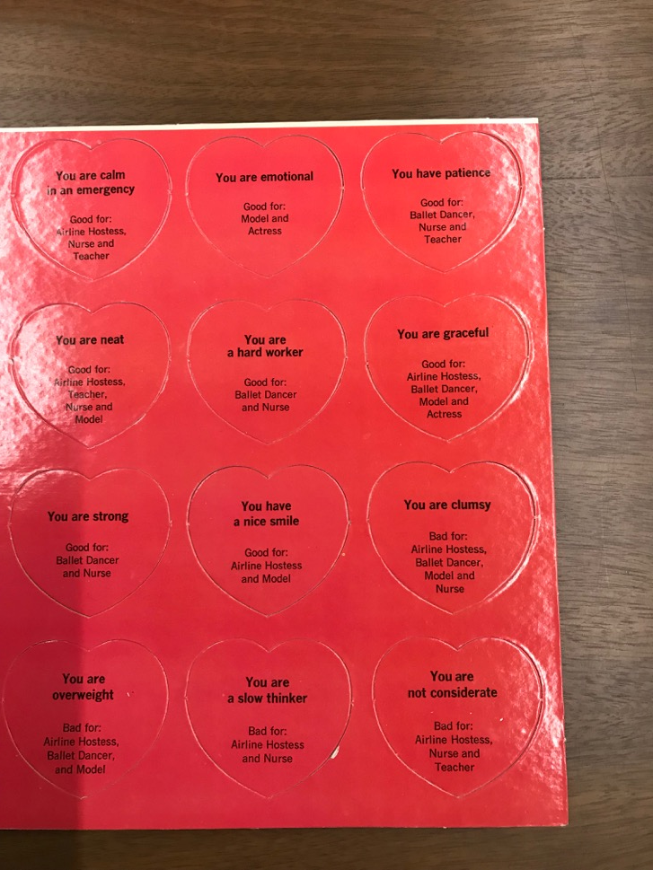

Slide 5
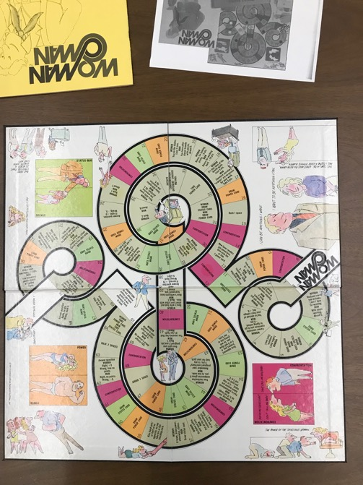
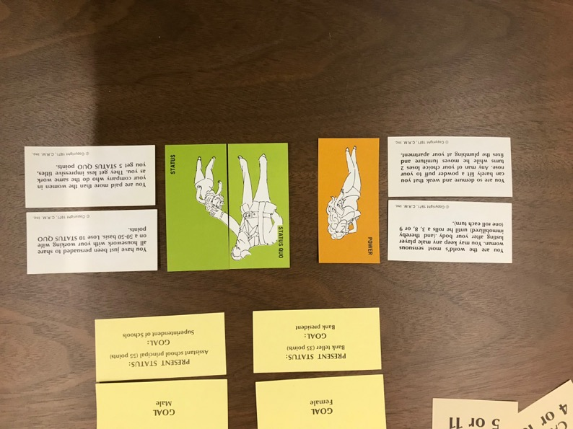
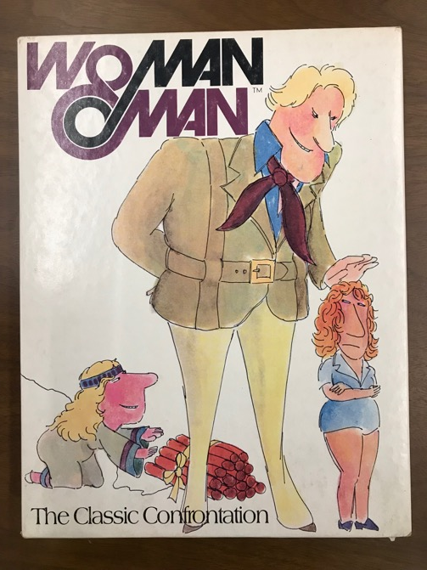

Slide 6
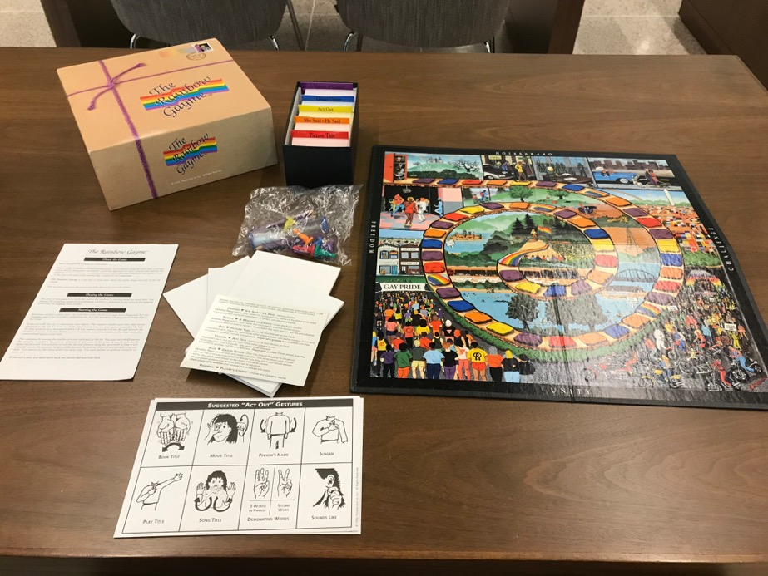
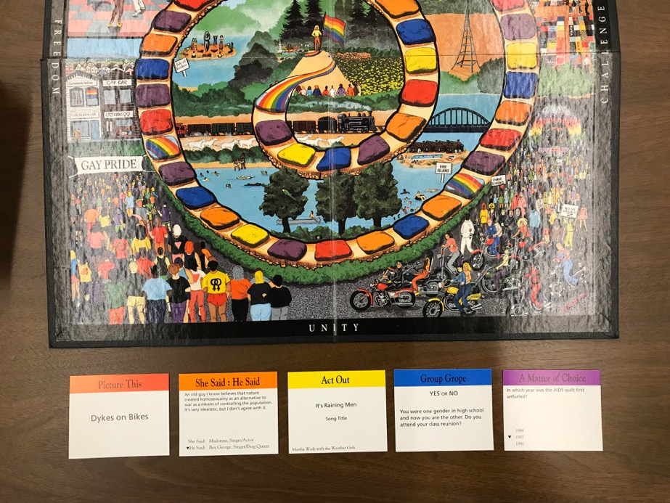

Slide 7
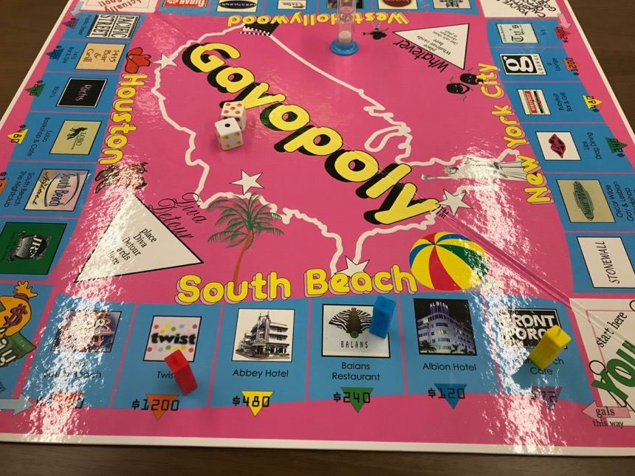
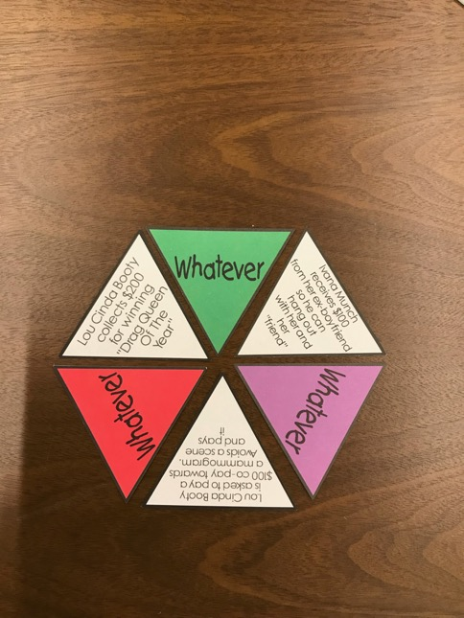
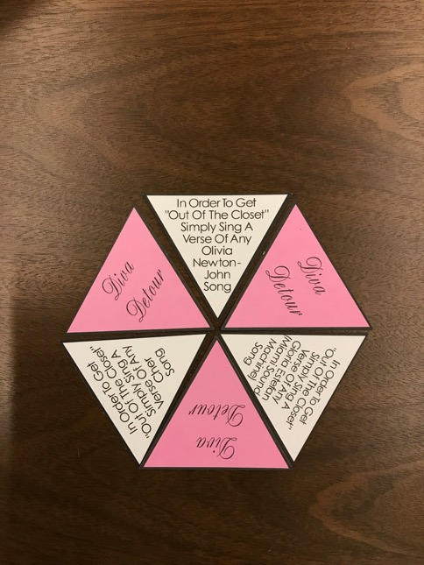

Slide 8
Concept Continued
The installation focus is a life size boardgame where the viewers can participate as the game pieces.
The initial game will run through a scripted round of the game performed by actors and/or the audience.
At the start of the performance a brief description of social justice will be provided, followed by a description of the game theme and rules. (at this time viewers will be invited to participate in the initial game and will be provided a script to play along)

Slide 9
Concept Continued
Additional Interactives wish list:
Tablets with 2D videos of Social Justice games from the Kislak Collection. A written and audio narration is to be included with a brief description of each game. Tablets will include headsets for listening to not disturb other attendees.
An App may be developed which can provide the same 2D experience on individuals’ phones and tables. The app can also provide a way to play the life size game setup on the bricks.
Display cases with the Kislak’s collection of Social Justice Games for viewing.
Boardgame table and seating setups for the audience to play
(Copyright permissions may be needed to include the boardgames in the 360 video.)

Slide 10
Concept Continued
Digital Displays:
About the installation
What is Social Justice
How Can You Get Involved?
360 videos
Additonal:
Social Justice advocates and brochures

Slide 11
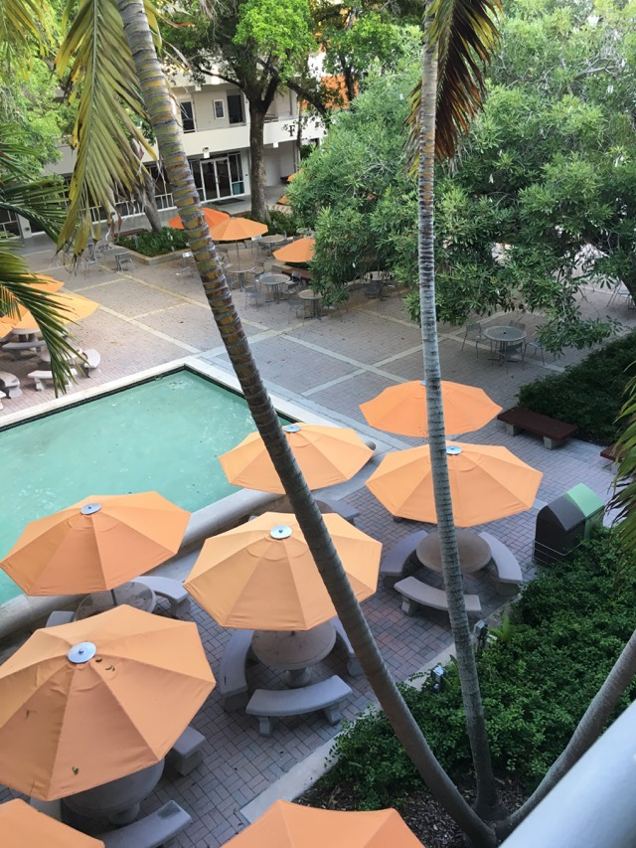
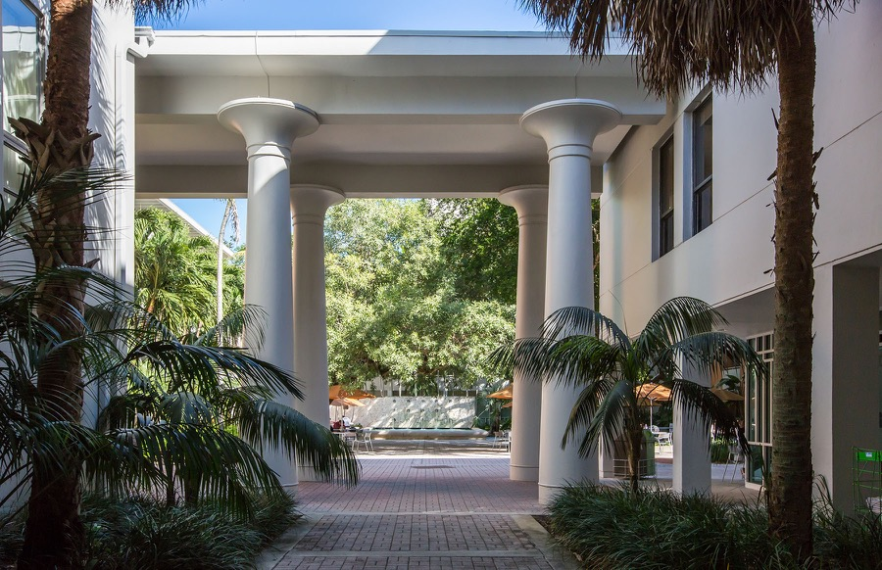
LOCATION
Miami Law The Hilarie Bass Bricks: Live game
Alma Jennings Foundation Student Lounge: Signage, game tables, 2D videos

Slide 12
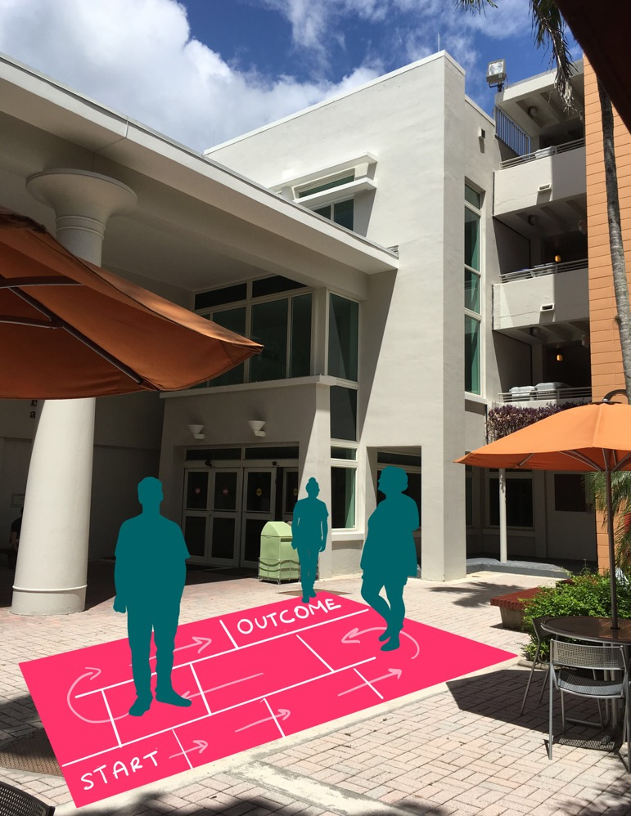
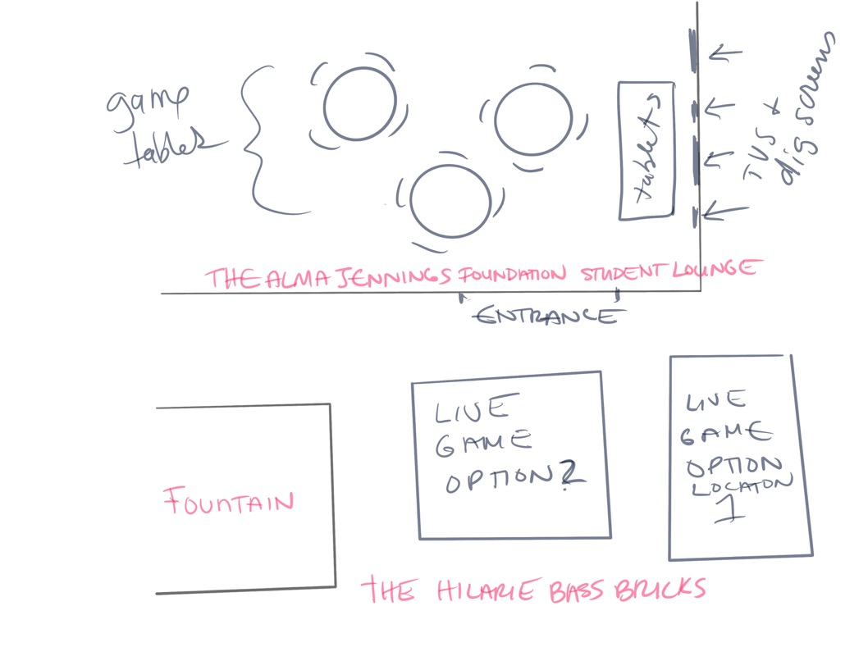

Slide 13
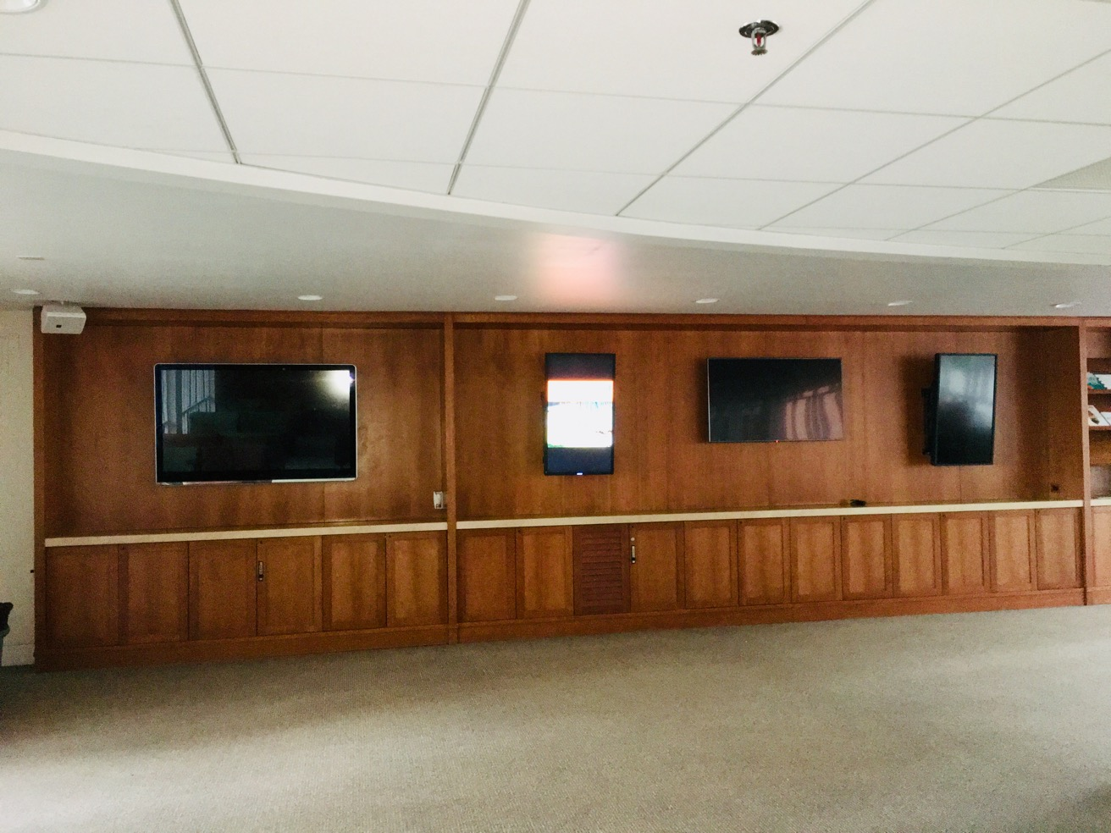

Slide 14

Next Steps:
Develop all aspects of the game with the help a focus group.
The group may include students, faculty and staff.
The group will provide insight to help develop out the theme including injustice issues and resolutions.
The game can be broad reaching (regional or national) or more localized to the city or even campus.
Once the main ideas are more concrete, the rules of the game can be hashed out.

Slide 15
Next Steps:
Possible focus group members and consultants at UM:
School of Comm, Interactive Media
Kislak Center
School of Law including HOPE Public Interest Resource Center at the Law School
Law School Student Organizations such as but not limited to the Student Bar Association, OUTLaw and Miami Law Women (Equity Playhouse if it becomes active again)
College of Arts and Sciences, Theatre Arts Students

