Slide 1
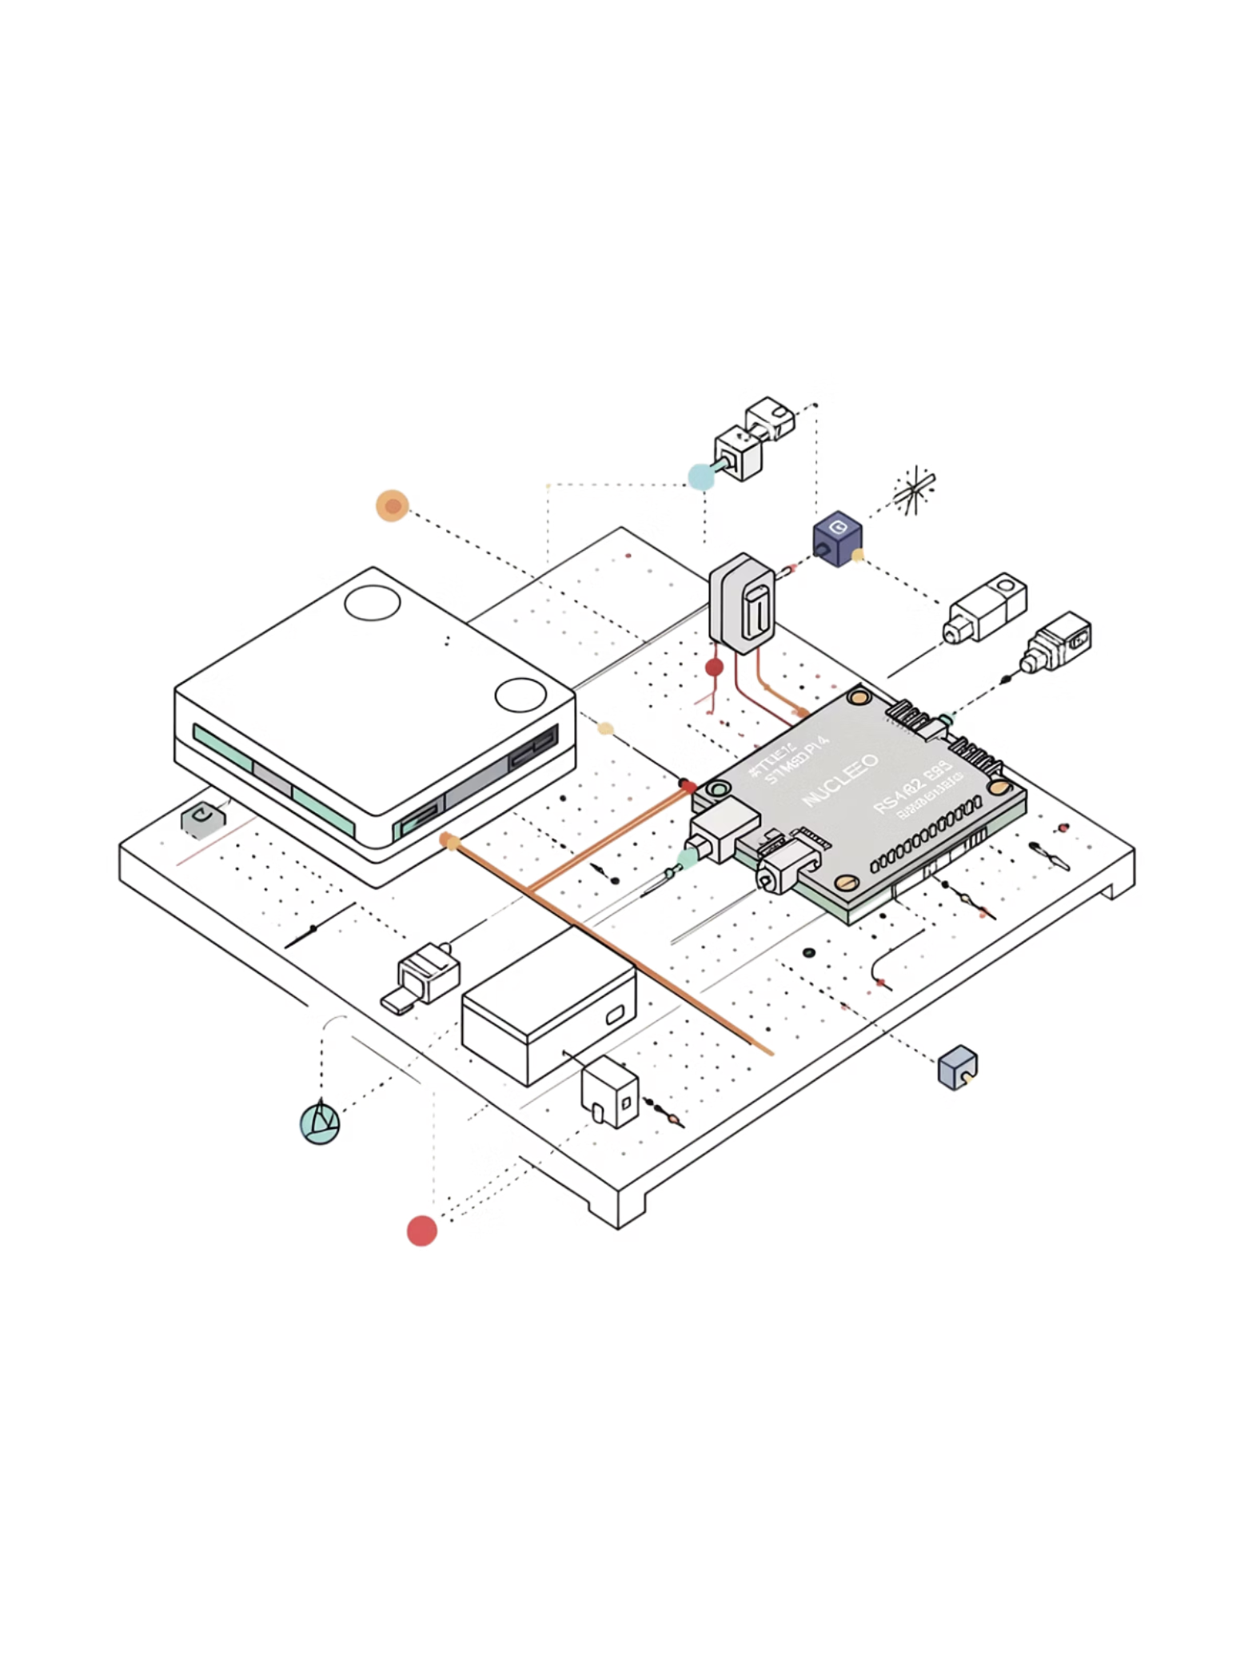
SAMPLE ROUTING MODULE (SRM)
MODULAR EMBEDDED COMMUNICATION SYSTEM
Daniele PerezEmbedded C/C++ Course Project
Gamma Intelligence OÜ

Slide 2
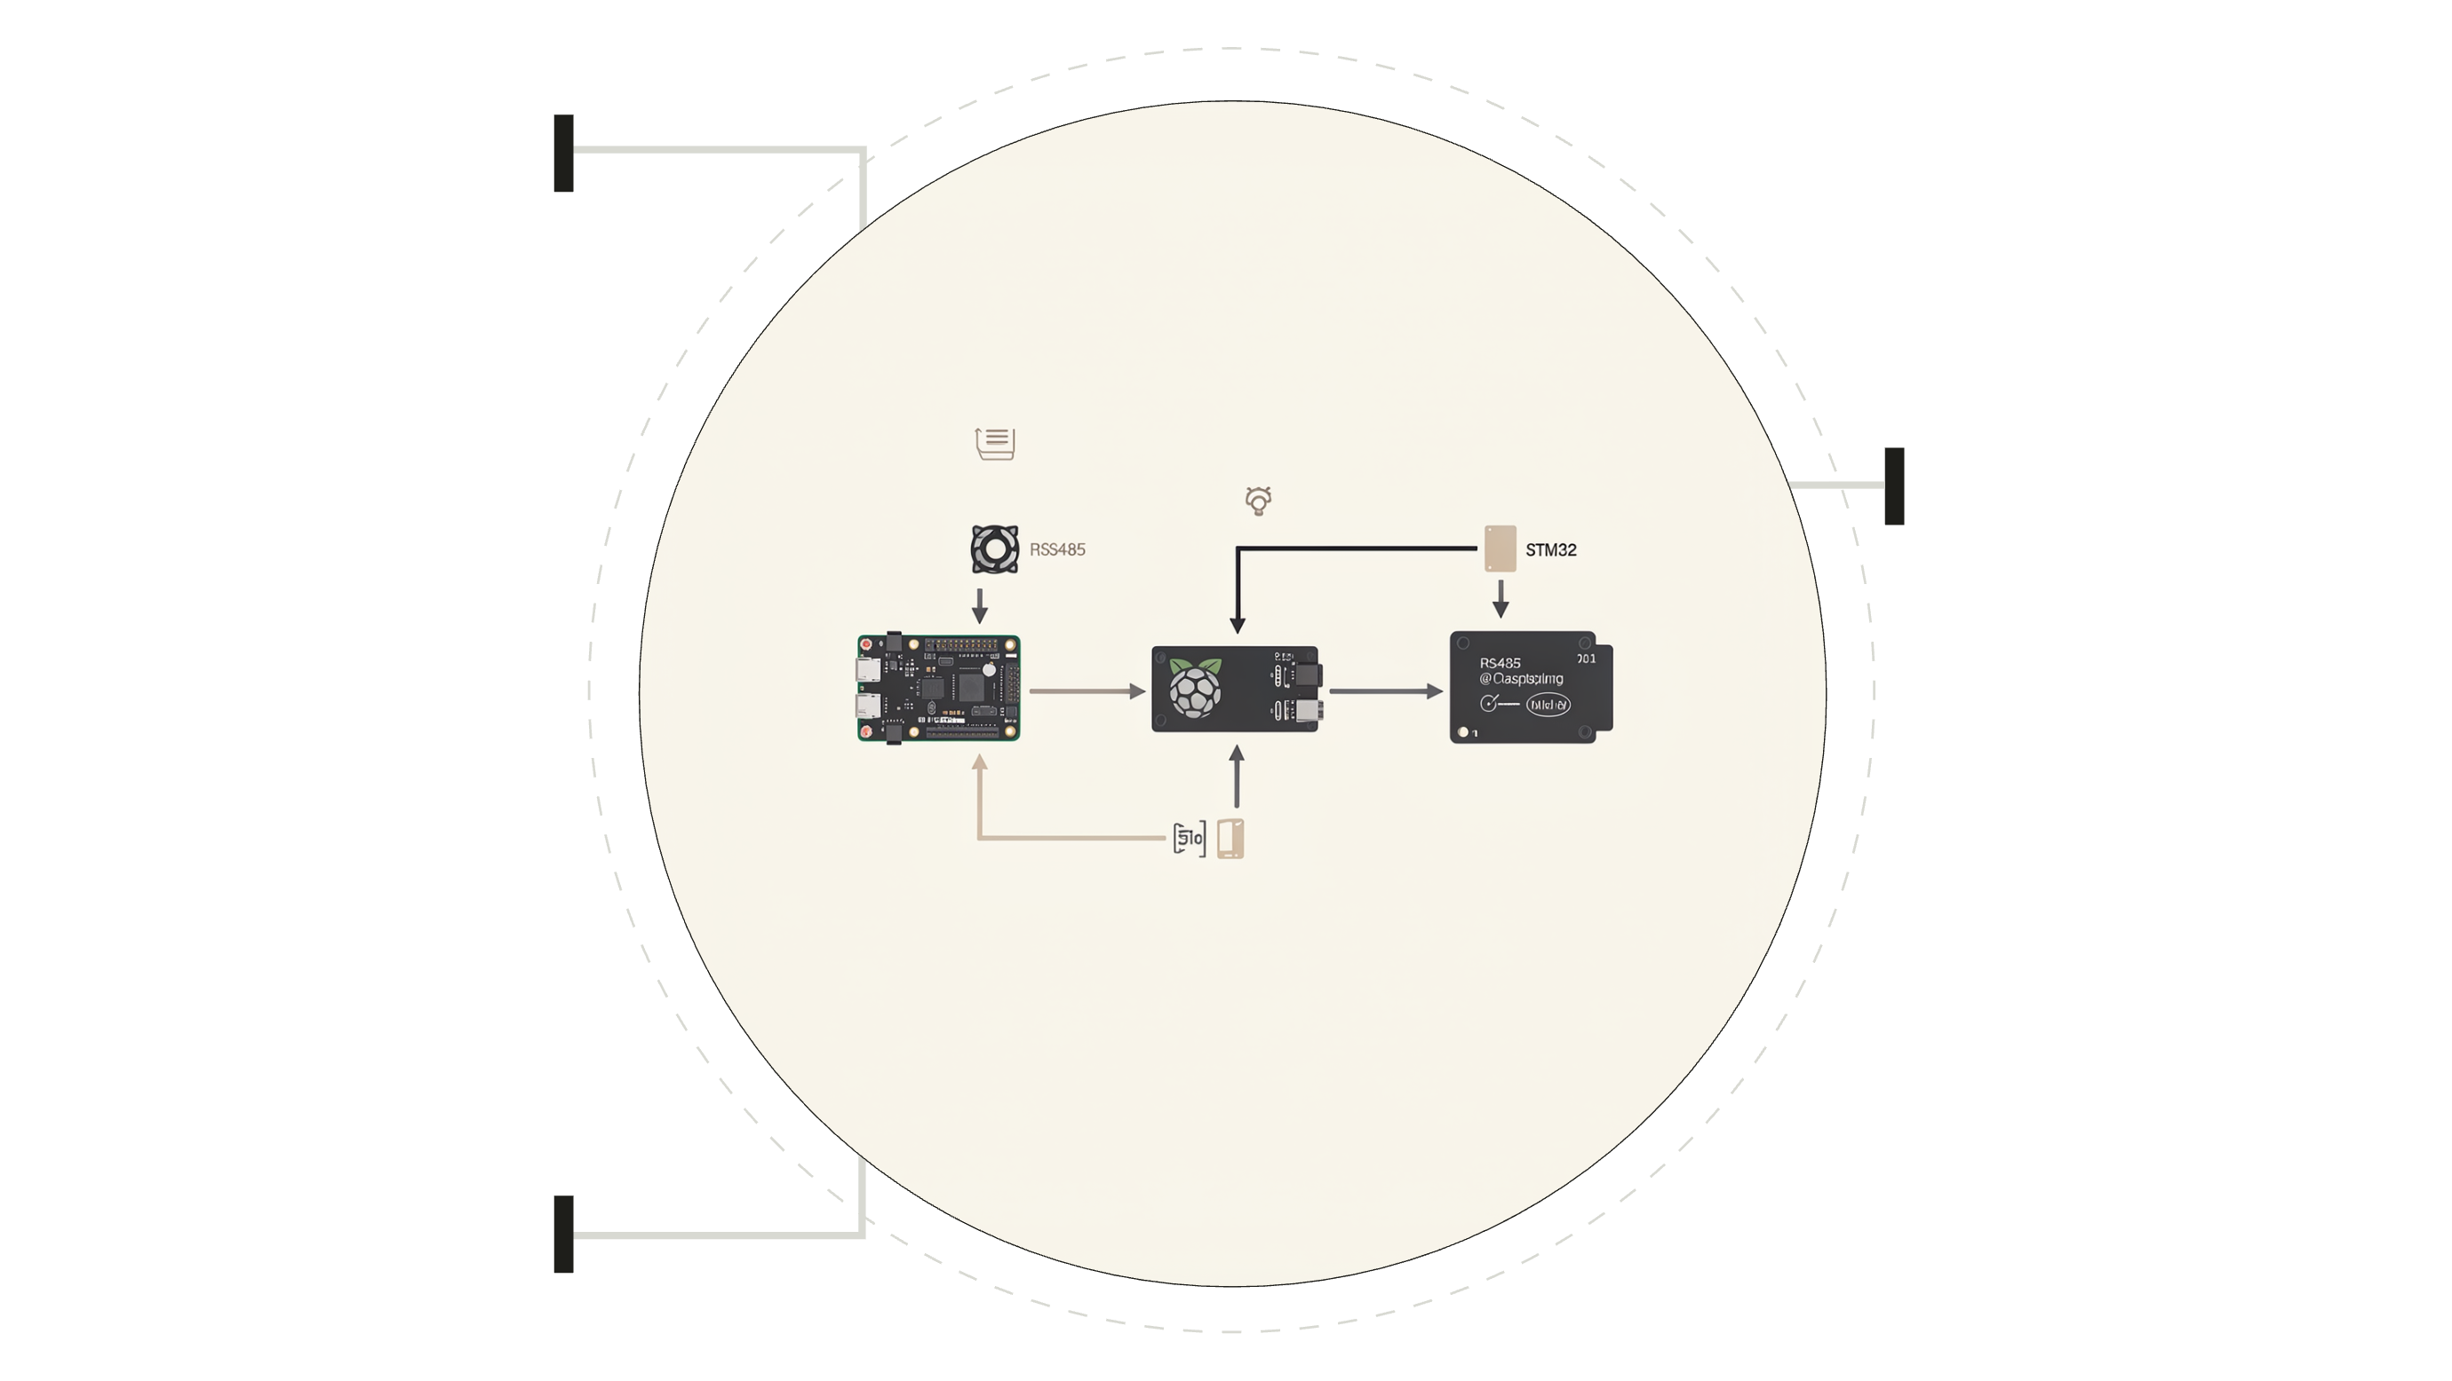
PROJECT GOAL
The Sample Routing Module (SRM) simulates a small industrial or medical machine using a master-slave architecture. The Raspberry Pi serves as the master controller, while the STM32 microcontroller acts as the slave device. Communication occurs via RS485 protocol, demonstrating a scalable embedded architecture suitable for industrial automation applications.
MASTER
Raspberry Pi invia comandi
BUS RS485
Collegamento seriale differenziale
SLAVE
STM32 esegue istruzioni

Slide 3

HARDWARE COMPONENTS
RASPBERRY PI 4 MODEL B
STM32 NUCLEO-F207ZG
Master controller with Linux OS
ARM Cortex-M3 slave processor
RS485 TRANSCEIVER MODULE
LCD1602 I2C DISPLAY
Differential serial communication
16×2 character operator feedback
ULN2003 STEPPER DRIVER
28BYJ-48 STEPPER MOTOR
Motor control IC module
5V unipolar stepper motor
Additional components include USB-to-RS485 converter, jumper wires, and breadboard for prototyping.

Slide 4
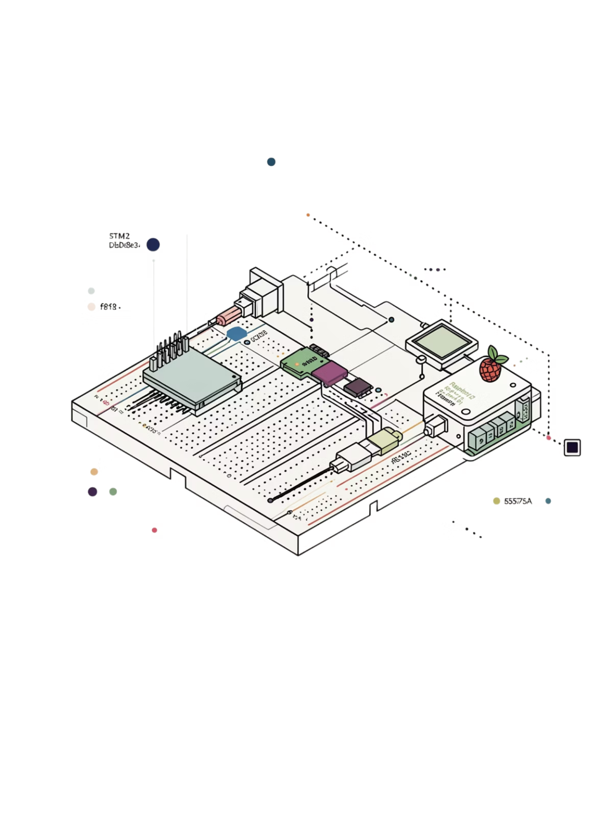
WIRING CONNECTIONS
STM32 PINOUT
POWER & GROUND
PB6 → RS485 TX
PB7 → RS485 RX
PB8 → LCD SCL
PB9 → LCD SDA
PD4 → ULN2003 IN1
PD5 → ULN2003 IN2
PD6 → ULN2003 IN3
PD7 → ULN2003 IN4
PA5 → Onboard LED
LCD1602 and ULN2003 connected to 5V power supply and common ground. RS485 module requires separate 5V connection for transceiver operation.

Slide 5
WHY RS485?
SUPERIOR NOISE IMMUNITY
LONG CABLE RUNS
Differential signaling rejects common-mode noise in industrial environments
Supports distances up to 1200 meters between devices
MULTI-DEVICE BUS
INDUSTRIAL STANDARD
Daisy-chain multiple slaves on single communication line
Common in medical equipment and factory automation systems
UART DIRECT CONNECTION
RS485 DIFFERENTIAL BUS
Short distance only, single device, susceptible to noise
Long distance, multi-device, noise-resistant differential pairs

Slide 6










SRM PROTOCOL FRAME
Custom binary protocol designed for reliable industrial communication with error detection and addressing capabilities.
SOF
Start of Frame
VER
Protocol Version
FLAGS
Control Flags
SRC/DST
Addressing
CMD
Command Type
SEQ
Sequence Number
LEN
Payload Size
PAYLOAD
Data Field
CRC16
Validation Check
EXAMPLE FRAME
AA 01 00 10 01 30 05 04 54 45 53 54 3F 92 - PING command from address 0x10 to 0x01 with "TEST" payload

Slide 7
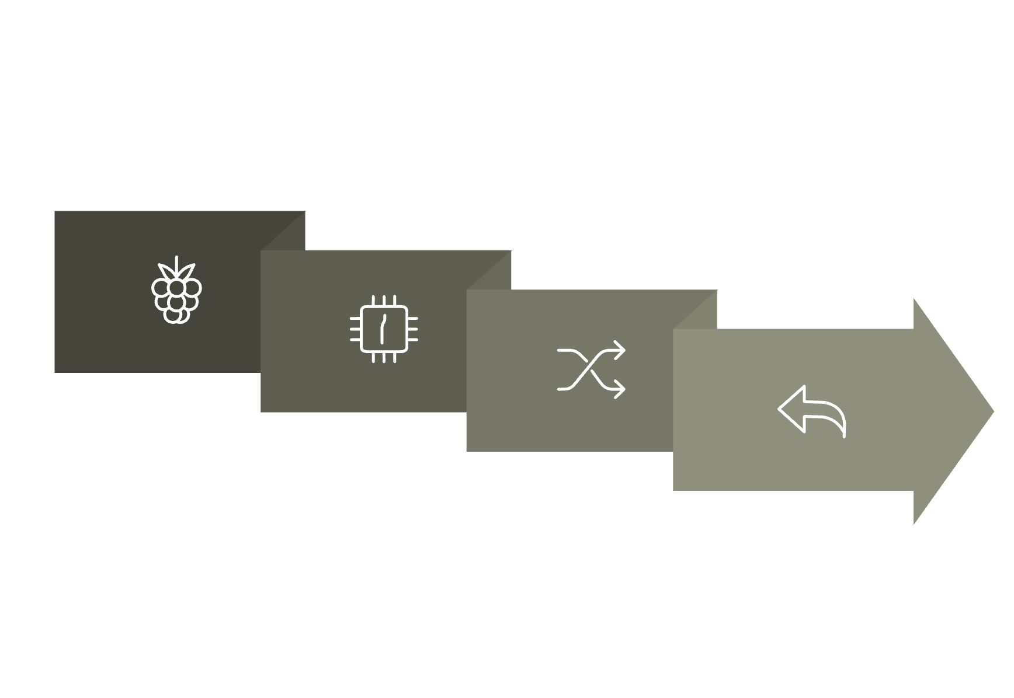
COMMAND FLOW
STM32: RECEIVE + CRC
STM32: ANSWER → PI VERIFY
PI: SEND COMMAND
DISPATCHER → EXECUTE
01
02
03
RASPBERRY PI SENDS COMMAND FRAME
STM32 RECEIVES COMPLETE FRAME
CRC16 VALIDATION CHECK
04
05
06
COMMAND DISPATCHER ROUTES REQUEST
PERIPHERAL EXECUTES ACTION
RESPONSE FRAME GENERATED
07
RASPBERRY VALIDATES RESPONSE

Slide 8
SUPPORTED COMMANDS
Command
Purpose
Action
PING
Test connection
Return PONG response
LED ON
Activate onboard LED
PA5 high, LCD shows "LED ON"
LED OFF
Deactivate LED
PA5 low, LCD shows "LED OFF"
STATUS
System status
Return system state and LCD message
LCD CLEAR
Clear display
Reset LCD, show "READY"
LCD WRITE L1
Line 1 text
Update first LCD line
LCD WRITE L2
Line 2 text
Update second LCD line
STEPPER CW
Rotate clockwise
Motor CW, LCD shows "MOTOR CW"
STEPPER CCW
Rotate counterclockwise
Motor CCW, LCD shows "MOTOR CCW"
STEPPER HOME
Return to origin
Software return, LCD shows "MOTOR HOME"

Slide 9
LCD FEEDBACK INTERFACE
READY
PONG
LED ON / OFF
System initialization complete, awaiting commands
PING command response received
Onboard LED state change confirmation
MOTOR CW / CCW
MOTOR HOME
Stepper motor rotation direction active
Software home position return initiated
The LCD1602 provides operator feedback in machine-style format, displaying current state and command execution results.

Slide 10



STEPPER MOTOR INTEGRATION
HARDWARE SETUP
SOFTWARE CONTROL
The ULN2003 stepper driver interfaces the STM32 GPIO pins to the 28BYJ-48 5V stepper motor. Four output pins control motor coils in sequence for precise rotation.
CW and CCW commands rotate motor in respective directions. HOME command implements software return to origin position. Future improvement: hardware end-stop switch for accurate homing.
COUNTERCLOCKWISE ROTATION
CLOCKWISE ROTATION
HOME POSITION RETURN

