Slide 1
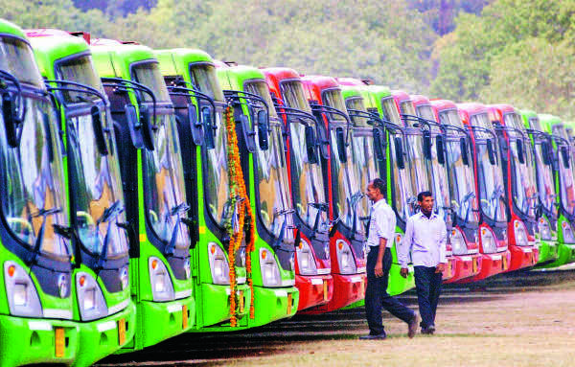
Social Network Analysis on Delhi Bus Route Network
By Parveen Bajaj & Abhishek Bohra

Slide 2
Proposal – Problem Definition
To analyze Delhi Bus Route Network using Social Network Analysis techniques.
Why Bus Route and Why Delhi?
What will we deliver ?
Systematic survey of Delhi Transport Network.
Present a model that with a small number of simple rules would be capable to reproduce the main properties.

Slide 3
Significance of Our Project
In other words the questions we want to address are :-
Identifying the routes that can be replaced by expressway corridors
Giant Components
How many bus routes are needed to get from one stop to another within city.
Distance
Avg number of bus stops that a line has.
Avg Degree
Avg number of routes a bus stop serves.
Avg Degree
Transfer Efficiency: Minimum Transfer Time
Identify bus stops used for better transfer among route.

Slide 4
Significance of Our Project (Conti..)
Diameter
Degree
Degree Correlation : Assortativity or Disassortativity
Location of possible bus terminals
Closeness
Betweenness

Slide 5
How will we go?
We will study the bus system based on four topological models
L Space
B Space
P Space
C Space
Nodes: Bus Stops / Routes

Slide 6
P, C, B & L Space Examples
L Space:
Nodes -> Bus Stop
Edges -> If nodes are adjacent.
B Space:
Two mode network (Bipartite Graph)
Bus Route and Bus Stops are nodes.
Each route node is linked to all stops that it serves
P Space:
Nodes are Bus Stops
Edge between bus stops if they are served by atleast one common route.
C Space:
Route nodes
Two routes are connected if they share a common station.

Slide 7
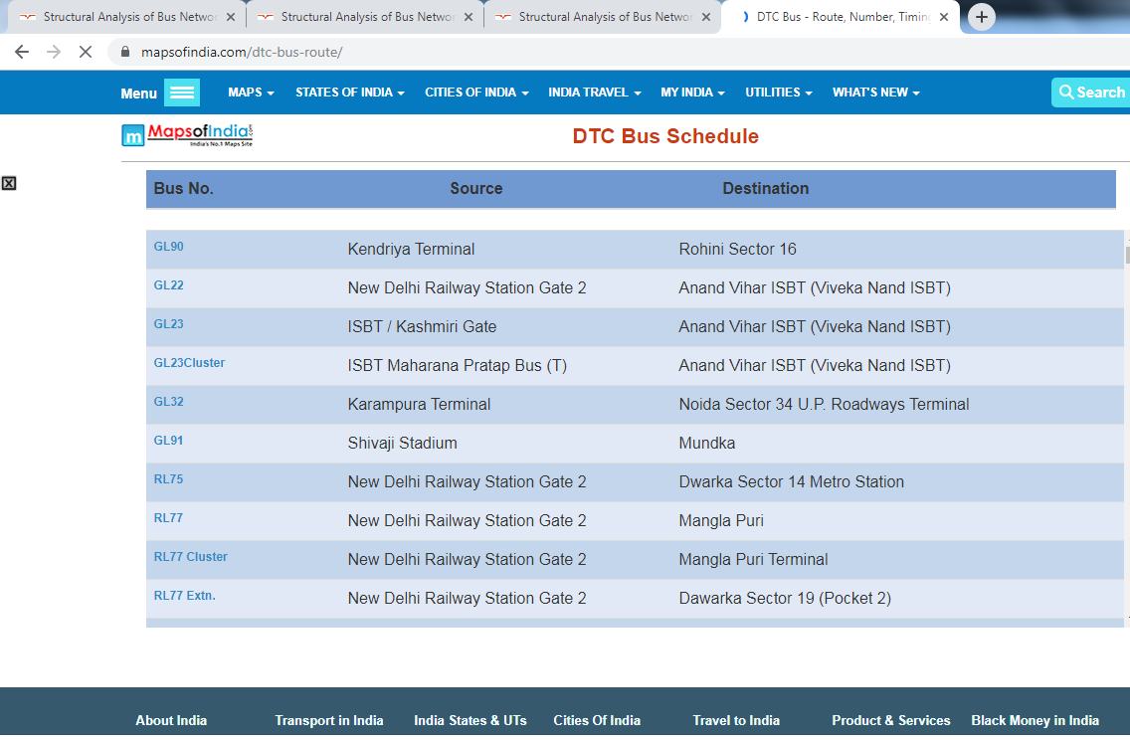
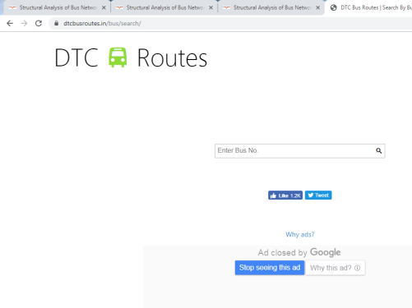
How will we go?(Conti..)
Use Gephi
Extract several properties.
Source of Data
https://www.dtcbusroutes.in/
https://www.mapsofindia.com/dtc-bus-route/

Slide 8
Literature Survey
The Analysis of the Properties of Bus Network Topology in Beijing Basing on Complex Networks by Hui Zhang,1 Peng Zhao,1 Jian Gao,1 and Xiang-ming Yao1,2
Bus transport network analysis in Rio de Janeiro based on topological models using Social Networks by Diego Carvalho.
Study on some bus transport networks in China with considering spatial characteristics by Xu-Hua Yang a,⇑, Guang Chen a,b, Sheng-Yong Chen a, Wan-Liang Wanga, Lei Wang .
Structural Analysis of Bus Networks Using Indicators of Graph Theory and
Complex Network Theory by Hui Zhang.
Public transport networks: empirical analysis and modeling by C. von Ferber

Slide 9
Thank You

