Slide 1
FINAL PROJECT · PYSPARK ML
Classifying Reddit Comments
Across 40 Subreddits
A comparison of four machine learning models on 500,000 comments
Team Members
Emma, Alia and Victor
Notes:
Good morning. Our project tackles a real-world NLP problem: given a Reddit comment, can a machine learning model predict which of 40 subreddits it came from? We processed 500,000 comments from different communities like gaming, sports, relationship advice, and politics. Our goal was to compare four different machine learning approaches on the exact same dataset to understand when simple models work better than complex ones.

Slide 2
MOTIVATION
The Problem
Research question Given the text of a Reddit comment, can a model predict which of 40 subreddits it came from?
Why it matters
Content moderation
Recommendation
NLP benchmark
Automatically route or flag comments to the right community context.
Suggest communities to users based on what they write.
A genuinely hard multi-class problem with noisy, short text.
The challenge 40 classes means a random-guess baseline of just 2.5%.
Reddit Subreddit Classification · PySpark ML
2 / 12

Slide 3
DATA
The Dataset
500K
FIELDS USED
body
The raw comment text — our main input
Reddit comments
subreddit
The community label — what we predict
40
score
Net upvotes (numeric)
controversiality
Binary flag for controversial comments
Subreddits (classes)
4
SOURCE & TOOLING
Stored on AWS S3 · processed with PySpark on AWS EMR
Variety of subreddits: gaming, sports, advice, politics, memes
Features used
Reddit Subreddit Classification · PySpark ML
3 / 12

Slide 4
PREPARATION — STEP 1 OF 2
Data Cleaning
01
02
03
Drop nulls
Filter markers
Normalize text
Remove rows missing a subreddit label or comment body.
Drop comments marked [deleted] or [removed] by moderators.
Lowercase everything; strip non-alphanumeric characters.
04
05
06
Balance classes
Clip for NB
Train / test split
Cap each subreddit at 12,500 rows via a window-function sample. Prevents dominant subs from skewing accuracy.
Set negative scores to 0 — Naive Bayes requires non-negative features.
Random 80 / 20 split with fixed seed for reproducibility.
Result 399,779 training rows · 100,221 test rows · evenly distributed across 40 subreddits
Reddit Subreddit Classification · PySpark ML
4 / 12
Notes:
Before we build any model, we need to clean the raw data. We followed six steps.
Step one: drop nulls. If a comment is missing its subreddit label or has no text, we remove it. We can't use it.
Step two: filter markers. When Reddit mods delete or remove comments, they leave behind strings that say [deleted] or [removed]. We don't want the model learning that the word "deleted" predicts anything. We want to learn from actual content.
Step three: normalize text. We convert everything to lowercase and remove non-alphanumeric characters. This reduces noise. The word "gaming" should be the same as "Gaming."
Step four: balance the classes. This is important. Some subreddits are way more active than others. If r/AskReddit dominates our dataset, the model learns to predict "AskReddit" all the time and ignores the other 39 communities. We capped each subreddit at 12,500 rows and randomly sampled. This is called stratification, and it's essential for multi-class problems.
Step five: clip negative scores to zero. This is specific to Naive Bayes, which needs non-negative numbers. We'll see later why this matters.
Step six: split the data 80 for training and 20 for testing, with a fixed random seed. That seed means we can reproduce our exact results.
After all this, we had 399,779 training examples and 100,221 test examples, evenly distributed across all 40 subreddits. Clean data, balanced classes, ready to work with.

Slide 5
PREPARATION — STEP 2 OF 2
Feature Engineering Pipeline
Raw text
Tokenize
Stop words
CountVectorizer
IDF weighting
Assemble
›
›
›
›
›
Cleaned
comment body
Split into
words ≥3 chars
Remove the,
and, is, ...
Top 15,000 words,
min doc freq = 5
Down-weight
common words
+ score, controv.
→ 15,002 features
DESIGN DECISIONS
CountVectorizer over HashingTF Builds an exact vocabulary — no hash collisions on 400k rows.
TF-IDF weighting Rare, distinctive words (e.g., "Targaryen") get more weight than common ones.
Two assembled vectors TF-IDF features for LR/DT/MLP; raw TF for Naive Bayes (needs non-negative).
Persist to memory Cached the full feature matrix so all four models reuse the same vectors.
Reddit Subreddit Classification · PySpark ML
5 / 12
Notes:
We collected 500,000 Reddit comments from 40 different subreddits and stored them on AWS S3. We processed everything using PySpark on AWS EMR. This matters because Reddit data is unstructured. We get raw text comments with some associated information.
We used four features from each comment. The comment body is our main input, the raw text we're analyzing. The subreddit label is what we're trying to predict. The score is the net number of upvotes, which is a numeric feature. And controversiality is a binary flag that Reddit assigns to controversial comments.
Our subreddit mix is diverse. We included gaming communities like r/gameofthrones, sports subreddits like r/nba, advice communities like r/AmItheAsshole and r/relationship_advice, political subreddits, and meme communities. This diversity matters because it forces the model to learn genuinely different vocabularies. It can't just learn a few obvious differences; it has to understand 40 distinct communities.
Why PySpark? Because 500,000 comments with 15,000 text features is too much for a single computer to handle easily. PySpark distributes the work across a cluster. The text vectorization, the model training, all of it can run in parallel.

Slide 6
APPROACH
The Four Models
Logistic Regression
Naive Bayes
Linear classifier. Learns a weight per word per class; high-weight words push toward that class.
Probabilistic. Assumes word occurrences are independent given the class. Fast and surprisingly strong on text.
maxIter = 30 · regParam = 0.01
multinomial · smoothing = 1.0
Decision Tree
MLP Neural Network
Rule-based. Splits the feature space with yes/no questions until each leaf is mostly one class.
Feed-forward neural net with two hidden layers. Can learn non-linear feature combinations.
maxDepth = 8
layers = 15002 → 128 → 64 → 40 · maxIter = 50
Reddit Subreddit Classification · PySpark ML
6 / 12
Notes:
Logistic Regression — maxIter = 30, regParam = 0.01
Logistic regression learns by adjusting its weights step by step.
maxIter = 30 means the model was allowed up to 30 rounds of training. If it found a good solution earlier, it stopped automatically.
regParam = 0.01 adds a small penalty to prevent the model from relying too heavily on any one word. This helps reduce overfitting, especially for rare words, while still allowing important words to influence the prediction.
Naive Bayes — Multinomial, smoothing = 1.0
We used multinomial Naive Bayes because it is designed for text data, especially word counts.
smoothing = 1.0 is Laplace smoothing. It prevents the model from assigning zero probability to words it did not see during training.
For example, if a word never appeared in one subreddit during training, the model should not completely rule out that subreddit just because the word appears in a new comment. Smoothing helps avoid that problem.
Decision Tree — maxDepth = 8
maxDepth = 8 limits how complex the decision tree can become.
At depth 8, the tree can create up to 256 final decision groups. That sounds like a lot, but it is small for our task because we are trying to classify 40 subreddits using 15,000 word features.
This limit likely hurt the Decision Tree’s performance. A deeper tree might perform better, but it would also overfit more easily and require much more memory.
MLP Neural Network — 15002 → 128 → 64 → 40, maxIter = 50
The MLP is a neural network with several layers.
The input layer has 15,002 features: 15,000 TF-IDF word features plus score and controversiality.
The hidden layers, 128 and 64, learn combinations of features rather than relying only on individual words.
The output layer has 40 neurons, one for each subreddit. The neuron with the strongest output becomes the model’s prediction.
maxIter = 50 means the model trained for 50 passes through the data. This is relatively low for a neural network, which may explain why it did not outperform logistic regression.

Slide 7
EVALUATION
How We Measured Performance
Accuracy
Macro F1
Fraction of test comments where the predicted subreddit matches the true subreddit.
Harmonic mean of precision and recall, averaged across all 40 classes — treats every subreddit equally.
(correct predictions) / (total)
balances precision & recall
REFERENCE POINTS
2.5%
100%
80 / 20
Random-guess baseline (1 / 40)
Theoretical ceiling — impossible in practice
Train / test split ratio
Reddit Subreddit Classification · PySpark ML
7 / 12
Notes:
We used two main metrics to evaluate performance.
Accuracy is straightforward. Out of all test comments, what fraction did we predict correctly? Everyone understands accuracy. It's intuitive. But it can hide problems if your classes are imbalanced. We solved that by balancing our training data.
Macro F1 is more sophisticated. F1 is the harmonic mean of precision and recall. Macro F1 means we compute F1 for each of the 40 subreddits separately, then average them. This treats all classes equally. It answers the question: does the model understand every community equally well?
We also established reference points. Random guessing gets you 2.5% accuracy, since there are 40 classes. That's our floor, our baseline. The ceiling is 100%, which is theoretically possible but practically impossible with noisy data. Our train-test split is 80-20, which is standard.
Everything we show you should be compared against these benchmarks.

Slide 8
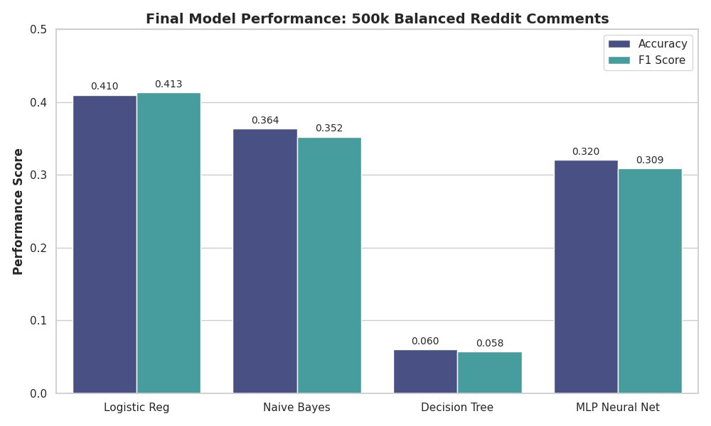
PERFORMANCE
Results
WINNER
Logistic
Regression
0.413 macro F1
KEY READS
16× better than random (2.5%)
LR > MLP
Simple beat complex
Tree collapses
At depth 8 on 15k features
Reddit Subreddit Classification · PySpark ML
8 / 12

Slide 9
ANALYSIS
Why Each Model Performed That Way
0.413
Logistic Regression
Text classification is roughly linear in TF-IDF space — a few distinctive words per subreddit are enough. Simple model + sparse high-dim features is a textbook match.
0.352
Naive Bayes
The independence assumption is technically wrong (words co-occur), but it's a useful approximation at scale. Loses to LR because it can't capture anti-correlations between words.
0.309
MLP Neural Network
Underperforms LR despite more capacity. With sparse TF-IDF input (no embedding layer) and only 50 training iterations, it never beats the linear model. Deep learning isn't automatically better on sparse text.
0.058
Decision Tree
A single tree of depth 8 can only carve out 256 regions — not enough to separate 40 classes across 15,000 features. Wrong tool for sparse, high-dimensional problems.
Reddit Subreddit Classification · PySpark ML
9 / 12
Notes:
Logistic Regression at 41.3%: Text classification in TF-IDF space is nearly linear. What does that mean? A handful of distinctive words per subreddit is enough to identify it. If you see "dragon," "throne," "Targaryen," you're probably in r/gameofthrones. Logistic regression is built exactly for this. It learns which words push toward which class. With sparse, high-dimensional features, linear separability actually works well. TF-IDF features plus logistic regression is a textbook match.
Naive Bayes at 35.2%: The independence assumption is false. Words don't occur independently. "LeBron" and "Lakers" appear together. But this false assumption is actually useful. It keeps the math simple and helps the model generalize. Naive Bayes underperforms logistic regression by about 6 percentage points because it can't capture anti-correlations. If "Targaryen" predicts Game of Thrones but "spoiler warning" makes it less likely, logistic regression learns both relationships. Naive Bayes treats them independently and misses the signal.
MLP Neural Network at 30.9%: This is where expectations fail. The neural network has more capacity. It can learn non-linear combinations of features. But sparse TF-IDF input doesn't benefit from that capacity. There's no embedding layer converting sparse vectors into dense learned representations. The network essentially learns linear combinations anyway, just with more overhead and less training time. Fifty iterations wasn't enough to beat logistic regression. With more training time, dropout, and better tuning, it might work better. But as set up, the neural network hurts performance.
Decision Tree at 5.8%: Pure combinatorial explosion. A tree of depth 8 creates 256 regions. For 40 classes across 15,000 features, 256 regions is way too few. Each leaf node represents a mixture of many classes. The tree fragments so badly it's nearly random. Single trees aren't built for high-dimensional problems. Random forests or gradient-boosted trees would fix this, but one tree is the wrong tool.

Slide 10
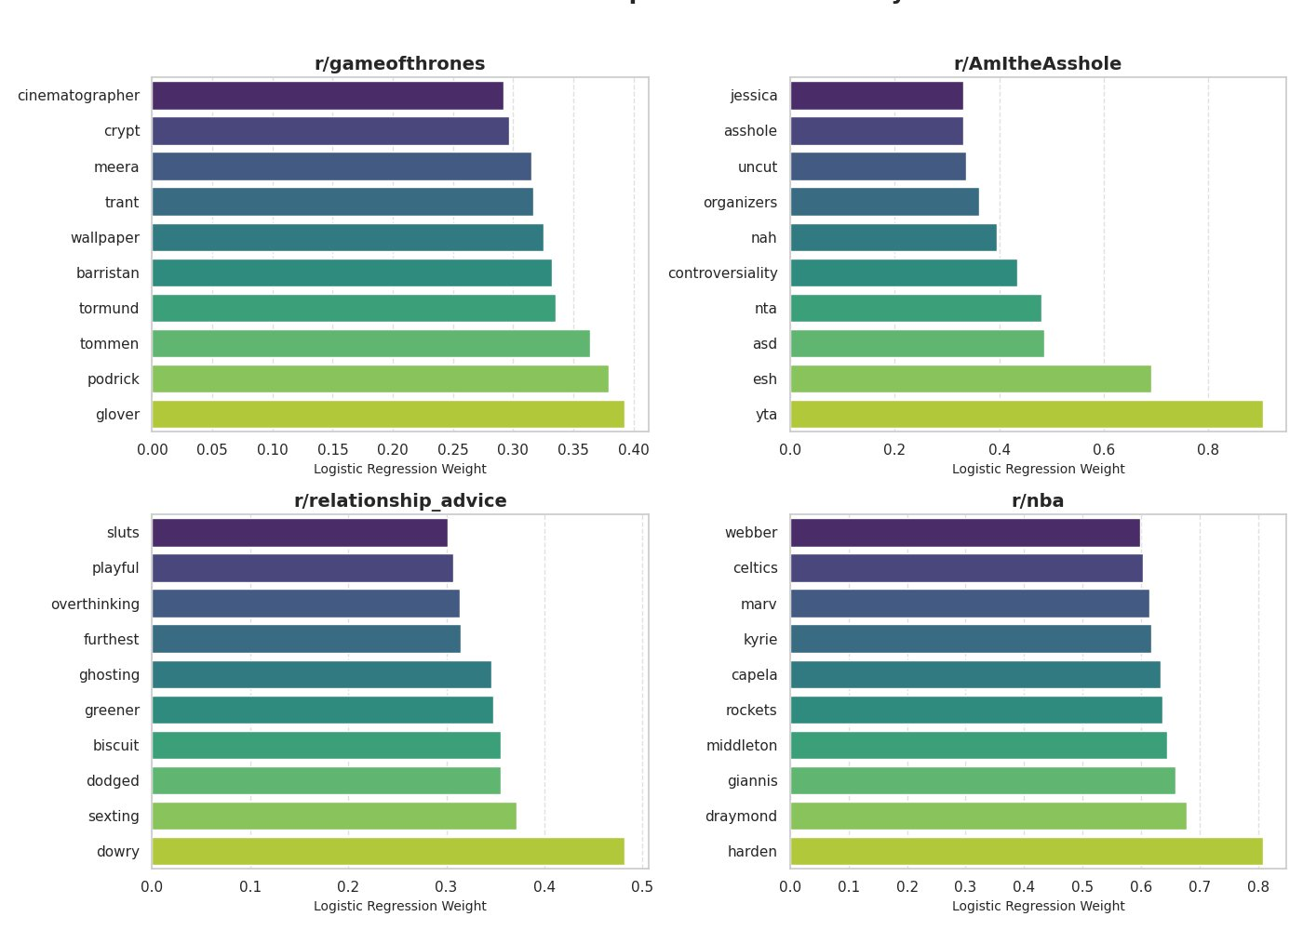
INTERPRETABILITY
What the Model Learned
OBSERVATIONS
Top predictors per subreddit
Logistic regression weights for r/gameofthrones, r/AmItheAsshole, r/relationship_advice, and r/nba.
What stands out
Character names (podrick, tormund, meera) for GoT. Player names (harden, giannis, kyrie) for NBA. Community slang (yta, nta, esh) for AmItheAsshole.
Why it matters
The model isn't a black box — it picks up genuinely distinctive vocabulary from each community.
Reddit Subreddit Classification · PySpark ML
10 / 12
Notes:
One advantage of logistic regression is that it's interpretable. We can extract the weights, see which words push toward each class, and understand what the model actually learned.
Looking at specific subreddits: r/gameofthrones has high weights for character names like Podrick, Tormund, Meera. That's the Game of Thrones universe. r/nba shows player names: Harden, Giannis, Kyrie. The actual basketball players. r/AmItheAsshole shows community slang: YTA means "You're The Asshole," NTA is "Not The Asshole," ESH is "Everyone Sucks Here." That's inside vocabulary. r/relationship_advice has words like "communicate," "boundaries," "therapy."
This matters. The model isn't a black box. It's not learning noise. It's picking up genuinely distinctive vocabulary from each community. The top predictors make sense. You can see why each word matters.

Slide 11
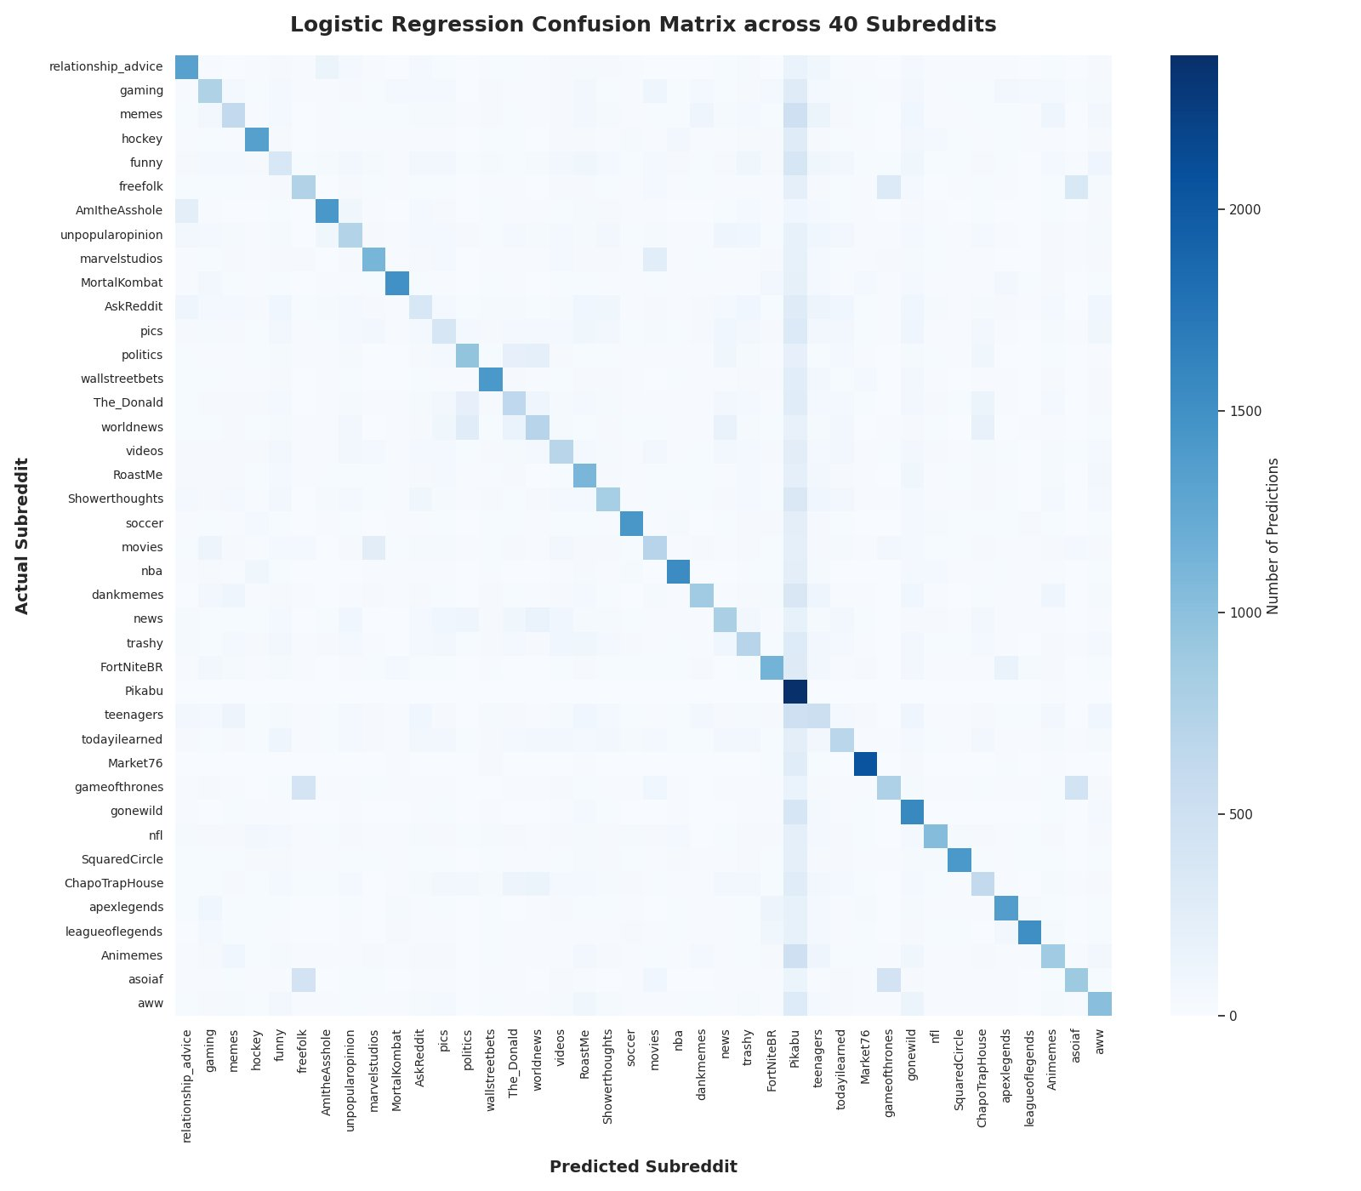
CONFUSION MATRIX
Where the Model Confuses Subreddits
HOW TO READ IT
Rows are the true subreddit, columns are the predicted subreddit. A perfect model would be a solid diagonal.
Clear diagonal
The model is learning real signal across all 40 classes.
Pikabu over-prediction
The Pikabu column is darker than others — the model leans toward it when uncertain.
Game-of-Thrones cluster
r/gameofthrones, r/asoiaf, and r/freefolk get confused — same fandom, overlapping vocabulary.
Advice overlap
r/AmItheAsshole and r/relationship_advice swap predictions — similar topics.
Reddit Subreddit Classification · PySpark ML
11 / 12

Slide 12
WRAP-UP
Conclusions & Future Work
KEY TAKEAWAYS
01
02
03
Right tool > fancy tool
16× random baseline
Interpretable signal
Simple logistic regression beat a deeper MLP on sparse, high-dimensional text features.
41% accuracy across 40 classes is a strong result — random would be 2.5%.
Top-weighted words match each community's real vocabulary (names, slang, topics).
FUTURE WORK
Word embeddings Word2Vec or BERT instead of TF-IDF — captures meaning, not just word counts.
N-grams Add bigrams/trigrams to capture short phrases ("not the asshole").
Better trees Gradient-boosted trees (GBT) or Random Forest would massively outperform one deep-8 tree.
Tune the MLP More epochs, dropout, a wider embedding layer — fairer comparison vs LR.
Reddit Subreddit Classification · PySpark ML
12 / 12
Notes:
Three main takeaways from this project.
First: the right tool beats the fancy tool. We tested four models with different levels of sophistication. The simplest one won. That doesn't mean neural networks are bad. It means we didn't have the right setup for neural networks. If we used word embeddings instead of TF-IDF, the story changes. But on sparse, high-dimensional text features, linear methods are hard to beat. The lesson generalizes: always start with simple baselines.
Second: 41% accuracy across 40 classes is genuine learning. Random guessing is 2.5%. We're 16 times better. That's empirically strong.
Third: the learned patterns are interpretable. The top-weighted words match reality. The model learned what different communities actually write about. That's not overfitting. That's learning real patterns.
For future work, there's room to improve. Word embeddings like Word2Vec or BERT would capture meaning, not just word counts. That's where neural networks would shine. Bigrams and trigrams would catch phrases like "not the asshole." Better tree ensembles, Random Forests or Gradient Boosted Trees, would massively beat a single decision tree. The MLP needs a fairer comparison: more training time, dropout, maybe an embedding layer before the dense layers.

