Slide 1
TCL Scripting for OPENLANE
Ahsen Tahir
Electrical Department
University of Engineering and Technology, Lahore

Slide 2

TCL Script File Execution
Make a file with the vim editor and tcl extension
To invoke the tclsh interpreter when executing file write #!/usr/bin/tclsh (where # is for comment)
To invoke the tclsh interpreter when executing file write #!/usr/bin/tclsh (where # is for comment)
To invoke the tclsh interpreter when executing file write #!/usr/bin/tclsh (where # is for comment)
To invoke the tclsh interpreter when executing file write #!/usr/bin/tclsh (where # is for comment) as first line
Execute on command prompt
sorry the filename.tcl is not in the path such as /usr/bin etc.
Please use ./filename.tcl (./ means present directory just like ../ means parent directory)
Linux needs execution permissions for the file through chmod command

Slide 3
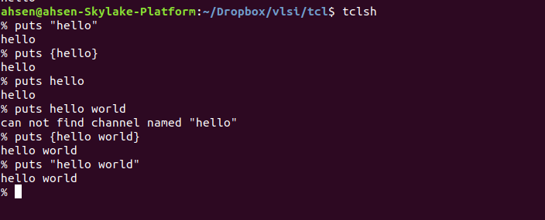
TCL Execution on Shell Interpreter

Slide 4
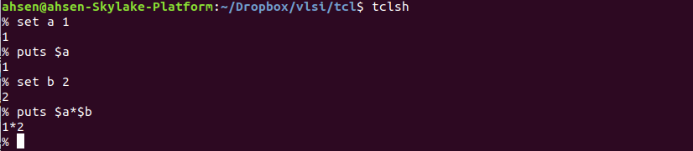
Assigning Variables
Assign a variable with set command
set a 1
set b flower
set c 2.2
Reference variable with $, e.g. $a, $b, $c, puts $a (/r for carriage return, /t for tab), puts “$a” (not {$a})

Slide 5
Mathematical Expressions
expr {$a+$b}
expr {$a == 1} or expr {$a eq 1}
Also eq, ne, !, <=, >=, << , >>
Arrays
set a(1) 10
set a(2) 7
set a(3) 17
set b 2
puts "Sum: [expr {$a(1)+$a($b)}]"

Slide 6
Loops
for {set i 0} {$i < 10} {incr i} {
puts $i
}
while {$i < 10} {
puts $i
set i [expr {$i + 2}]
}

Slide 7
If - else
set x 3
if {$x == 2} {
puts "x is 2"
} elseif {($x > 2) && ($x <= 4)} {
puts "x is greater than 2 and less than equal to 4"
} else {
puts "x is greater than 4"
}

Slide 8
Procedure/function in TCL
proc procedureName {arguments} {
body
}
proc sum {arg1 arg2} {
set x [expr {$arg1 + $arg2}] (or return [expr {$arg1 + $arg2}])
return $x
}
puts "[sum 2 3]"
set value [sum 2 3]

Slide 9
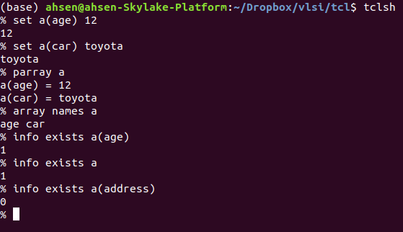
Associative Arrays
Array
set a(1) hello
set a(2) world
Associative Array
set a(age) 12
set a(car) toyota
parray a
a(age) = 12
a(car) = toyota
array names a
age car
info exists a(age)
1

Slide 10
TCL Array: env
Array env is used for environment variables by TCL
e.g. env(PATH), env(USER), env(HOSTNAME) and openlane flow variables
env has a global name space and can also be written ::env()
Try parray env to get the list and puts [array names env] to get index
Used in openlane config files for variables
e.g. set ::env(DESIGN_NAME) alu, set ::env(CLOCK_PERIOD) "10.000"
set ::env(CLOCK_PORT) "clk"
Check if a particular env variable (index→ DISPLAY) exists
if { [info exists ::env(DISPLAY) ] }
Other global variables argv → Tcl list of arguments to tclsh or wish.

Slide 11
Misc. Built-in Commands
puts [info script] → ./filename.tcl
puts [file normalize [info script]] → /home/ahsen/vlsi/filename.tcl
puts [file dirname [file normalize [info script]]]→ /home/ahsen/vlsi
lappend will append new path to internal paths maintained by TCL
e.g. lappend ::auto_path $::env(OPENLANE_ROOT)
e.g. lappend ::auto_path “$::env(OPENLANE_ROOT)/scripts”
Execute commands/programs in tcl
e.g. exec tclsh >&@stdout
(>&@stdout → sends standard output from the last command and standard error from all commands to standard output )
glob command is used to match file names and outputs a list
glob *.v → design_2.v design_1.v

