Slide 1
eevidtron episode 003
Numerically Solving Planar DC Problems
using Resistor Meshes, Matrix Math and Python

Slide 2
What Voltage is measured if the sheet conductivity of the surface is 2.9 kS?

Slide 3
Resistance, Conductivity,
Sheet Conductivity
The conductivity G is the reciprocal of the resistance R:
  U = R*I G = 1/R => I = G*U
SI-Unit of conductivity:
  1 Siemens = 1 S = 1/Ω (sometimes also: 1 Moh = 1 ℧ = 1/Ω)
The conductivity of a surface …
  Increases with width: G ~ w
  Decreases with length: G ~ 1/l
The conductivity of a square sheet segment is called the sheet conductivity σ of the sheet material: G = σ * w / l

Slide 4
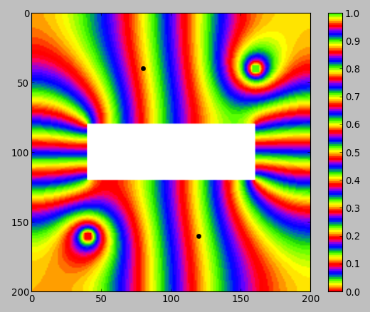
Numerical Solution: Overview
We divide the surface in small rectangular cells. (Think: Pixels)
We describe the behavior of each cell in a way we can calculate easily.
The picture shows a solution with 200 x 200 = 40.000 cells.
We can't calculate this by hand. But we can use a computer for the calculation.
For our simple problem a Python script using NumPy and SciPy can do the job easily.

Slide 5
Node Potentials and Current Equations
Each cell has a node Potential U_{i}.
A grid of resistors connect the cells.
Current from U₁ to U₂:
I₁₂ = (U₁ – U₂) * G₁₂
For example the equation for U₅:
(U₅ – U₂)G₅₂ + (U₅ – U₄)G₅₄ +
(U₅ – U₆)G₅₆ + (U₅ – U₈)G₅₈ = 0
Which is a simple linear equation in U_{i}:
(G₅₂+G₅₄+G₅₆+G₅₈)U₅ – G₅₂U₂ – G₅₄U₄ – G₅₆U₆ – G₅₈U₈ = 0

Slide 6
Voltage and Current Sources
Setting a cell to a fixed potential:
  Simply replace the equation for the cell, e.g: U₅ = 10
  Behaves like a voltage source to ground
  At least one cell must be set to a fixed potential
Creating a real two-terminal voltage or current source:
  Requires the addition of 1 additional variable
  Left as homework exercise as it is not needed for our problem

Slide 7
Calculating edge conductance
Current from U₁ to U₂: I₁₂ = (U₁ – U₂) * G₁₂
G₁₂ is the edge conductance for the edge from U₁ to U₂
Let G_{i} be the conductivity of cell i.
So each resistor in cell i has resistance R = 1/(2G_{i})
Therefore:
Sanity check: G₁ = G₂, G₁ = 0
Notes:
\frac{1}{G_{12}} = \frac{1}{G_{21}} = \frac{1}{2 G_1} + \frac{1}{2 G_2}
\hskip1em\Rightarrow\hskip1em
G_{12} = G_{21} = \frac{2 G_1 G_2}{G_1+G_2}

Slide 8
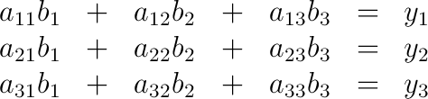
Quick Introduction to Matrix Math (1/3)
Consider the following system of linear equations
In linear algebra (“matrix math”) we simply write this as one equation: A b = y
A is a matrix, i.e. a table of all the a_{ij} values
b and y are vectors, i.e. lists of the b_{j} and y_{i} values
Notes:
\begin{matrix}
a_{11} b_1 &+& a_{12} b_2 &+& a_{13} b_3 &=& y_1 \\
a_{21} b_1 &+& a_{22} b_2 &+& a_{23} b_3 &=& y_2 \\
a_{31} b_1 &+& a_{32} b_2 &+& a_{33} b_3 &=& y_3 \\
\end{matrix}

Slide 9
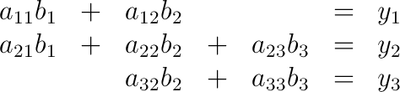
Quick Introduction to Matrix Math (2/3)
Now consider the following system of linear equations:
This can still be written as A b = y.
But now some entries in A are zero.
  This is called a sparse matrix.
  Special libraries for sparse matrix math can handle this case efficiently by only caring about the non-zero entires.
For our problem we need a matrix with 40.000 x 40.000 = 1.600.000.000 entries! But most of them are zero, so we only need to care about the 40.000 x 5 = 200.000 non-zero entries.
Notes:
\begin{matrix}
a_{11} b_1 &+& a_{12} b_2 & & &=& y_1 \\
a_{21} b_1 &+& a_{22} b_2 &+& a_{23} b_3 &=& y_2 \\
& & a_{32} b_2 &+& a_{33} b_3 &=& y_3 \\
\end{matrix}

Slide 10
Quick Introduction to Matrix Math (3/3)
Why matrix math?
  Because it provides an easy and compact language to describe huge mathematical problems.
  Because there are software libraries to do the calculations efficiently.
So is this all there is to know?
  No! It is not even the tip of the iceberg..
  I've only given you the bits you need for understanding the solution to this simple problem.
  Recommended videos:
    The Kahn Academy Linear Algebra Videos
      https://www.khanacademy.org/math/linear-algebra
    MIT OpenCourseWare Linear Algebra Lectures
      http://ocw.mit.edu/courses/mathematics/18-06-linear-algebra-spring-2010/

Slide 11
Code review and demo:
dcmesh.py, demo_simple3x3.py

Slide 12
What about diagonal currents?
Theoretical argument:
  Because of linearity a diagonal current can be described as the superposition of a horizontal and vertical current.
  So if the model is correct for orthogonal currents it is also correct for diagonal currents.
Experimental argument (sanity check):
  We create a problem that can be rotated easily and see if the numerical solution changes when we rotate the problem.

Slide 13
Code review and demo:
demo_circle.py

Slide 14
Reformulation of the original problem
Instead of forcing a current through the surface we apply an arbitrary voltage (for example 1V – it's just a simulation ;-).
Then we read out the current produced and scale the results according to the ratio between the current we wanted and the current we got.
This way we get away without adding real current sources to the simulation.

Slide 15
Code review and demo:
demo_puzzle.py

Slide 16
Beyond our example
Smarter tessellations
  Usually using triangles (2D) or tetrahedrons (3D)
  Fine in some places and coarse in others
  Maybe even adaptive at run-time
Non-geometric and/or non-uniform problems
  For example simulation of arbitrary electronic circuits
More complex math
  More than one variable per cell
  More than one parameter per cell
  Non-linear models (can be done using Newton Method)
  Integration of differential equations (implicit or explicit)

Slide 17
Thank you for watching!
Discuss and comment on Reddit.
See video description for links.

