Slide 1
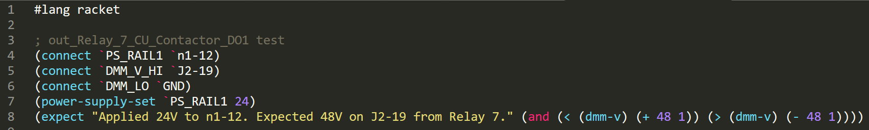
Structure of a Test Case
A test case is a small program written in Scheme language (Racket)
Constructs a circuits using relay matrix (connect)
Controls test power sources (power-supply-set)
Performs measurement using DMM (Digital Multi Meter) (dmm-v)
Evaluates test expression (expect)
Displays an error message if test expression is #f (false).

Slide 2

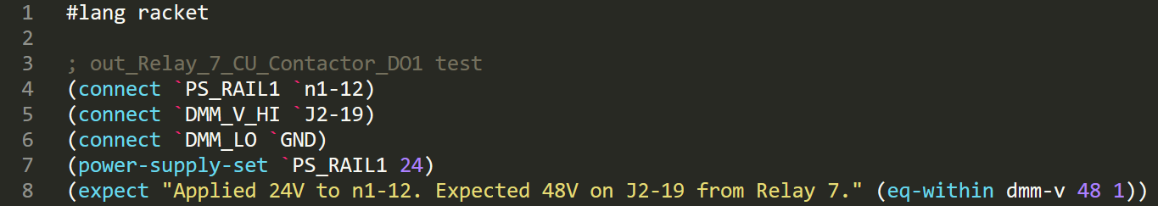
Simplifying Common Patterns
Using Racket you can factor our common code patterns to make tests less repetitive
Functions in Racket are short and sweet
DRY (Do Not Repeat Yourself)

Slide 3
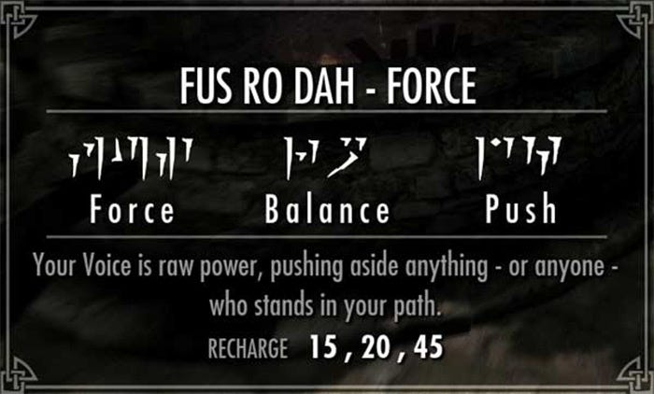
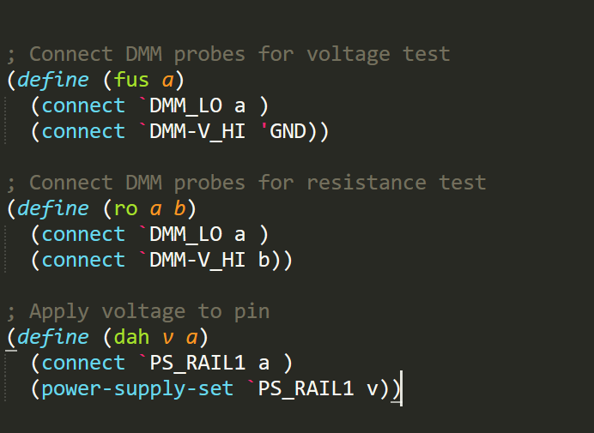
Simplifying Common Patterns
Shape your own language to solve problems efficiently, don’t shape your problems to the language

Slide 4
Why Test Cases are different from normal software?
Test are written to fail! - If your test can’t fail, you don’t need the test.
Full code of the test must be VISIBLE to the operator!!! - If I don’t understand the test, I can’t fix it.
Tests are written to be debugged. - I want to interact with the tester to reproduce the problem.
Tests are not written to test the tester. - I need to trust the tester to do the right thing.

Slide 5
It may seem beneficial to scan every pin and do pair-wise resistance testing between each test to catch cross-talk. This could be achieved by restructuring many tests to alter a background snapshot of voltage and pairwise resistance across the whole target and then compare measured snapshot to the expected snapshot.
The downside of such setup is slower testing speed, complexity of troubleshooting when issues arise and reduced flexibility. If the test touched 100 relays, how do I know which one caused the problem? The programmers will say “I will write an error message”. But we all know programmers can’t write meaningful error messages and you can’t rely on that to save your life. Far more beneficial is to test what you actually care for and to keep tests simple.

