Slide 1
생활 속의 Perl

Slide 2
use JAVA;
use C;
use Perl;
my $name = ‘정 경훈’;
my $irc_nick = ‘TAFKA_HoliK’;
my $company = ‘Fuji Xerox Korea’;
my %SNS = (
‘twitter’ => ‘@eeyees’,
‘googlePlus’ => ‘eeyees@gmail.com’ );

Slide 3
좋아하는 것 :
Game, Music, Animation, etc...

Slide 4
First !!
Youtube Downloader!

Slide 5
우리에게는 CPAN이 있으니깐...

Slide 6
WebService::GData::YouTube

Slide 7
WWW::YouTube::Download

Slide 8
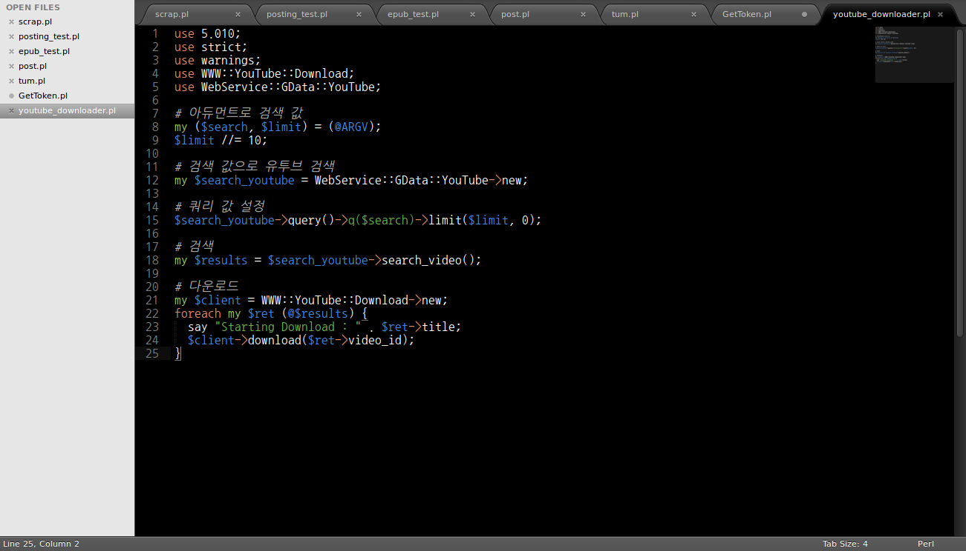

Slide 9
Second
Publishing my e-book...

Slide 10
Web::Scraper

Slide 11
Ebook::EPUB

Slide 12
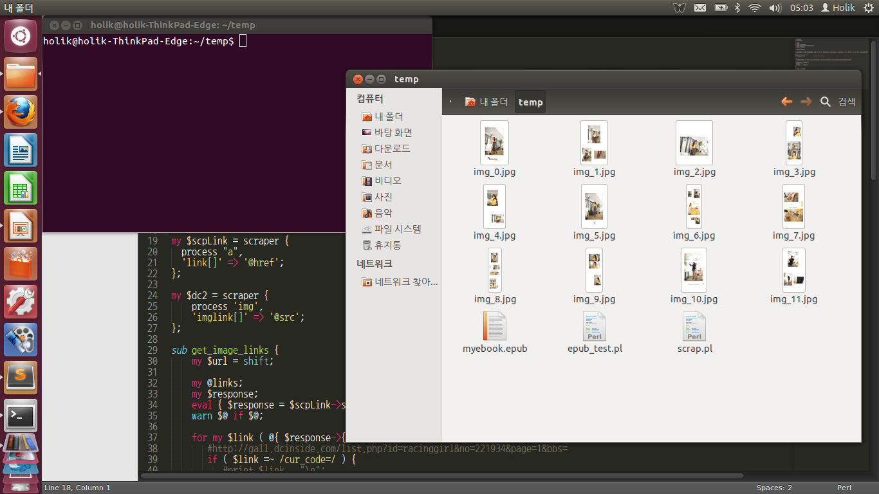

Slide 13
Thanks to ‘홍선생’ and ‘진사마’

Slide 14
my $perl = ‘better life’;

