Slide 1
Java基础与面向对象程序设计
主讲人：易凯
Email：williamyi96@gmail.com
2016-9-24

Slide 2
课程之前，你需要
1.一颗学好android的心
2.配置好java所需要的环境变量
3.文本编辑器

Slide 3
Part One –-Java基础

Slide 4
Java的前尘往事
1990：Sun公司设计出了平台独立的语言Oak
1995:1 Oak 改名为java,同年5月java发布
1996年初：Sun发布jdk1.0
2010:10 Sun公司被Oracle收购

Slide 5
为何要学习java？
1.java所具有的优势
2.Java对安卓的帮助

Slide 6


Slide 7
Java所具有的优势
1.简洁有效，省略了cpp中难以解释的成分，运算符重载，指针等
2.可移植性，Write Once, run anywhere. → JVM
3.OO，每个字文件就是一个对象
3.强大联网能力，特别适合进行分布式计算
4.多线程处理能力，更好的交互性与实时性
6.智能化—垃圾回收机制。对内存自动分配，自动释放内存

Slide 8
Java对安卓的帮助
Android Studio是基于IntelliJ IDEA这个java的IDE开发的，因此java目前是AS的官方语言

Slide 9
Java程序运行流程
OS(Windows, linux, unix)
→ JVM → .class → .java

Slide 10
Java技术架构
J2EE：企业版，是以企业为环境开发应用程序的解决方案
J2SE:标注版，是为桌面开发和低端商务应用的解决方案
J2ME：小型版，是致力于消费产品和嵌入式设备的最佳解决方案

Slide 11
多分支条件语句的使用
public class caseTest {
//the operator of division
public static void main(String[] args) {
int a = 10, b = 7;
char oper = '/';
//using switch statement
switch(oper) {
case'+':System.out.println(a + "+" + b + "=" + (a + b));
break;
case'-':System.out.println(a + "-" + b + "=" + (a - b));
break;
case'*':System.out.println(a + "*" + b + "=" + (a * b));
break;
case'/':System.out.println(a + "/" + b + "=" + (a / b));
break;
default:System.out.println("Unknown Operation!");
}
}
}

Slide 12
循环语句的使用—99乘法表
public class loopTest {
public static void main(String[] args) {
for(int i = 1; i <= 9; i++) {
for(int j = 1; j <= 9; j++) {
System.out.print(i + "*" + j + "=" + (i*j) + "\t");
}
System.out.println();
}
}
}
How to solve this question by while and do-while？

Slide 13
一维数组的使用—求数组最大值
public class oneDivArrayTest {
public static void main(String[] args) {
int min, max;
int arr[] = {1,2,5,3,4};
min = max = arr[0];
for(int i = 0; i < arr.length; i++) {
//System.out.print(arr[i] + "");
if(arr[i] > max) {
max = arr[i];
} else if(arr[i] < min) {
min = arr[i];
}
}
System.out.println("the maximum element in the array is:" + max);
System.out.println("the minmum element in the array is:" + min);
}
}

Slide 14
数组操作的相关API
public class arrayAPItest {
public static void main(String[] args) {
int arr1[] = {1,2,3};
int arr2[] = {4,5,6};
for(int i = 0; i < arr1.length; i++) {
System.out.println("elements in array one are:" + arr1[i]);
}
for(int i = 0; i < arr2.length; i++) {
System.out.println("elements in array two are:" + arr2[i]);
}
System.out.println('\n');
//copy two array, you need to pay attention to the formal parameters
System.arraycopy(arr1,0,arr2,0,2);
//print two array and find whether their elements have been changed
for(int i = 0; i < arr1.length; i++) {
System.out.println("elements in array one are:" + arr1[i]);
}
for(int i = 0; i < arr2.length; i++) {
System.out.println("elements in array two are:" + arr2[i]);
}
}
}

Slide 15
Any other questions about statements and variables？

Slide 16
Part2--Java面向对象的结构特性

Slide 17
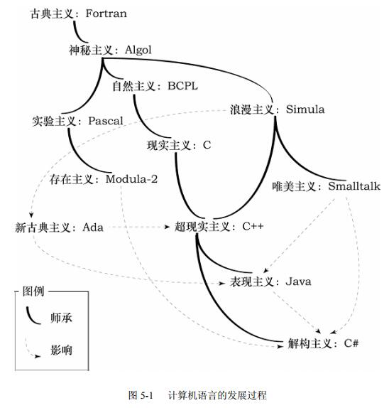
计算机语言的发展史

Slide 18
什么是对象？
静态特征+动态特征
对象 = 数据+操作

Slide 19
什么是类？
相同属性和相同行为的一组对象，是对象的抽象

Slide 20
面向对象程序设计的三大特征
1.封装性
2.继承性
3.多态性

Slide 21
封装性： 1.把对象的属性和行为封装成密不可分的整体 2.将无需对外界显示的信息隐藏 继承性： 从一般属性的类中派生出反映特殊事物的类 多态性： 允许程序重名的现象：方法重载，成员覆盖

Slide 22
构造方法—我是老司机
class Person {
private String name;
private String occupation;
public Person(String n, String ocp) {
name = n;
occupation = ocp;
System.out.println("public Person(String n, String a)");
}
public String talk() {
return "my name is " + name + ", I am a " + occupation + "! "
+ "\nDo you want to drive with me?";
}
}
public class constructTest {
public static void main(String[] args) {
Person p = new Person("Lei Guo", "old driver");
System.out.println(p.talk());
}
}

Slide 23
对象的比较
public class EqualTest {
public static void main(String[] args) {
String str1 = new String ("java");
String str2 = new String ("java");
String str3 = str2;
if(str1.equals(str2)) {
System.out.println("1");
} else {
System.out.println("0");
}
if(str2.equals(str3)) {
System.out.println("2");
} else {
System.out.println("0");
}
if(str1 == str2) {
System.out.println("3");
} else {
System.out.println("0");
}
if(str2 == str3) {
System.out.println("4");
} else {
System.out.println("0");
}
}
}
“==”比较的是内存地址的值，
“equals”比较的是内容

Slide 24
静态变量和静态方法
class Person {
String name;
static String occupation = "good student";
public Person(String n) {
this.name = n;
//this.occupation = ocp;
}
public String talk() {
return "My name is " + this.name + " , I am a " + occupation + "!";
}
}
public class staticTest {
public static void main(String[] args) {
Person p1 = new Person("Lei Guo");
Person p2 = new Person("bboylin");
Person p3 = new Person("Wan Xu");
Person p4 = new Person("Wei Xuan Guang");
Person p5 = new Person("President Mao");
}
//before you change their occupation
System.out.println(p1.talk());
System.out.println(p2.talk());
System.out.println(p3.talk());
System.out.println(p4.talk());
System.out.println(p5.talk());
System.out.println("\n");
p1.occupation = "old driver";
//after you change theri occupation
System.out.println(p1.talk() + "haha");
System.out.println(p2.talk() + "haha");
System.out.println(p3.talk() + "haha");
System.out.println(p4.talk() + "haha");
System.out.println(p5.talk() + "haha");
}

Slide 25
对象数组的使用
class Person {
String name;
static String occupation = "old driver";
public Person() {
}
public Person(String n) {
this.name = n;
//this.occupation = ocp;
}
public String talk() {
return "My name is " + this.name + " , Actually, I am an " + occupation + "!";
}
}
public class objectArrayTest {
public static void main(String[] args) {
Person p[] = {
new Person("Lei Guo"),
new Person("bboblin")
};
for(int i = 0; i < p.length; i++) {
System.out.println(p[i].talk());
}
}
}

Slide 26
类的继承
class Person {
String name;
String occupation;
}
class OD extends Person {
String loveAffair;
}
public class extendTest {
public static void main(String[] args) {
OD od = new OD();
od.name = "Lei Guo";
od.occupation = "old driver";
od.loveAffair = "eager for a girlfriend";
System.out.println(od.name + " is an " + od.occupation + " , and he is " + od.loveAffair + "!");
}
}

Slide 27
抽象类
abstract class Person {
String name;
int age;
String occupation;
//declare an abstract method talk()
public abstract String talk();
}
class OD extends Person {
public OD(String name, int age, String occupation) {
this.name = name;
this.age = age;
this.occupation = occupation;
}
//override the talk() method
public String talk() {
return "My name is " + name + " , I am " + age + " years old, and I am an " + occupation + "!";
}
}
class abstractClassTest {
public static void main(String[] args) {
OD od = new OD("Lei Guo", 80, "old driver");
System.out.println(od.talk());
}
}

Slide 28
接口实现
interface Person {
String name = "Lei Guo";
String occupation = "old driver";
//declare an abstract method
public abstract String talk();
}
class OD implements Person {
//override the talk() method
public String talk() {
return "My name is " + name + " , I am an " + occupation + "!";
}
}
class interfaceTest {
public static void main(String[] args) {
OD od = new OD();
System.out.println(od.talk());
}
}

Slide 29
多态性实例
class Person {
public void fun1() {
System.out.println("Lei");
}
}
class OD extends Person {
public void fun1() {
System.out.println("Guo");
}
}
class poTest {
public static void main(String[] args) {
Person p = new OD();
p.fun1();
}
}

Slide 30
感谢大家的聆听与实践！

