Slide 1
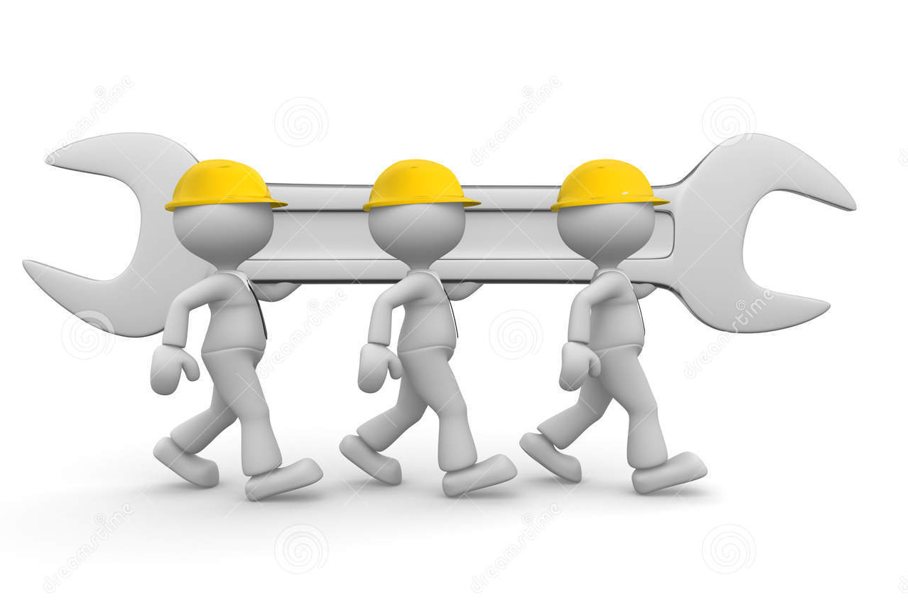
Cooperation with other teams
We conferred the other team be saying you can do it and you’ll do great.
When we were in our 2th round the team next to us were nervous so we said “you’ll do great” .

Slide 2

Cooperation in our team
We cooperate by encouraging our are teammates and we worked together to change our program so are robot can do better. On the first round we did bad and one of our teammates cried so we fixed our robot and did awesome in the last round!

